Slide 1
Celebrating the Journey of FCE and ACWW
“Walking the Dream”

Slide 2
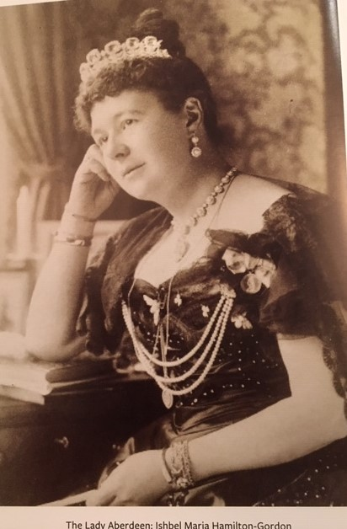
Lady Aberdeen

Slide 3
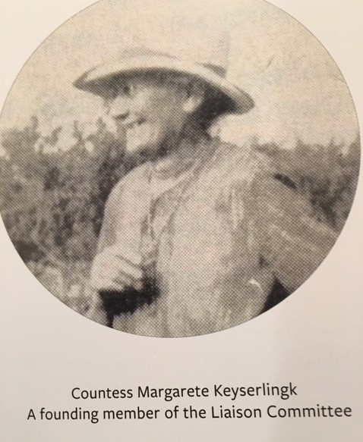
Countess Margarete Keyserlingk, founding member of the Liaison Committee

Slide 4
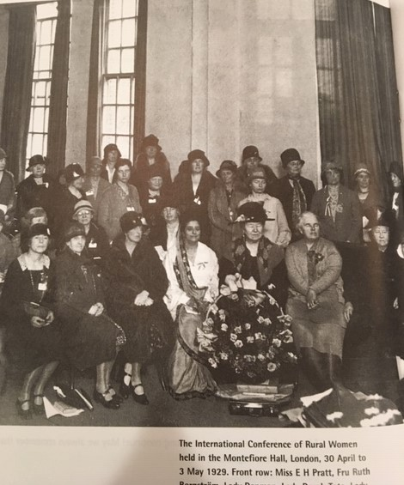
1929 International Conference of Rural Women

Slide 5
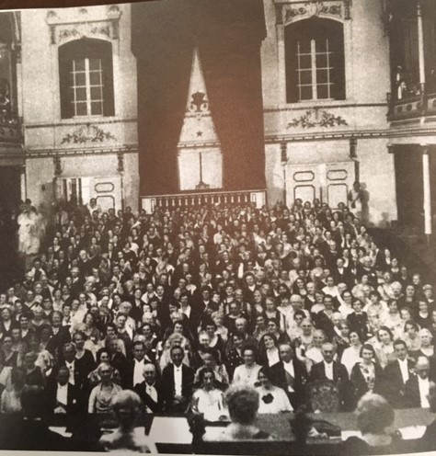
Stockholm, Sweden, 2nd Triennial Conference

Slide 6
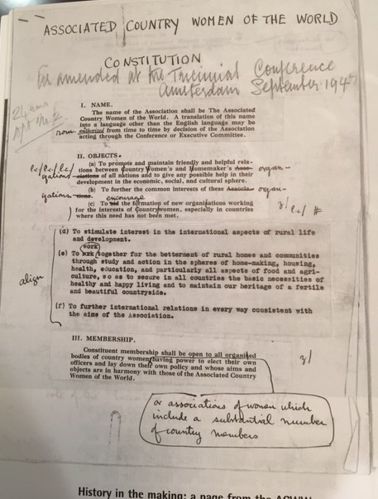
We have a Constitution!

Slide 7
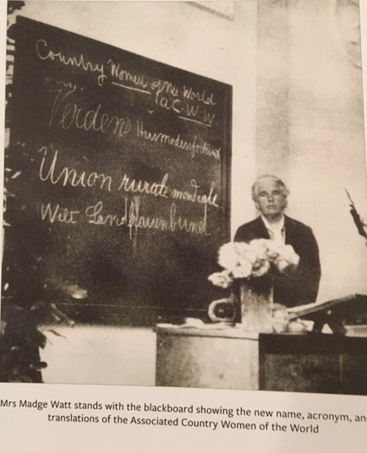
And a Name!!

Slide 8
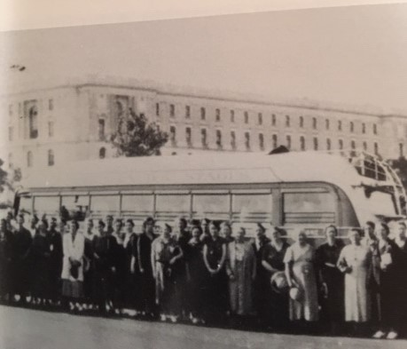
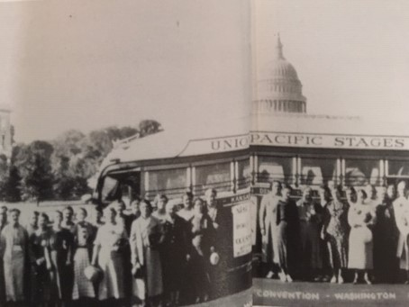
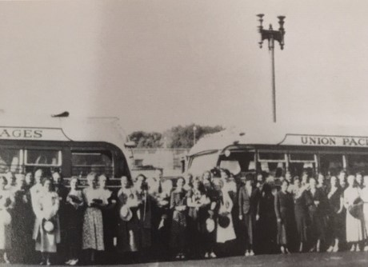
The “Journey” to Washington DC

Slide 9
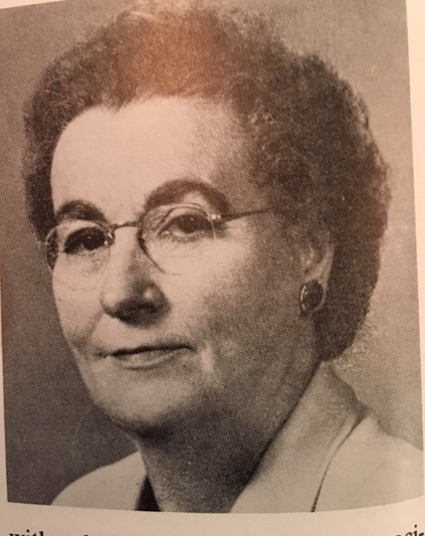
Mrs. Ora (Guy) Roop

Slide 10
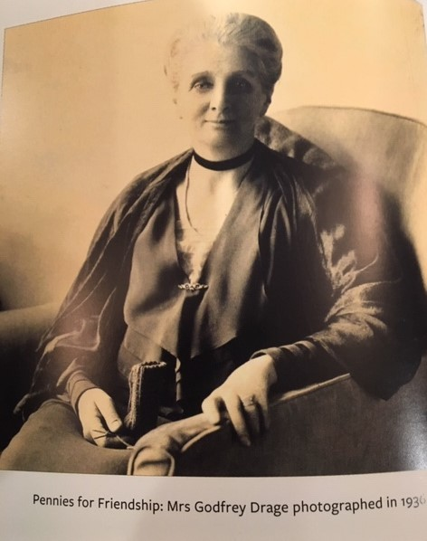
Pennies for Friendship

Slide 11
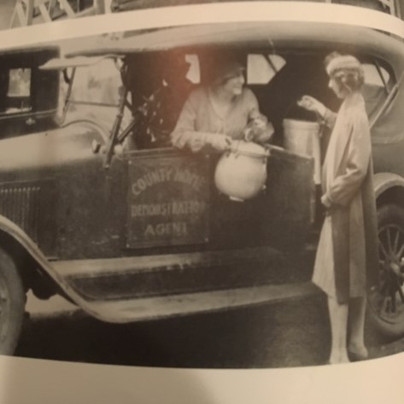
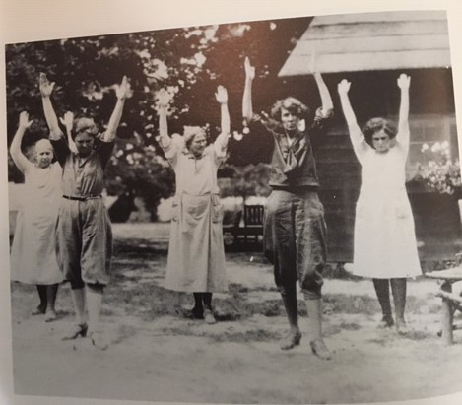
What fun classes our mothers had!!

Slide 12
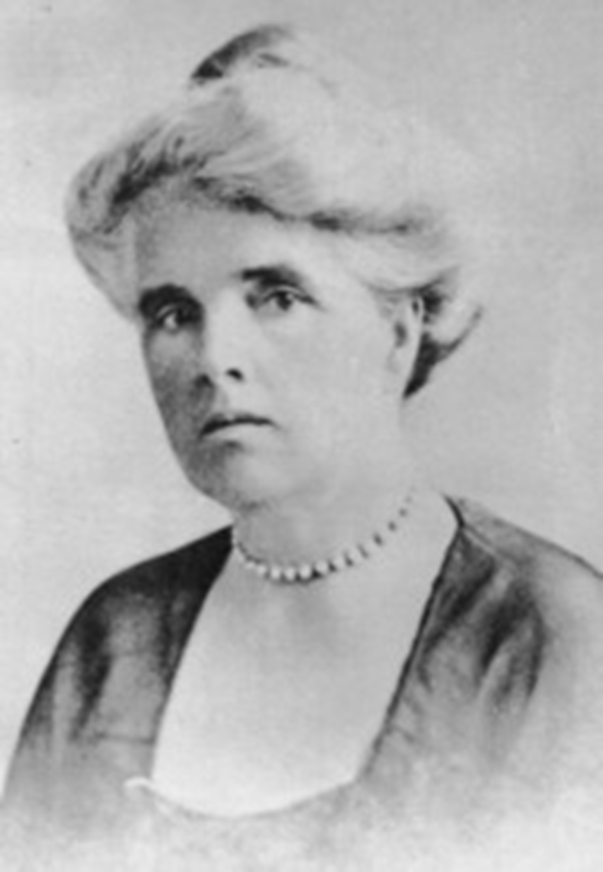
Who is ACWW
In 1929 Mrs. Alfred Watt (Madge) chaired the first International Conference of Rural Women, this conference was set up to correspond with and exchange of ideas between rural women in various parts of the world.
ACWW was formed in 1929 to bring together rural women and their organizations all over the world…”. Before ACWW was formed, rural women’s organizations operated independently. When these groups began communicating, they united to pursue shared goals.
"Margaret Robertson Watt." Wikipedia, The Free Encyclopedia. Wikipedia, The Free Encyclopedia, 22 Apr. 2026. Web. 30 May. 2026.
Notes:
In 1933 in Stockholm Sweden the Associated Country Women of the World was created from the liaison committee of rural women’s organizations.
In 1947, the ACWW began adopting resolutions in Amsterdam to improve the lives of rural women around the world after the war.

Slide 13
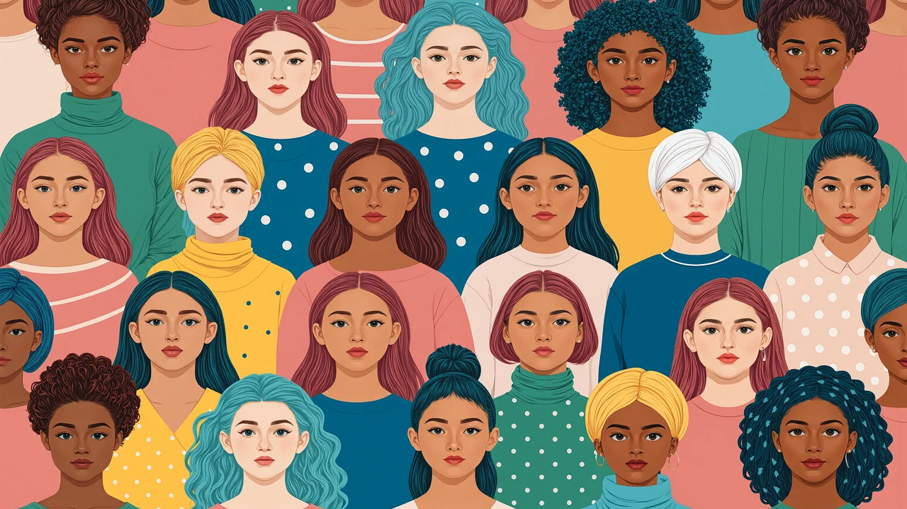
ACWW’s Why
Rural women
  Rural women work extremely hard but often earn extraordinarily little, they are often discriminated against and in some cases, they are not allowed ownership of land. Rural women are also often not allowed control of the money they earn. When rural women are empowered through education, employment, and other benefits, it can lead to alleviating the poverty of the individual woman, but also their family and community.

Slide 14
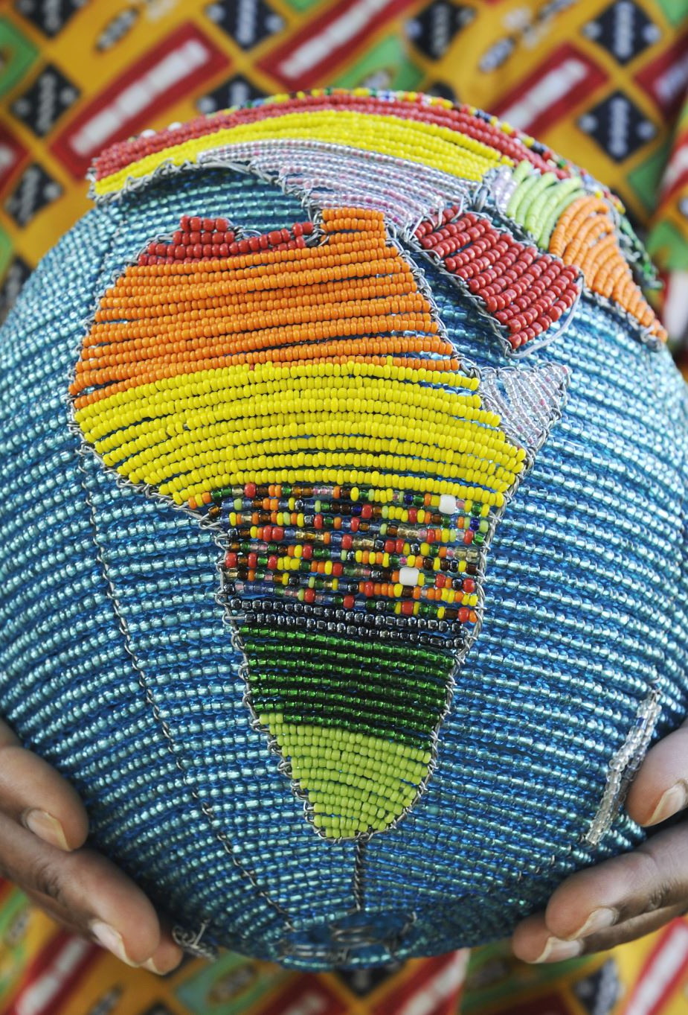
Who does acww advocate for
Associated Country Women of the World advocates issues faced by rural women of the world. Rural women can face greater hurdles compared to non-rural women. A few of these include socioeconomic disadvantages, lower academic achievements, reduced general healthcare, increased birth rates while having limited access to reproductive healthcare to name just a few of the disadvantages they can face

Slide 15
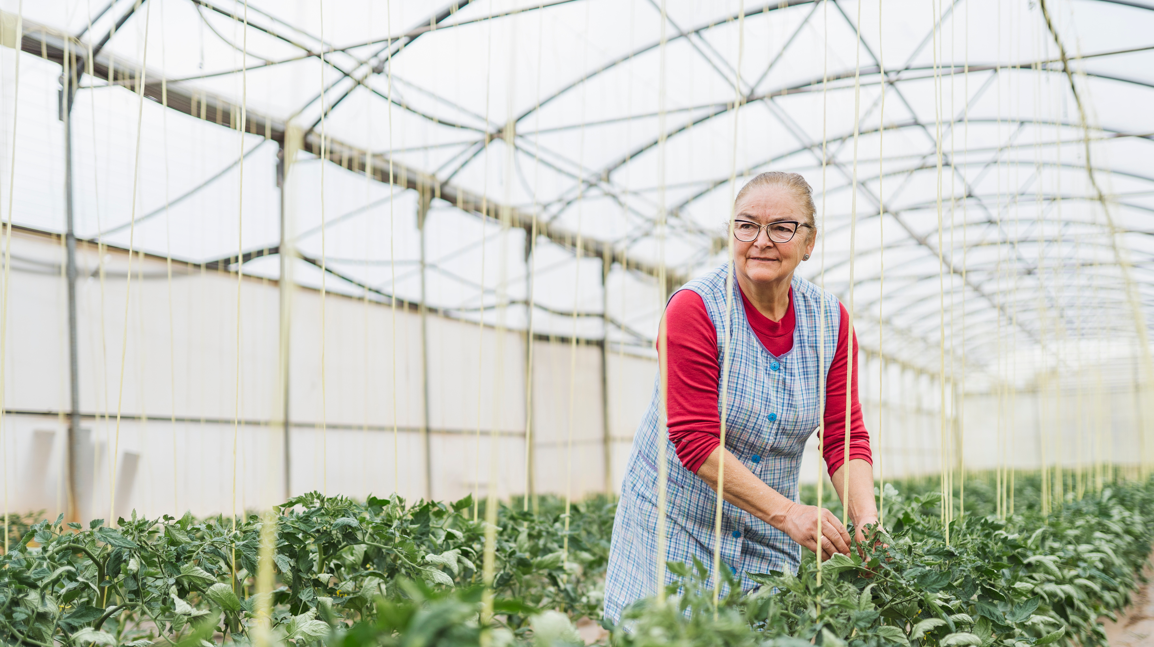
Climate smart Agriculture
Across low-income countries, women are filling roles in management and food production to the tune of forty eight percent, yet they are disproportionally challenged by rural men. Rural Women are more likely to face food insecurity, access to land, market information, and resources. They can also lack decision making power.
With a commitment for promoting Climate Smart Agriculture and small project funding, ACWW is helping rural women farmers to have access to information helping them to adapt to the challenge of climate change, choosing indigenous seed varieties for drought resistant crops, learning about irrigation systems, and harvesting rainwater as examples.

Slide 16
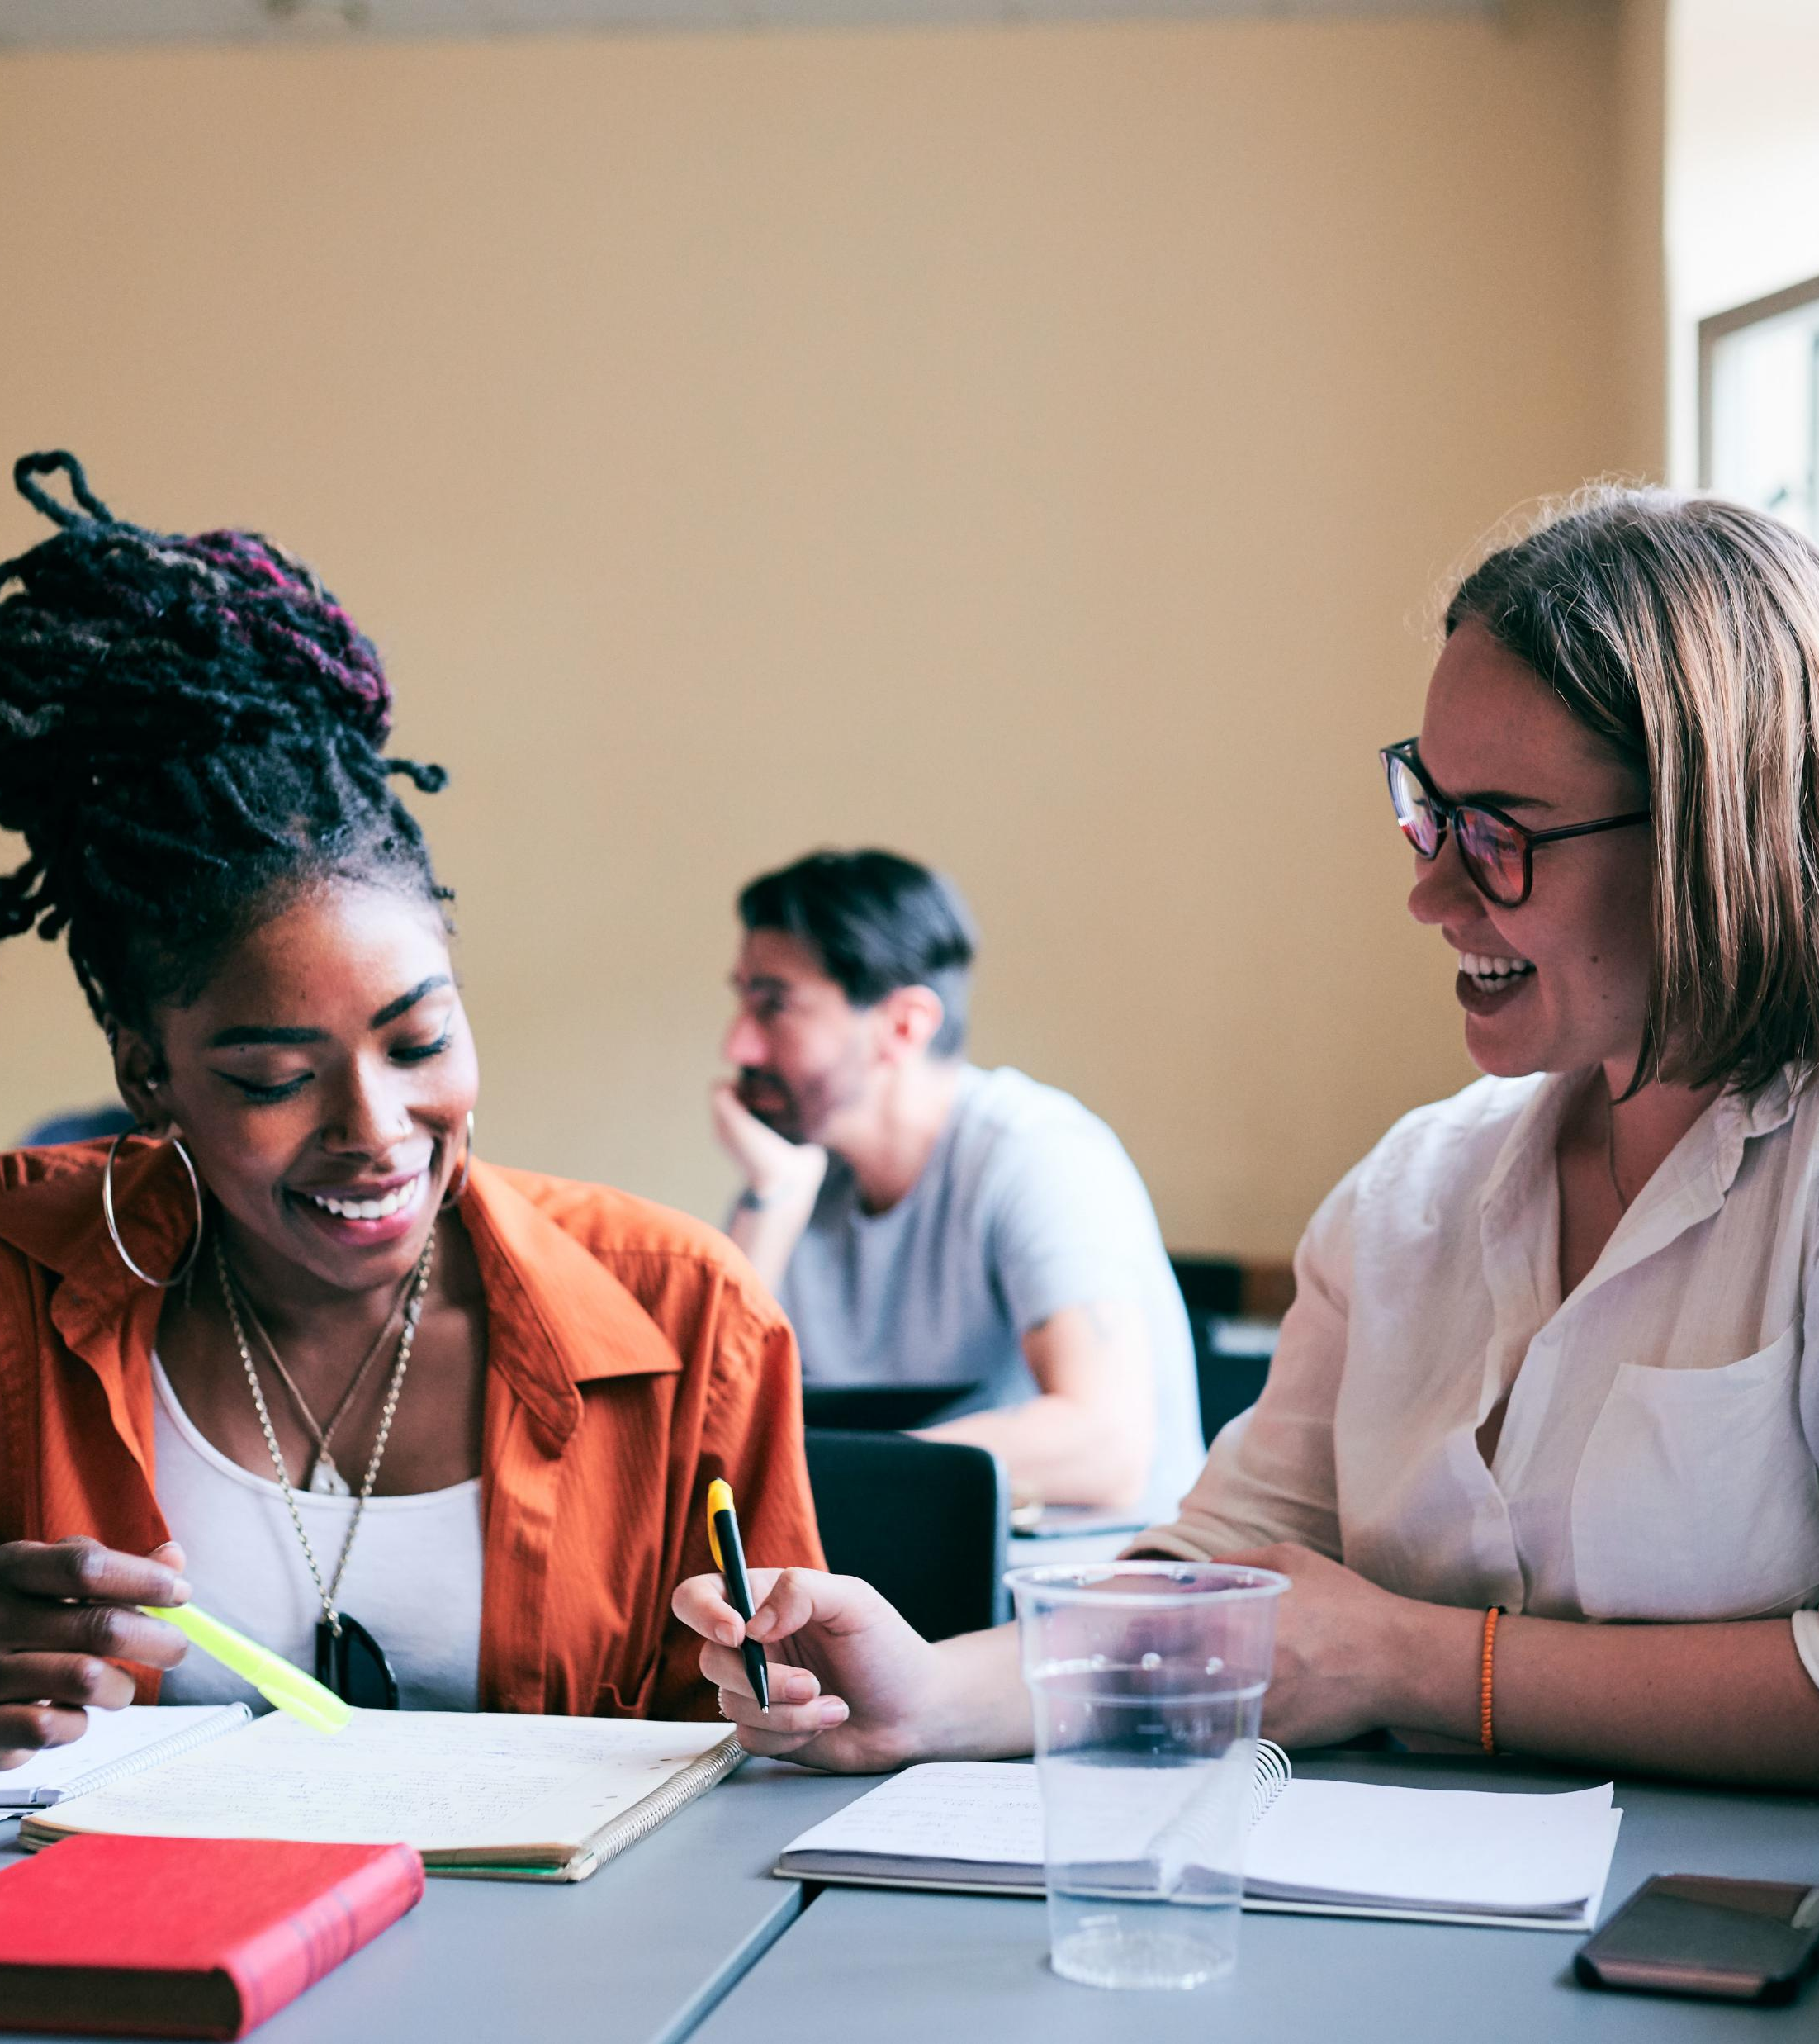
Education and community development
The United Nations has identified two-thirds of adults who cannot read or write as women. This statistic underscores the importance of education in rural communities around the world. When rural women are unable to complete basic education, their earning potential is reduced, and their families often experience poorer health and nutrition outcomes. ACWW wants to change this for rural women.

Slide 17

Rural women’s health
This core project area is focused on increasing rural women’s access to good and affordable health care, including comprehensive information, maternal and reproductive care, medicines, and local health services. Traditionally women have always had a lower standard of health care. There has been a focus on maternal and reproductive care, leaving out other issues that impact women of all ages. ACWW is dedicated to improving rural women health by ensuring they have reliable access to complete, inclusive and high quality health care

Slide 18
ACWW and Me
Where do I fit in and what can I do?

Slide 19
Associated Country Women of the World:
A voice for the voiceless
Makes the invisible, visible
Unites Rural Women
Empowers Women and Families in Rural Areas

Slide 20
What is my role?
Become an Individual Member
Participate in ACWW Projects and Activities
Advocate for Rural Women
Learn and Educate Others
Act on the Resolutions

Slide 21
You cannot raise your children the way you were raised because the world for which you were raised no longer exists
Quoted by Ruth Shanks Past World President at the 2019 Triennial World Conference

Slide 22
What will you do to WALK the DREAM?

