Slide 1
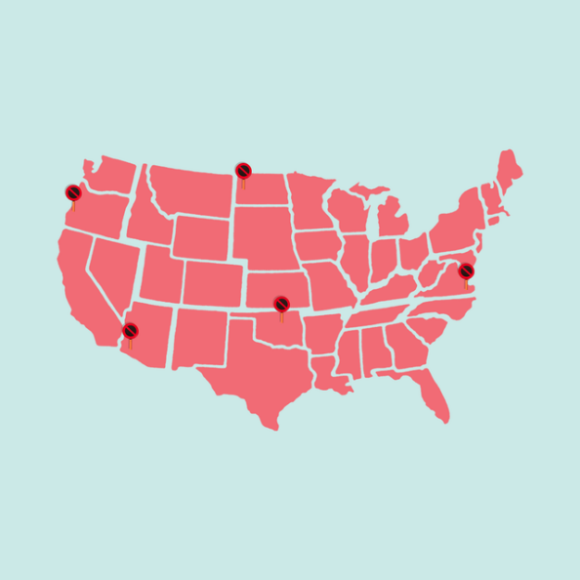
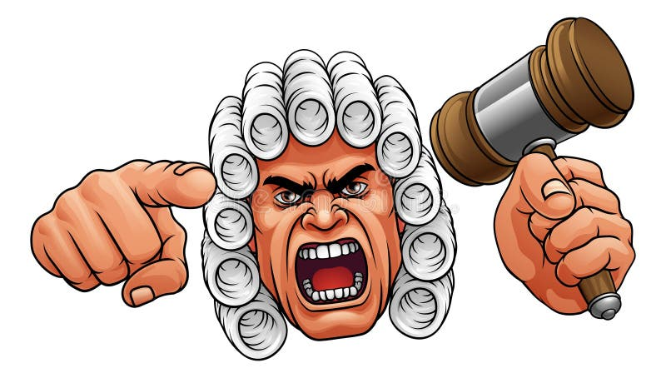

“Crazy Laws of Oregon and the USA”
Designed for and presented at the
2026 Oregon Association for Family and Community Education (FCE) State Conference
Developed and written by: Marian Shields
Oregon Association for Family and Community Education – FCE Member; Oregon FCE State Secretary
Assisted by: Scott Teeples – FCL Certified Leader Trainer
Oregon Association for Family and Community Education – FCE Member; 2018-2026 Oregon FCE President; Past Oregon FCE Secretary; Past National FCE Board Member
Note: PowerPoint of this lesson is available. Please contact Scott Teeples 541-891-6456 – email sfteeples@outlook.com Also see www.oregon-fce.org
Revised 8-22-26

Slide 2


Goals and Objectives
Participants will gain an understanding of what some of the crazy and outdated laws are while taking a humorous look at them.
(Hand out and discuss HO #1)

Slide 3

Crazy Laws of Oregon and the USA
Strange But True Laws
Most American have a general understanding of what constitutes a crime.
However, there are a host of “strange but true” laws which exist in states, cities, and towns across America which may come as shock to most people.

Slide 4
While some of these laws have been taken off the books, and are therefore no longer considered a crime, in other cases, these laws remain in statutes or codes, but have lain dormant and have not been enforced for years.
By all means, the following are intended to be only a representative sample of strange laws… there are plenty more of them out there, so be on your guard!

Slide 5
Strange Laws in Oregon That Still Exist
We all know the usual illegal activities like driving under the influence, theft, or assault.
However, Oregon also has some lesser-known, outdated laws that may leave you scratching your head.
These quirky laws are relics of a different era, but surprisingly, they’re still in effect.
Let’s take a look at some of the weirdest laws you might encounter in Oregon today.

Slide 6
Oregon’s Odd Laws
No weddings at ice-skating rinks: If you were planning on tying the knot on the ice, think again—getting married at an ice-skating rink is prohibited in Oregon.
Untied shoelaces are a no-go: Walking down the street with untied shoelaces? Technically, that’s against the law in this state, so double-knot them just to be safe.

Slide 7
Oregon’s Odd Laws (cont.)
No lifting weights while driving: For those multitaskers out there, weightlifting behind the wheel is strictly illegal in Oregon.
Ice cream on Sundays: While it’s illegal to eat ice cream on Sundays, don’t worry—this doesn’t apply to sundaes.

Slide 8
Even Stranger Oregon Laws
Donut dilemmas in Marion County: Walking backward while eating a donut in Marion County is illegal, so stick to facing forward while enjoying your treat.
No fortune telling in Yamhill: Predicting the future is prohibited in Yamhill, making psychic readings a legal no-no in the area.
Fishing with canned corn: Planning to fish with canned corn? Think again—it’s not an acceptable bait in Oregon waters.

Slide 9
Even Stranger Oregon Laws (cont.)
Juggling requires a license in Hood River: If you aspire to juggle in Hood River, make sure you have a juggling license on hand; otherwise, you’re breaking the law.
Other strange restrictions: Whistling underwater, female wrestling in Salem, and owning pet reptiles in Springfield are all against the law. Ministers in Marion County also face restrictions—they’re banned from eating onions or garlic before giving a sermon on Sundays.

Slide 10
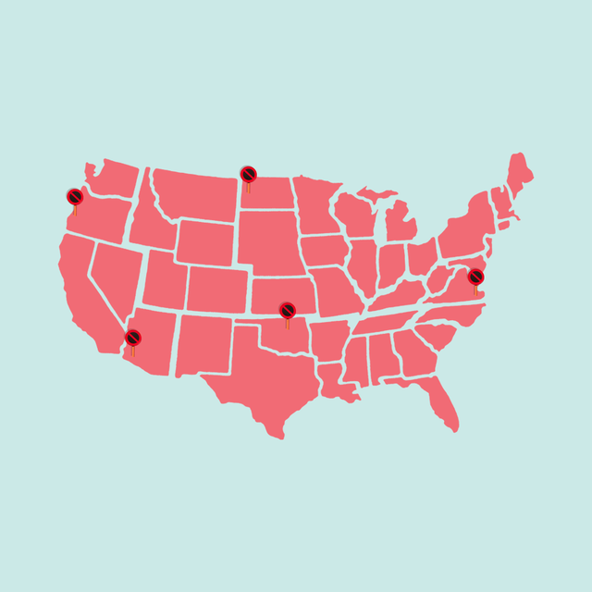
50 Craziest State Laws from Around the United States
There's no doubt about it: There are some crazy, bizarre state laws that exist in the United States. Sure, they may have made sense when they were written, but today these truly weird state facts about American laws are enough to make anyone question why they were created in the first place — not to mention they make for some great random trivia to stump your friends!

Slide 11
50 Craziest State Laws from Around the United States (cont.)
Who knew, for instance, that it's illegal for a donkey to sleep in a bathtub in Arizona, or that you technically can't send your friends a surprise pizza in Louisiana?
Many of these antiquated laws may no longer be enforced today, but it's definitely still a blast to think about how they were once necessary (and somehow still exist, in some cases!).

Slide 12
50 Craziest State Laws from Around the United States (cont.)
From random facts about food to truly ridiculous rules about animals in every state, get ready to laugh, gawk, and master your side-eye while clicking through the most absurd laws and bans in the great United States.

Slide 13
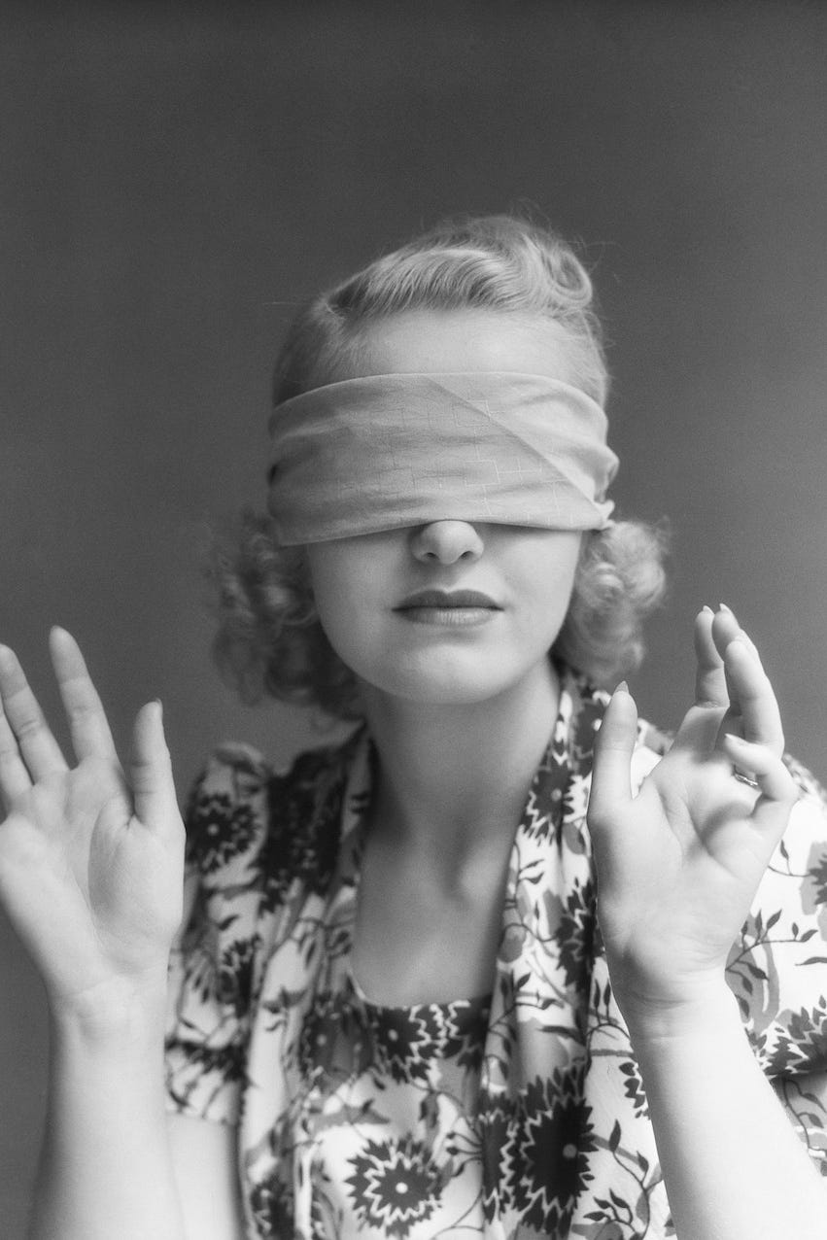
1 In Alabama ... it's illegal to drive blindfolded.
Sounds like word didn't make it to everyone in the Yellowhammer State about the common phrase "Keep your eyes on the road." One Alabama law prohibits driving while blindfolded. Our eyes are wide open after hearing this one!

Slide 14
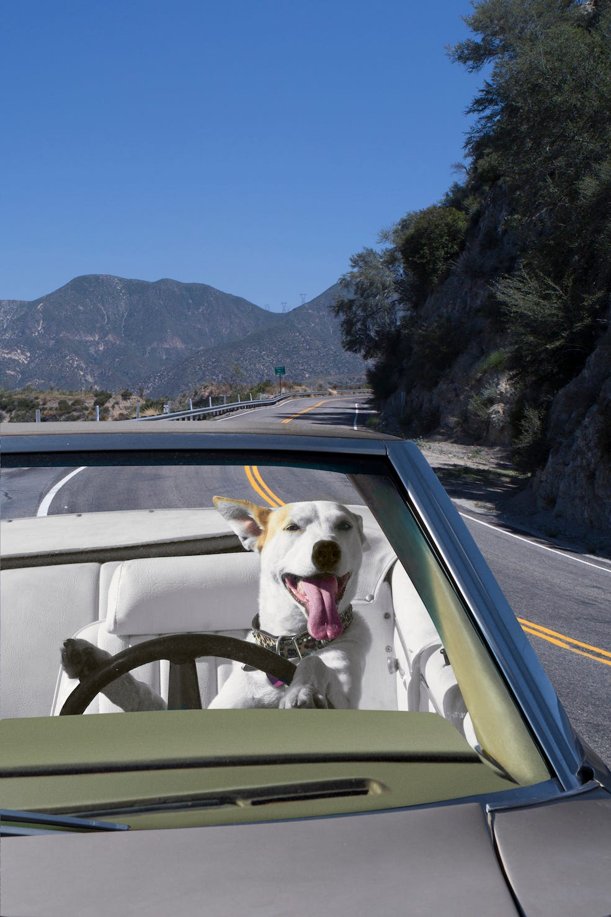
2 In Alaska ... you can't put an animal in the back of an open vehicle.
To a dog, nothing sparks more joy than the cool breeze of the open road. However, in Alaska, the back of an open vehicle is off-limits unless the dog's tail wags 46 inches or higher. The law was put into effect after one pup was reported as a public nuisance. Ruff life

Slide 15
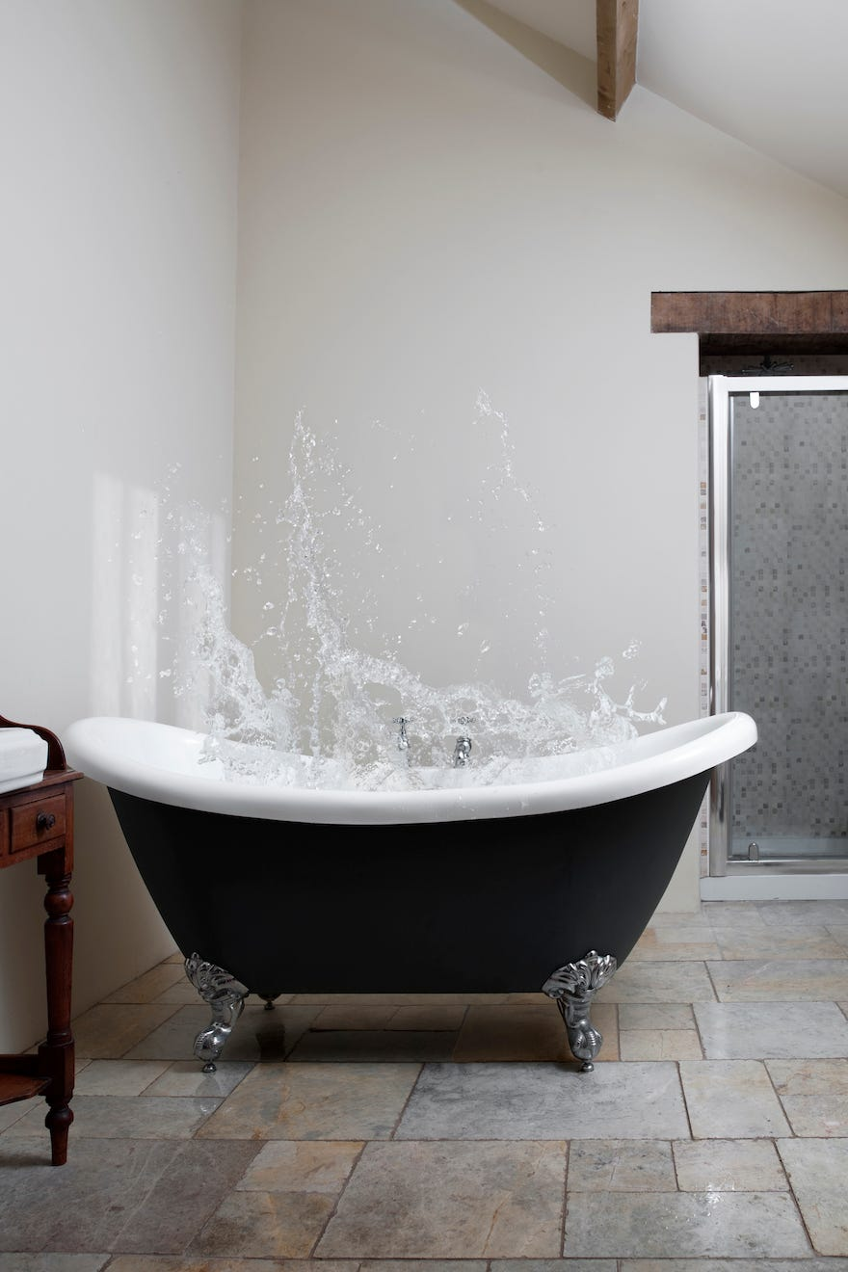
3 In Arizona ... it's illegal for a donkey to sleep in a bathtub.
In the 1920's, a local dam broke, flooding a rancher's home. The rancher's donkey had become accustomed to sleeping in the bathtub, which filled with water and whisked him miles away. After working to rescue the animal, the town passed a law that prohibits donkeys from sleeping in the bathtub (though it's okay for them to stand in one!).

Slide 16
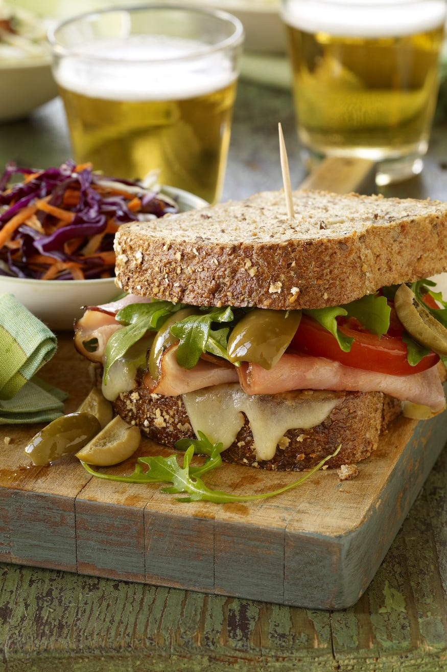
4 In Arkansas ... you can't honk your horn near a sandwich shop after 9 p.m.
A hangry fool may be to blame for this law, but hey, most of the sandwich shops are closed in the sleepy state of Arkansas by 9 p.m. anyway. If you do feel the urge to honk after hours, you'll be disturbing the peace and you'll still be hungry.

Slide 17

5 In California ... it's illegal to whistle for a lost canary before 7 a.m.
We're not entirely sure how this bizarre law came about, but according to California.com, the city of Berkeley, CA prohibits anyone from whistling for their lost canary before the wee hours of 7 a.m. Here's to hoping we don't lose our canaries!

Slide 18
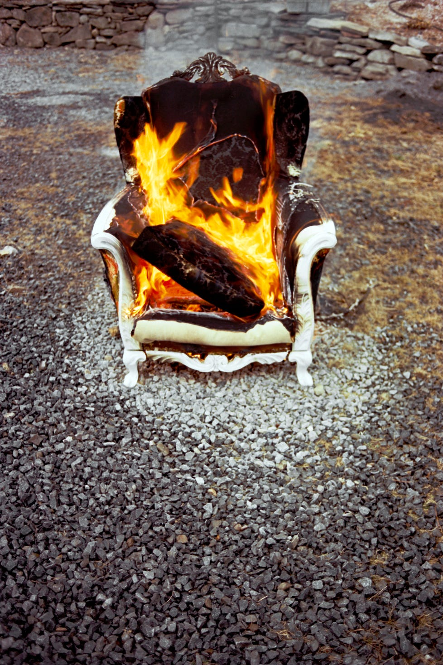
6 In Colorado ... it's illegal to keep a couch on your porch.
Boulder busted the University of Colorado for burning couches, causing a law to go into effect that keeps couches and porches mutually exclusive. This law is currently active — but the verdict is still out as to whether it actually prevented any couch bonfires.
!

Slide 19
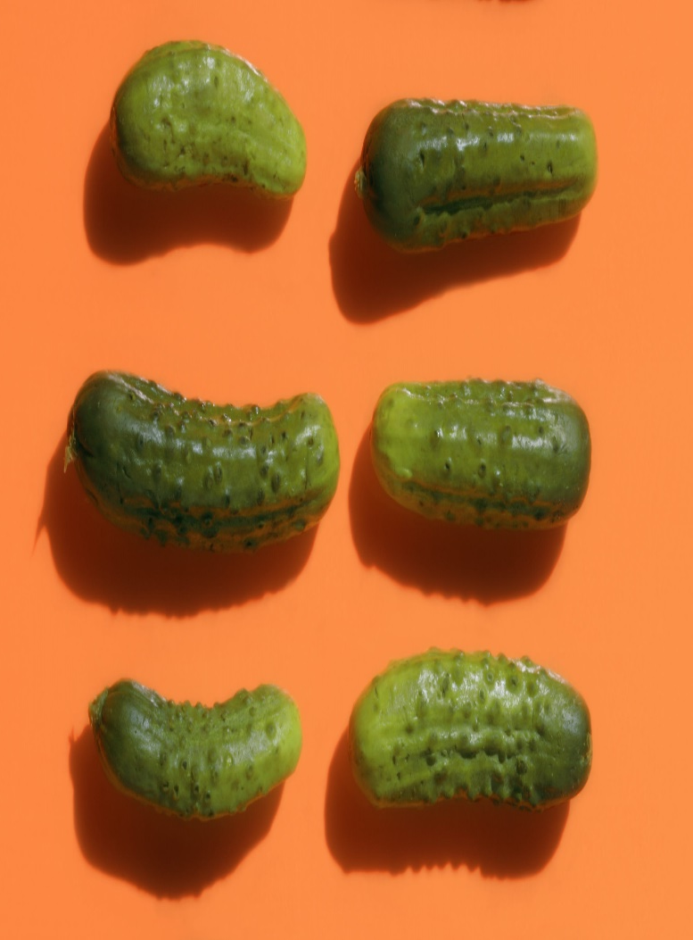
7 In Connecticut ... a pickle must be able to bounce.
Here's a law that puts Connecticut farmers in quite a pickle. In 1948, two men were arrested for selling pickles that were "unfit for human consumption." Discussing ways to check for good pickles, officials declared that a pickle is legitimate only if it bounces. The pickles in question did not bounce — so the two men were arrested and fined, and the pickles were destroyed!

Slide 20
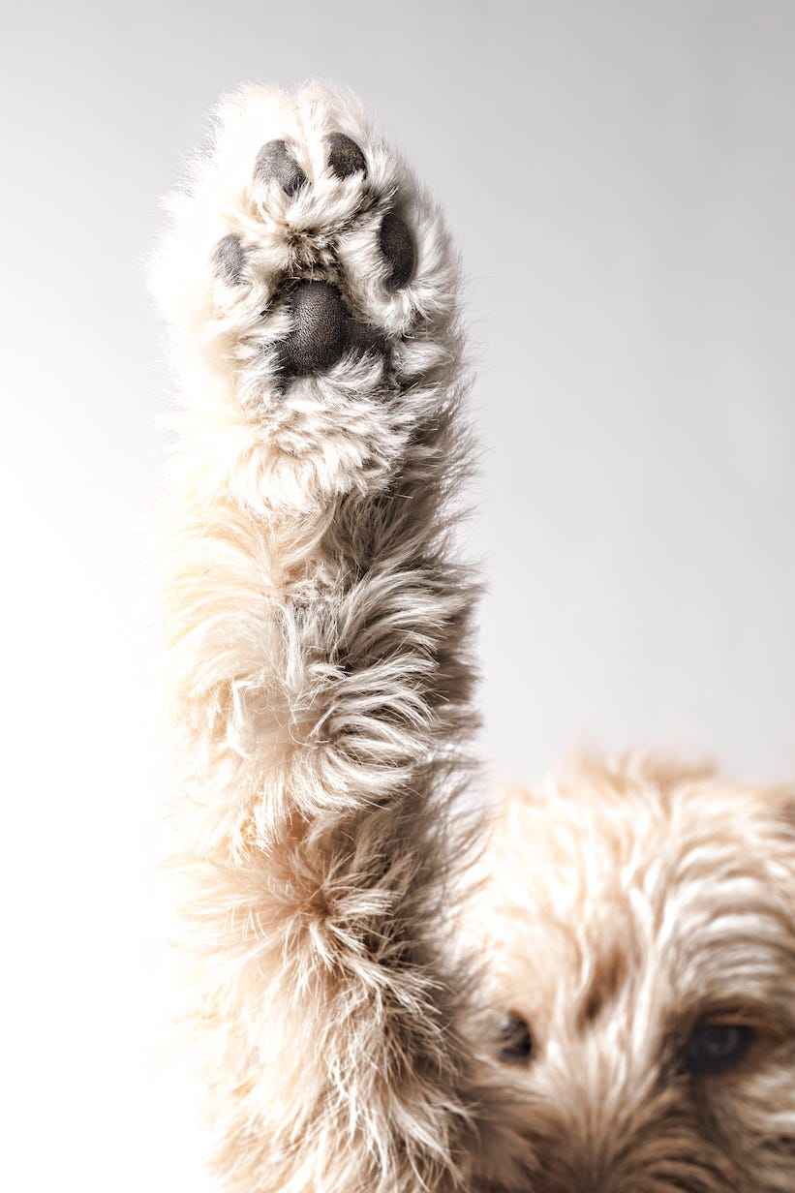
8 In Delaware ... you can't sell dog hair.
State residents of Delaware are barred from selling the hair of a dog or cat. We wonder how much money residents used to be able to cash in for all the hair left on the sofa.

Slide 21
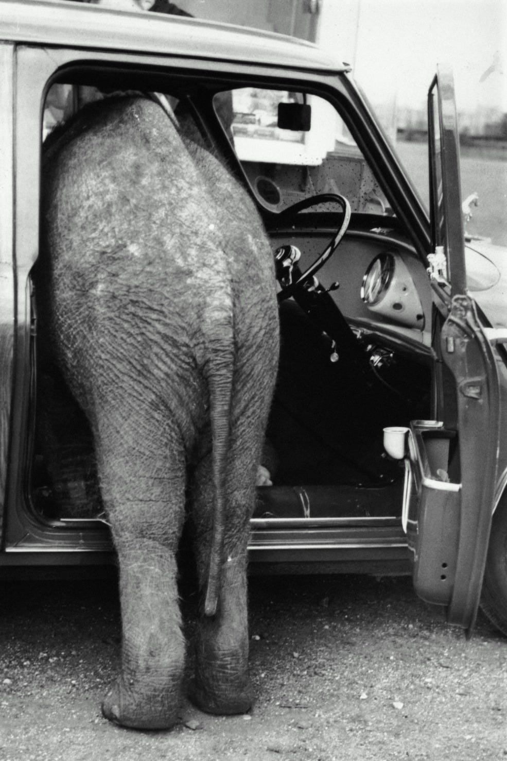
9 In Florida ... legal parking fees toward animals must be paid.
Sounds like Jumanji was real once upon a time in Florida, because legal fees have to be paid for animal parking — including elephants, camels and horses. According to Country Living, this law took effect in the 1920s, when the Ringling Bros. Circus moved its winter show operations to Florida.

Slide 22
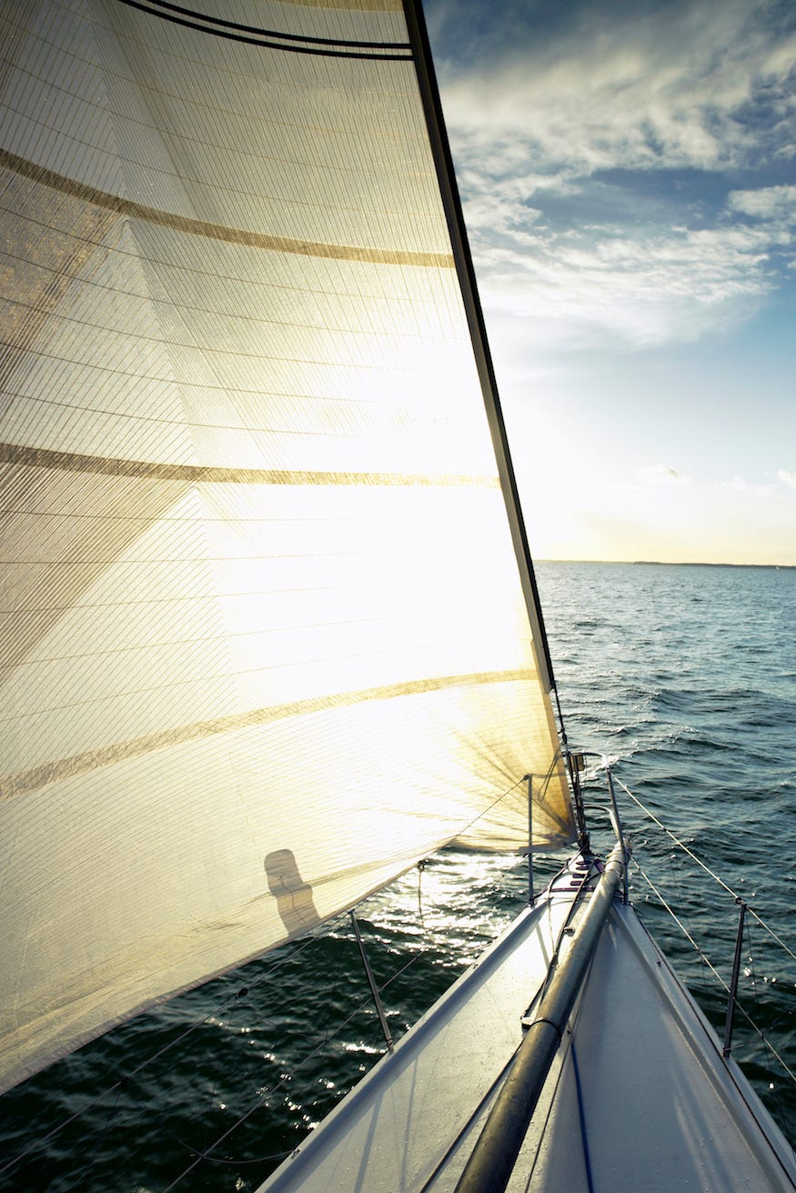
10 In Georgia ... it's illegal to live on a boat for more than 30 days.
Oh buoy! If you're planning to retire on a boat, the Peach State is definitely not the place for you. According to state law, it is prohibited to live on a boat for more than a month.

Slide 23

11 In Hawaii ... it's illegal to place a coin in one's ear.
Magic shows must be boring in the Rainbow State. Apparently, this strange law was enacted to protect the Kingdom of Hawaii coinage, when Hawaii officially joined the United States in 1900.

Slide 24
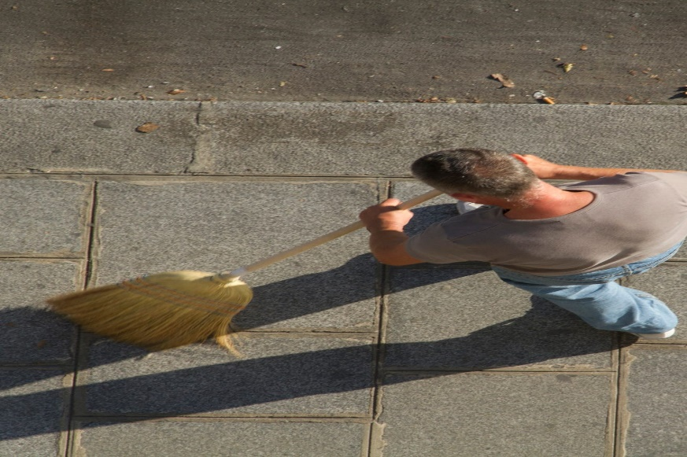
12 In Idaho ... it's illegal to sweep debris into the streets.
One man's trash is certainly not another man's treasure in Idaho, as it's illegal to sweep debris onto streets, highways, alleys, or any road used for public travel. If only other cities would enforce this law!

Slide 25

13 In Illinois ... it's legal for underage culinary students to drink alcohol.
In 2012, the state passed a law nicknamed "Sip and Spit," which allows culinary students under 21 years of age to legally taste (by sipping and spitting) alcoholic beverages, based on the reasoning that students need to learn how to taste wine during their early years of culinary school. Cheers to a well-rounded, or should we say full-bodied, learning experience!

Slide 26
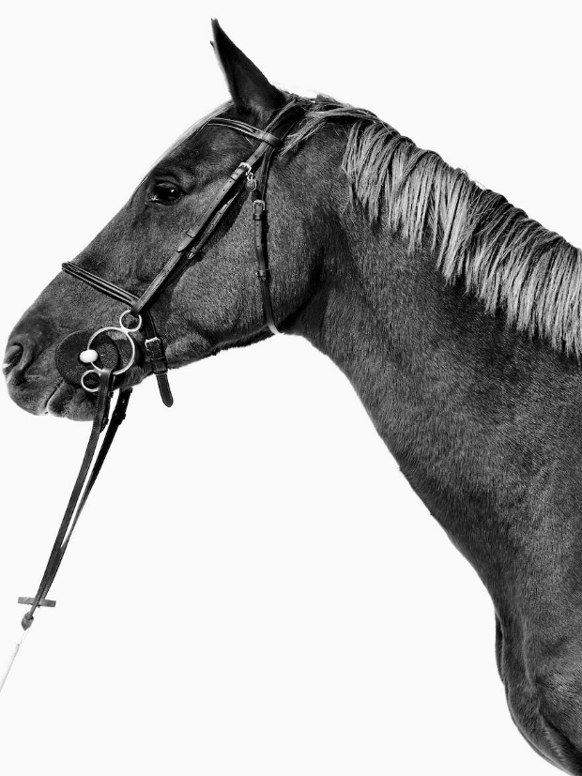
14 In Indiana ... it's illegal to ride a horse above 10 MPH.
Hopefully your horse has a speedometer! No horse shall be "driven" at a speed above 10 MPH in Indiana, due to high-speed horse races back in the day.

Slide 27
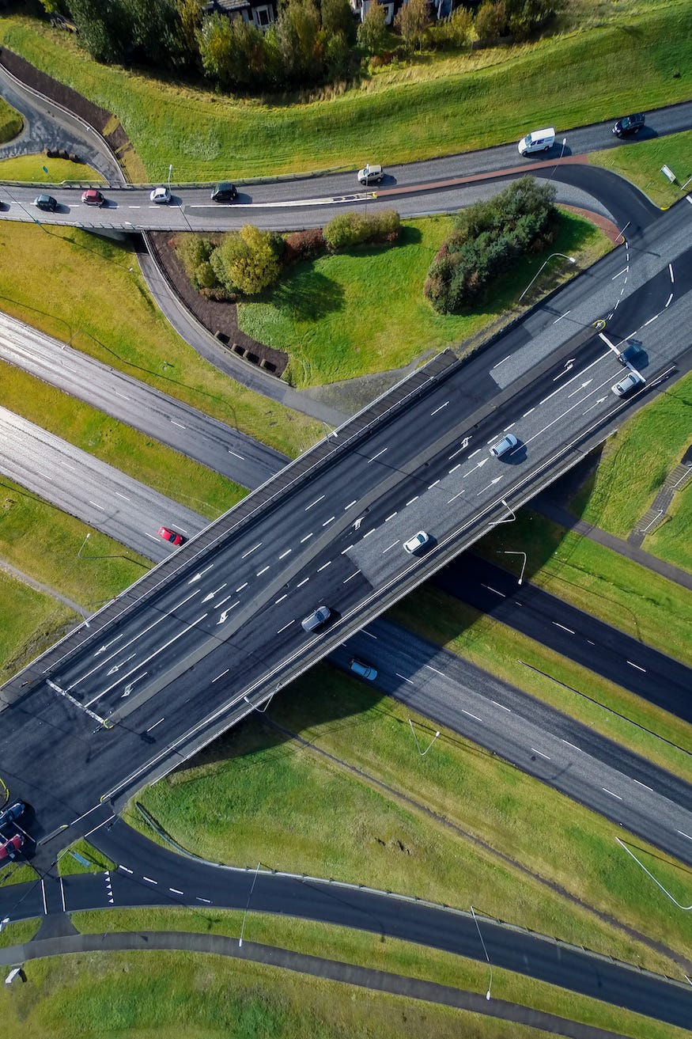
15 In Iowa ... you can't throw a brick onto a highway.
This Corn State law seems to be written in stone. Throwing bricks — or any other "dangerous instruments or toys," for that matter — onto a highway, street, or any public ground is prohibited in Iowa, unless you have written permission from the City Council.

Slide 28

16 In Kansas ... tire screeching is banned.
Another disturbing-the-peace victim for ya! If you live in Kansas, make sure your gears are greased and your tires are checked — as tire screeching is not only considered unlawful, but painfully annoying to listen to.

Slide 29
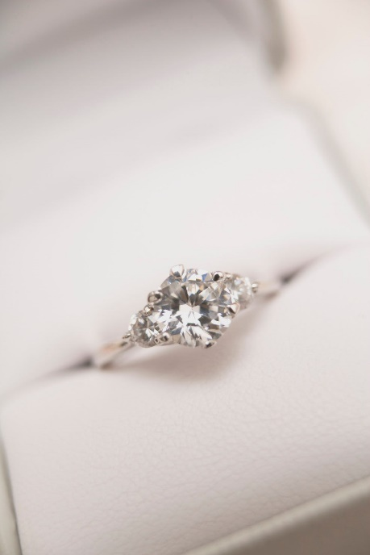
17 In Kentucky ... a woman cannot marry the same man four times.
According to Woman's Day, a law in Kentucky forbids a woman from marrying the same man more than three times. Hopefully, third time really is the charm!

Slide 30
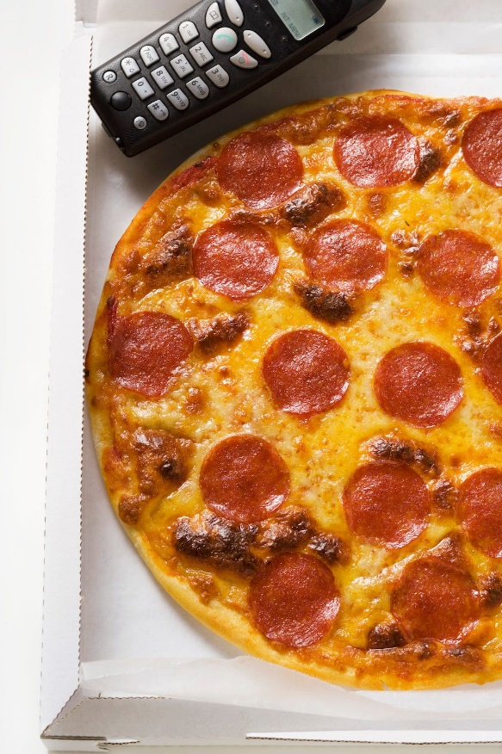
18 In Louisiana ... it's illegal to send a surprise pizza.
Well, we sure do wish this would happen more to us, but sending an unprompted pizza is actually considered harassment in Louisiana! Triple check your address if you live in the Pelican State, or else you may be handing over a $500 fine.

Slide 31

19 In Maine ... it's illegal to park in front of Dunkin' Donuts.
You donut even know how much the town of South Berwick, Maine, loves its Dunkin' Donuts coffee. This law was enacted because the coffee and donut chain is a hot-spot and the parking lot can turn into a mega traffic jam. Talk about a caffeine rush!

Slide 32

20 In Maryland ... sleeveless shirts are banned in public parks.
You definitely won't like this one if you're a fan of muscle tees: In Baltimore, it's technically considered a park rule violation to be in a public park with a sleeveless shirt (yes, even if you're outside)

Slide 33
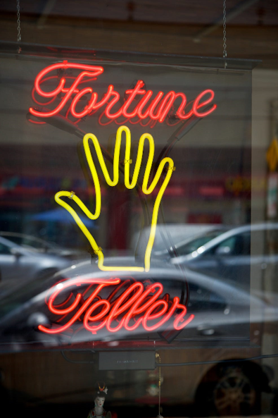
21 In Massachusetts ... it's illegal to tell fortunes without certification.
Another hurdle: A fortune teller must live in Massachusetts for at least one year in order to apply for a license. This law helps prohibit psychics from taking all of your mullah in exchange for false predictions.

Slide 34
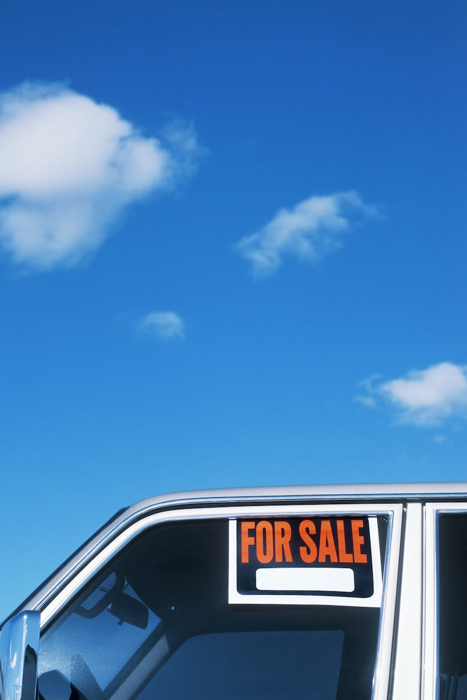
22 In Michigan ... you can't sell your vehicle on a Sunday.
This law was enacted way back in 1953: It is unlawful to sell, trade or buy motor vehicles on a Sunday in Michigan due to religious reasons. According to the Wolverine State, time is better spent with family, friends or at church.

Slide 35
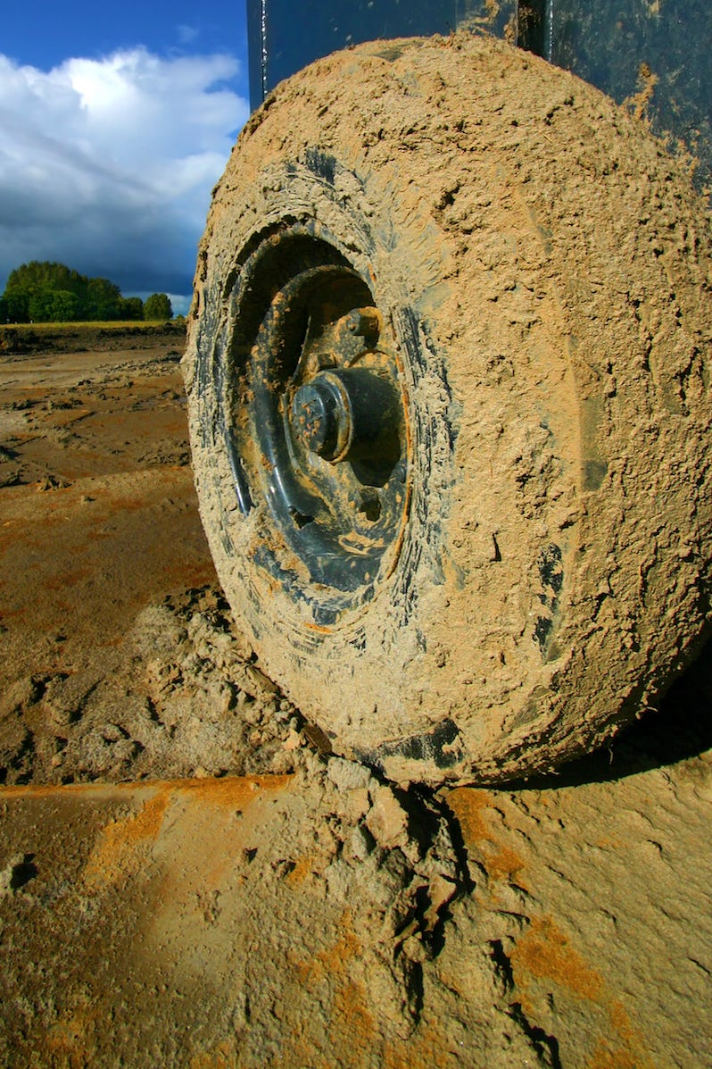
23 In Minnesota ... dirty tires are banned.
Driving through Minnesota soon? Make sure to get your car washed prior, as dirty tires are considered a public nuisance if they deposit mud, dirt, or other substances on a street or highway!

Slide 36
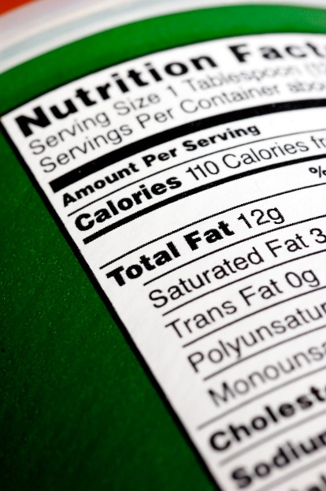
24 In Mississippi ... nutrition labels cannot be enforced.
In 2013, lawmakers barred towns from forcing restaurants to include nutrition information or calorie counts on menus. The same bill — also known as the Anti-Bloomberg Bill — bans communities from requiring restaurants to limit portion sizes. At least you're kept in the dark when it's cheat day?

Slide 37
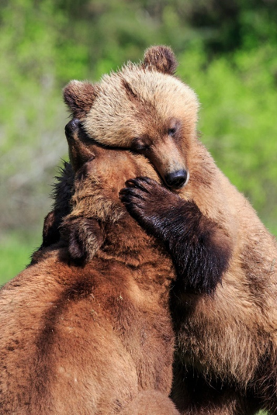
25 In Missouri ... bear wrestling is banned.
We all love a good bear hug now and then, but the real deal is outlawed in Missouri. This law was initiated due to animal cruelty violations, and is still in effect today!

Slide 38
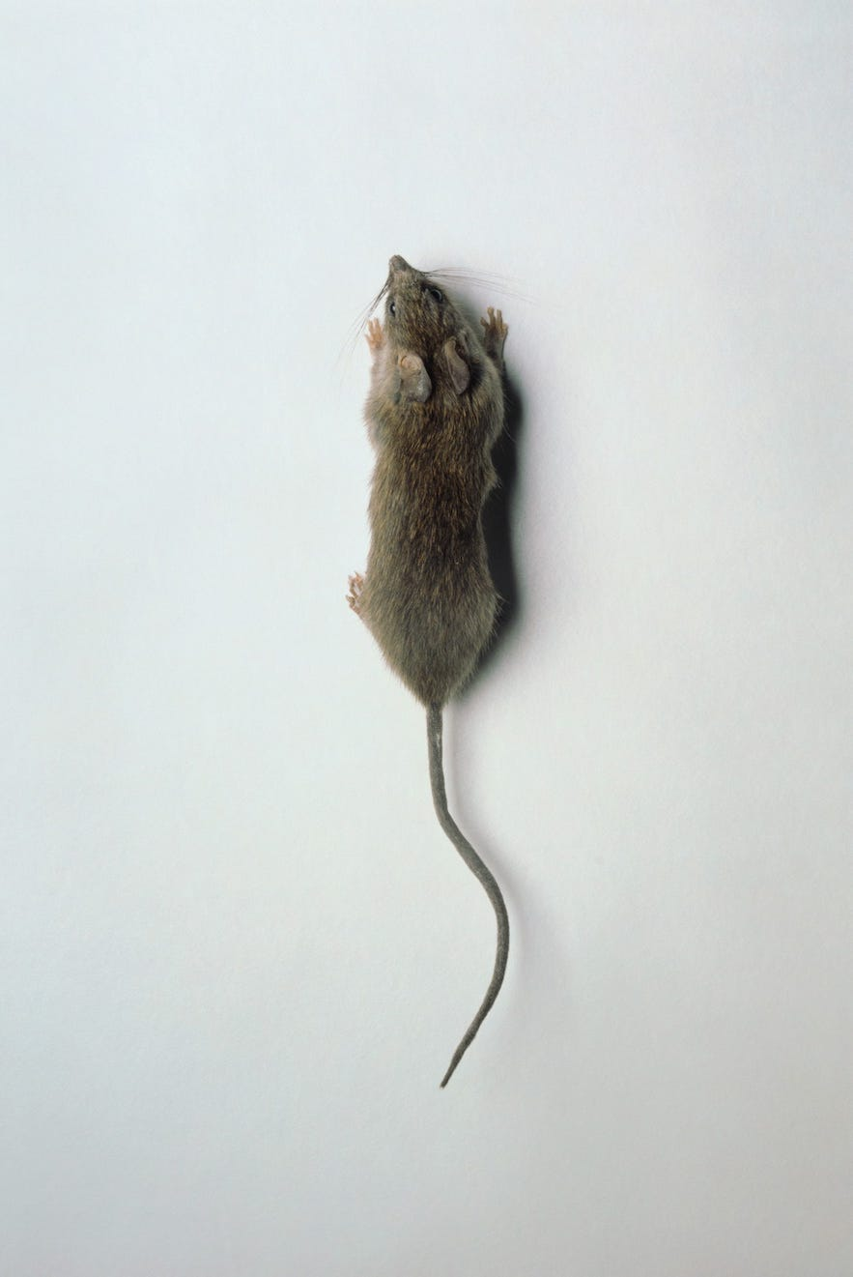
26 In Montana ... it's illegal to give a rat as a present.
Bad news if you were planning to have a pet rat in Big Sky Country: In Montana, it is unlawful to raise, sell, or give away rats except as food for reptiles, birds of prey, or both.

Slide 39
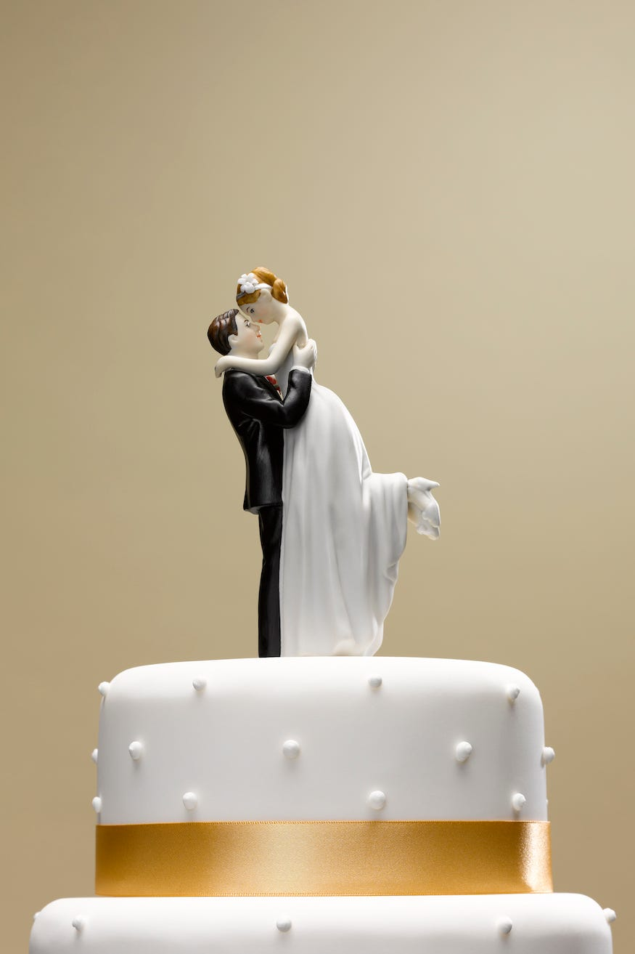
27 In Nebraska ... you can't get married if you have a venereal disease.
According to this law, a person afflicted with a "venereal disease" (that's a nice way of saying STDs!) can't marry in the state of Nebraska

Slide 40
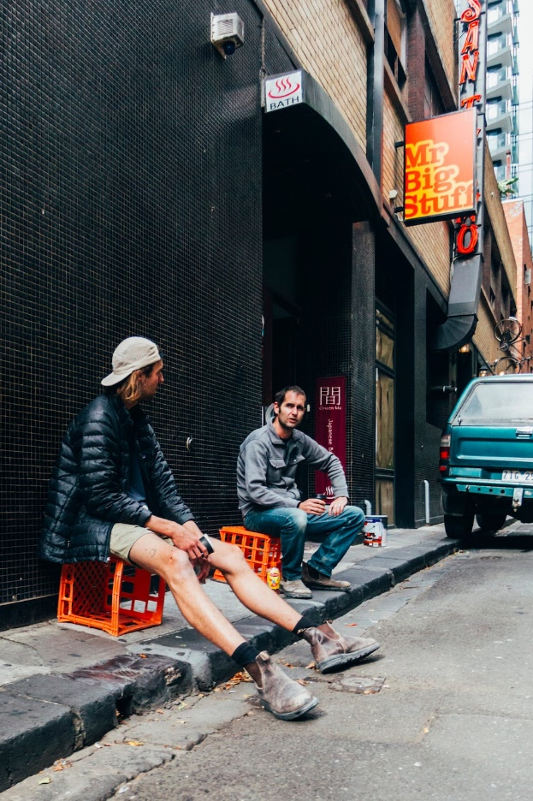
28 In Nevada ... it's illegal to sit on sidewalks.
The Silver State never sleeps — or even rests for that matter. It's unlawful to sit or lie down on public sidewalks in Reno, Nevada, as it interferes with the primary purpose of the sidewalk and threatens public safety.

Slide 41

29 In New Hampshire ... it's unlawful to pick up seaweed off the beach.
In 1973, New Hampshire outlawed carrying or picking up seaweed off the beach at night. It's rumored that in colonial times, seaweed was used as fertilizer and was thus a hot commodity.

Slide 42
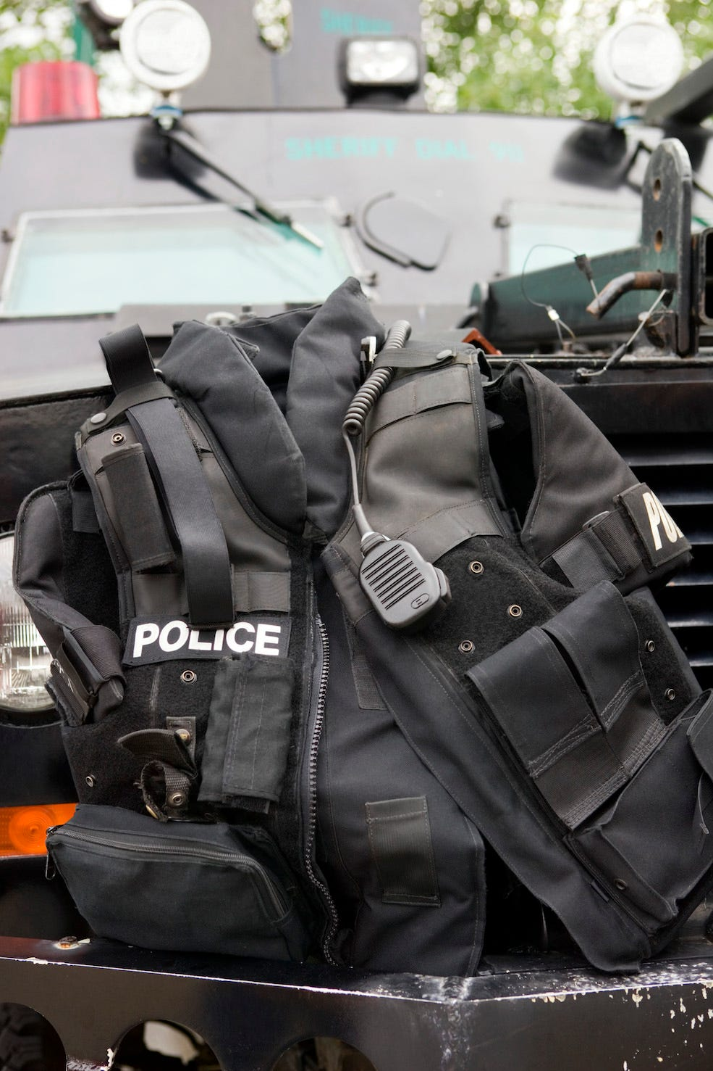
30 In New Jersey ... bullet-proof vests are banned while committing a crime.
Amended in 1999, this Garden State law prohibits people from wearing a bullet-proof vest while you're committing — or attempting to commit — a crime. If caught, a person can be charged separately for it!

Slide 43
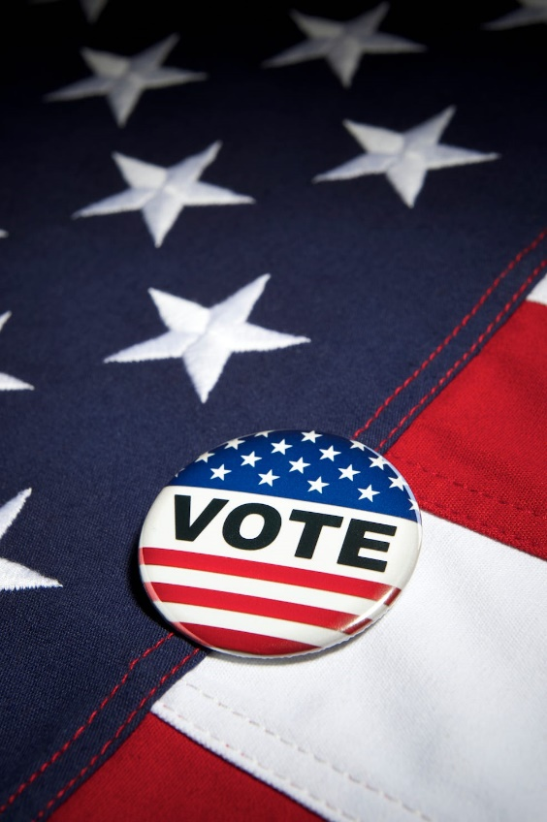
31 In New Mexico ... "idiots" are banned from voting.
One law in the state of New Mexico prohibits "idiots" as well as "insane persons convicted of a felonious or infamous crime" from voting. To our knowledge, this crazy law isn't enforced elsewhere.

Slide 44
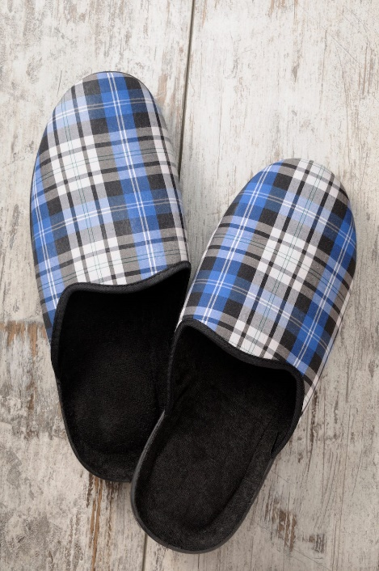
32 In New York ... slippers are banned after 10 p.m.
Bad news for those who love rocking some fashionable, comfy slippers all day and night around the house: One old law says that slippers are not to be worn after dark in New York (though we can't imagine how this law exactly came about!).

Slide 45
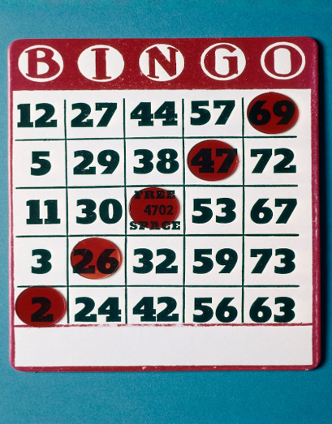
33 In North Carolina ... drunk bingo is unlawful.
How's this for a party foul you never saw coming? Apparently, it's illegal in North Carolina to sell or consume any alcoholic beverage in a room while a bingo game is being played.

Slide 46
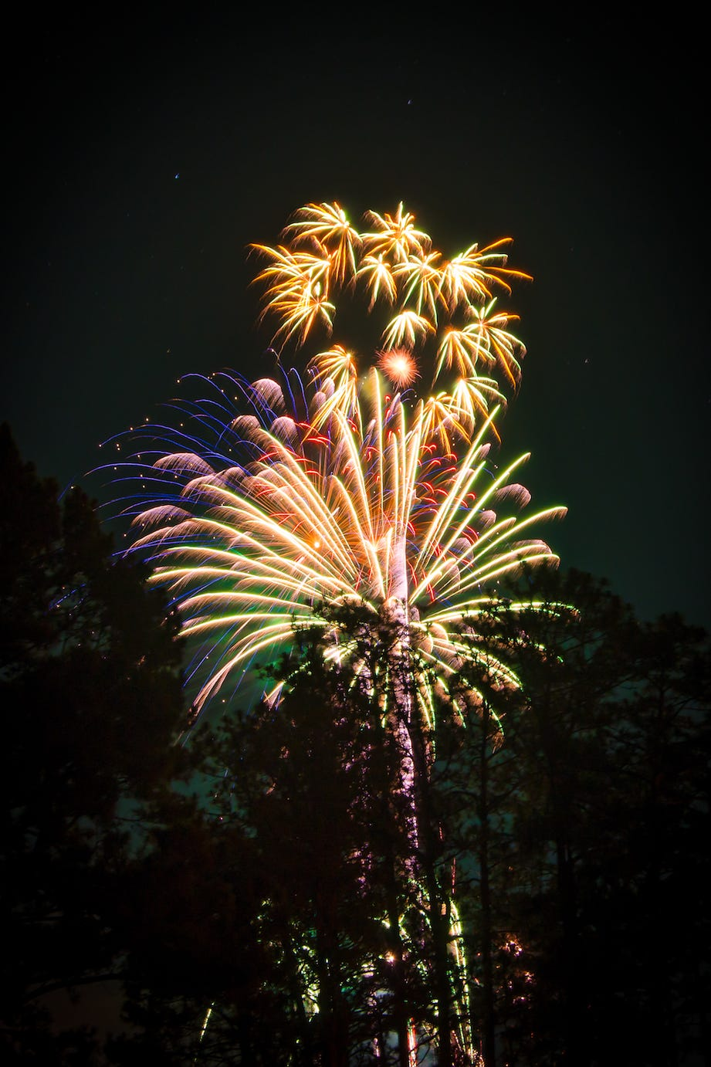
34 In North Dakota ... you can't shoot fireworks after 11 p.m.
Fourth of July must be pretty tame in Devils Lake, North Dakota. Fireworks are banned after 11 p.m., as it is a violation of disturbing the peace. However, you're safe to fire as early as 8 a.m. Fireworks and eggs, anyone?

Slide 47
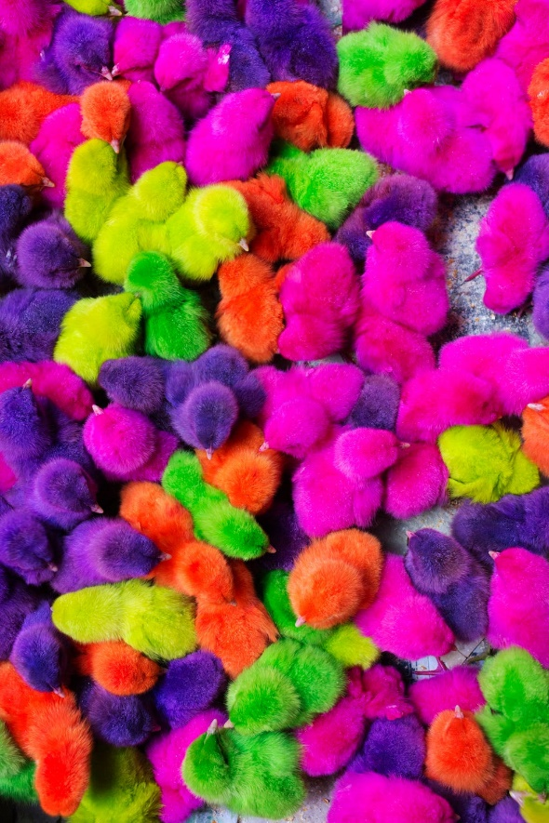
35 In Ohio ... it's illegal to sell dyed chickens.
Rainbow rabbits and chickens are banned from all sales displays in Akron, Ohio, due to animal cruelty violations. Buy Peeps instead!

Slide 48
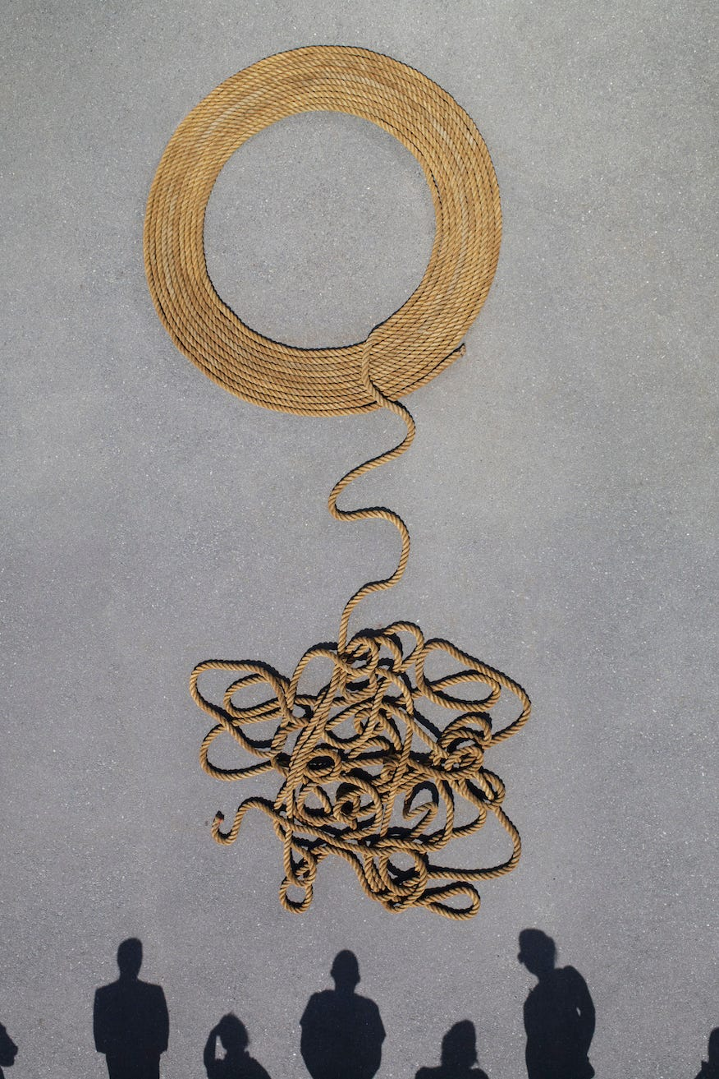
36 In Oklahoma ... tripping a horse is outlawed.
It is prohibited to promote, engage in or be employed at a horse tripping event in Oklahoma after it was ruled unlawful due to animal cruelty.

Slide 49

37 In Oregon ... it's illegal to go hunting in a cemetery.
Most people bring flowers to a cemetery, but apparently some brought guns back in the day. This became illegal in the Beaver State after a hunter was charged with harvesting an animal on cemetery grounds.

Slide 50
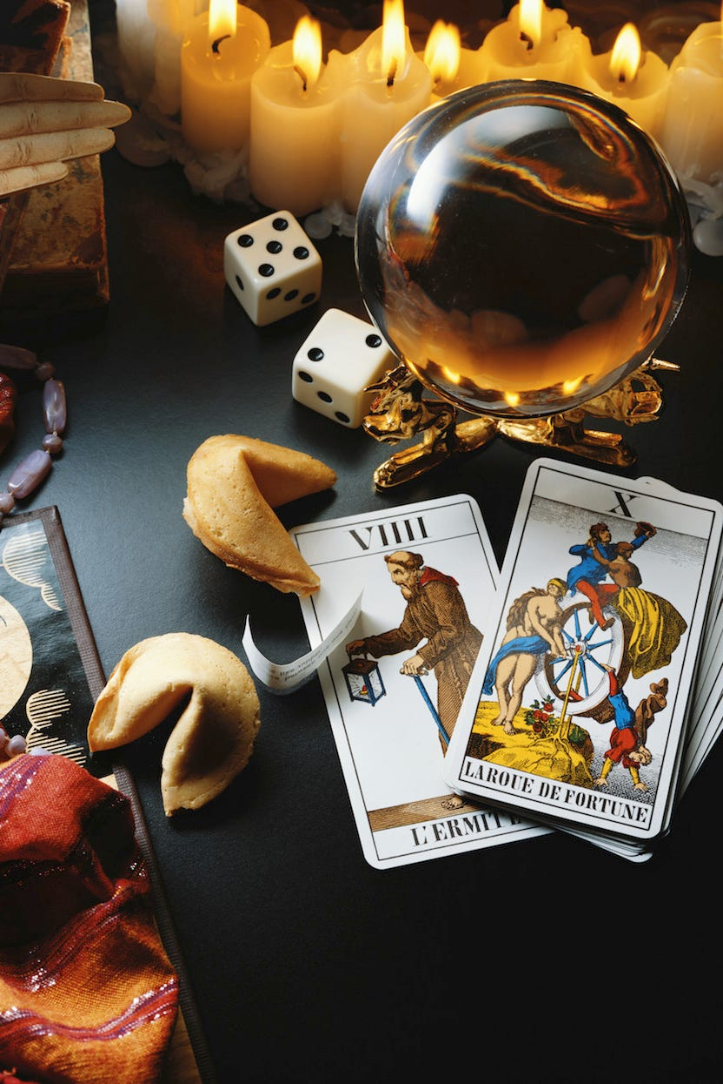
38 In Pennsylvania ... you're breaking the law if you pay a psychic.
Fortune tellers in the Keystone State probably aren't too psyched about this ban, but it's actually illegal in Pennsylvania to engage in things like fortune telling, tarot card reading, or the like for monetary compensation. You'll have to go somewhere else if you want to get your palms read!

Slide 51
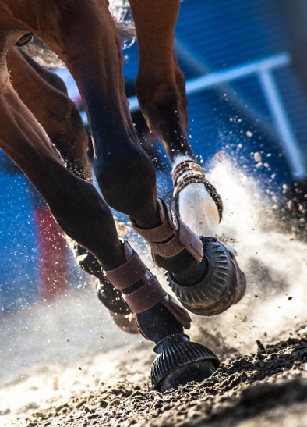
39 In Rhode Island ... it's illegal to race a horse on a highway.
This old law from the Ocean State prohibits racing or testing the speed of a horse over a public highway. Failure to comply will result in a $20 fine or imprisonment of 10 days or less!

Slide 52
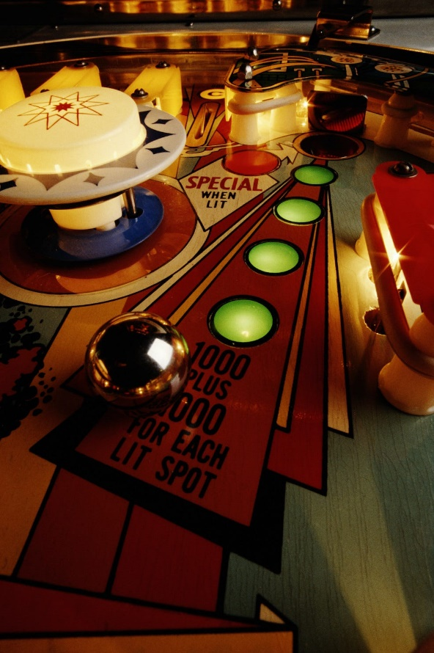
40 In South Carolina ... you can't play pinball if you're a minor.
Sorry, kids! Minors under 18 years old aren't allowed to play a pinball machine in South Carolina — and if temptation gets the best of you, you'll be handed a status offense violation. Better stick to harmless board games at home!

Slide 53
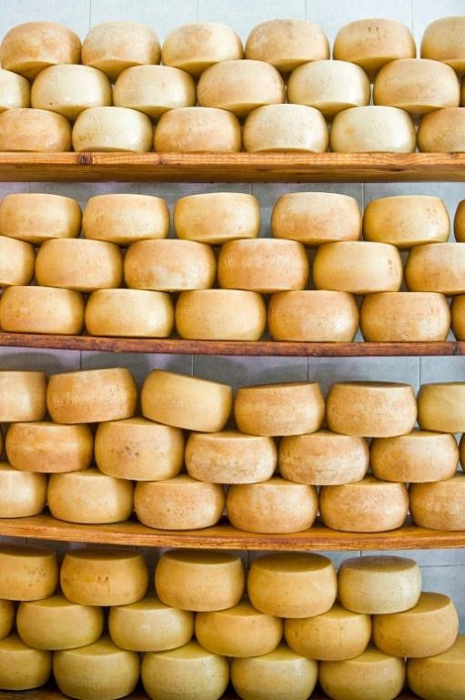
41 In South Dakota ... it's illegal to sleep in the cheese factory.
Apparently, this was outlawed with the same logic behind not falling asleep at the wheel. It's not the wisest idea to be operating large machinery while dozing off; however, if the cheese is packaged you're in the clear to work around the clock!

Slide 54

42 In Tennessee ... it's illegal to share your Netflix password.
Passed in 2011, this law is directed at hackers who sell log-in credentials in bulk. However, other individuals (cough, your friends, cough) who share passwords and don't live under the same roof are also included. Oops!

Slide 55
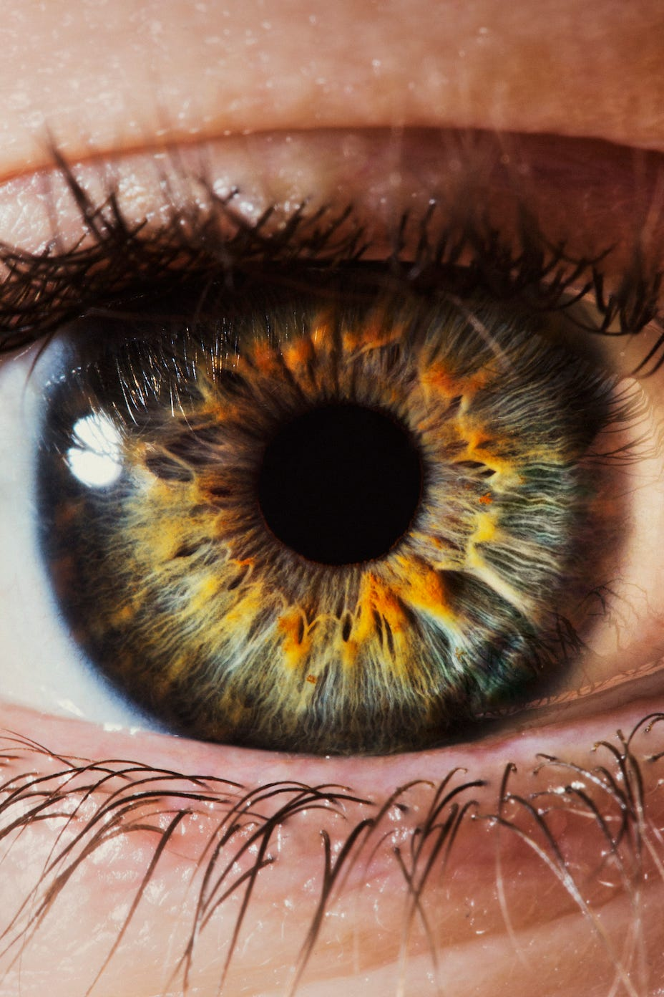
43 In Texas ... you can't sell a human eye.
Other human organs and tissues are included in this law, too — like the kidney, liver, heart, lung, pancreas, bone or any other organ that doesn't include hair or blood.

Slide 56

44 In Utah ... biting is banned in boxing.
All we can say is the match that made passing this law necessary was probably nothing like the studio class that you took last week! Unfortunately, the origin is unknown but maybe it's best to keep this one under wraps.

Slide 57

45 In Vermont ... it's illegal for women to wear fake teeth without their husband's approval.
Here's one jaw-dropping law for you: In Vermont, it's technically mandatory for women to get written permission from their husbands if they want to opt for false teeth. Better let your hubby know you're eyeing those shiny veneers.

Slide 58
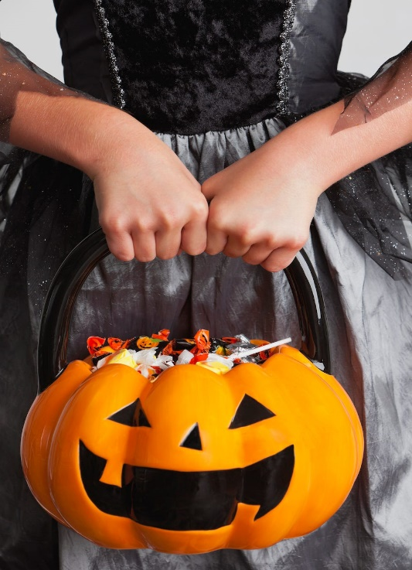
46 In Virginia ... you can't go trick-or-treating if you're over 14 years old.
In Chesapeake City, children over the age of 14 are banned from trick-or-treating due to mass complaints of older teens wreaking havoc on Halloween. The same ordinance also prohibits trick-or-treating after 8 p.m.!

Slide 59

48 In West Virginia ... hats are banned in theaters.
We all have bad hair days every once in a while, but it's a no-go if you're planning to wear a hat to the movies — as one old law bans the wearing of hats in theaters and performances, based on the fact that they obstruct other people's views.

Slide 60
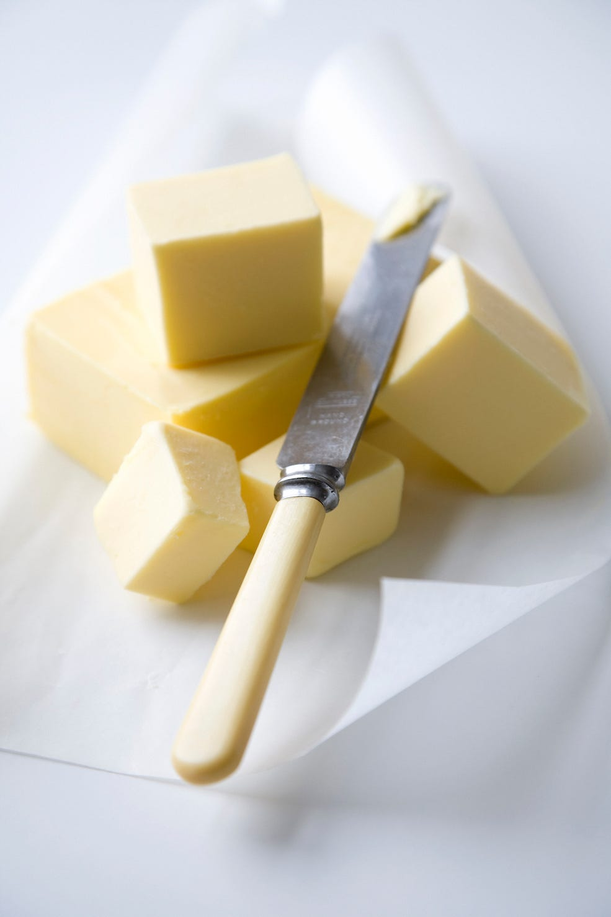
49 In Wisconsin ... butter substitutes are banned without permission.
Apparently, nothing is better than Wisconsin's butter. A public eating establishment may not serve margarine as a substitute for butter unless requested by the customer in fear of sudden allergic reactions.

Slide 61

50 In Wyoming ... buildings that cost $100,000+ must display pricey art.

Slide 62
Thank You!
Questions and Comments?
What other Crazy Laws are you aware of??
Check out your Handout #1
Please See Printed Lesson for References and Resources Credit Given to

