Slide 1
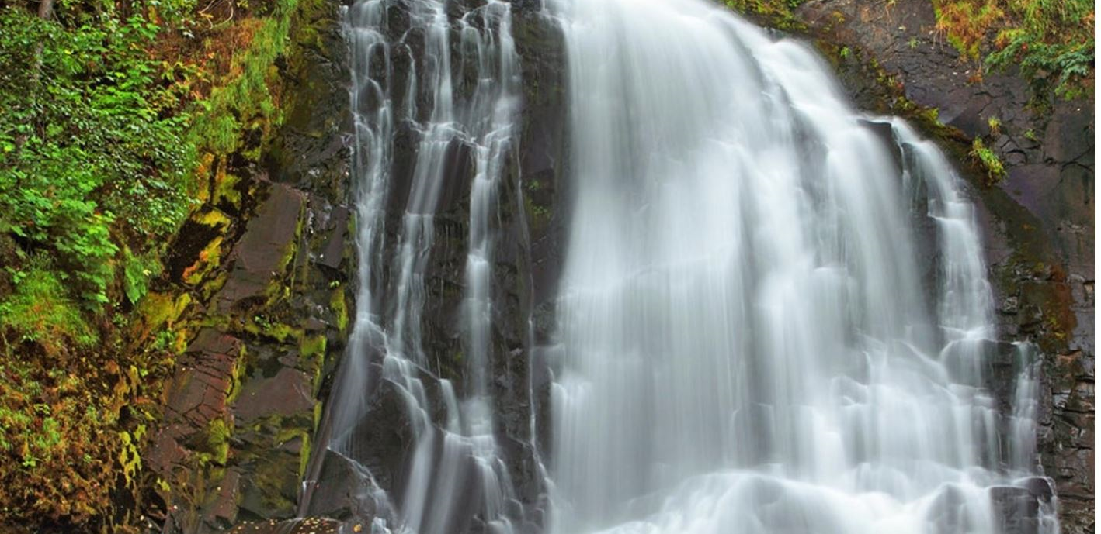
Falling Waters of Oregon
From Oregon FCE Lesson “Falling Waters” written by Linda Bird, Dorothy Burgess, and Ida Lee Knapp – 2003 State Conference
https://www.nps.gov/places/youngs-river-falls.htm

Slide 2
https://www.oregon-fce.org/_files/ugd/663f2d_55a3348688884e8e824788e657186f90.pdf
Full lesson PDF located here and has a plethora of amazing information!!

Slide 7
Types of Waterfalls

Slide 8
Types of Waterfalls

Slide 9
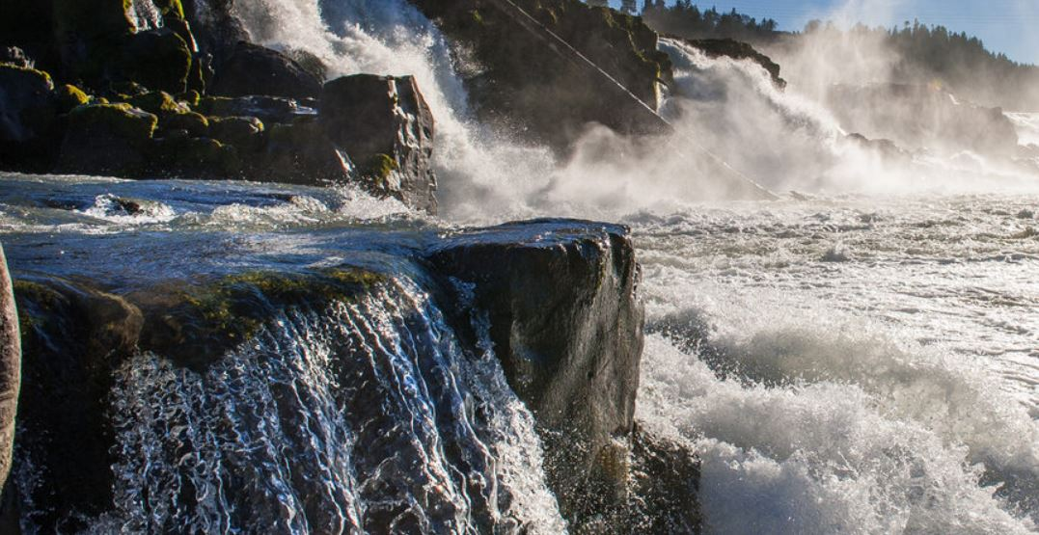
Clackamas County
Willamette Falls
https://www.oregonmetro.gov/news/inside-willamette-falls-qa-designer-michelle-delk

Slide 10
Clatsop County

Slide 11
Youngs River Falls
https://www.nps.gov/places/youngs-river-falls.htm

Slide 12
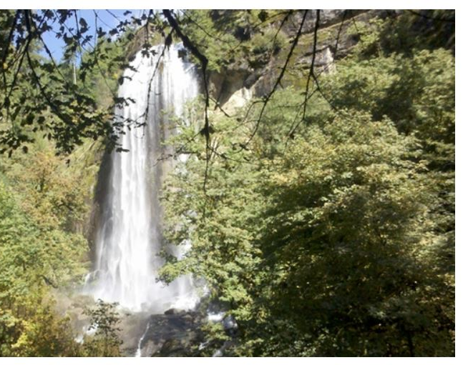
Columbia and Coos County
Silver Falls
https://stateparks.oregon.gov/index.cfm?do=park.profile&parkId=67

Slide 13
Crook and Curry County

Slide 14
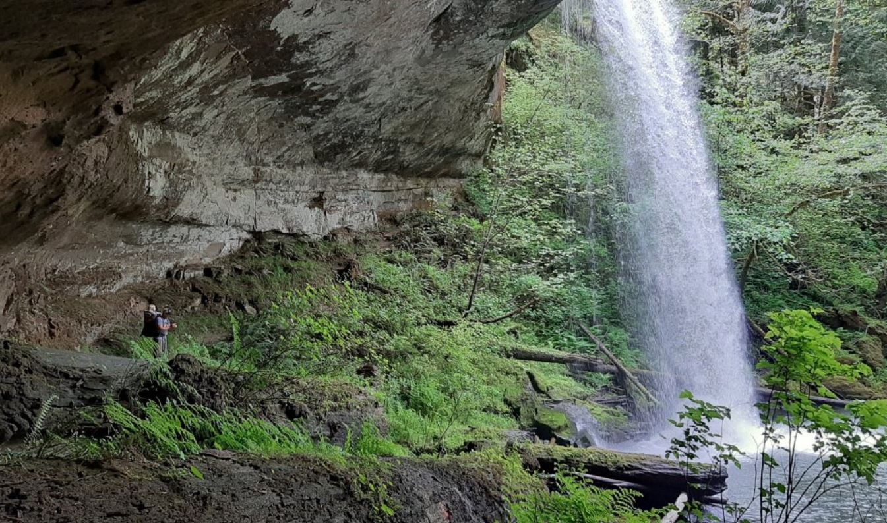
Lost Creek Falls
https://www.oregonhikers.org/forum/download/file.php?id=75254&sid=8d0835d0ca1d79b2c737b235366309e6&mode=view

Slide 15
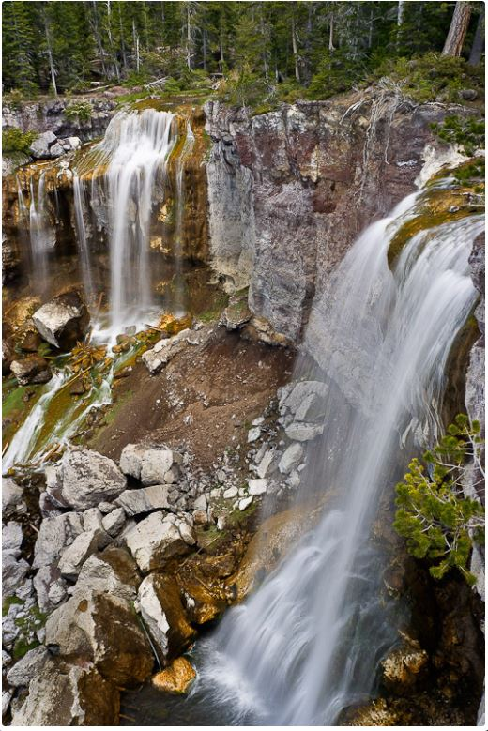
Deschutes County
Paulina Creek Falls
https://www.waterfallsnorthwest.com/waterfall/Paulina-Creek-Falls-4253

Slide 16
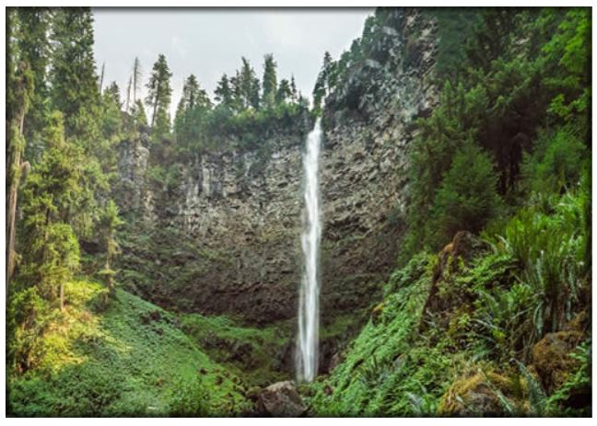
Douglas County – MIN 40!!!
Watson Falls
https://www.fs.usda.gov/recarea/umpqua/recarea/?recid=63652

Slide 17
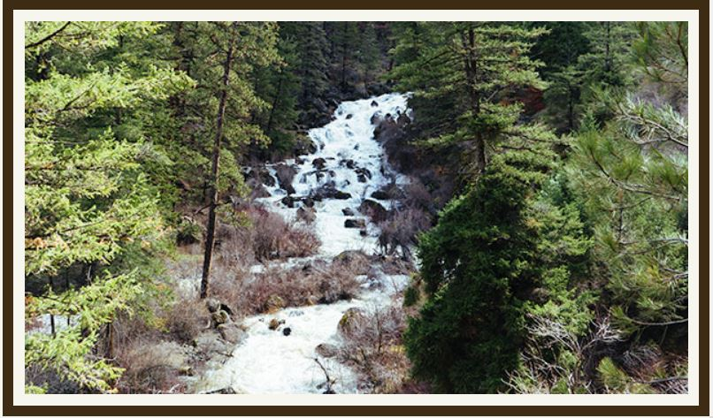
Grant County
South Fork Falls
http://www.oregonwildandscenic.com/south-fork-john-day/

Slide 18
Hood River County

Slide 19
Starvation Creek Falls
https://stateparks.oregon.gov/index.cfm?do=park.profile&parkId=122

Slide 20
Jackson and Jefferson County
Mill Creek Falls
https://www.blm.gov/or/districts/roseburg/recreation/ScenicByway/mill_creek_falls.html

Slide 21
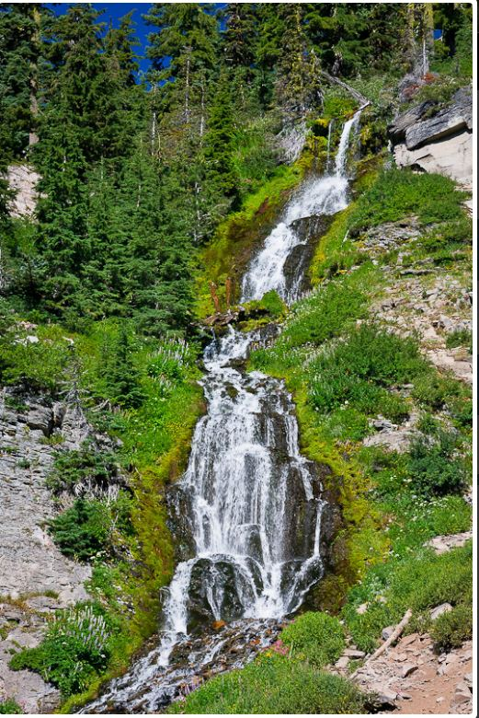
Josephine and Klamath County
https://www.waterfallsnorthwest.com/waterfall/Vidae-Falls-4143

Slide 22
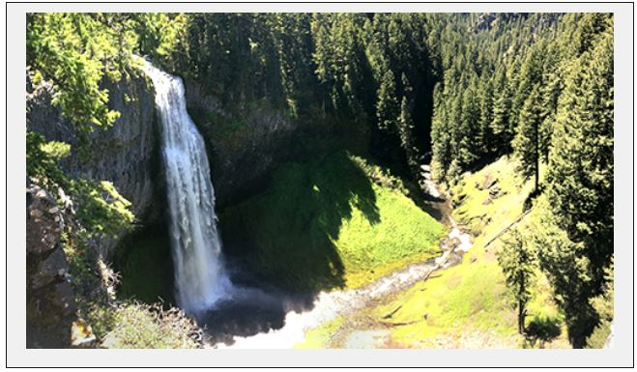
Lake and Lane County
https://www.fs.usda.gov/recarea/willamette/recarea/?recid=82005

Slide 23
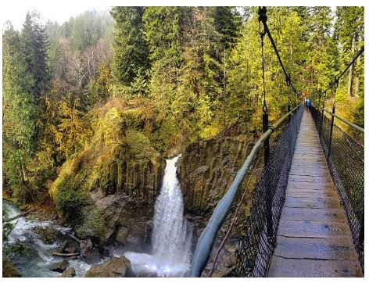
Lincoln and Linn County
Drift Creek Falls
https://www.oregoncoast.org/directory/hike-drift-creek-falls-trail/

Slide 24
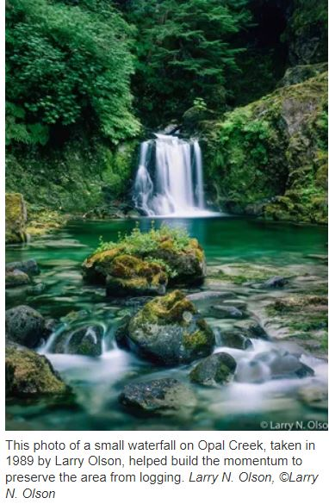
Marion County
Opal Falls
https://www.statesmanjournal.com/story/travel/outdoors/2016/07/15/picture-helped-save-opal-creek/86916866/

Slide 25
Multnomah County

Slide 26
https://www.wta.org/go-hiking/hikes/multnomah-falls
Multnomah Falls

Slide 27
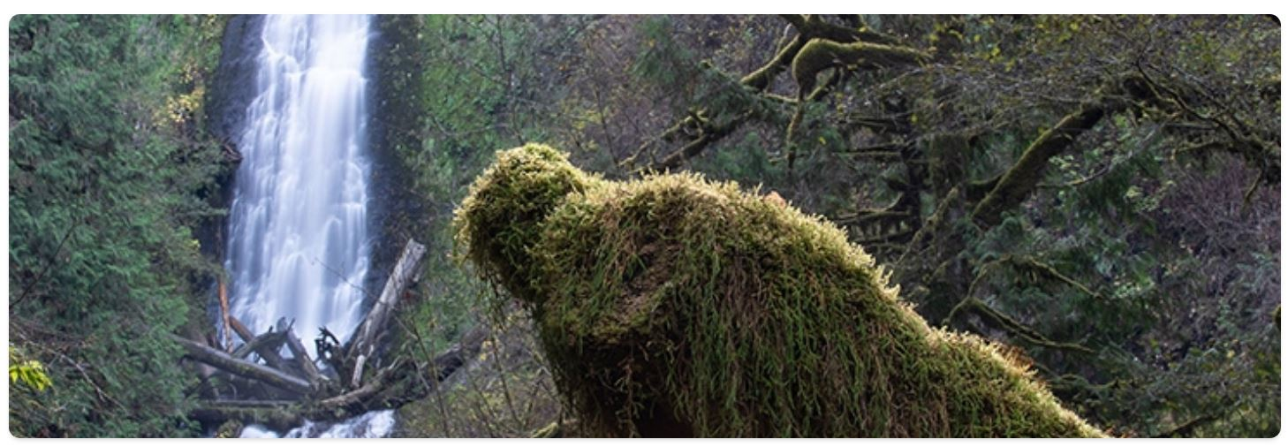
Polk and Tillamook
Munson Creek Falls
https://stateparks.oregon.gov/index.cfm?do=park.profile&parkId=175

Slide 28
Wallowa and Wasco
https://gorgefriends.org/hike-the-gorge/mosier-creek-falls.html

Slide 29
Washington and Yamhill

Slide 30
Where will the falling waters lead you?
https://www.world-of-waterfalls.com/waterfalls/pacific-northwest-pheasant-creek-falls/
Niagra Falls

