Slide 1
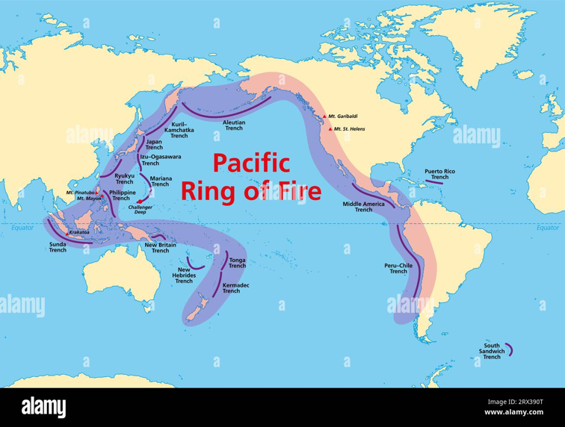
PACIFIC RING OF FIRE -CASCADE RANGE
2026 Oregon FCE State Conference
Prepared and Presented by Sandie Bolyard
Oregon FCE Vice President for Public Policy; National FCE Treasures
PowerPoint by Scott Teeples
Oregon FCE State President
PowerPoint Presentation to be used with Pacific Ring of Fire – Cascade Mountains Leaders Guide
Revised 8-26-26
Notes:
Ring of Fire
The Ring of Fire also called the Girdle of Fire has between 750 and 915 active and dormant volcanos including many submarine vents and fissures that erupt
underwater which accounts for 75 percent of the world’s volcanic action.
The Ring of Fire runs 25,000 miles long and 310 miles wide.
Nearly all the countries that surround the Pacific Ocean which includes Chili, Mexico, USA, Canada, Russia, Japan, China, Australia and New Zealand are within the Ring of Fire and it is responsible for 90 percent of the earthquakes that happen around to world.
The Cascade Volcanic Arc extends for 700 miles from Southern British Columbia through Washinton and Oregon into Northern California. The only break is the Columbia Gorge.
The Cascade Range was born by the subduction of the North American Plate with the Juan de Fuca Plate.
We will journey from Mt. Rainier to Mt, St Helens and Mt. Adams in Washington across the Columbia Gorge to Mt. Hood, Mt. Jefferson, Three Sisters, Newberry Volcano, Mt. Thielsen, Mt. Mazama and Mt Mc Loughlin in Oregon on to Medicine Lake Volcano, Mt Shasta and Lassen Peak in Northern California.
Lewis & Clark called the Cascade mountains the “Cascade Rapids at the Columbia Gorge” before long, the great white capped mountains were called “Mountains by the Cascades” and later simply the “Cascades”.
All the volcano areas were inhabited by Native Americans and were later encountered by early explorers and settlers
The most used descriptions you will hear are;
Stratovolcano~ also known as a composite volcano, a conical volcano built up of many layers of hardened lava and tephra, characterized by a steep profile with a summit crater.
Shield volcano~ low profile resembling a Greek Warrior’s shield lying on the ground with gently sloping surface with a central raised area.
Tephra~ fragmented material produced by a volcanic eruption consisting of ash, cinders, and blocks.

Slide 2
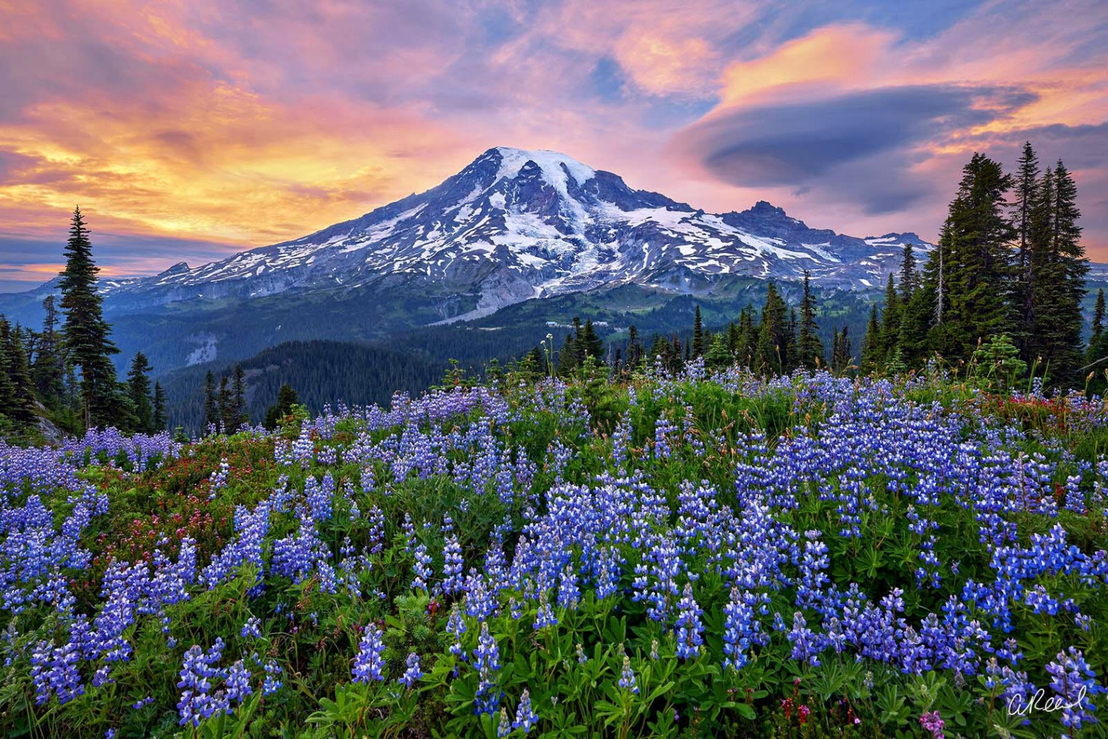
Mt. Rainier - Washington
Notes:
Mt. Rainier, Washington… Stratovolcano 14,399.6 feet,
Named for Rear Admiral Peter Rainier
The highest in Washington and the tallest in the Cascade Volcanic Arc, located about 59 Southeast of Seattle. Due to the high probability of an eruption in the near future and its proximity to major urban areas, it is considered one of the most dangerous in the world.
Between 1950 and 2018, over 439,000 people have climbed this mountain. In 1888 John Muir climbed Mt Rainier and although he enjoyed the view he concluded it was best appreciated from below.
Over millennia there have been more than 20 different names from the many indigenous peoples living near this mountain. I don’t want to offend them by trying to pronounce the names, but some of the various names mean “sky wiper”, and “one who touches the sky”, and “Tahoma” although residents of Tacoma changed the spelling for their city.
Evidence suggests a tradition of Native Americans setting fire to areas of the mountain each year to encourage meadow develop.

Slide 3
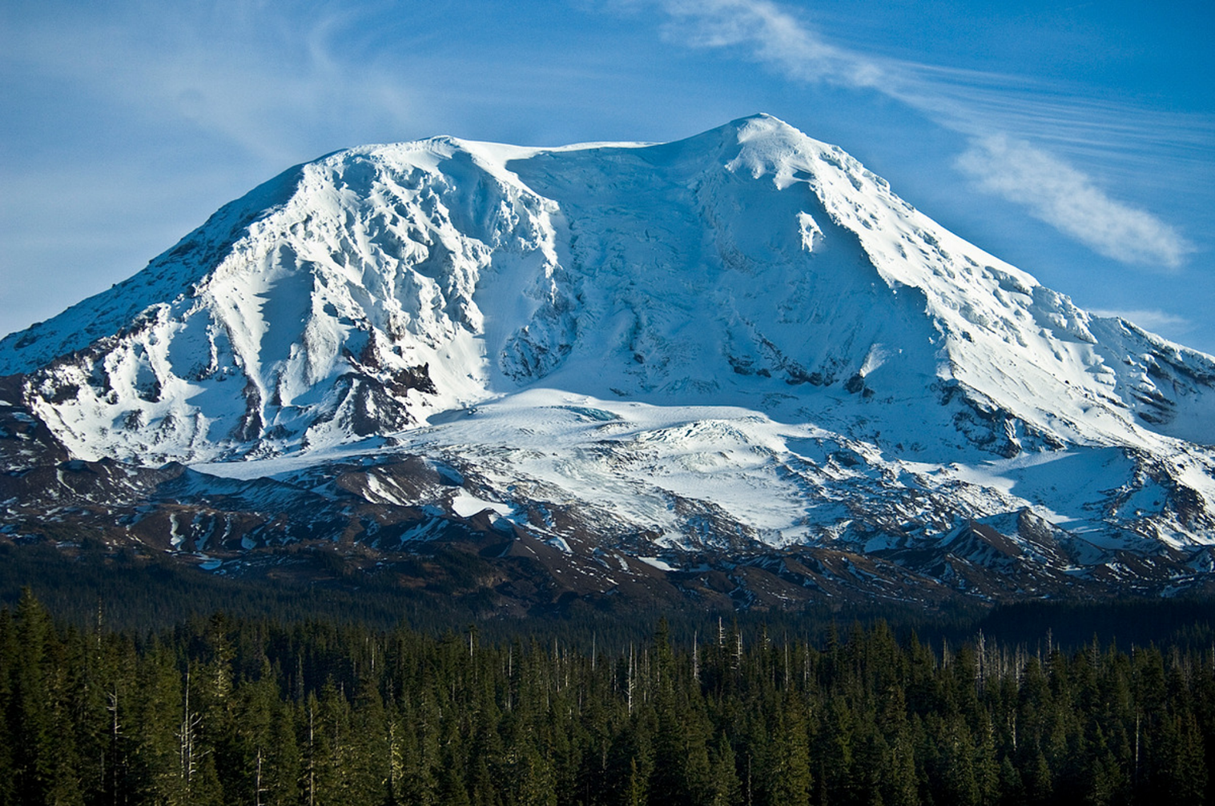
Mt. Adams - Washington
Notes:
Mt. Adams, Washinton… Dormant Stratovolcano 12,307 feet
Named for John Quincy Adams.
Even though Mt. Adams is the second highest in Washington and the second highest and second largest by volume in the Cascades after Mt. Shasta in California, Adams has a history of being ignored, Lewis & Clark who were usually great at map making, somehow completely missed Mt. Adams. Over the early years it has been mistaken for Mt. Hood and St. Helens even though it is larger than either of them. Although it hasn’t had any major eruptions for over 1,000 years it is merely dormant not dead.
A large slide in1921 was caused by a steam explosion and steam vented from the area for three years. Hydrogen Sulfide continues to come from the crater.
Ironically, being the most remote of the northwest volcanoes was the only one exploited for commercial use, between 1929 and 1931 sulfur was mined and hauled down on the backs of mules. Native Americans called it Pah-to or a son of the great spirit.

Slide 4
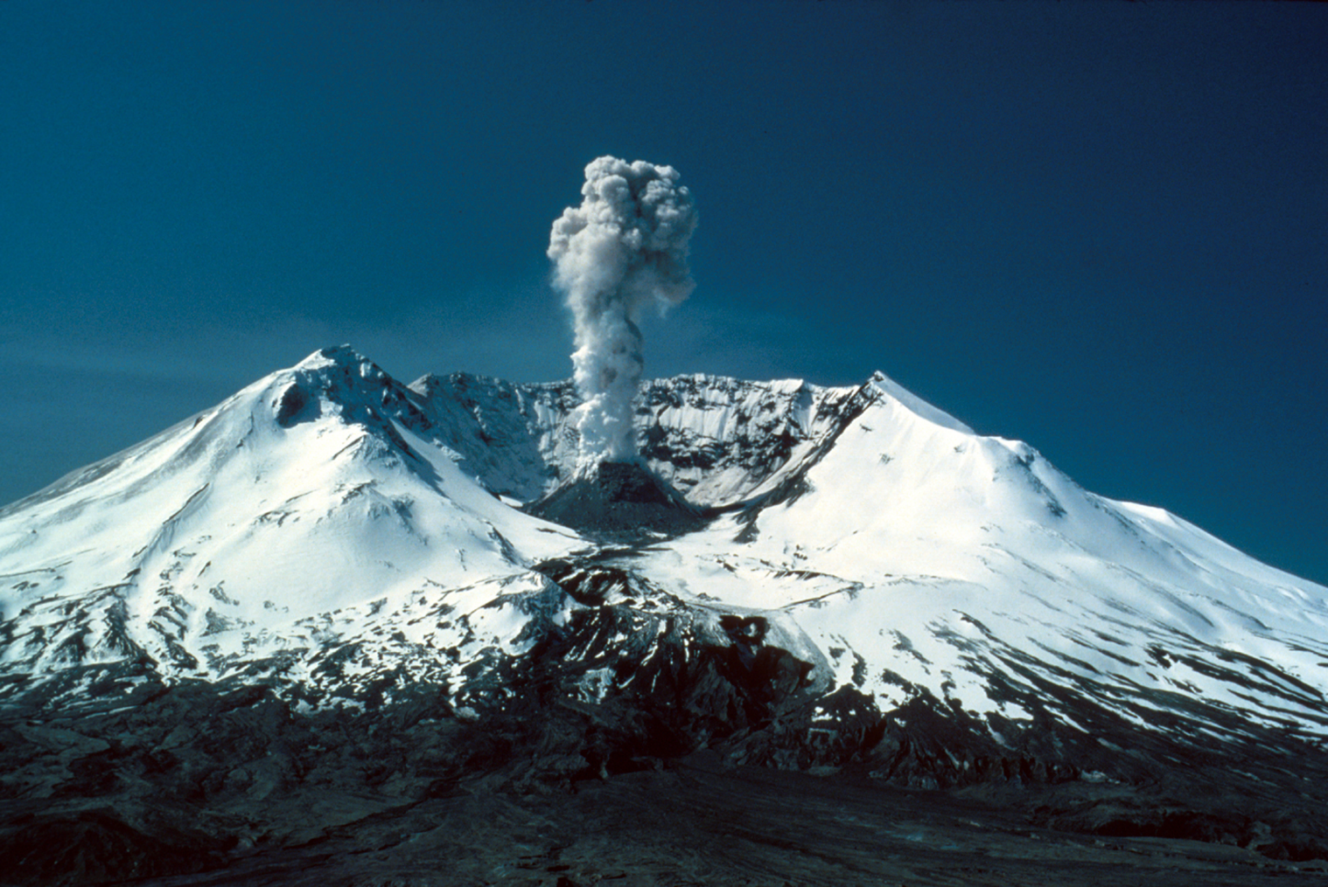
Mt. Saint Helens - Washington
Notes:
Mt. St. Helens, Washington… Active Stratovolcano 8,363 feet
Named for Alleyne Fitzherbert the 1st Baron of St Helens, a British Diplomat.
It lies 52 miles northeast of Portland, Oregon. Mt. St. Helens major eruption in 1980 triggered by a 5.1 earthquake, caused a lateral eruption that reduced the elevation from 9,677 to 8,363 feet. leaving a mile wide horseshoe shaped crater. it was the most economically destructive volcano event in U.S. history. 57 people were killed, 200 homes,47 bridges,15 miles of railway and185 miles of highway were destroyed, by contrast the aquatic ecosystems in the area benefited from the large amounts of ash allowing aquatic life to multiply rapidly, within 6 years all aquatic life was back to normal.
I guess it’s true there is always a silver lining.

Slide 5
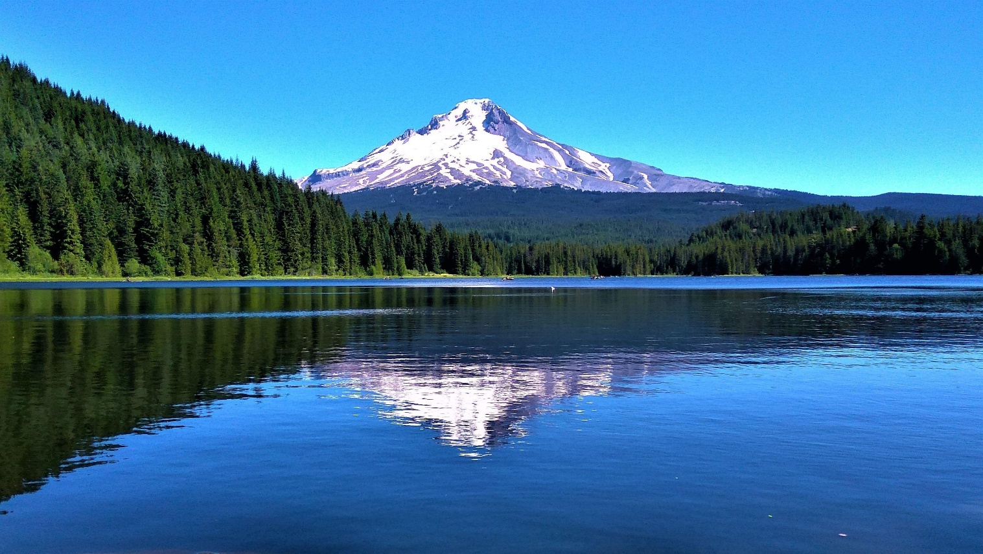
Mt. Hood - Oregon
Notes:
Mt. Hood, Oregon …11,249 feet Active Stratovolcano
Named for Lord Samuel Hood, Admiral of the Royal Navy
Native Americans in that area called it Wy’East, Son of the Great Spirit.
The highest mountain in Oregon and fourth highest in the Cascade Range, it’s located about 50 miles Southeast of Portland and attracts about 10,000 climbers a year second only to Mt. Fuji. The mountain has 12 glaciers that provide water for the area during dry summer months. Mt Hood has a long history of major eruptions over the last 15,000 years, the last one in the 18th century shortly before the arrival of Lewis and Clark. The last minor eruption was in 1907 when climbers noticed a cloud of steam, the mountain continues to emit sulfur dioxide and carbon dioxide. On clear days when the weather is just right, condensation can be seen from Portland.
Geological Surveys considers it potentially active but informally it’s considered dormant by scientists but there is an estimated 3-7% chance of erupting in the next 30 years.

Slide 6
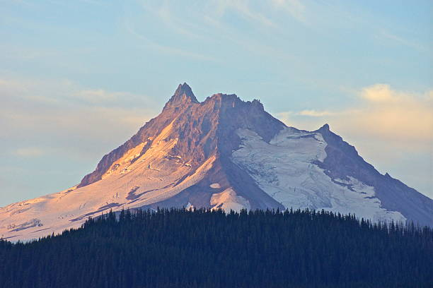
Mt. Jefferson - Oregon
Notes:
Mt. Jefferson, Oregon… Stratovolcano 10,502 feet
Known as Seekseekqua by Native Americans
Named for President Thomas Jefferson
The second highest mountain in Oregon after Mt Hood,it is situated within Linn, Jefferson and Marion Counties. Last eruption was 950 AD. Despite the low chance of future eruptions, mudflows are still considered a major threat. When the glaciers retreated after the little Ice Age in the 29th century, water filled in the spaces left behind, forming moraine-dammed lakes which are more common in the Jefferson Wilderness and he nearby Three Sister Wilderness than any where else in the contiguous United States.

Slide 7
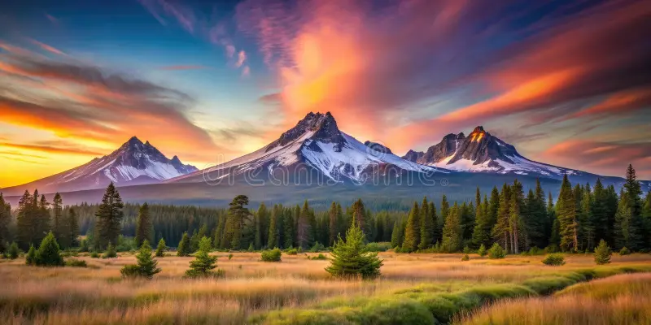
Three Sisters - Oregon
Notes:
Early settlers called them Faith, Hope and Charity.
Three Sisters, Oregon lies within Lane and Deschutes Counties. They are he center of closely grouped volcanic peaks in contrast to the typical 40-60 mile spacing between volcanoes elsewhere in the Cascades.
North Sister also known as “Faith” a shield volcano, at 10,090 feet it overlays a more ancient shield volcano named “Little Brother” she is the oldest and most eroded of the three. It is estimated that her last eruption was about 46,000 years ago. Erosion has reduced her height from more than 11,000 feet down to 10,090 feet.
Middle Sister also known as “Hope’ a stratovolcano with an elevation of 10,052 feet the smallest and least studied of the three. of the Three Sisters, middle Sister has the most ice cover, 700 million cubic feet which continue to cut away at the mountain.
South Sister also known as “Charity” a stratovolcano overlying an older shield structure. At 10,363 feet is the tallest of the trio. Unlike its sister peaks, South Sister has an uneroded summit crater, about1/4 mile in diameter that holds a small crater lake known as Teardrop Pool.

Slide 8
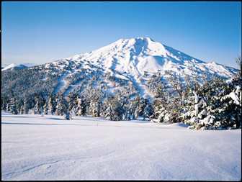
Mount Bachelor - Oregon
Notes:
Mt. Bachelor 9,068 feet…a dormant stratovolcano sits atop a shield volcano
and lies within Deschutes County. It remains unclear whether the volcano is extinct or just inactive. The Mt. Bachelor volcanic chain southeast of South Sister runs for 5 miles and encompasses an area of about 100 square miles consists of cinder cones, lava flows and three shield volcanoes. Mt. Bachelor has not erupted in 8,000 to 10,000 years it is entirely covered in Mazama Ash from the eruption of Mt. Mazama about 6,845 years ago. Listed as a moderate threat level there is no evidence of becoming active in the near future. It remains unclear whether Mt. Bachelor is dormant or completely extinct. Mt Bachelor is currently the center of winter recreational activities offering alpine skiing, snowboarding, cross-country skiing and dog sledding.

Slide 9
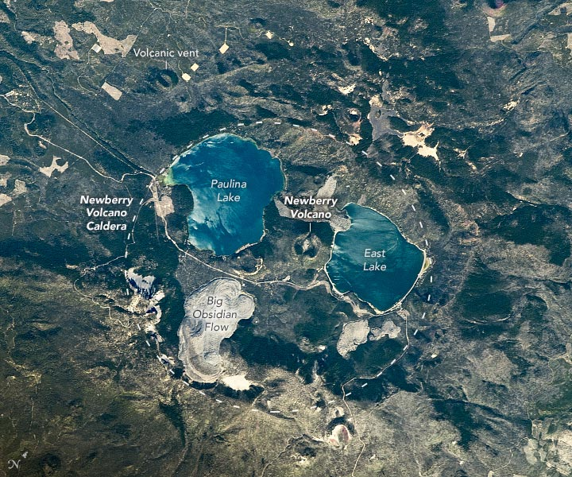
Newberry Volcano - Oregon
Notes:
Slide 1 of 2 – No Comments

Slide 10
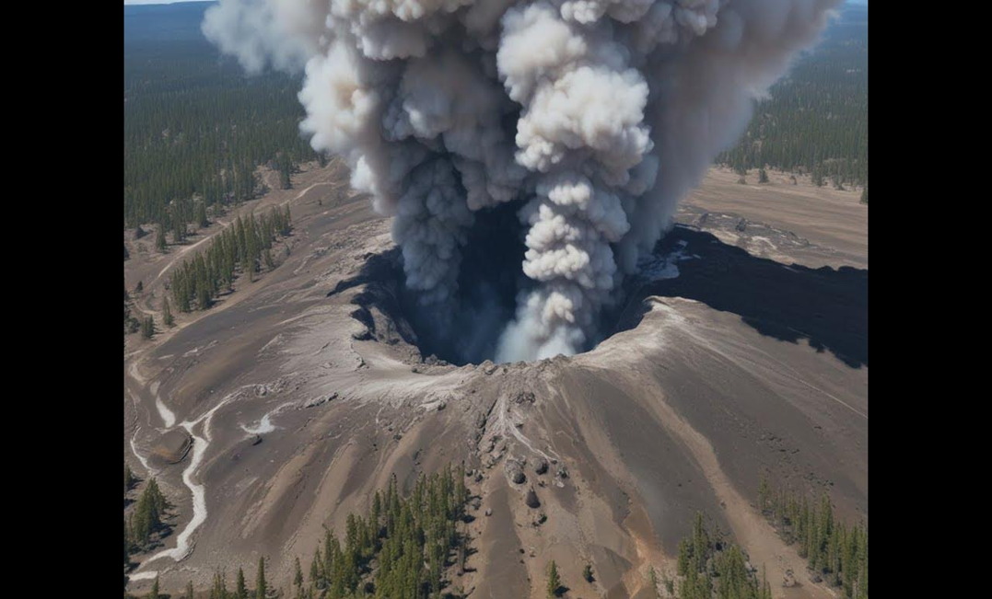
Newberry Volcano - Oregon
Notes:
Newberry Volcano, Oregon… active shield volcano.. 7,989 feet
Named after John Strong Newberry, Geologist and Surgeon.
Located 20 miles south of Bend. The largest volcano in the Cascade Volcanic Arc with an area of 1,200 square miles when the lava flow is taken into account, it is roughly the size of Rhode Island, from north to south the volcano is 75 miles long with a width of 27 miles with a large caldera 4 by 5 miles in diameter, within the caldera is Lake Paulina and East Lake which are filled by precipitation and percolation of ground water.
Newberry has more than 400 vents, the most of any volcano in the contiguous United States. Still considered active, it could erupt and produce lava flows, lahars, ashfall, earthquakes, avalanches and floods, it is being closely monitored.

Slide 11
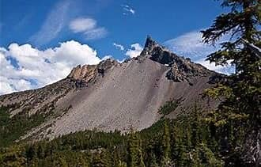
Mount Thielsen - Oregon
Notes:
Mt. Thielsen, Oregon… extinct shield volcano… 9,184 feet
Named for Hans Thielsen a railroad engineer and builder who played a major part in the construction of the California and Oregon Railroad
The volcanic cone of Mt Thielsen sits upon prior shield volcanos and is a member of extinct volcanos distinguished by their sharp peaks. Its spire-like shape attracts lightning strikes so often it has earned the nickname “the lightning rod of the Cascades”. Mt Thielsen is part of a series of extinct volcanoes termed pyramidal peaks or “the Matterhorns” for their steep, spire-like peaks. One of Mt. Thielsen’s eruptions formed Diamond Lake. Mt. Thielsen is so deeply eroded by glaciers that it has no summit crater the top of the mountain is more or less a horn.
Native Americans lived in the area and grew irritated with the new settlers so in 1865 Fort Klamath was built as a protective sanctuary. A wagon road was later built to connect the Rogue Valley to the fort.

Slide 12
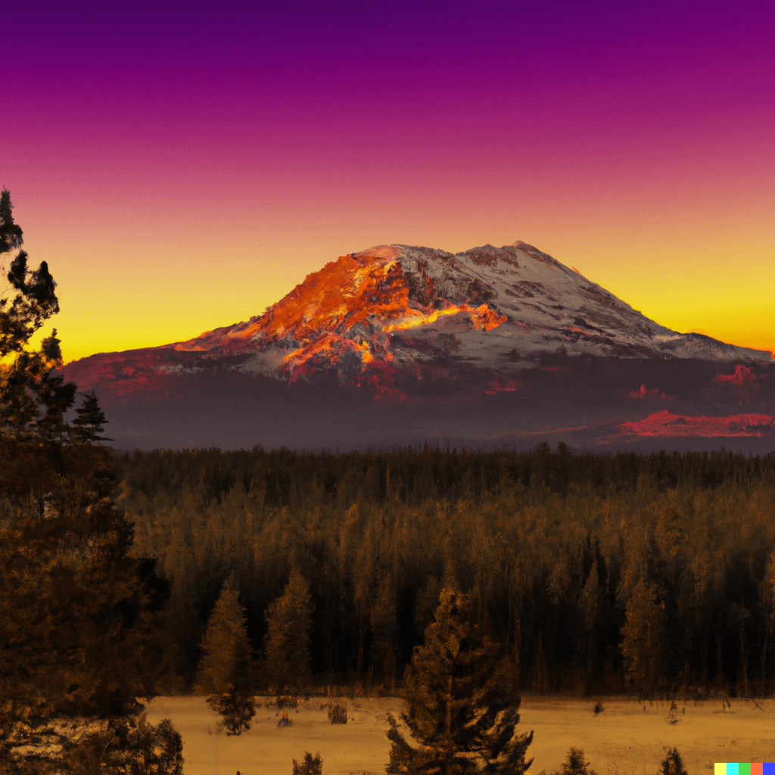
Mount Mazama - Oregon
Notes:
Slide 1 of 2. No Comments

Slide 13
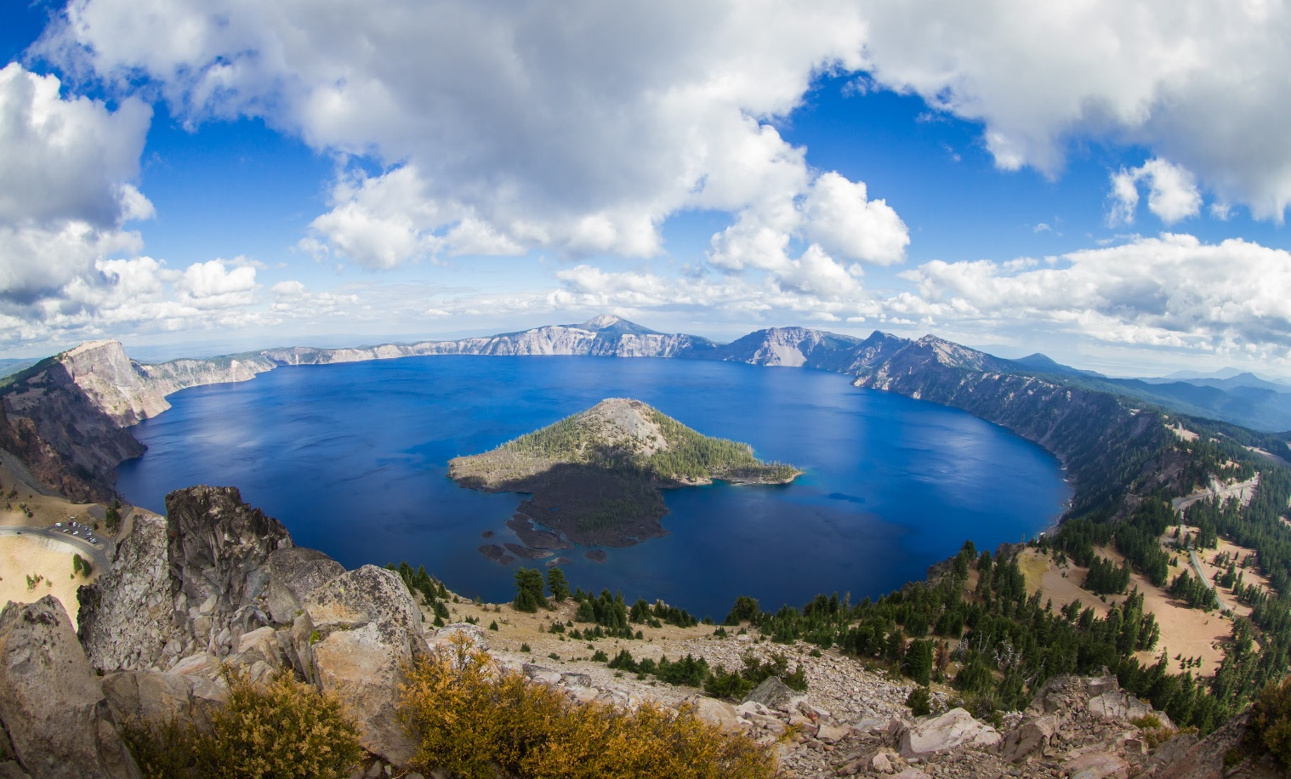
Mount Mazama, Crater Lake - Oregon
Notes:
Mt. Mazama, Oregon… dormant Stratovolcano caldera complex 8,157
Named
Located 60 miles north of the California-Oregon border, it’s collapse due to the eruption of magma emptying the underlying chamber caused the cone to collapse forming Crater Lake, a 2,148 foot deep caldera Crater Lake at 1,943 feet deep, it is the deepest freshwater lake in the U.S. Mt Mazama originally had an elevation of 12,000 feet, after the eruption it was reduced to 8,157 feet.

Slide 14
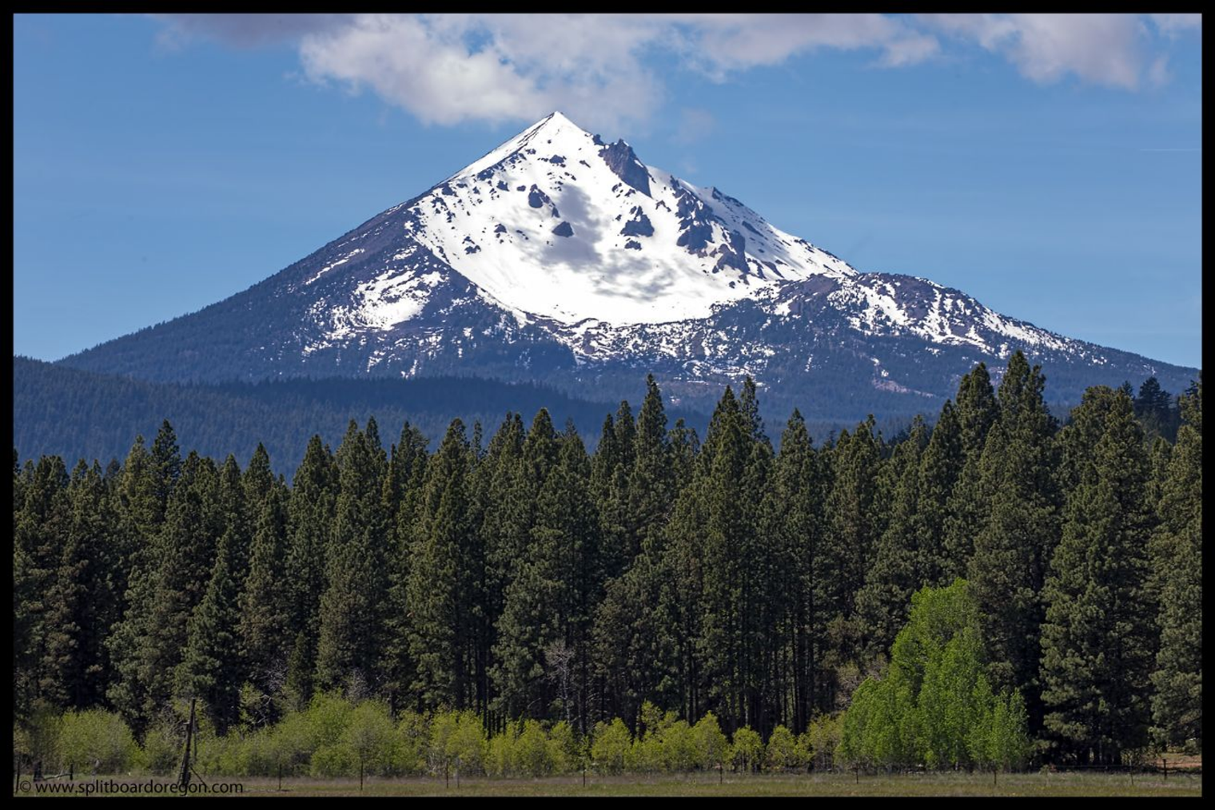
Mount McCloughlin - Oregon
Notes:
Mt. McLoughlin, Oregon… dormant stratovolcano… 9,493 feet
Named
A prominent landmark for the Rogue River Valley, it lies between Jackson County to the west and Klamath County to the east it rises over the Sky Lakes Wilderness with a width of 6 miles and length of 27 miles which encompasses more than 200 bodies of water including Lake of the Woods, Fourmile Lake, Upper Klamath Lake and Summit Lake plus numerous creeks and tributaries. McLoughlin has gone through an identity crisis as it was called by at least 9 different names since 1827. It was called Mt. Pitt for many years but was officially renamed as Mt. McLoughlin in 1905. Since 1926 the melting glaciers on the west side feeds the municipal watershed for Medford.

Slide 15
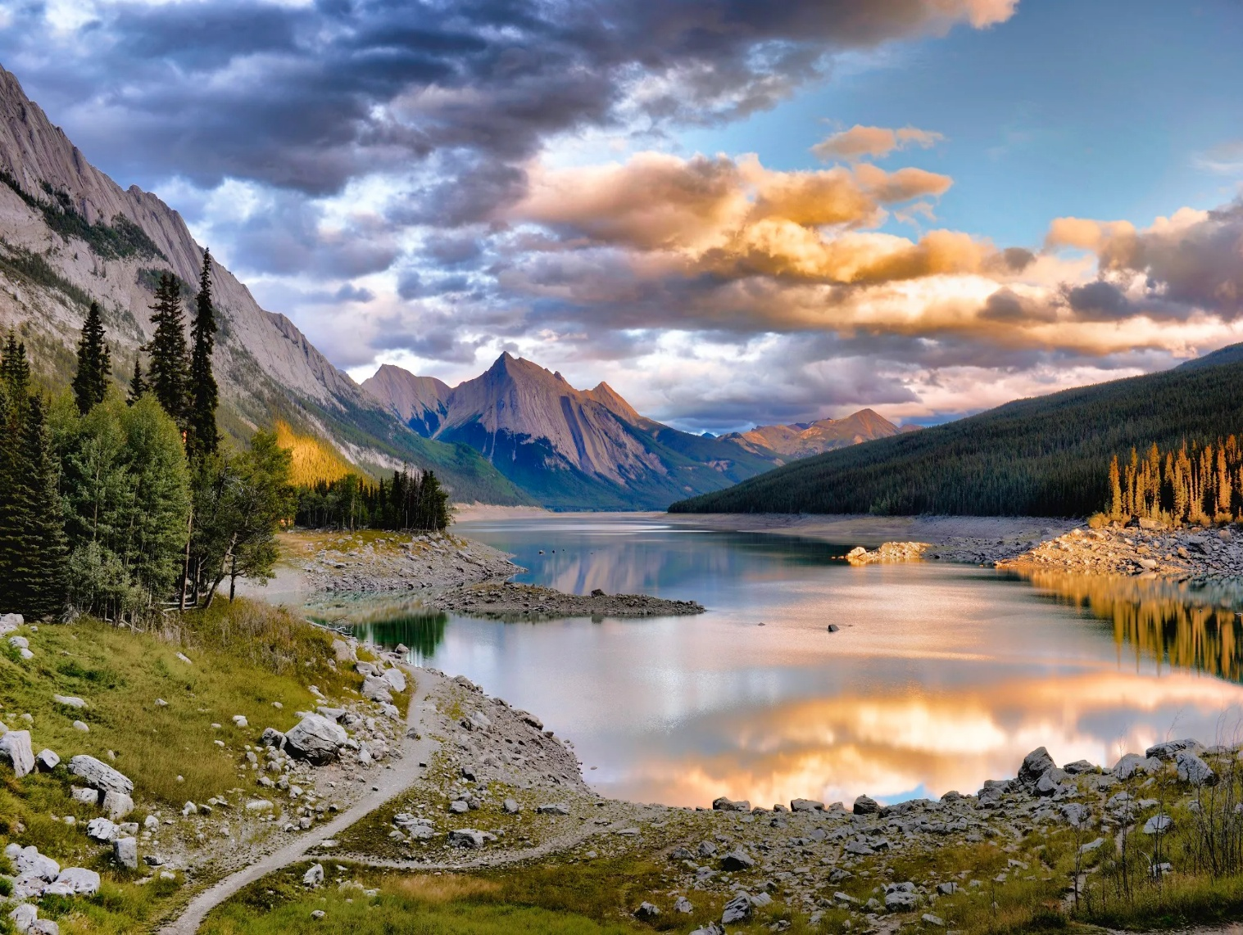
Medicine Lake - California
Notes:
Medicine Lake Volcano, California… shield volcano… 7,921 feet
Medicine Lake is a large shield volcano about 30 miles Northeast of Mount Shasta. Lava flows from Medicine Lake are estimated to be at least 140 cubic miles in volume making it the largest volcano by volume in the Cascade Range, Newberry Volcano in Oregon has the second largest volume. Medicine Lake is unique, having many small magma chambers rather than one large one as most volcanos, and collapsed instead of erupting leaving Medicine Lake, similar to the formation of Kilauea caldera in Hawaii.

Slide 16
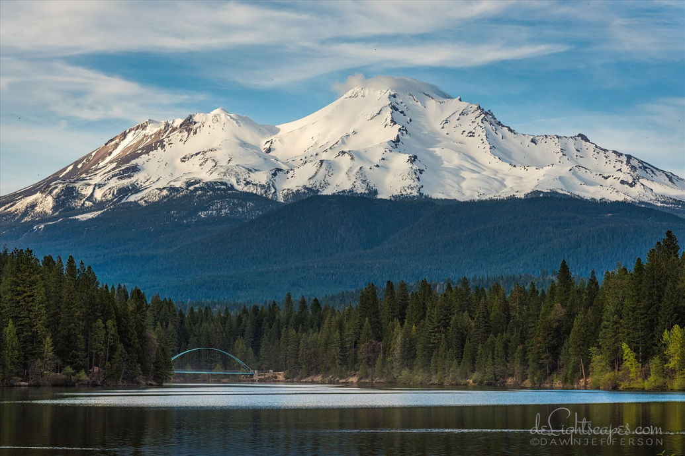
Mount Shasta - California
Notes:
Mt. Shasta, California…stratovolcano..14,179 feet
A potentially active volcano at the southern end of Cascade Range. The second highest peak in the Cascades. The mountain consists of four overlapping dormant volcanic cones that have a complex shape, the main summit and the prominent conical satellite cone of 12,330 feet was originally named Shastina. In 1854 Elias Pearce had several failed attempts to climb to the top, but in 1856 the first women Henrietta Eddy and Mary McCloud and their party reached the summit.
A prime example of what women can do.
There are many legends surrounding Mt. Shasta, some of the Klamath Tribes believed it was inhabited by the Spirit of the Above World, Skell, who descended from Heaven at the request of a Klamath Chief. Skell fought with Spirit of the Below World Llao who resided at Mt. Mazama by throwing hot rocks and lava representing the eruptions of both mountains.

Slide 17
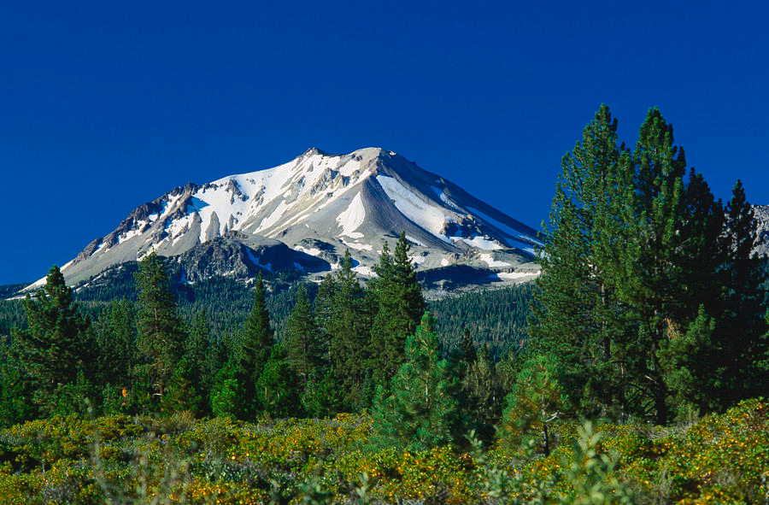
Mount Lassen - California
Notes:
Lassen Peak, California …10,457 feet, One of the largest lava dome on earth classified as dormant not extinct.
Named to honor Peter Lassen, a Danish blacksmith who guided immigrants past the peak to the Sacramento Valley during the 1830’s.
Commonly referred to as Mt. Lassen located in the Shasta Cascade region above the northern Sacramento Valley, it is the southernmost active volcano in the Cascade Volcanic Arc. Lassen is merely inactive and has a functioning magma chamber still capable of erupting causing a threat to the area through lava flows, mudslides, lahars, ash, avalanches and floods.
Lassen Peak in [1915] and Mt St. Helens in Wahington [ 1980 and 2004] are the only two volcanoes within the contiguous United States to erupt during the last century.
The geothermal area inside Lassen Peak represents the largest geothermal area in the United State besides the one in Yellowstone National Park.

Slide 18
Conclusion
Questions or Comments?
Thank You
Notes:
Conclusion
Many of the Mountains we have visited are considered dormant but some can have future activity. Many scientists from Washington, Oregon and California gather research of past eruptions in order to predict how mountains in this arc will behave and what they are capable of in the future. In the last century we have had some examples of eruptions, they are Lassen in 1915, St. Helens in 1980 and 2004. Statistics place the likelihood of a major eruption in the Cascade Range at 2 to 3 per century.
I hope you have enjoyed our journey through the Pacific Ring of Fire

