Slide 1
Mental Health & Mental Wellness Series
i. Basic Fundamental idea

Slide 2
What is Mental Health?
Mental health includes our emotional, psychological, and social well-being. It affects how we think, feel, and act, and helps determine how we handle stress, relate to others, and make choices. Mental health is important at every stage of life, it can affect you over the course of your life, from childhood and adolescence through adulthood, your thinking, mood, and behavior could be affected.

Slide 3

What is a Mental Health Condition(s)?
Mental illnesses are disorders, ranging from mild to severe, that affect a person’s thinking, mood, and/or behavior. According to the National Institute of Mental Health, nearly one-in-five adults live with a mental illness.

Slide 4
Biological factors, such as genes or brain chemistry
Life experiences, such as trauma or abuse
Family history of mental health problems

Slide 5
Antisocial personality disorder
Anxiety disorders (including generalized anxiety, panic disorders, obsessive-compulsive disorder (OCD), phobias, and social anxiety)
Depression
Post-traumatic Stress Disorder (PTSD)
Seasonal affective disorder (SAD)
Suicide and suicidal behavior
Self-harm

Slide 6
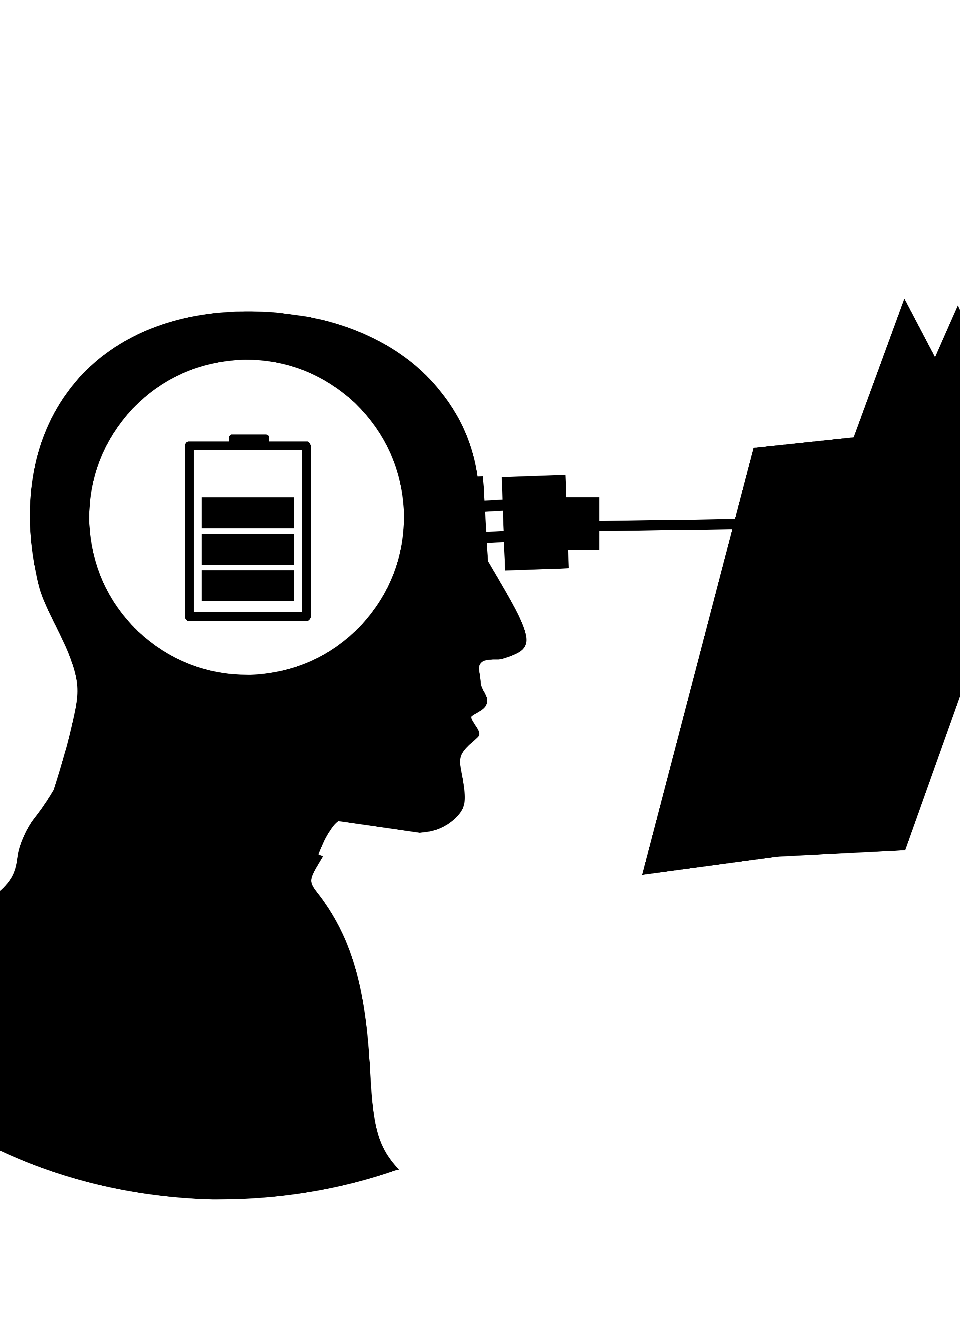
A Serious Mental Illness (SMI):
is a mental illness that interferes with a person’s life and ability to function. Despite common misperceptions, having an SMI is not a choice, a weakness, or a character flaw. It is not something that just “passes” or can be “snapped out of” with willpower.

Slide 7
Early Warning Signs & Symptoms
Experiencing one or more of the following feelings or behaviors can be an early warning sign of a problem:
Eating or sleeping too much or too little
Pulling away from people and usual activities
Feeling numb or like nothing matters
Feeling helpless or hopeless
Feeling unusually confused, forgetful, on edge, angry, upset, worried, or scared

Slide 8
Continued…
Yelling or fighting with family and friends
Having persistent thoughts and memories you can't get out of your head
Hearing voices or believing things that are not true
Thinking of harming yourself or others
Inability to perform daily tasks like taking care of your kids or getting to work or school

Slide 9
Tips for Living Well with a Mental Health Condition
Having a mental health condition can make it a struggle to work, keep up with school, stick to a regular schedule, have healthy relationships, socialize, maintain hygiene, and more.
However, with early and consistent treatment—often a combination of medication and psychotherapy—it is possible to manage these conditions, overcome challenges, and lead a meaningful, productive life.

Slide 10
Today, there are new tools, evidence-based treatments, and social support systems that help people feel better and pursue their goals. Some of these tips, tools and strategies include:
Stick to a treatment plan.
Keep your primary care physician updated.
Learn about the condition.
Practice good self-care.
Reach out to family and friends.
Develop coping skills.
Get enough sleep.

Slide 11

Need Help?
Call 911 for emergency services. go to the nearest hospital, emergency room , or call your doctor.
If you or someone you know is struggling or in crisis, help is available. Call or text 988 or chat 988lifeline.org. veterans crisis line 988+1 or text 838255. call 24-hour national suicide prevention lifeline at 1-800-273-8255. call national domestic violence hotline 1-800-799-7233 or text “start” to 88788.

Slide 12
Need Help? Continued…
CALL NATIONAL HUMAN TRAFFICKING HOTLINE AT 1-888-373-7888 OR TEXT “HELP” OR “INFO” TO 233733.
CALL THE STRONGHEARTS NATIVE NATIVE HELPLINE AT 1-844-762-8483.
NATIVE CRISIS TEXT LINE- SIMPLY TEXT “NATIVE” TO 741741
TO LEARN HOW TO GET SUPPORT FOR MENTAL HEALTH, DRUG, AND ALCOHOL ISSUES, VISIT FINDSUPPORT.GOV.
TO LOCATE TREATMENT FACILITIES OR PROVIDERS, VISIT FINDTREATMENT.GOV OR CALL SAMHSA’S NATIONAL HELPLINE AT 800-662-HELP (4357).

Slide 13

A Break in the Clouds
Source: https://www.samhsa.gov/mental-health

Slide 14

Christine Miserandino

Slide 15
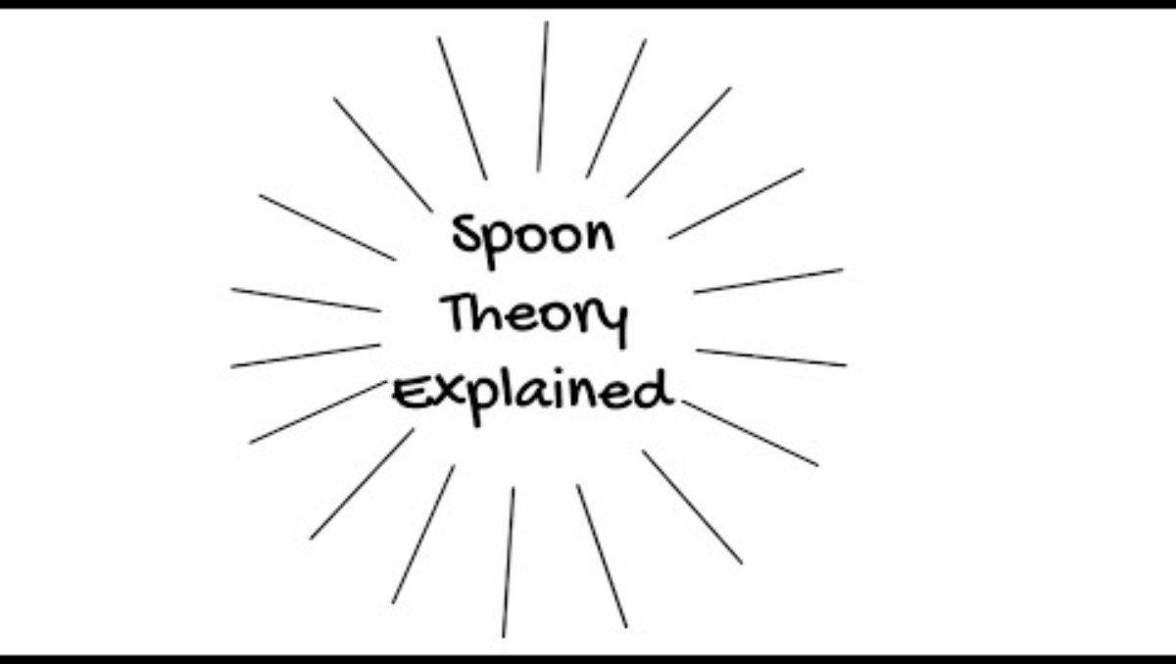
The Spoon theory is a creative way metaphor to explain to healthy family and friends what it’s like living with a limited amount of physical and/or mental energy, that we each have a day available for tasks and activities and how it can become limited.

Slide 16
Mental Wellness with global institute
What is the wellness economy?

Slide 17
MENTAL WELLNESS INITIATIVE
The Mental Wellness Initiative of the Global Wellness Institute aims to understand those pathways that help people stay well and thrive mentally as well as physically. The lens of mental wellness extends from the very inner aspects of individual experience through to the influence and condition of what is sometimes called the ‘social mind’ – i.e. the mental condition of the surrounding society and its effect on &/or contribution to mental wellness.
We believe in empowering and communicating mental wellbeing for people around the world. Through the exchange of knowledge, we can promote and support lifelong growth, happiness, creativity, inner peace, compassion and wisdom.

Slide 18
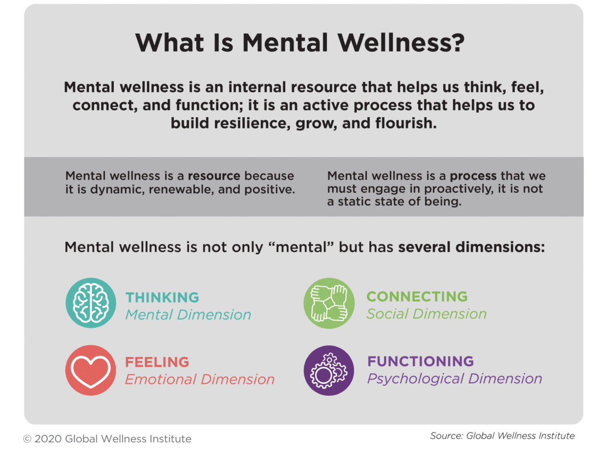

Slide 19
Five key things to know about mental health
1. Mental wellness is more than just the absence of mental illness.
2. Mental wellness is an active process of moving from languishing to resilience to flourishing.
3. Mental wellness helps to shift the perspective away from stigma to shared humanity.
4. Mental wellness grows out of a grassroots, consumer-driven movement.
5. Mental wellness is multi-dimensional, holistic and personal.

Slide 20
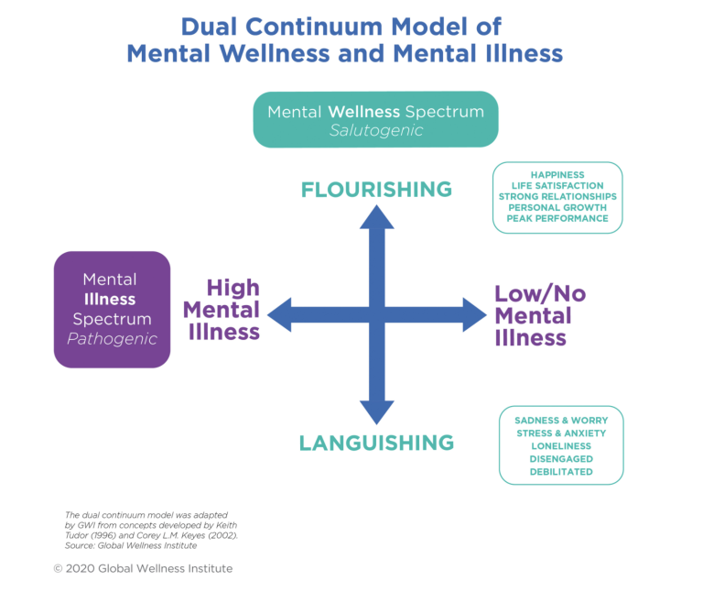
1-3

Slide 21
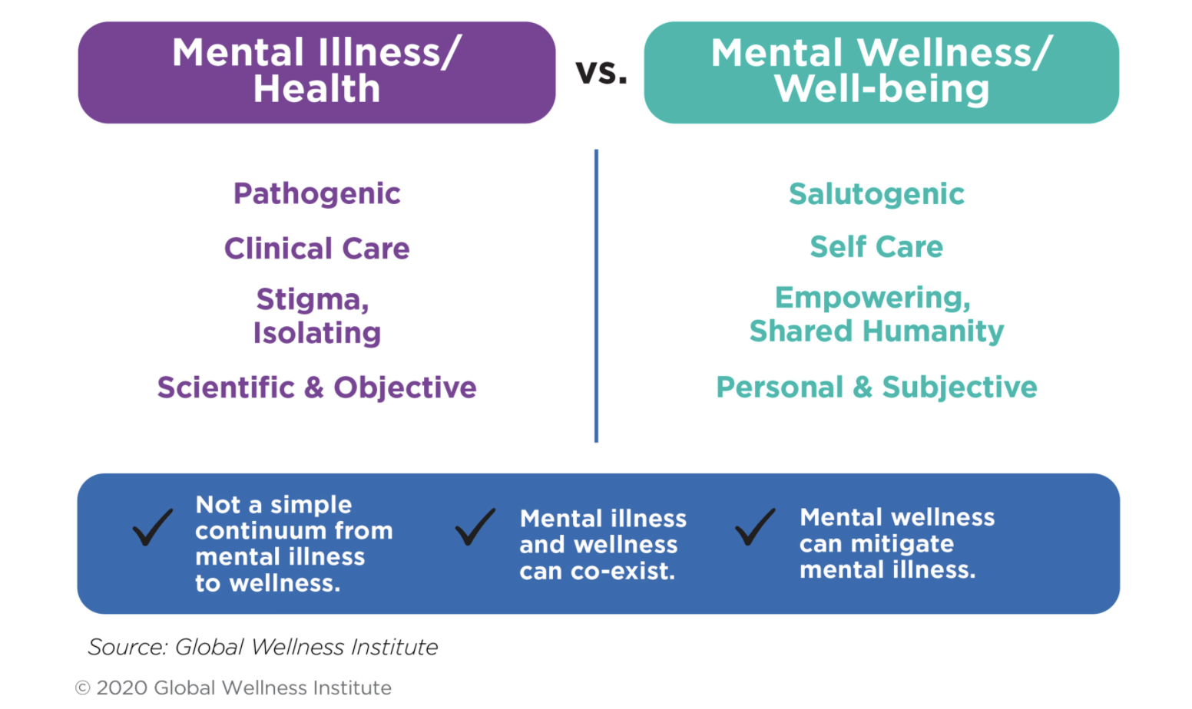

Slide 22
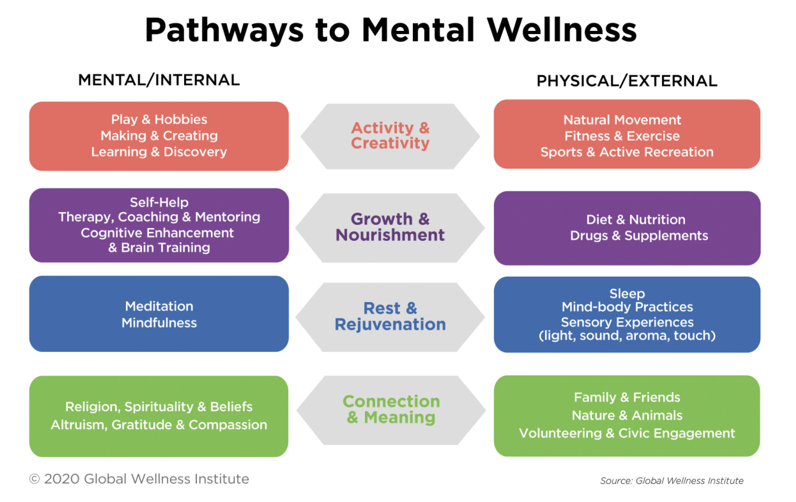

Slide 23
The Mental Wellness Economy
GWI defines the mental wellness economy as consumer spending on activities, products and services whose primary aim is to help us along the mental wellness pathways of growth and nourishment and rest and rejuvenation.

Slide 24
It encompasses four subsectors:
Self-improvement
Brain-boosting nutraceutical and botanicals
Meditation and mindfulness
Senses, spaces and sleep

Slide 25
GWI estimates that the global mental wellness industry was worth $120.8 billion in 2019 (see figure below). This estimate represents consumer expenditures on the four subsectors that we have defined as part of the mental wellness industry; it focuses on proactive, wellness-focused, consumer- and private sector-driven activities (that is, things outside of the psychiatry, psychology and clinical/medical spheres). These figures are broad, global estimates that we aggregated based on a wide range of secondary data sources. [Note that the data presented here were extracted from GWI’s 2020 report, Defining the Mental Wellness Economy. Updated mental wellness data can be found at: Wellness Economy Data Series.]

Slide 26
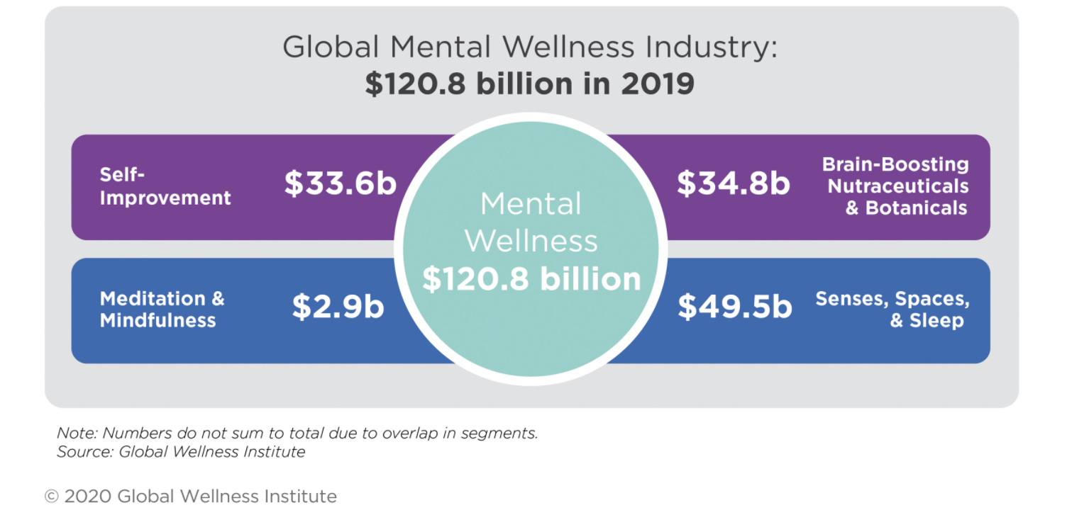

Slide 27
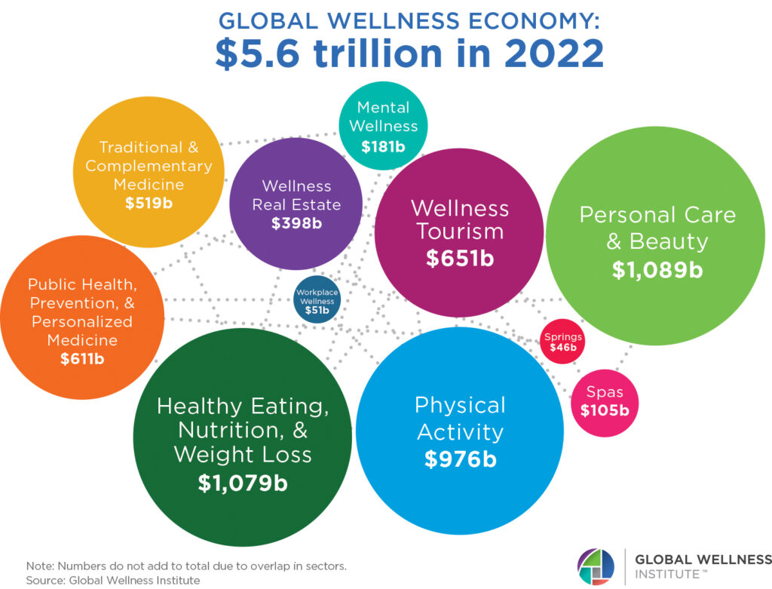

Slide 28
Conclusion
If the market was worth a record $4.9 trillion in 2019, and then shrank 11% to $4.4 trillion in the pandemic year of 2020, the research indicates that the wellness economy has seen recent, economy-defying momentum. It grew 27% since 2020 to reach $5.6 trillion, with 7 of the 11 wellness sectors now surpassing their 2019, pre-pandemic values. With consumers, the medical world, and governments now placing a much bigger value on prevention and wellness, the GWI forecasts that the wellness economy will grow at an impressive 8.6% annual pace through 2027, when the market will reach $8.5 trillion—nearly double its 2020 size.

Slide 29
Note:Numbers donot sum to total due to overla in segments source:global wellness institute
“We are surprised by the resiliency of the global wellness economy, and how quickly it has bounced back from the pandemic. It has exceeded our own expectations and forecasts,” said Katherine Johnston, GWI senior research fellow. “If the pandemic disrupted industry momentum in the short term, it has simultaneously created a dramatic shift in the long-term opportunities and trajectory for wellness.”

Slide 30
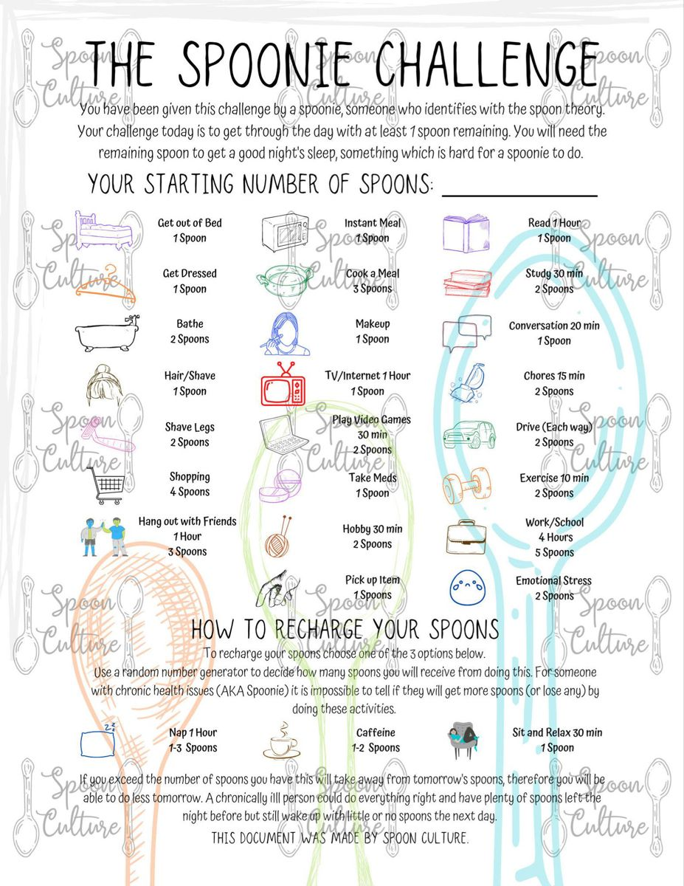

Slide 31
