Slide 1
THE SILENT KILLER
Margaret Polen, Past National FCE President
and
Faye Spencer, National FCE Program Coordinator

Slide 2
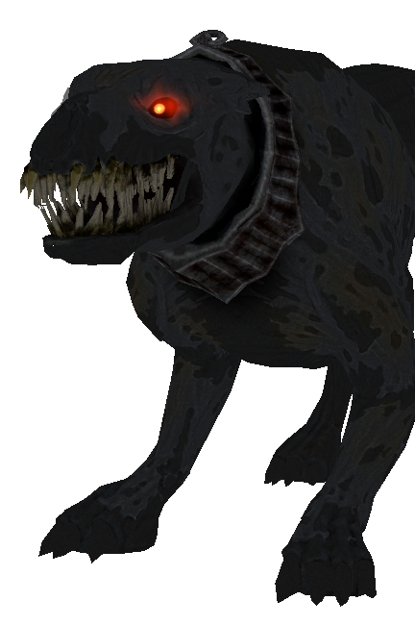
ANNUALLY
12,810 lives in the U.S.
207,000 lives globally

Slide 3
OUR O’S

Slide 4
WHAT an OVARY RESEMBLES

Slide 7
PROJECTION for 2040, World
Diagnosis with ovarian cancer will rise by 37%
Dying from ovarian cancer will rise 50%

Slide 8
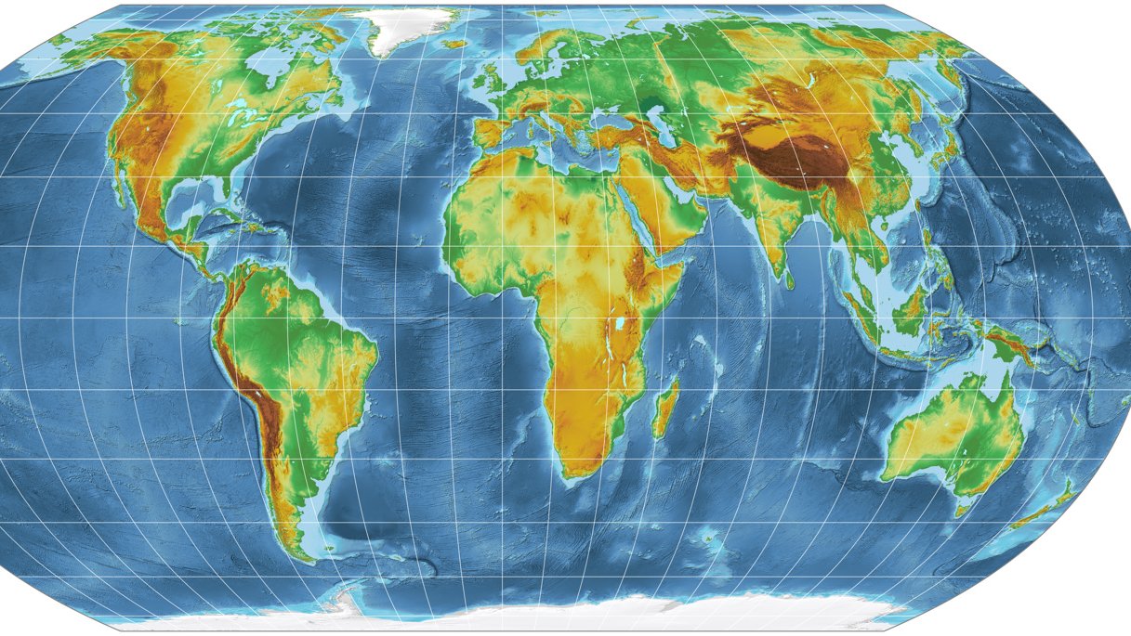
7th most common cancer in women—worldwide
8th most common cause of death in women—worldwide
5th most common cause of death in women—U.S.
Accounts for more deaths than any other cancer of female reproductive system in U.S.

Slide 9
HOW ARE YOU FEELING??
Fatigue
Stomach Upset Nausea
Pressure in back or pelvis
Back Pain

Slide 10
SYMPTOMS
Pain During Sex
Constipation
Changes in
Period
Abdominal Swelling with Weight Loss

Slide 11
MIMICS of OVARIAN CANCER
OVARIAN CYSTS
IRRITABLE BOWEL SYNDROME
PREMENSTRUAL SYNDROME
ENDOMETRIOSIS

Slide 12
MORE MIMICS
MENSES
UTERINE FIBROIDS
PELVIC INFECTION

Slide 13
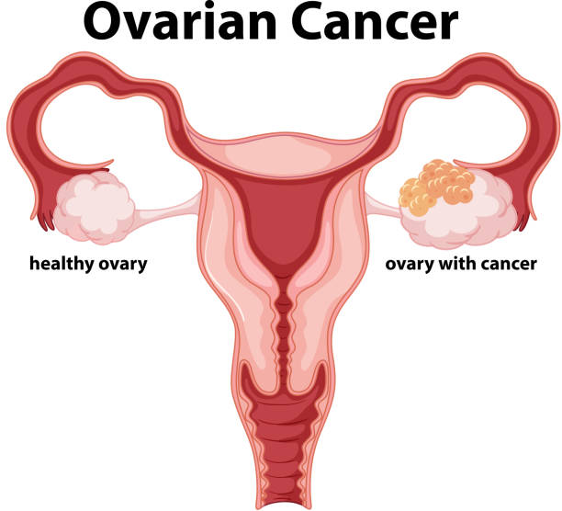
OVARIAN CELLS
Epithelial
Ovarian Germ Cell
Ovarian Stromal Tumors

Slide 14
RISKS
Getting Older
Being Overweight or Obese
Having children late in
life/no full-term pregnancy
Taking Hormone Replacement Therapy (HRT)

Slide 15
Risks, continued…
Family History
Family Cancer Syndrome
Hereditary Breast & Ovarian Cancer Syndrome (HBOC)

Slide 16
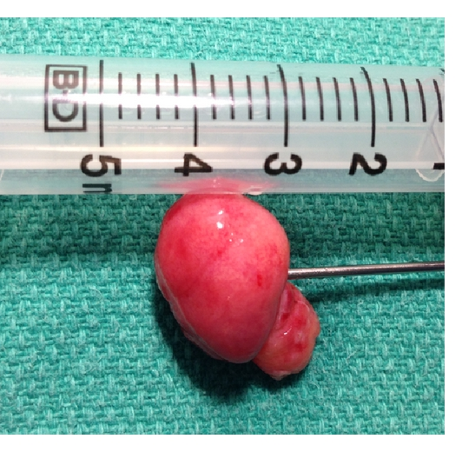
More Risks…
Hereditary Nonpolyposis Colon Cancer
Peutz-Jeghers Syndrome
MUTYH-Associated Polyposis

Slide 17
More…
Other Hereditary Ovarian Cancer Genes
Use of Fertility Treatments
Have Had Breast Cancer

Slide 18
Lastly…
Smoking

Slide 19
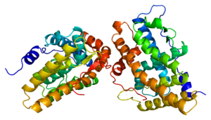
UNCLEAR EFFECTS on OVARIAN CANCER
ANDOGENS (such as testosterone)
TALCUM POWDER
DIET
This Photo by Unknown Author is licensed under C BY-

Slide 20
LOWER YOUR RISK
Pregnancy & Breast Feeding
Birth Control
Hysterectomy and/or Oophorectomy
This Photo by Unknown Author is licensed under CC BY

Slide 21
PREVENTION
Don’t Take Hormone Replacements After Menopause
Stop Smoking
Keep Your Weight Down & Eat Healthy
Take Oral Contraceptives
This Photo by Unknown Author is licensed under CC BY-ND

Slide 22
PREVENTION
Tubal Ligation and Hysterectomy
Oophorectomy with a BRCA mutation present
This Photo by Unknown Author is licensed under CC BY-ND

Slide 23
PREVENTION
Getting Pregnant Before 40, but NOT Early Teens
Breast Feeding
This Photo by Unknown Author is licensed under CC BY

Slide 24
TESTING
Annual Exam
Tell Provider Your Risk Factors
Ultrasound, CT scan, Upper/Lower GI, MRI,
PET scan & X-rays

Slide 25
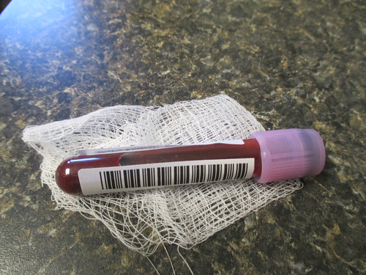
THEN…
Laparoscopy
Colonoscopy
Biopsies
Blood Tests

Slide 26
WHAT STAGE ARE YOU AT?

Slide 28
QUESTIONS TO ASK
WHEN YOU ARE DIAGNOSED
WHEN DECIDING A TREATMENT PLAN
DURING TREATMENT
AFTER TREATMENT

Slide 29
OVARIAN CANCER AWARENESS
SEPTEMBER
TEAL

Slide 31
NO WOMAN LEFT BEHIND
This Photo by Unknown Author is licensed under CC BY-SA

Slide 33
THANK YOU!

