Slide 1

Plants Are Speaking. Are You Listening?
By Linda Langelo
Illustrations – Linda Langelo

Slide 2
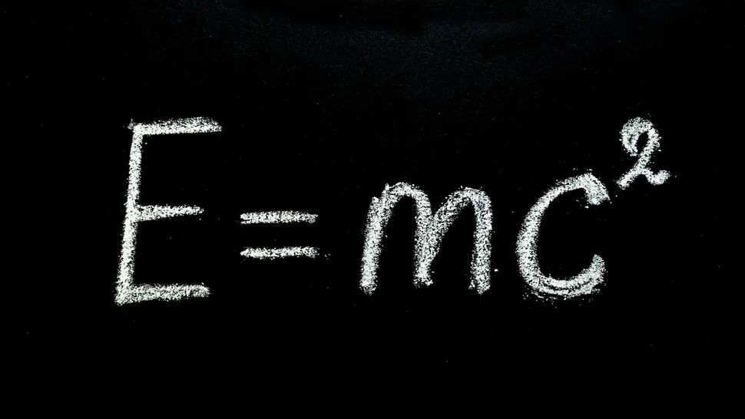
Energy
Einstein -

Slide 3
Energy
When Einstein said, “Everything is energy”, he meant that all matter in the universe contains energy, and energy itself cannot be created or destroyed – it just changes form.
Light is a type of kinetic energy, a form of electromagnetic radiation detectable to our eyes, and photons are in light energy.
Sound- kinetic energy caused by the physical vibration of air particles or molecules. Sound transmits through air, water, and objects. Manifests as a vibration – sound waves.
Vibration –The Law of Vibrational Energy

Slide 4
The Law of Vibration
everything in the universe, from the vast galaxies to the tiniest particles, is in constant motion, vibrating at specific frequencies. Nothing rests; everything moves and emanates energy, even when it appears stationary to our limited human senses.
Balance

Slide 5
The Vibrational Spectrum
Everything has its unique frequency. These frequencies form a vast vibrational spectrum, from low-frequency vibrations associated with dense matter and negative emotions to high-frequency vibrations linked to ethereal matter and heightened spiritual consciousness.

Slide 6
Gardening is an US Mindset
Resonant Frequency
Every cell organ and function in the body performs to a specific frequency.
The body communicates through frequency as an electromagnetic wave of energy. If the body's natural frequency is scattered, self regulation is reduced and results in disease and degeneration. Every illness and emotion has a specific frequency. I have used Petite Fleur Essences and our Antique rose essences to return the body to a healthy frequency communication.

Slide 7
Plant Essences
How do essences work in the body?
Placed on the skin and absorbed into the skin – they travel on the polarity created between the circulatory system and nervous system

Slide 8

The Human Body processes energy through chakras

Slide 9
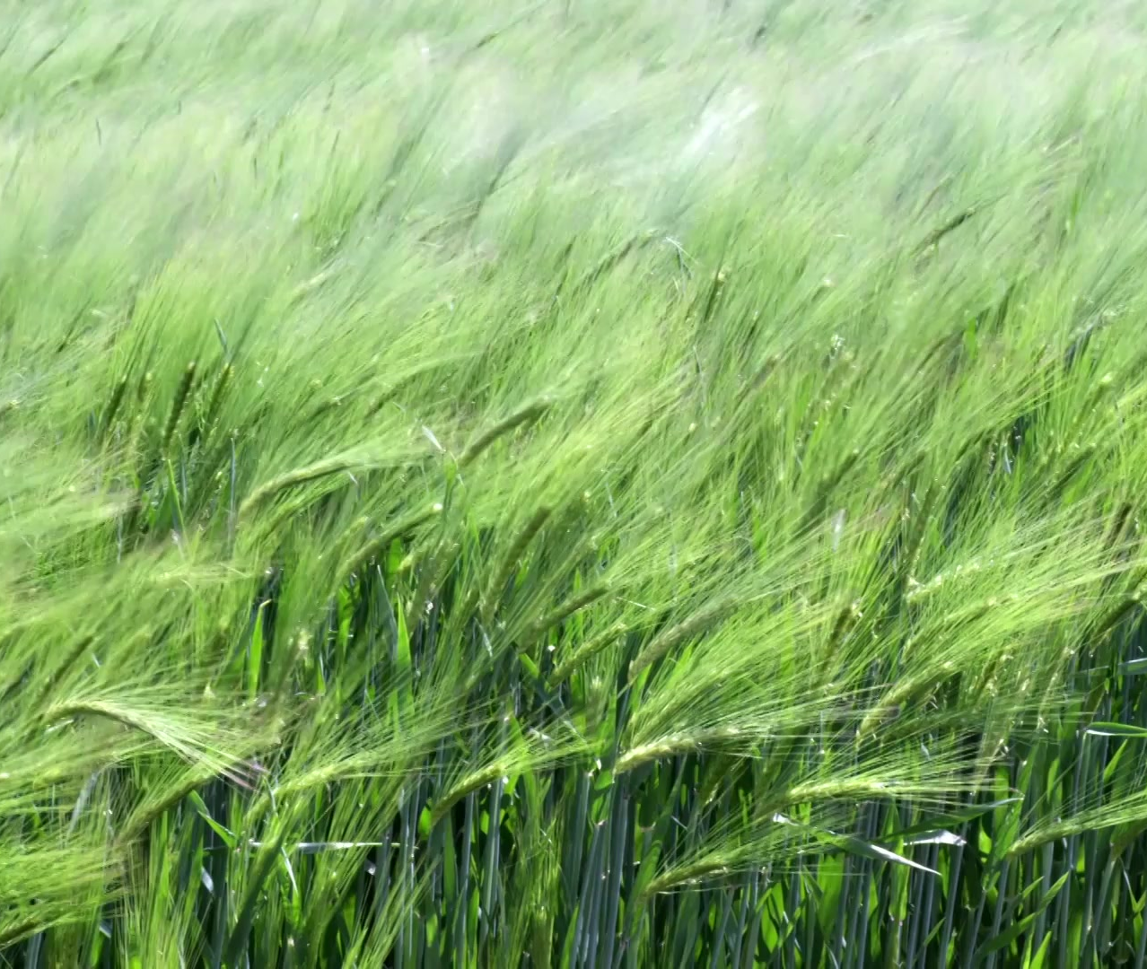
Plants have their own bioelectromagnetic fields for emitting and receiving energy

Slide 10
What is disruptive to our human and animal electromagnetic systems
Antennas of 5G cells, placed every 100-200 meters, use millimeter waves combined with microwave waves.
Heavy metal toxicity
The cornea of our eyes absorbs wavelengths of energy and travels through our systems, causing disruptions to our bodies.
Dr. John Downing, Pioneer in Light Therapy – light-induced photocurrents activate the visual cortex and other areas of the brain. Stimulate the limbic system- hypothalamus – connects to both the autonomic nervous system and the pituitary gland, regulating the endocrine system- includes the thyroid, adrenals, and gonads. Controlling our hormones.
In terms of the colors of flowers, what does this mean?

Slide 11
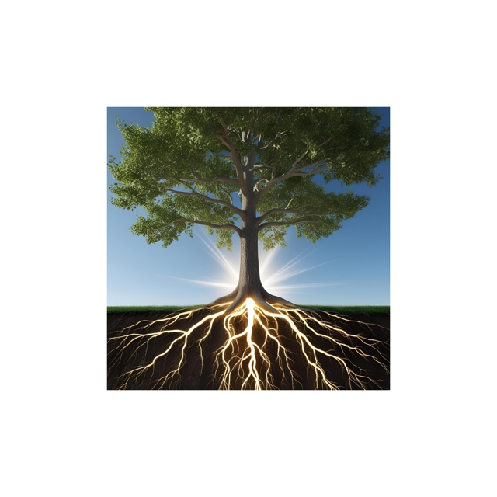
What is a Tree?
An elongated stem called a trunk.
A tree is the light.
Embrace a tree and you are one with the tree’s energy.
Giant Sequoia trees emit a vibration to balance the needs of a human being to restore their balance.

Slide 12
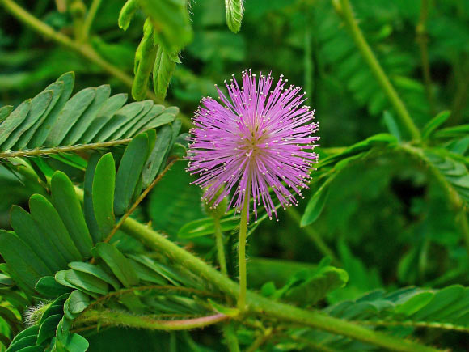
Dr Gagliano’s Experiment with Mimosa Trees
They learn and remember in the same way that animals do. Water was repeatedly dropped on their leaves. Over time, the mimosa stopped closing because this disturbance was not harmful.

Slide 13
FLOWERS
When we perceive colors from flowers, we naturally receive these healing photocurrents.
(pg 41 – Plants Are Speaking)
Roses, especially antique roses, have the highest frequency, 320 megahertz, of any plants or gemstones. In comparison, 3 times stronger than lavender. (106 megahertz)

Slide 14
Sound is ubiquitous in nature.
Recent evidence supports the notion that naturally occurring and artificially generated sound waves contribute to plant robustness.
Resistance and Growth

Slide 15
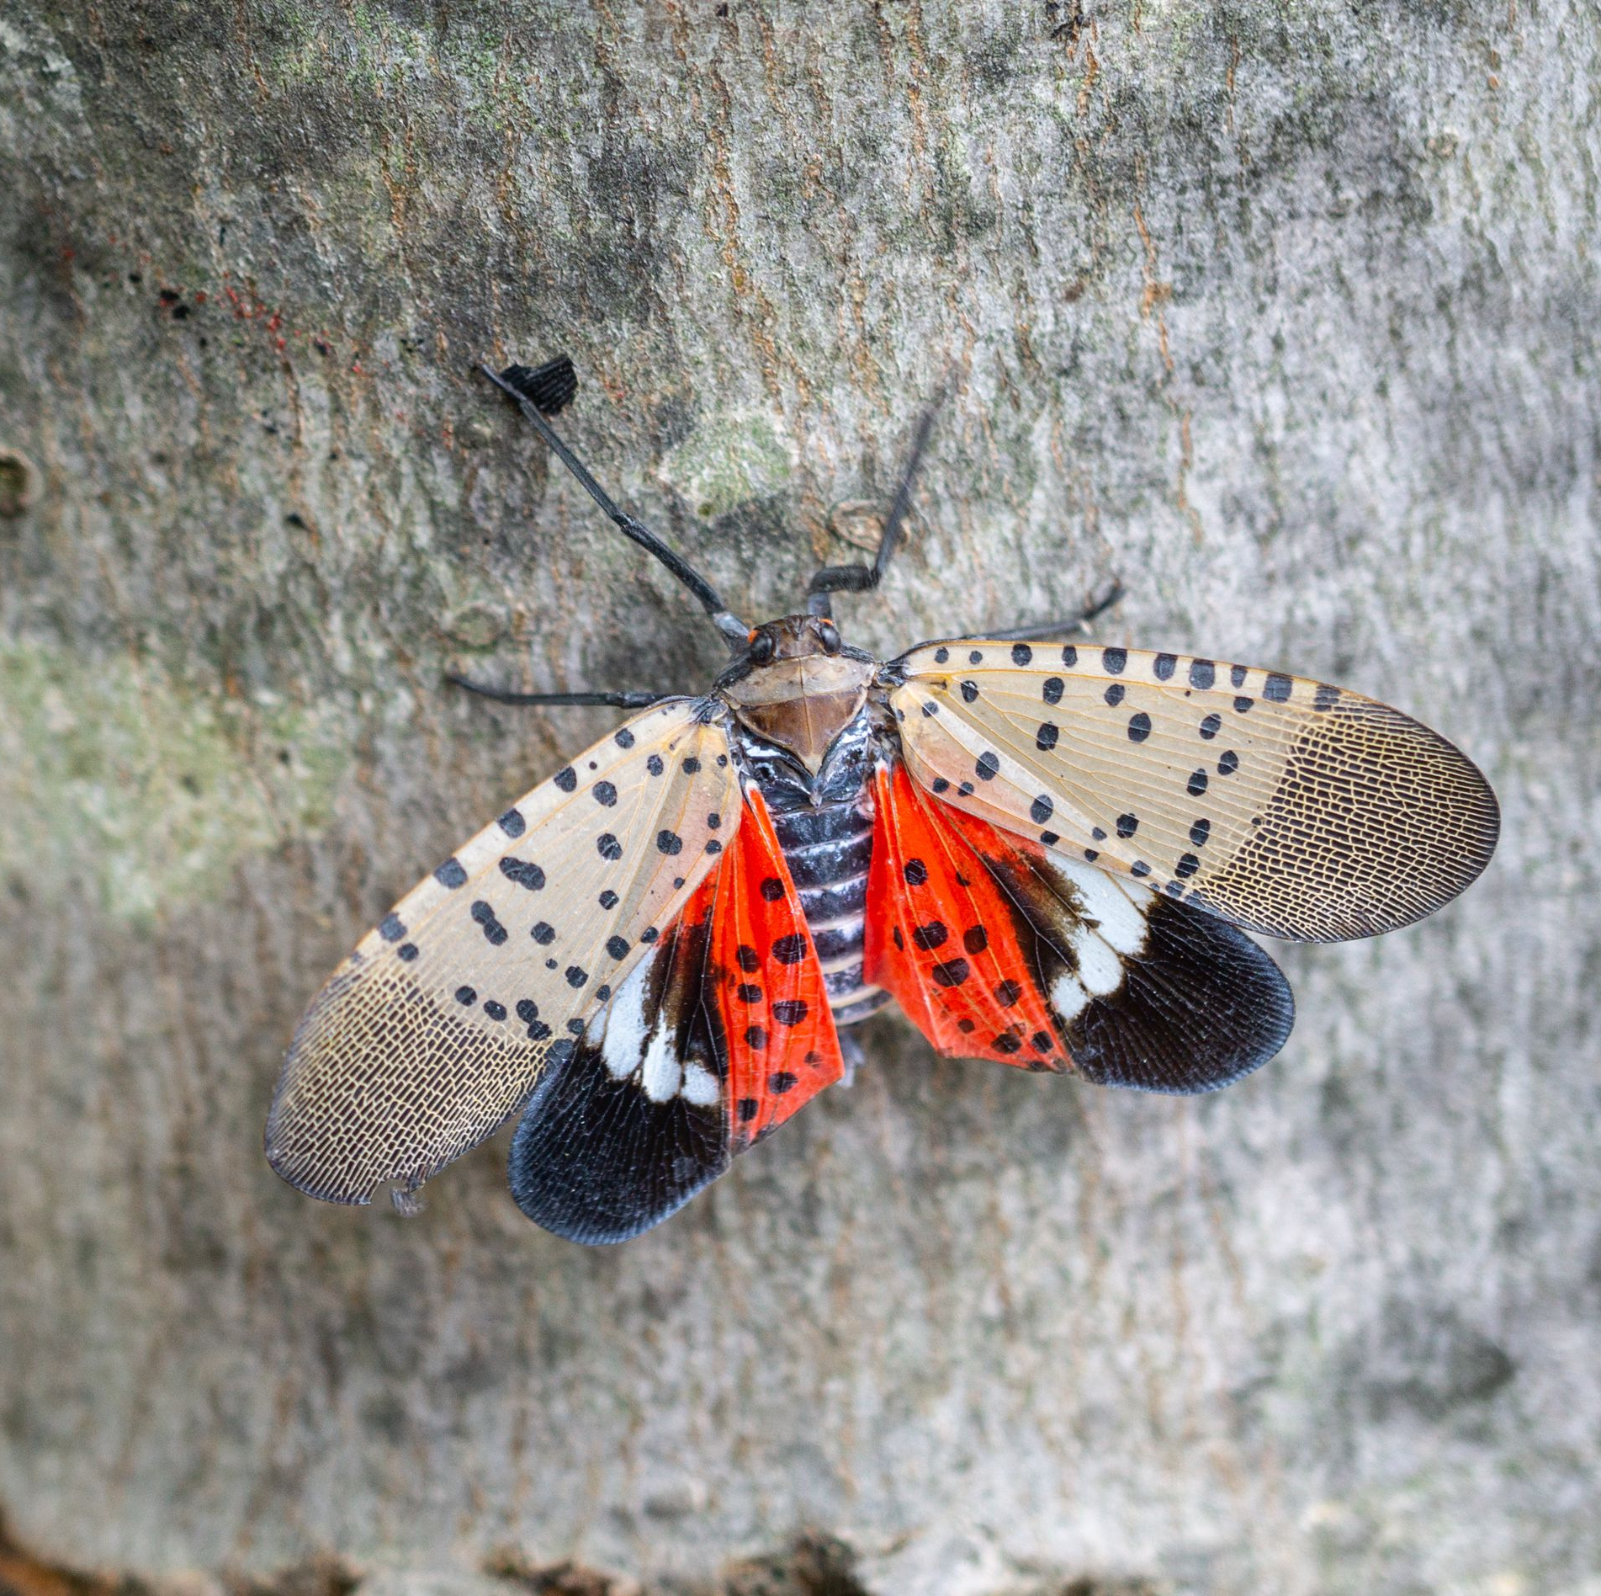
Entomologists and Lantern Flies
Entomologists had released Lantern Flies in the lab. They discovered that raising the vibrational energy to 78 hertz attracted the Lantern Fly to one location.

Slide 16
Music Made By Plants
https://www.youtube.com/watch?v=U7gkBjZpDuk

Slide 17
Plant Wave
Four plants playing in Harmony with one another
https://www.youtube.com/watch?v=e8a8mOZSAEw

Slide 18
Music For Plants
For Growth and Healing
https://www.youtube.com/watch?v=glHX6b_srvE

Slide 19
The Latest Frontier of Plant Research
Acoustic Perception and Communication
Living beings are capable of recognizing their surroundings and responding to a multitude of stimuli by modifying their growth and development.
Another study showed how the impact of a 4 kHz sound stimulus positively promoted plant drought tolerance.
Hertz– one cycle of the wave energy – sound measured in wavelengths
1 Hertz = 0.000001 megahertz – one million megahertz = 1 hertz

Slide 20
Electromagnetic Universe
We are all connected.

Slide 21
https://www.youtube.com/@PlantsAreSpeaking/videos
YouTube Channel – Plants Are Speaking. Are You Listening?

Slide 22
My Book – Plants Are Speaking. Are You Listening?
It is the intertwining of science and spirituality of plants
YouTube Channel @plants are speaking

Slide 23
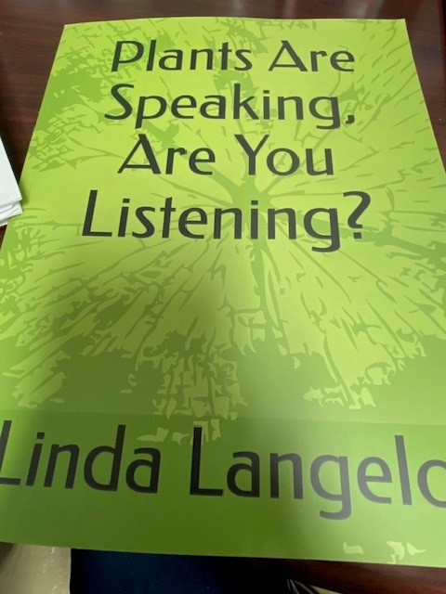
Follow me on YouTube @plantsarespeaking; website: lindalangelo.com
Instagram- akalagh11k Facebook: Linda Langelo Pinterest

