Slide 1
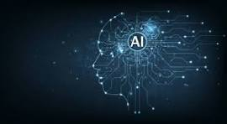

“Artificial Intelligence, the Good, the Bad and the Ugly”
Designed for and presented at the
2026 Oregon Association for Family and Community Education (FCE) State Conference
Developed and written by: Scott Teeples – FCL Certified Leader Trainer
Oregon Association for Family and Community Education – FCE Member; 2018-2026 Oregon FCE President; Past Oregon FCE Secretary; Past National FCE Board Member
Assisted by Bonnie Teeples – FCL Certified Leader Trainer
Oregon Association for Family and Community Education – FCE Member, 2026-2029 National FCE President; Past ACWW-USA Area President; Past National FCE President; Oregon FCE Secretary.
Note: PowerPoint of this lesson is available. Please contact Scott Teeples 541-891-6456 – email sfteeples@outlook.com Also see www.oregon-fce.org
Revised 7-19-26

Slide 2
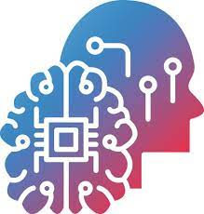
Goals and Objectives
Participants will gain an understanding of what Artificial Intelligence is. Some of the history of Artificial Intelligence, and what are some of the good things it offers, the bad things about it, and what are some of the ugly things about it.
(Hand out and discuss HO #3)

Slide 3


“Artificial Intelligence (AI)”
The Good, The Bad, and The Ugly.
Don’t be fooled by rumors and misinformation about Artificial Intelligence. Get the facts, and the myths about it. And test your knowledge of common beliefs about artificial intelligence.
Before we begin let’s look at 4 things that have changed our lives and each of them can be good, bad, or ugly.

Slide 4


1. The internet:
  The internet became available for public use in the early 1990s.
  Many feared this new technology because it was something new and they didn’t fully understand it. Many were concerned about this “evil internet” and were afraid of it and were very concerned with the mysteries of it and all of the bad things it could bring.

Slide 5
1. The internet: (cont.)
  Many were excited about this new technology and realized the great and wonderful things that it could do. It could make the world a smaller place and open huge doors of information for everyone in all parts of the world.
  The truth is that it also has some great things, some bad things and some ugly things. It has characteristics like fire itself.
  Can you image your life, or the world without the internet????

Slide 6

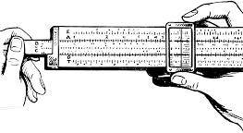
2. Electronic calculators:
  Electronic calculators came into existence in the 1970s. They greatly increased our ability to do mathematical equations very easily and quickly.
  They were much better than doing them by hand or even with a slide rule.

Slide 7

2. Electronic calculators:
  Many math teachers would not allow them to be used because they considered them as “cheating.” Often, they would say “Are you always going to have a calculator in your pocket?” Now almost everyone has an electronic calculator on their phones.
  Electronic calculators are now used in every classroom and in all our lives. They are a tool that has helped us immensely in our lives.

Slide 8

3. Fire:
  Fire is something we use every day of our lives. It has been, is, and will be a great tool in all our lives.

Slide 9



3. Fire: (cont.)
  We must always remember that fire can also have its good, bad, and ugly. The same fire that heats our homes, cooks our food, and can give a feeling of comfort, is the same fire that can destroy our homes, our property, and possibly cause the death of many. We must learn to use it properly and safely.

Slide 10
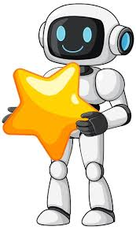
4. Artificial Intelligence
    Artificial Intelligence is the subject for today’s presentation. It is new to all of us. Whether we realize it or not, it is used every day of our lives. It, like fire or the internet, can be good, bad or ugly.

Slide 11
What is Artificial Intelligence (AI)?
AI, or artificial intelligence, is a field of computer science focused on creating systems that can perform tasks that typically require human intelligence, such as learning, reasoning, problem-solving, and decision-making.
AI systems work by analyzing large datasets to recognize patterns and make predictions, allowing them to adapt to new inputs and improve their performance over time without being explicitly programmed for every task.

Slide 12
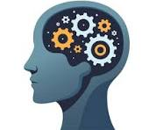
What is Artificial Intelligence (AI)? (cont.)
Artificial intelligence (AI) is technology that enables computers and machines to simulate human learning, comprehension, problem solving, decision making, creativity and autonomy.

Slide 13
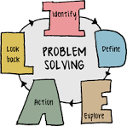
What exactly does AI do?
AI enables machines to perform tasks that typically require human intelligence, such as learning, problem-solving, and decision-making, by processing vast amounts of data. It does this through a variety of methods, including recognizing patterns, understanding and responding to language, and generating creative content.
AI is used for everything from recommending products and translating languages to self-driving cars and medical diagnostics.

Slide 14
The four main types of AI are Reactive Machines, Limited Memory, Theory of Mind, and Self-Awareness. Reactive machines and limited memory AI currently exist, while theory of mind and self-aware AI are still theoretical concepts.
These types represent a range of complexities, from simple task-based systems to hypothetical future AIs with human-like consciousness.

Slide 15
1. Reactive Machines
Description: These are the most basic AI systems. They lack memory and cannot use past experiences to inform current decisions.
Function: They perceive the world directly and act on what they see, performing specific tasks without any memory of past events.
Example: IBM's Deep Blue, the chess-playing computer that beat Garry Kasparov, is a classic example.

Slide 16
2. Limited Memory
Description: This is the type of AI that is currently in widespread use.
Function: These systems can look into the past by storing and using data from previous experiences to make better decisions.
Example: Self-driving cars use limited memory to observe the speed and direction of other cars, which helps them navigate safely.

Slide 17
3. Theory of Mind
Description: This is a more advanced and theoretical type of AI.
Function: It is not yet a reality, but the goal is to create AI that can understand emotions, intentions, beliefs, and thoughts, both its own and those of others.
Example: A hypothetical AI of this type would be able to interact with humans in a more human-like way by grasping their mental states.

Slide 18
4. Self-Aware
Description: This is the most advanced and hypothetical type of AI, which does not yet exist.
Function: Such an AI would have its own consciousness, self-awareness, and sentience, similar to humans.
Example: This is the AI seen in science fiction, where machines possess a consciousness and a sense of self.

Slide 19
Who invented AI?
No single person invented AI; it was developed through the work of many pioneers. However, John McCarthy is often called the "father of AI" because he coined the term "artificial intelligence" in 1955 and organized the pivotal 1956 Dartmouth conference that formally established AI as a field.
Other key early figures include Alan Turing, who laid the theoretical groundwork, and Marvin Minsky, Allen Newell, and Herbert A. Simon, who collaborated on early AI concepts and programs.

Slide 20

Is AI good or bad?
Artificial intelligence provides numerous benefits such as reducing human errors, time saving capabilities, digital assistance, and unbiased decisions. However, the disadvantages include emotional intelligence, encouraging human laziness, and possible job displacement.

Slide 21


Which country is no. 1 in AI?
The United States
While China leads the world with 230 AI clusters, the United States leads with 50% of global compute power for AI, according to a new report on global AI superpowers by TRG Datacenters. In second and third place for AI compute, perhaps less obvious candidates: the United Arab Emirates and Saudi Arabia. (Sep 11, 2025)

Slide 22
Where does AI get its information from?
AI gets its information from massive datasets scraped from the internet, including public websites, books, and articles, as well as private data like customer information and specialized archives.
Common public sources include sources like Wikipedia, Reddit, and Common Crawl, while private data can come from companies' internal records or third-party vendors.
This data is cleaned, structured, and used to train algorithms that identify patterns to make predictions and generate outputs.

Slide 23
Who is the owner of AI?
No single entity "owns" AI, as it's a conceptual framework with ownership varying between the technology's developer, the user, and the organization implementing it. Major tech companies like Microsoft have significant ownership stakes in specific AI companies, such as OpenAI, but these arrangements are complex and may not extend to all AI development or products.
Ultimately, ownership of the AI models themselves resides with the developing organizations, while the output generated by the AI can belong to the human user or be subject to intellectual property laws.

Slide 24

What does the Bible say about artificial intelligence?
The Bible does not directly mention artificial intelligence (AI), as it was written long before the concept existed.
However, biblical principles can be applied to it, suggesting that humans, created in God's image, should use their God-given creativity to develop AI as a tool for good, while exercising wisdom and discernment.
Key principles include maintaining human dignity, recognizing that AI lacks a soul or true wisdom, and not placing ultimate trust in technology over God.

Slide 25

Can AI replace humans?
No, AI is not expected to replace humans entirely; instead, it will likely work alongside them, augmenting human capabilities by handling repetitive tasks and improving efficiency.
Humans will still be needed for roles requiring emotional intelligence, creativity, ethical judgment, and complex problem-solving, though many jobs will transform as AI integration becomes more common.

Slide 26

What is a scary fact about AI?
AI Can Become Unexplainably Evil. AI researchers sometimes talk about “black box” systems — those algorithms so complex that even their creators can't fully understand how they work. Sometimes, this can lead to strange, unethical, or downright creepy behavior.

Slide 27
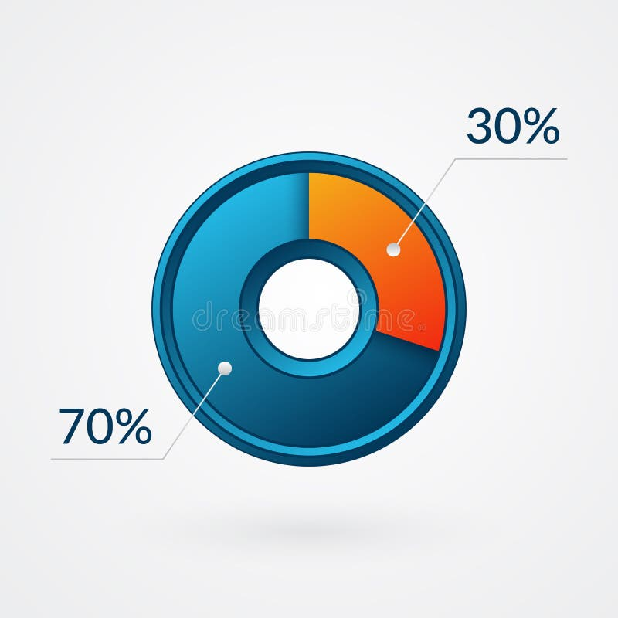
What is the 30% rule for AI?
The “30% AI rule” is a simple guideline designed to help students (and adults!) use AI responsibly.
It means that when you're creating something — whether it's an essay, a project, or a piece of code - no more than about 30% of the work should come directly from AI tools.

Slide 28


Who has invested the most in AI?
The biggest investors in AI are both large corporations like Microsoft, Alphabet, and Amazon, and venture capital firms such as Sequoia Capital and Andreessen Horowitz (a16z).
Microsoft has a significant investment in OpenAI, while Alphabet has made numerous investments through its venture capital arm, GV. Sequoia Capital is a top venture capital investor, with a portfolio including companies like OpenAI and xAI.

Slide 29

How to explain AI to an old person?
Think of AI like a really smart assistant that's constantly learning, noticing patterns, and trying to help—sometimes well, sometimes not so well.
AI stands for Artificial Intelligence. That’s a fancy way of saying a computer or machine that’s been trained to “think” and “learn” like a human.

Slide 30
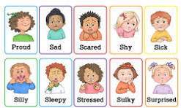
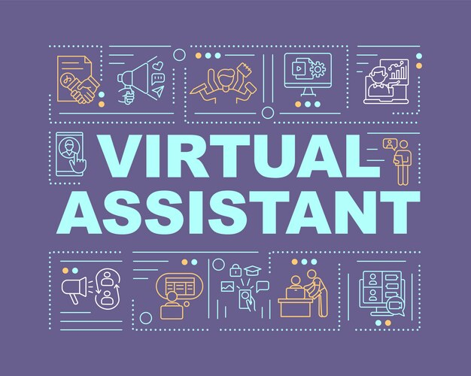
How to explain AI to an old person? (cont.)
Now, to be clear—AI doesn’t have emotions. It doesn’t have thoughts the way people do. But it can:
  Understand what you say (like virtual voice assistants)
  Recognize pictures and faces (like in photo apps).

Slide 31

How to explain AI to an old person? (cont.)
Predict your preferences (like what movie you’ll want to watch)
Make decisions (like sorting your email or detecting fraud)

Slide 32

The Good: How AI Is Making Life Easier—Especially for Older Adults
AI can be very helpful, particularly as we age. Here are 5 real-life examples of how it’s being used today:

Slide 33

1. Virtual Assistants Like Alexa, Siri, and Google Assistant
You can ask these devices:
  “What’s the weather today?”
  “Remind me to take my pills at 8:00 PM.”
  “Call my daughter.”
  “Play Frank Sinatra music.”
These assistants understand your voice and respond in seconds—no need to press buttons or remember complicated steps.

Slide 34

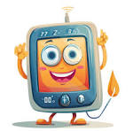
2. Smart Home Devices
Smart lights turn on when you enter a room.
Smart thermostats adjust the temperature based on your comfort.
Smart plugs can turn off appliances automatically if forgotten.
This isn’t just about convenience—it can help prevent falls, save money, and reduce stress.

Slide 35

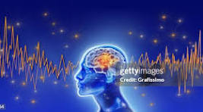
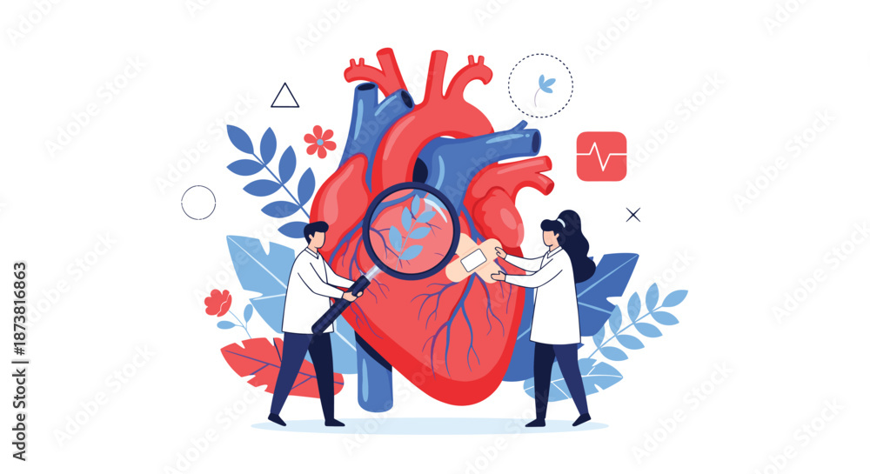
3 Healthcare Tools
AI helps doctors:
Spot signs of Alzheimer’s or heart problems earlier by reviewing test results and brain scans faster than a person could.
Monitor patients at home with wearable devices that track blood pressure, sleep, or heart rate.

Slide 36

3 Healthcare Tools (cont.)
AI helps doctors:
Send automatic reminders for appointments or medications.
There are even pill dispensers that talk to you and alert caregivers if a dose is missed.

Slide 37


4. Safety and Emergency Alerts
Some retirement communities use AI systems that:
  Detect when a person has fallen or hasn’t moved in a while
  Notice unusual patterns, like not opening the fridge all day
  Automatically alert staff or family without the person needing to push a button
This gives independence while also adding a layer of safety.

Slide 38
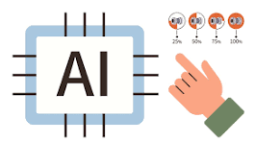
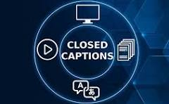


5. Staying Social and Connected
AI powers:
Video calls that adjust lighting and volume automatically
Captioning tools that help people with hearing loss see what others are saying
Smart photo frames that display new pictures from family members, updated wirelessly
Even something like Facebook or your email is using AI in the background to sort messages and highlight what’s most important.

Slide 39


The Bad: What to Watch Out For
While AI can help, it’s not perfect. Sometimes it causes problems.
Here are a 3 examples to be aware of:

Slide 40


1. Privacy Concerns
AI needs data to “learn.” That might include:
  What you search online
  What you say to your smart speaker
  What products you buy
This information can sometimes be used to show you ads—or, in worse cases, sold to other companies. Always review privacy settings or ask a trusted family member or friend to help you set up devices securely.

Slide 41
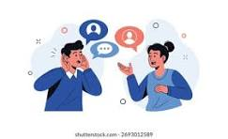
2. It Doesn’t Always Understand You
Have you ever asked Alexa to play music, and it gives you the wrong song? Or tried voice-to-text on your phone, and it typed total nonsense?
That’s because AI doesn’t always understand accents, background noise, or unclear instructions. It’s getting better, but it’s far from perfect.

Slide 42
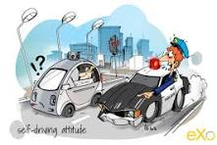
3. Over-Automation
Some people fear AI will replace jobs, including in healthcare, customer service, or transportation (like self-driving cars).
While this shift might not affect your day-to-day, it’s something your adult children and grandchildren may be thinking about.

Slide 43


The Ugly: When AI Goes Off the Rails
AI has some downright strange or even risky sides. Here are 3 examples that might raise eyebrows.

Slide 44
1. Scams That Sound Real
AI can now copy voices. Scammers can use a few seconds of someone’s real voice (taken from a voicemail or social media video) to create a fake phone call that sounds like a loved one asking for money.
Example: You get a call from someone who sounds like your grandson saying, “Grandma, I need help—please wire me $500.” It’s fake, but convincing.
What to do: Always hang up and call them back on their regular number. Don’t trust emotional, urgent messages without double-checking.

Slide 45
2. Fake Photos and Videos (“Deepfakes”)
AI can create images and videos that look real, but aren’t. You might see a video online of a celebrity saying something they never actually said. These are being used in politics, scams, and even fraud.
Tip: Be cautious about what you see online. If something looks shocking, check if it’s been verified by a reliable source (like a news channel you trust).

Slide 46

3. Emotional Confusion
Some AI systems are designed to act like people. They respond with kindness, offer emotional support, and even “chat” with you if you’re lonely. While that might sound comforting, remember they’re still machines. They don’t have feelings or real relationships, no matter how friendly they seem.

Slide 47

So… Should You Be Worried?
No—but you should be aware.
Just like microwaves, smartphones, or even credit cards—AI is a tool. It can be extremely helpful when used with care, but it’s not magic. And it’s not always right.
Here’s the best advice: use AI to support your life, not control it.

Slide 48

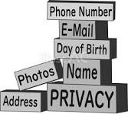
Tips for Seniors to Use AI Safely and Smartly
Ask for help. Whether it’s a grandchild or a friendly neighbor, most people are happy to walk you through how something works.
Don’t give personal info to a device, app, or person you don’t fully trust.

Slide 49

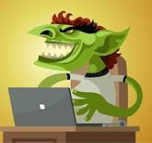

Tips for Seniors to Use AI Safely and Smartly (cont.)
Write things down. Keep a notebook of passwords, commands, and instructions—it’s not “old-fashioned,” it’s smart!
Use well-known brands and avoid sketchy websites or devices.
Stay curious. Take a class at the library or senior center. The more you know, the safer and more confident you’ll feel.

Slide 50


Final Thoughts
AI isn’t here to replace people.
It’s here to make some things easier—if you let it, and if you understand it. And just like any big change, it takes time to get used to.

Slide 51

Final Thoughts
Don’t be afraid to ask questions. Don’t feel silly for not knowing how something works. You’ve lived through a lot of changes in your lifetime—this is just another one.

Slide 52

Final Thoughts
And who knows? Maybe the next time your smart speaker plays your favorite song before you even ask… you’ll smile, knowing you’ve got the hang of this after all.

Slide 53
Thank You!
Questions and Comments?
HO #1: List of Common Names of AI
HO #2. Compilled list of the Good, the Bad, and the Ugly!
HO #3. How about your list of “the Good, the Bad, and the Ugly?”
Please See Printed Lesson for References and Resources Credit Given to

