Slide 1
WHAT DOES FOOD SECURITY LOOK LIKE?
Developed and Written By:
Pamela McIntrye-Albaro, Program Coordinator & National FCE Certified FCL Leader
Kristin Walker, Public Policy Coordinator & National FCE Certified FCL Trainer

Slide 2
WHAT DOES FOOD SECURITY MEAN TO ME?

Slide 3
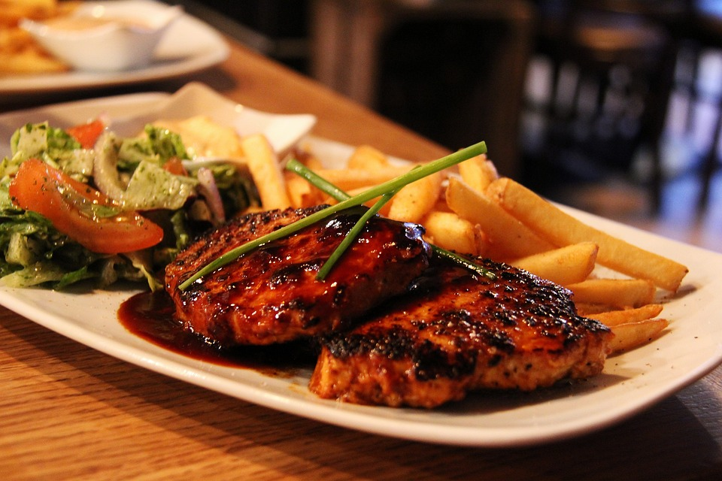
WHAT AM I GOING TO EAT???

Slide 4
FOOD SECURITY
“Food security is all people, at all times, having access to sufficient, safe, and nutritious food to meet dietary needs and food preferences for a healthy and active lifestyle”.
World Food Summit, 1996
World Food Summit, 1996

Slide 5
FACTS and FIGURES
2022……..9.2%
2019……..7.9%
2023~~~~~691-783 MILLION!! families worldwide

Slide 7
PILLARS
AVAILABILITY

Slide 8
PILLARS
ACCESS

Slide 9
PILLARS
UTILIZATION

Slide 10
PILLARS
STABILITY

Slide 11
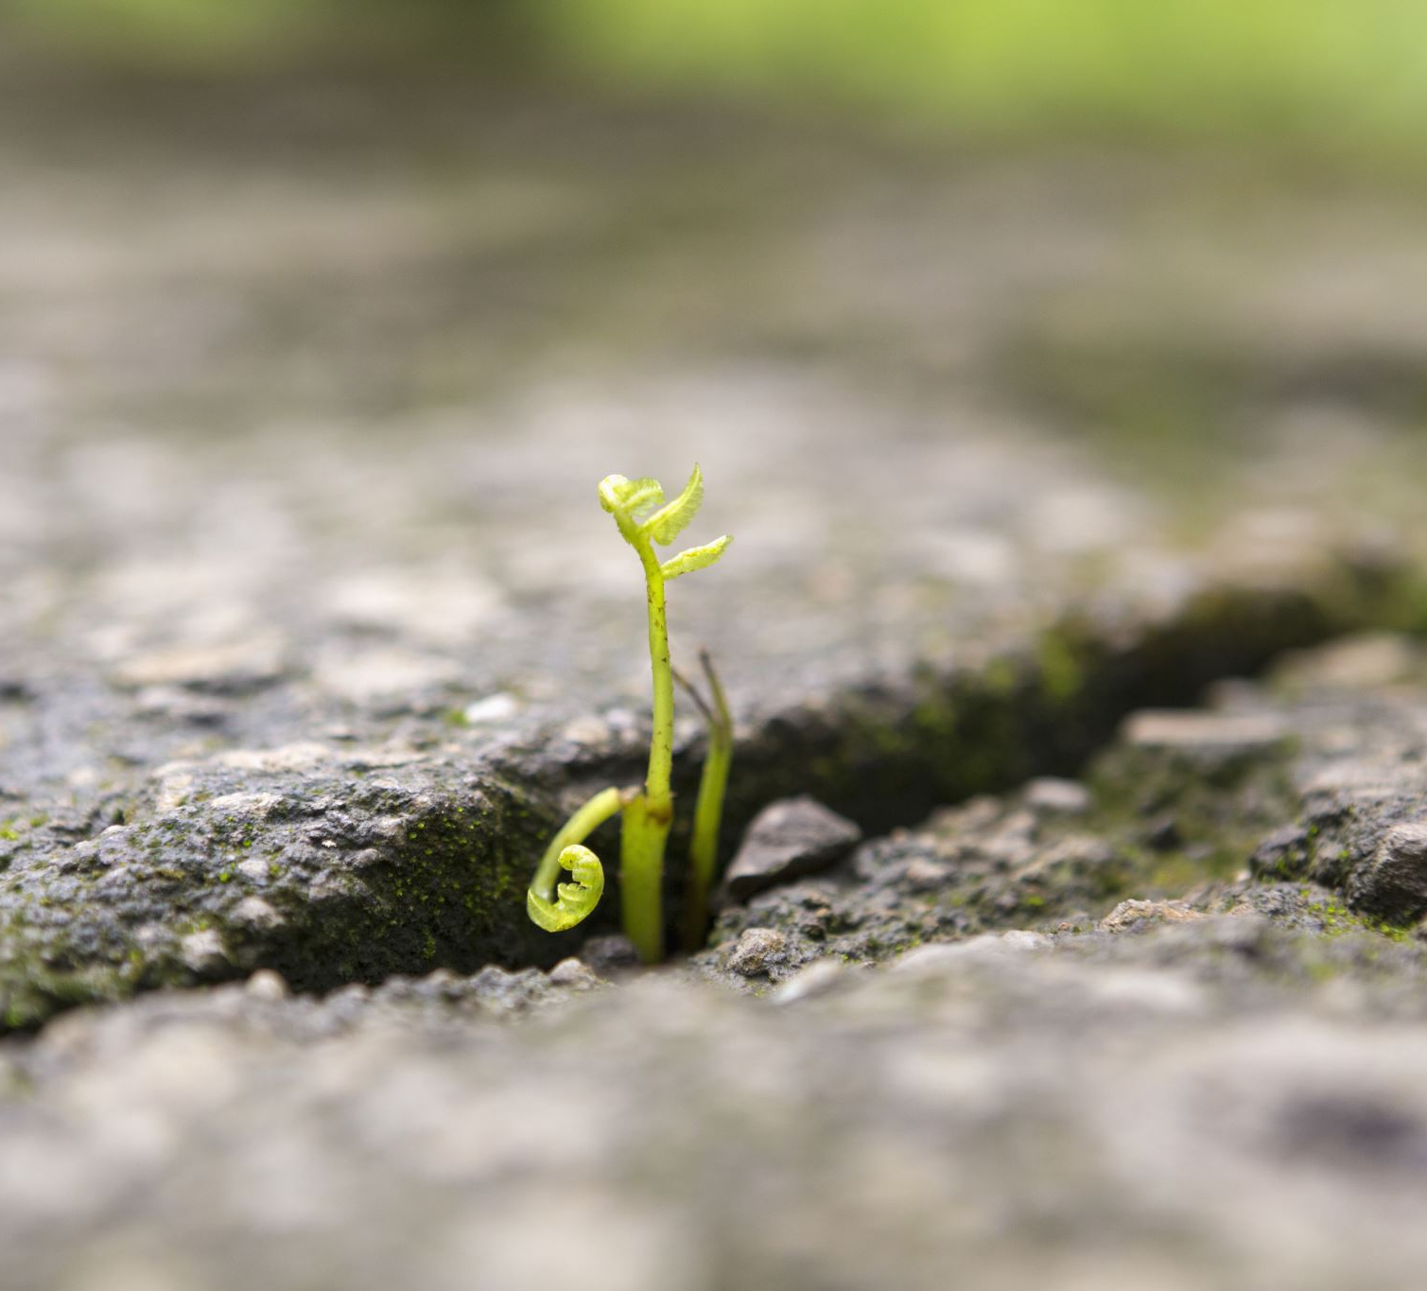
AVAILABILITY

Slide 12
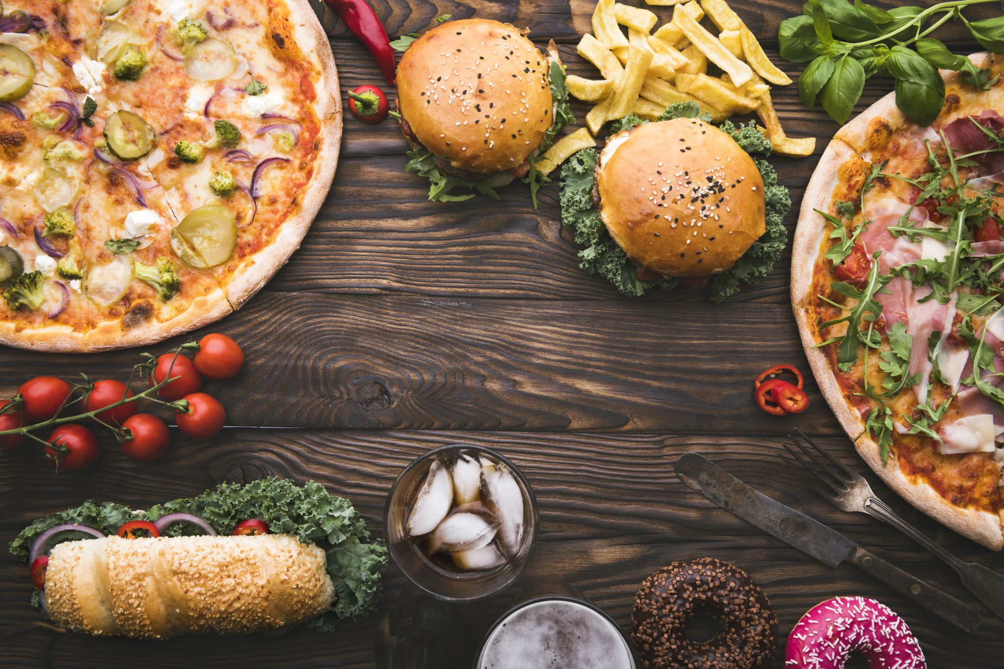
ACCESS

Slide 13
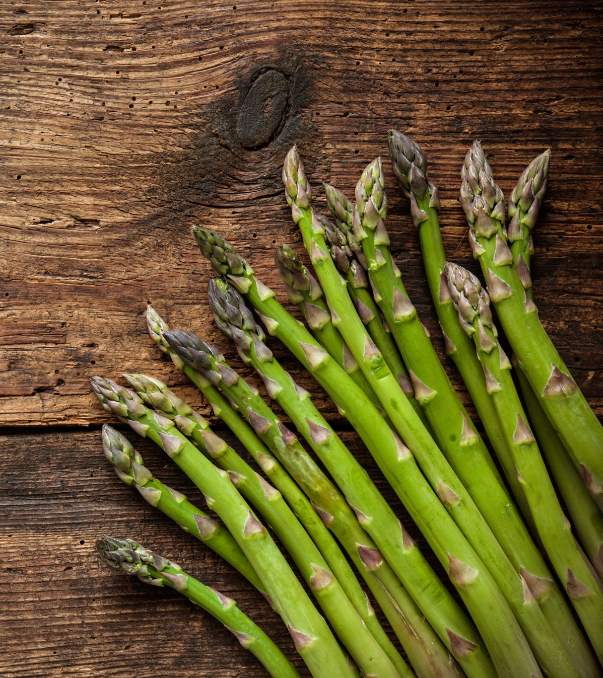
UTILIZATION

Slide 14
STABILITY

Slide 15
Myfridgefood.com

Slide 16
FOOD SECURITY!!

