Slide 1

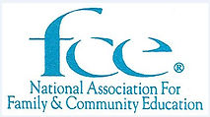
Pollinators, they are not just bees!
Hearth Fire #82
Developed and Presented by:
Pamela McIntrye-Albaro, Program Coordinator
Peggy Martens, Vice Pres. for Program
Mary Alice Weber, Program Coordinator

Slide 2
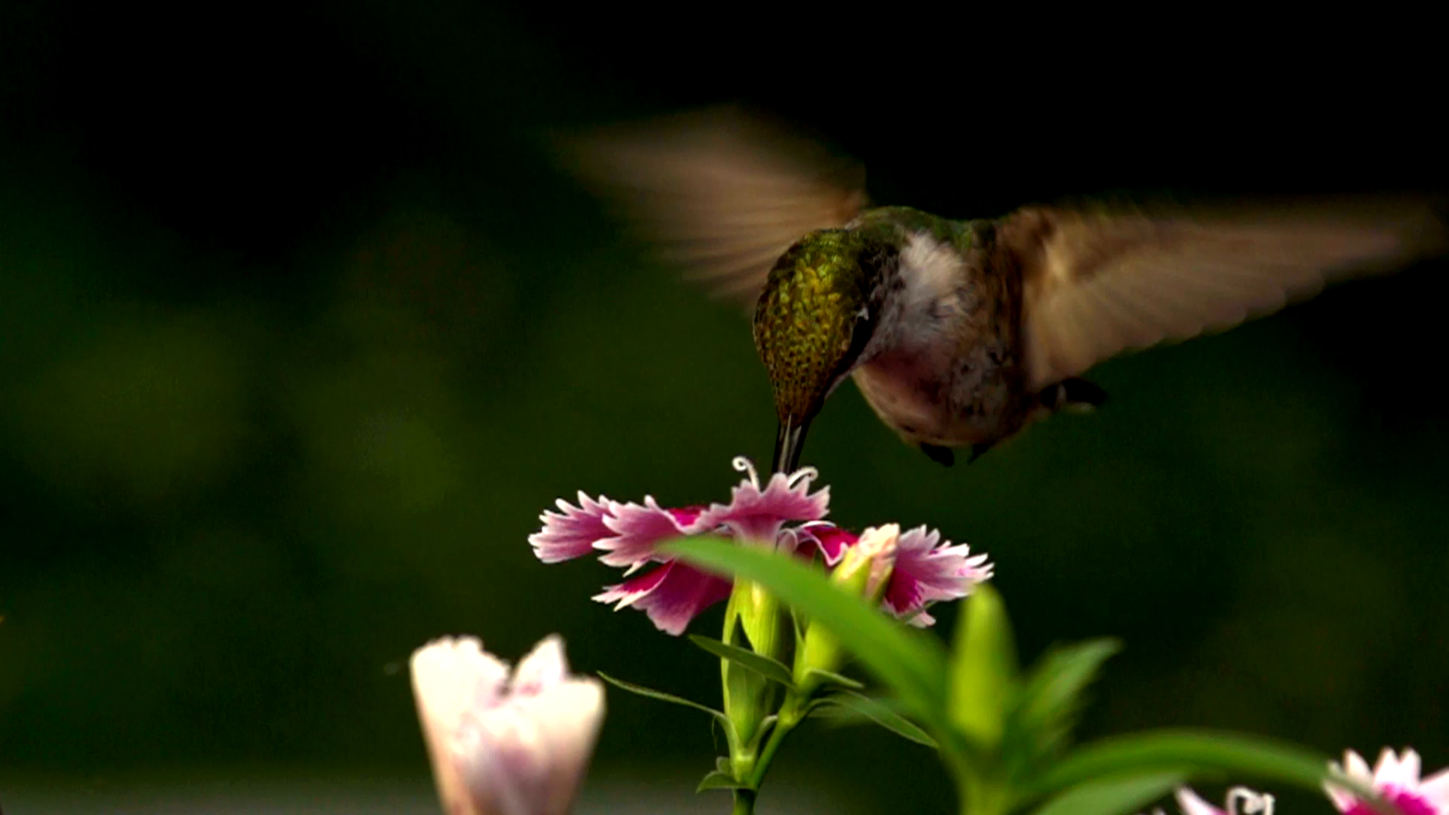
Pollinators!
They are not just Bees!!

Slide 3
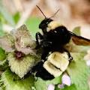
Could you name three different pollinators?
Hint: bees are not the only pollinators!

Slide 4
LET’S DEFINE POLLINATORS
The National Park Service defines pollinators as anything that helps to carry the pollen from the male portion of a flower to the female portion (can be the same or another flower).

Slide 5
Some Facts and Figures?
VITAL in FOOD SAFETY
1 in 3 BITES!
NEARLY ALL SEED PLANTS REQUIRE POLLINA-TION
THERE ARE 1400 FOOD PLANTS & CROPS WORLDWIDE

Slide 6
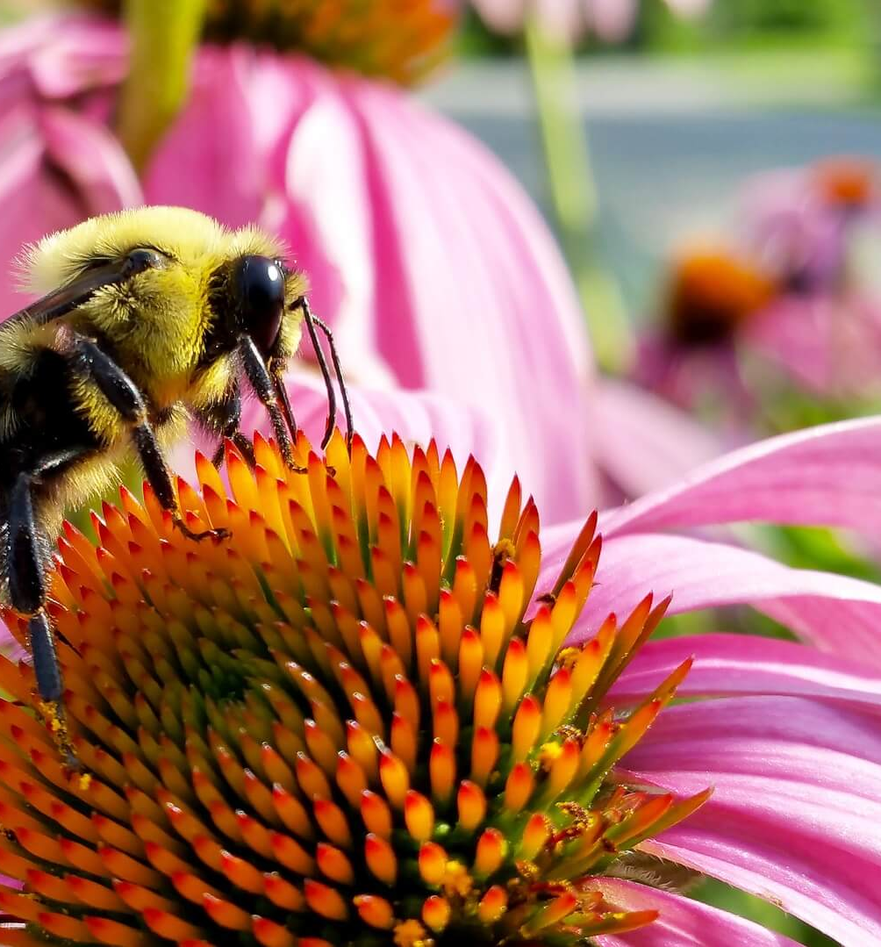
A few more facts:
It is essential for the survival of the ecosystem. Humans, along with earth’s biomes (grasslands, deserts, forests, and tundra) would not survive.
Pollinators provide us with fruits that are more flavorful and larger and higher crop yields.

Slide 7

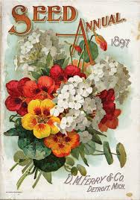

Slide 8
WHAT IS HAPPENING TO OUR POLLINATORS?
STUDIES SHOW:
DECLINE
THREAT

Slide 9
What are some of the threats our world’s pollinators are facing?
Loss of habitat
Parasites and Pathogens
Non-native and invasive plant species
Climate Change
Pesticides
Neonicotinoids

Slide 10
Habitat Loss
Loss of food and shelter
Habitat loss
Loss of nesting sites for birds and animals

Slide 11
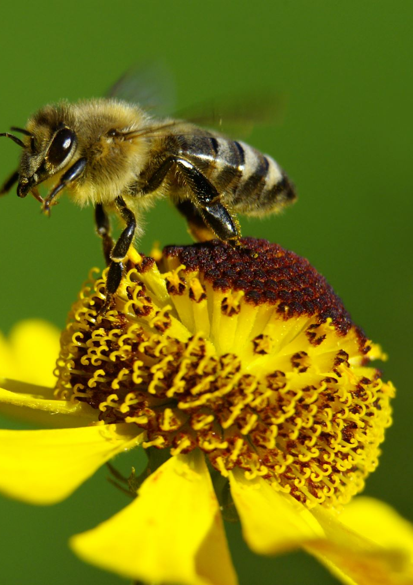
Pesticides
OVERUSE
MISUSE
NEONICOTINOIDS

Slide 12
Parasites and Pathogens
Parasites
Mites, Lice and some insects that live or feed upon their host
Pathogens
Bacterium, fungus or virus that attacks the bee colony from within and can be carried onto a particular mite that attacks the bee’s food source.

Slide 13
Non-native and
Invasive Species
Invasive plants can grow unchecked and kill off the native plants needed by the pollinators
Non-Native plant species can confuse the pollinators
Life cycle is not the same

Slide 14
Climate Change
Temperature
Unusual Weather Patterns
Fire
Natural Disasters

Slide 15
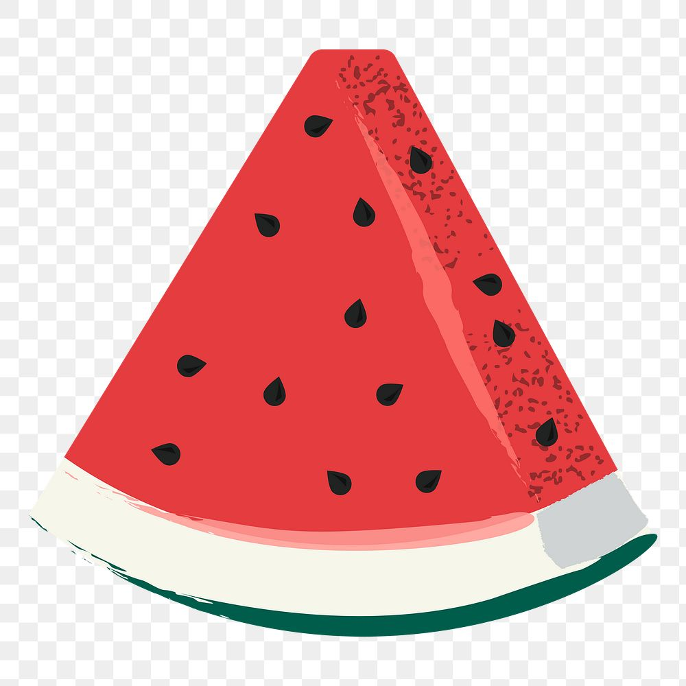


Help Save our Pollinators
PLANT YARDS and LAWNS to ATTRACT POLLINATORS
LIMIT USE of PESTICIDES
SUPPORT LOCAL BEEKEEPERS and
ORGANIC
FARMERS

Slide 16
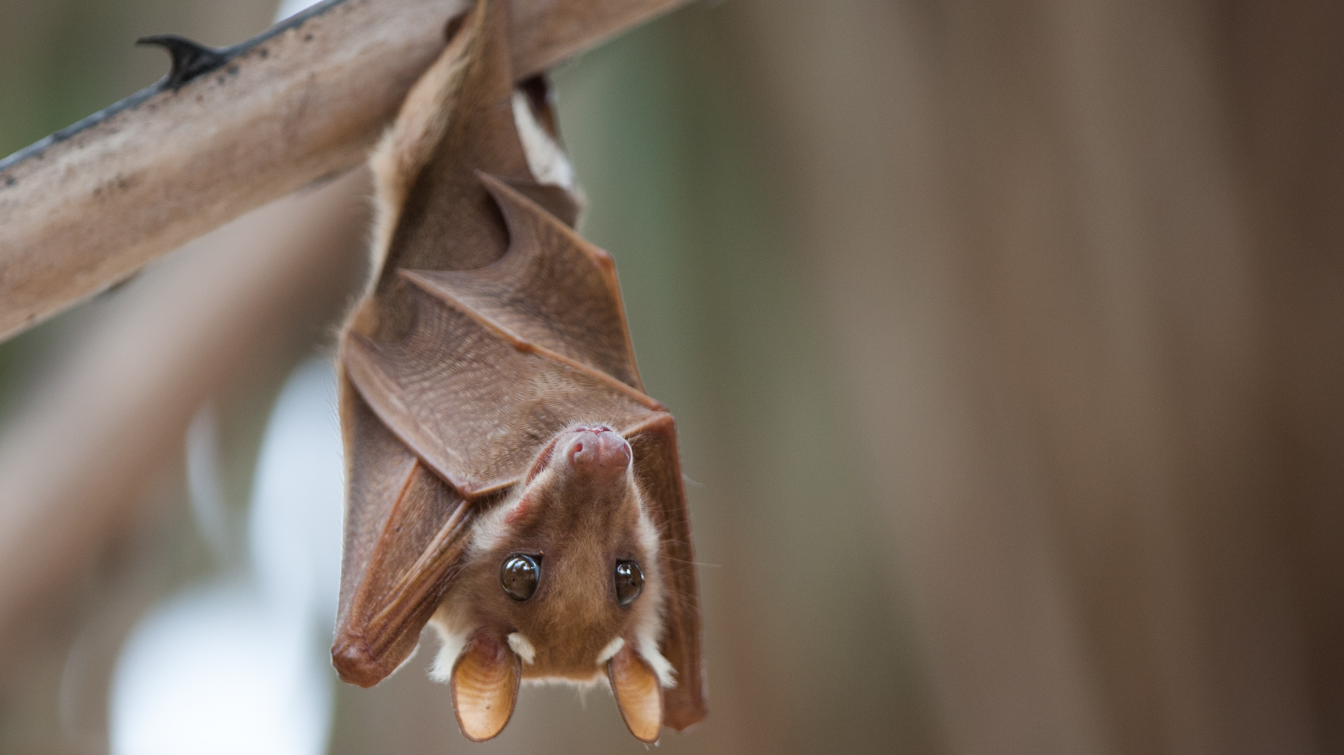
THANK YOU!

