Slide 1

Forgotten Towns of Oregon
Presented by Sally Wyffels & Lynda Nyseth
2025 Oregon FCE State Conference
(slides for presentation)
Historians have claimed that there are over 200 ghost towns in the state of Oregon. Some Forgotten communities in the state are well known while others are “really obscure”.
Revised -9-19-25

Slide 2
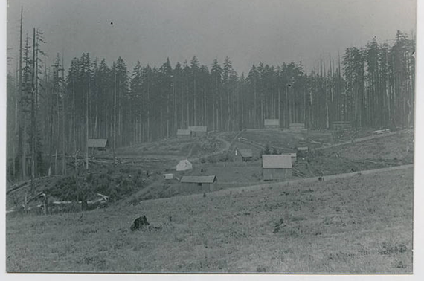
Bacona, Oregon

Slide 3
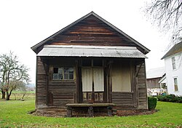
Glencoe, Oregon

Slide 4
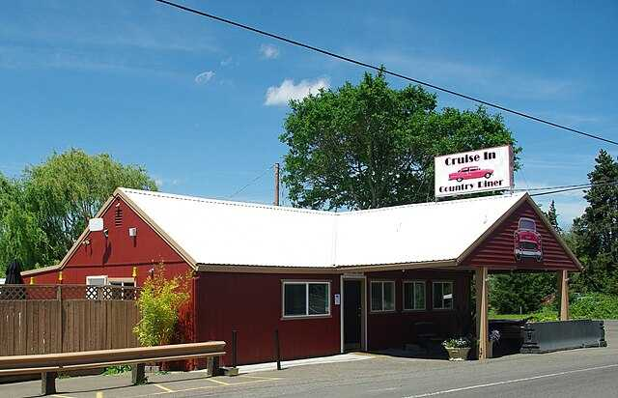
Former diner at Farmington, Oregon

Slide 5
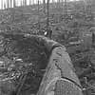
Train load of larch as seen from cab. Bridal Veil Lumber

Slide 6
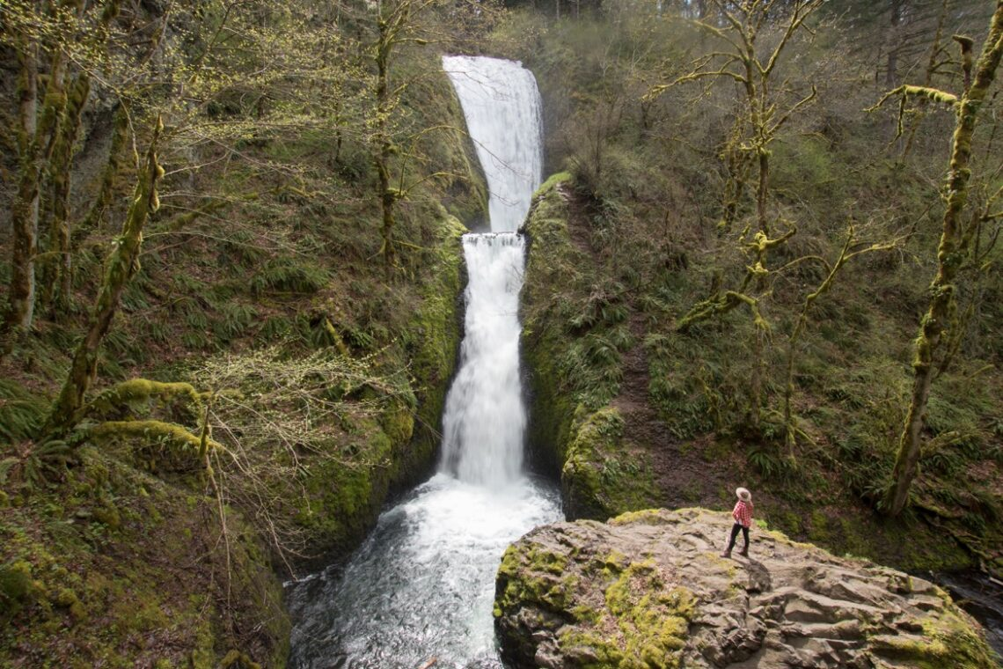
Bridal Veil Falls

Slide 7
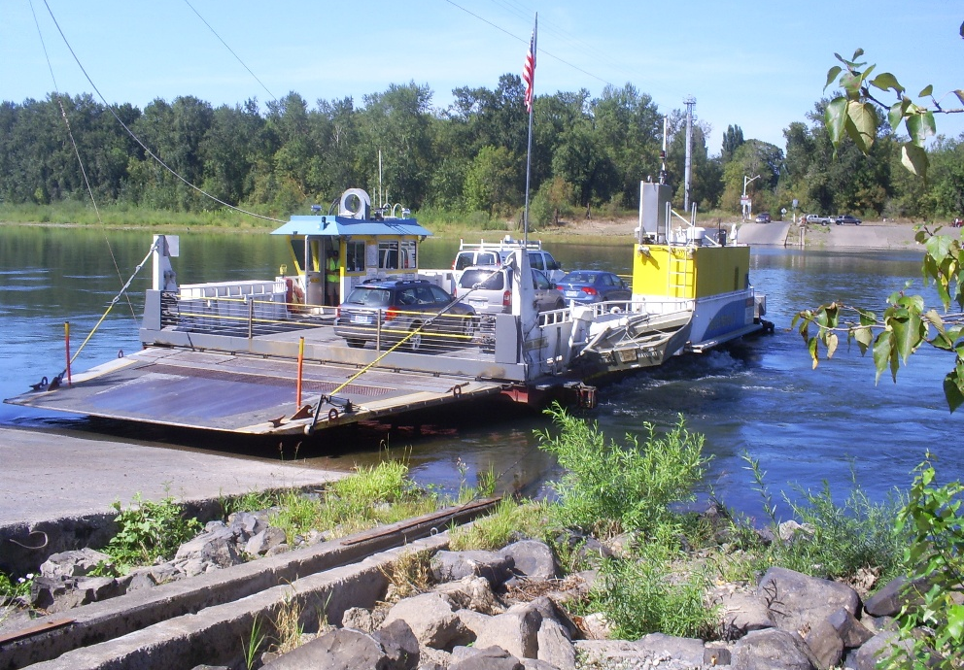
Wheatland Ferry, oldest ferry operating since 1844

Slide 8
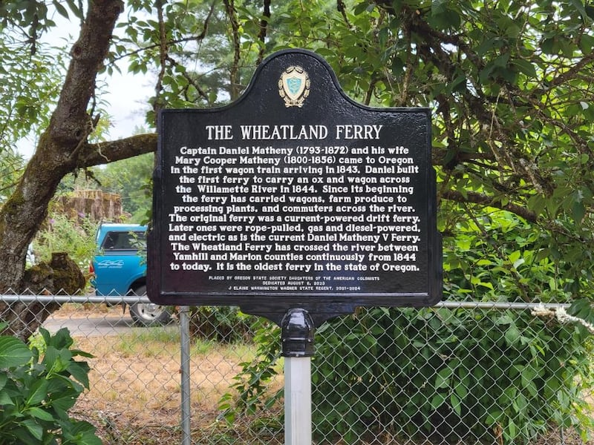

Slide 9
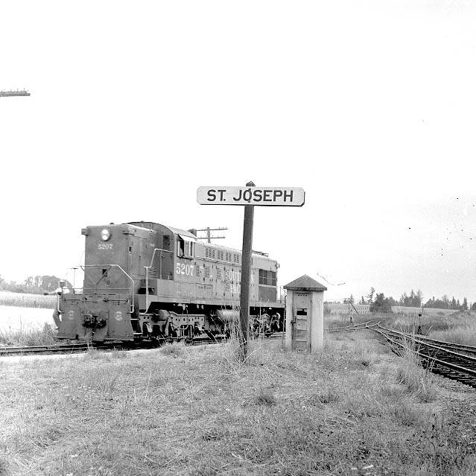

Slide 10
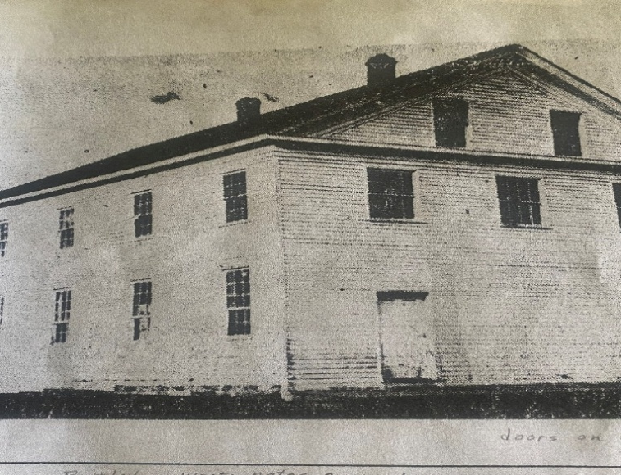
Bethel School District

Slide 11
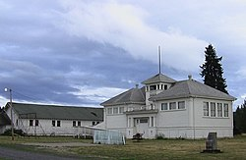
Present Bethel School building and gymnasium before it burned.

Slide 12
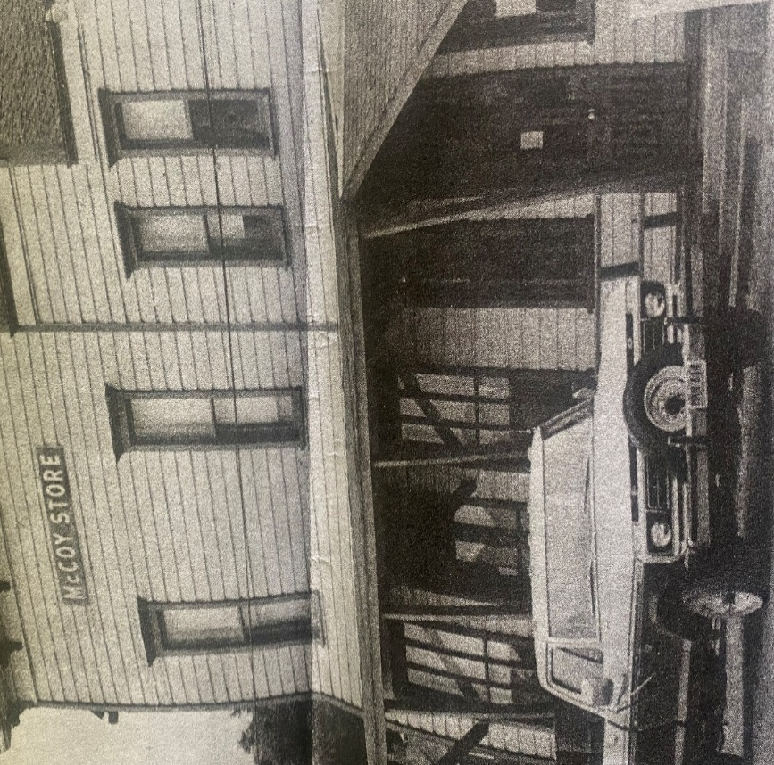
McCoy Store

Slide 13
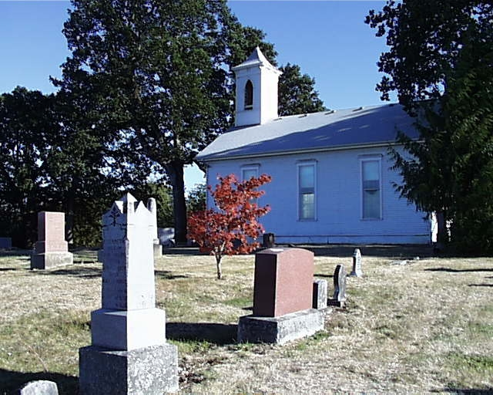
Zena Church

Slide 14
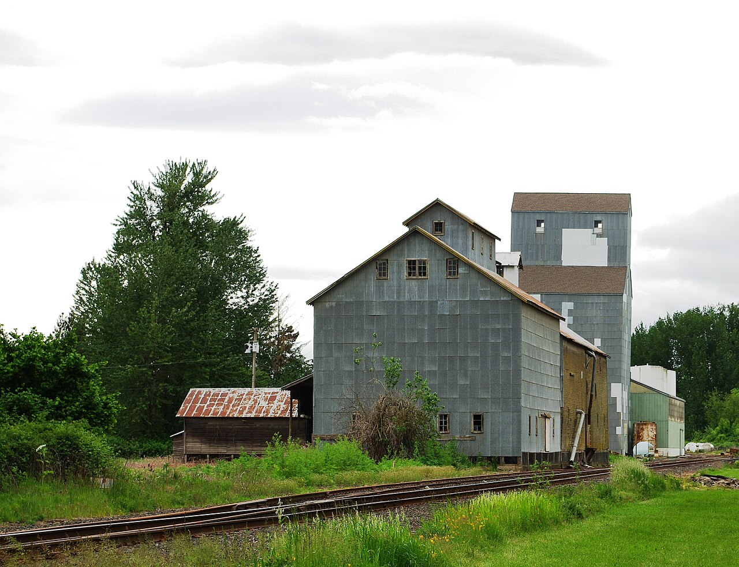
Ballston, Oregon

Slide 15
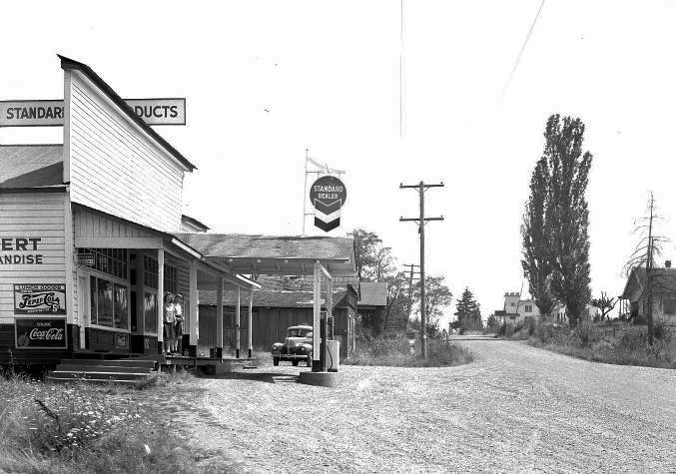
Airlie, Oregon

Slide 16
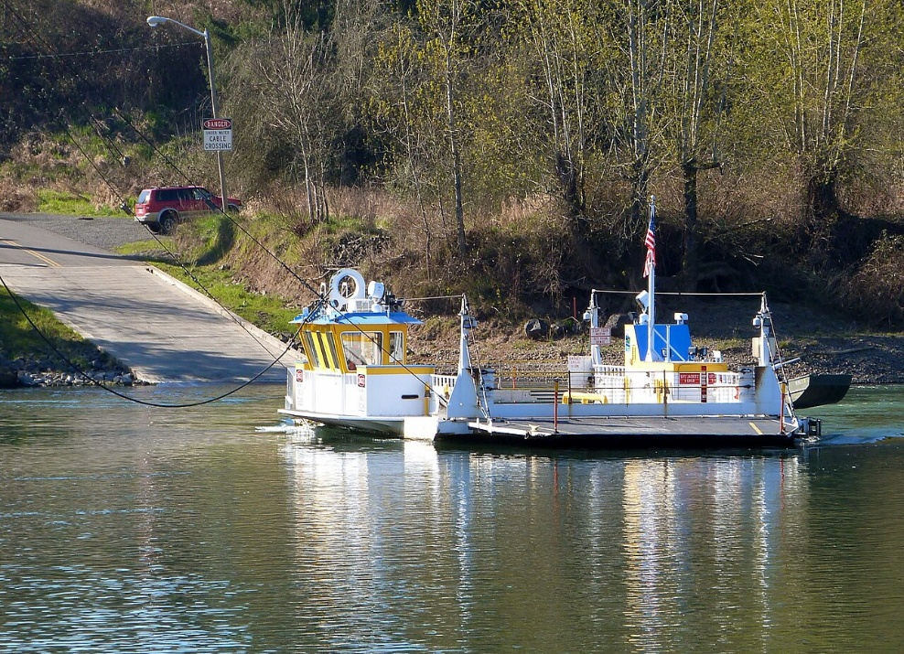
Buena Vista Ferry

Slide 17
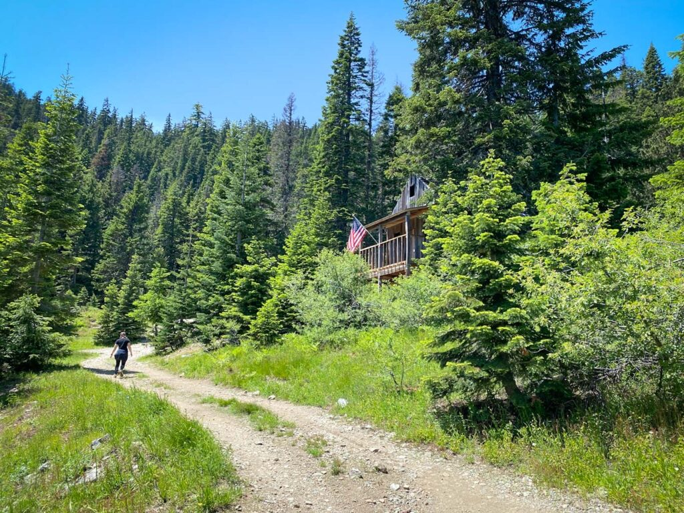
Bohemia Mine Post Office

Slide 18
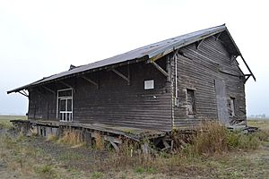
Luper, Oregon

Slide 19
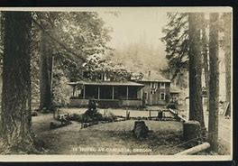
Hotel in Cascadia, circa 1925

Slide 20
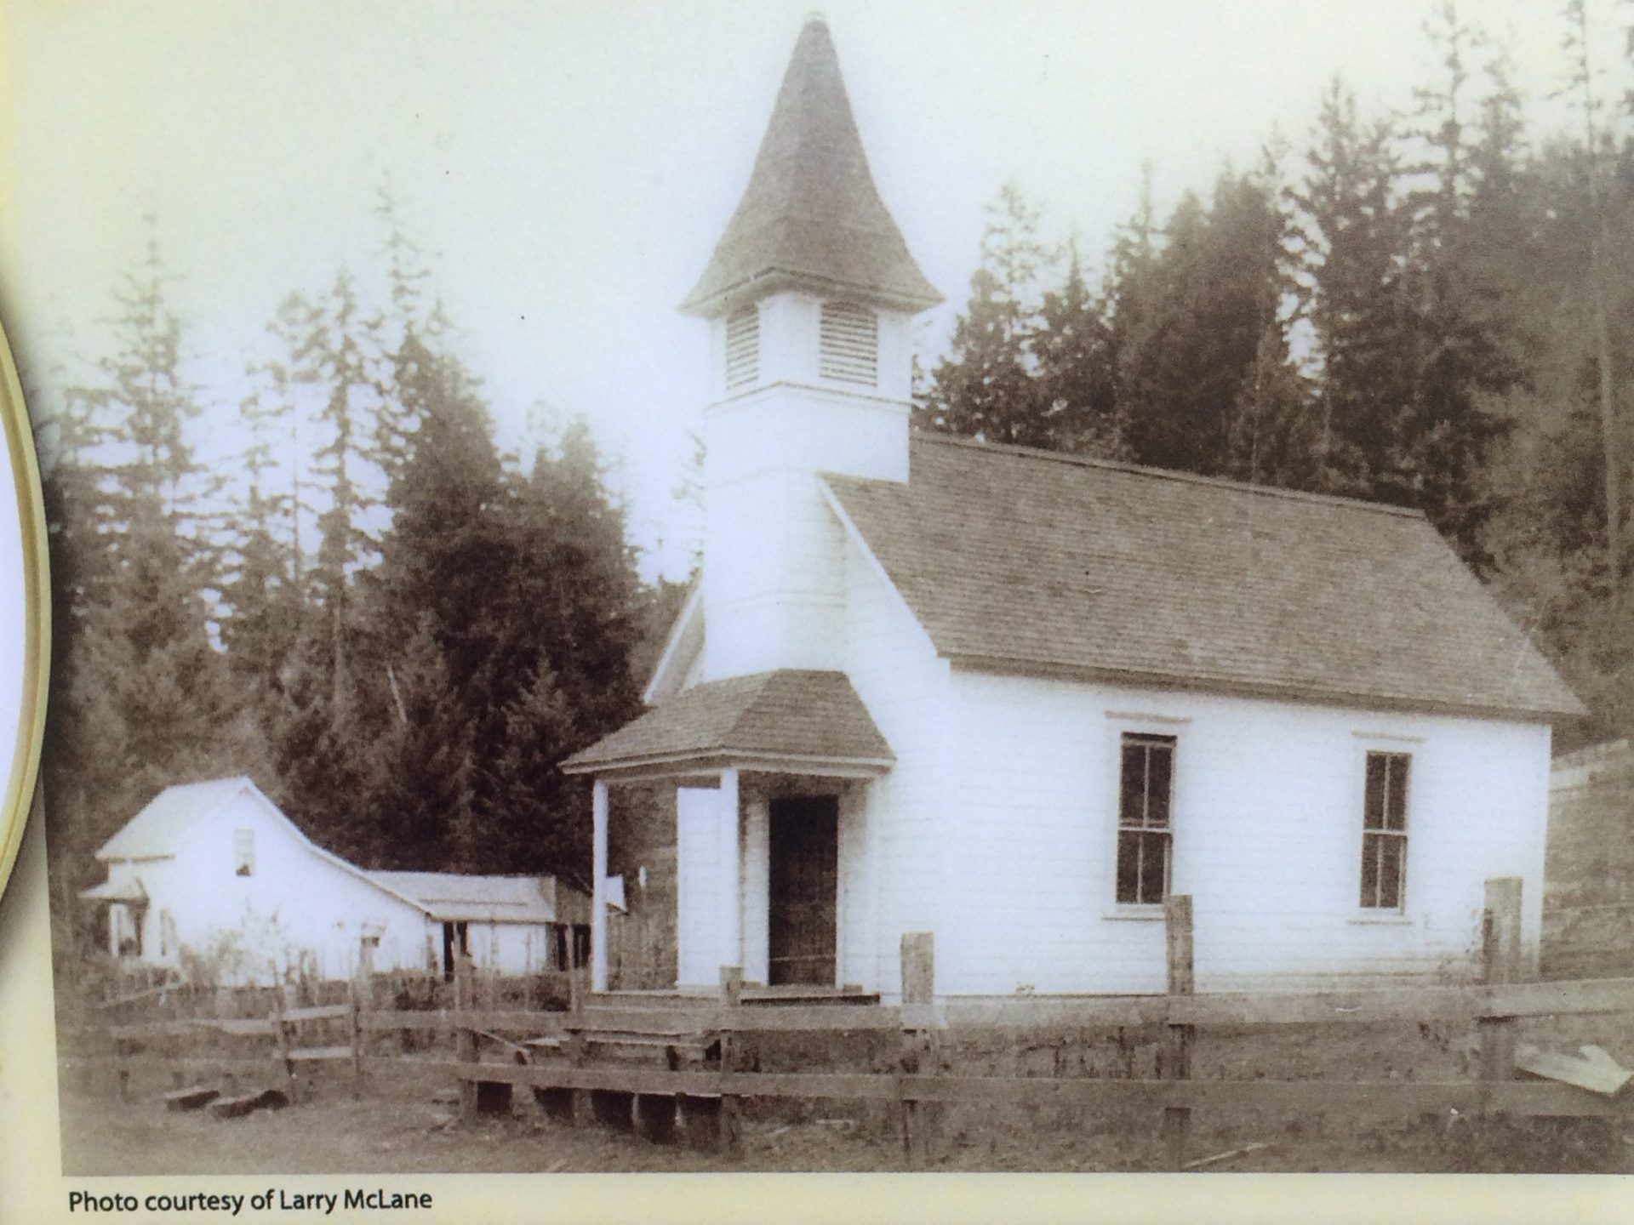
Golden Community Church

Slide 21
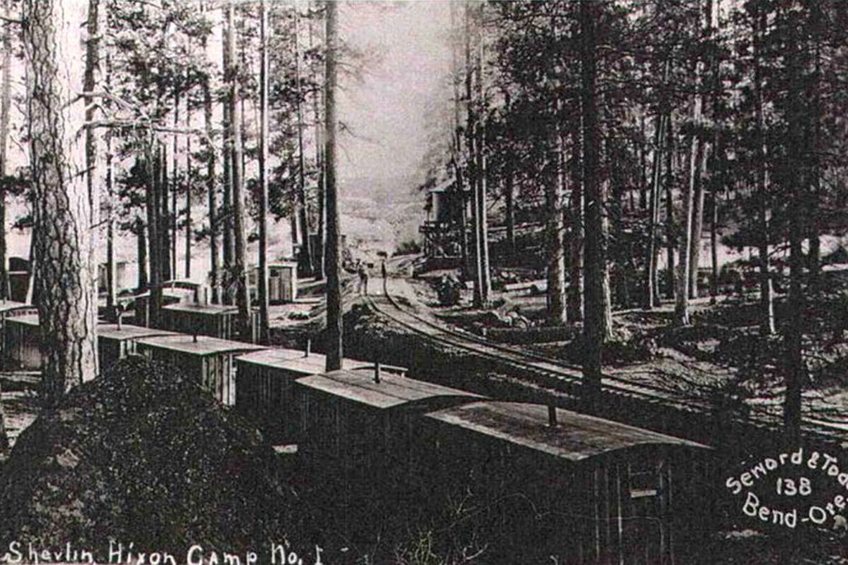
Shevlin camp

Slide 22
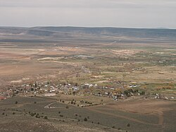
Paisley, Oregon

Slide 23
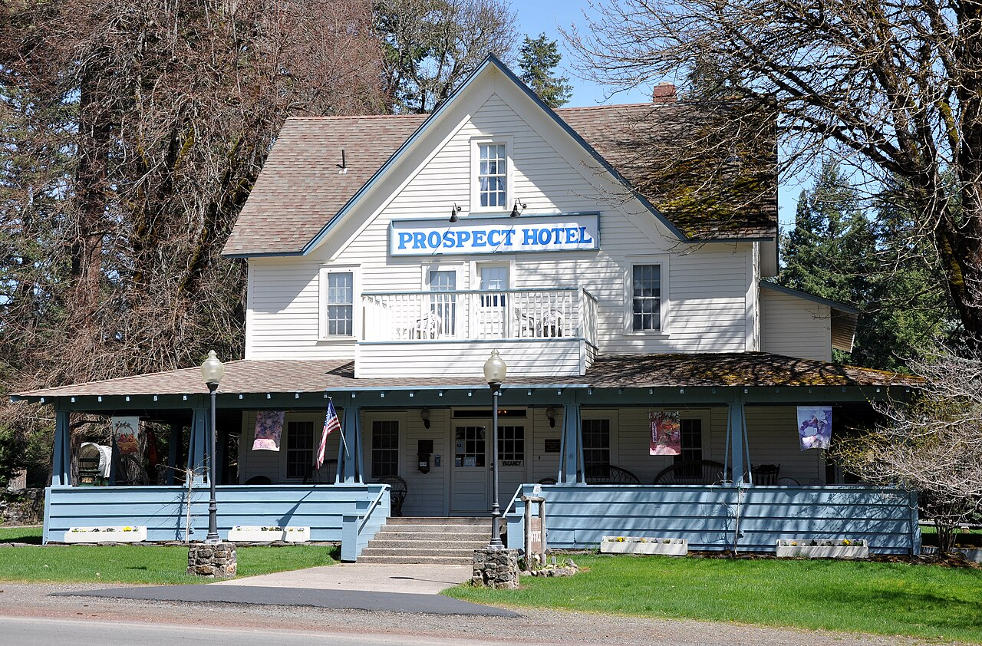
Prospect Hotel

Slide 24
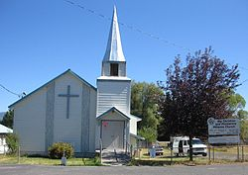
Stone Church

Slide 25
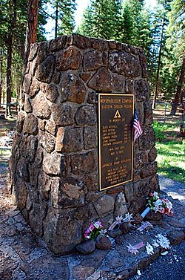
World War II Memorial at Bly, Oregon

Slide 26
Forgotten Towns of Oregon
What other Oregon towns and places do you know of that have been forgotten?
THANK YOU

