Slide 1
AUTISM:
Up-to-Date Research, Expanded Knowledge
National FCE Conference July 20-23, 2026
Notes:
Good afternoon! Thank you for being here today. We are honored to share with you up-to date research and expanded knowledge about autism and ways we can support those on the autism spectrum. (14 sec.)

Slide 2

Developed and Written by:
Mary Alice Weber, National FCE Program Coordinator, National FCL Certified Trainer
Sharon Giacometti, National FCE Public Policy Coordinator,
National FCL Certified Trainer
Connie Larrington, Vice President for Program
National FCL Certified Trainer
Notes:
Mary Alice Weber is a National FCE Program Coordinator and a National FCL Certified Trainer. Mary Alice is a Past President for the Central Region of Tennessee; and currently serves as her county secretary and club treasurer. She is a Retired Physical Therapist with 20+ years experience with toddlers and children with autism, and a former member of the Waves Autism Spectrum Disorders Program. She and her husband also led a community Top Soccer program for a few years.
.
Sharon Giacometti serves as a National FCE Public Policy Coordinator and is a National FCL Certified Trainer. Sharon is a 4O-year member of Sliferette FCE and unit president for 37 years. She is a Past Kansas State President and currently the Southeast District Education Program Chairperson.
A sincere thank you to our illustrious Connie Larrington for serving as our mentor. Connie serves as the National Vice President for Program and is a National FCL Certified Trainer.
The content of this lesson was externally Reviewed by: Alicia Lankford, an Education Specialist and Licensed and Board-Certified Behavior Analyst and by: Whitney Loring, who is a Licensed Clinical Psychologist and Associate Professor of Pediatrics at Vanderbilt Kennedy Center Treatment and Research Institute for Autism Spectrum Disorders (TRIAD) and the Vanderbilt University Medical Center Division of Developmental Medicine. (1 min. 38 sec.)

Slide 3
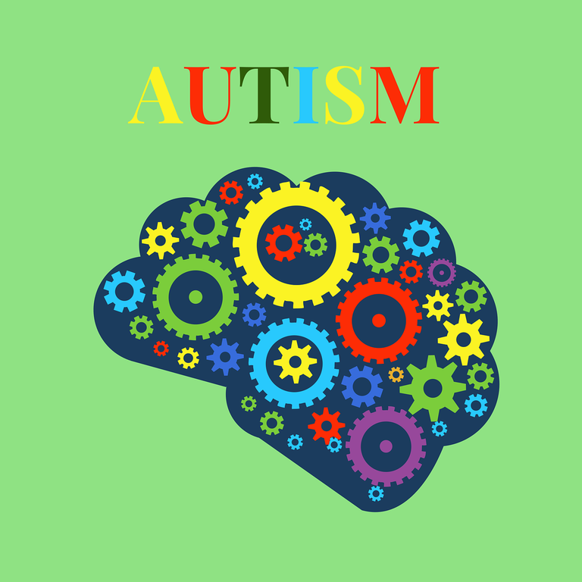
Autism Definition:
A neurological and developmental disorder that affects how people interact with others, communicate, learn, and behave. (NIH)
Image by sanjay k j (Pixabay)
Notes:
In the span of only a few decades, change has occurred in our awareness and understanding of autism. The term autism was first used in 1911 by the Swiss psychiatrist Eugen Bleuler "OY-gen BLOY-leh.“ Early studies of the disorder in the 1930’s and 1940’s included the works of Leo Kanner in the U.S. and Hans Asperger in Austria. It was not until the 1960’s, that the term acquired its current behavioral references.
The current definition of autism according to the National Institutes of Health appears on the screen... Although autism can be diagnosed at any age, it is described as a “developmental disorder” because symptoms generally appear in the first two years of life. Both autism and autism spectrum disorder (or ASD) are acceptable ways of referring to the condition.
(56 sec)

Slide 4
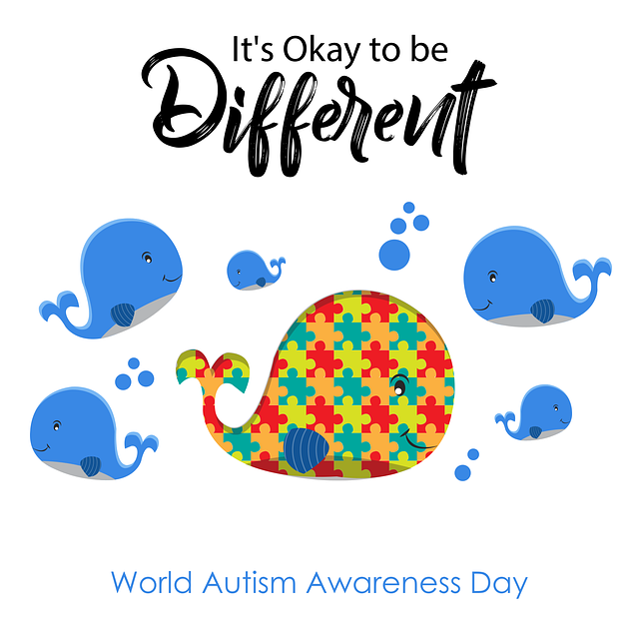
Neurodiversity
  differences are not always deficits
  diversity of all people
  everyone is worthy of belonging
  focus on positive aspects
of differences
Image by satheeshsankaran (Pixabay)
Notes:
Neurodiversity is a rather new terminology.....
-Neurodiversity describes the idea that people experience and interact with the world around them in many ways, with no one "right" way of thinking, learning, and behaving.
-Differences are not always deficits.
-Neurodiversity refers to the diversity of all people and recognizes that we all have strengths, and areas needing support, and that our differences can be very valuable.
-It also recognizes that everyone is worthy of belonging and being able to live a fulfilling life with goals that are meaningful to them.
-Referring to someone as neurodivergent is a way to focus on the positive aspects of their differences and what that can bring to the group.
Autism looks different for everyone, and each person with autism has a definite set of strengths as well as challenges. Some people with autism can speak, while others are non-speaking and communicate in other ways. Some have intellectual challenges, while some are highly intelligent. Some require significant support in their daily lives, while others need less support and may live independently.
(1 min. 15 sec.)

Slide 5
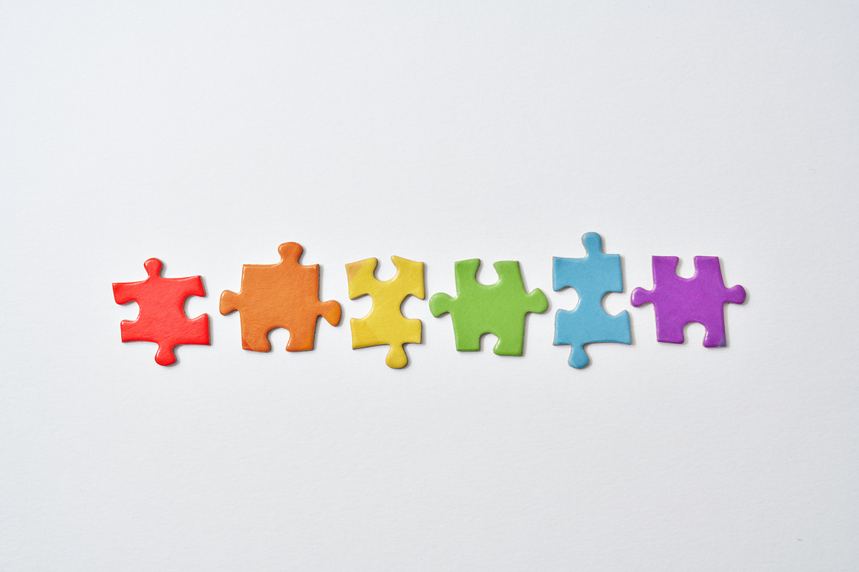
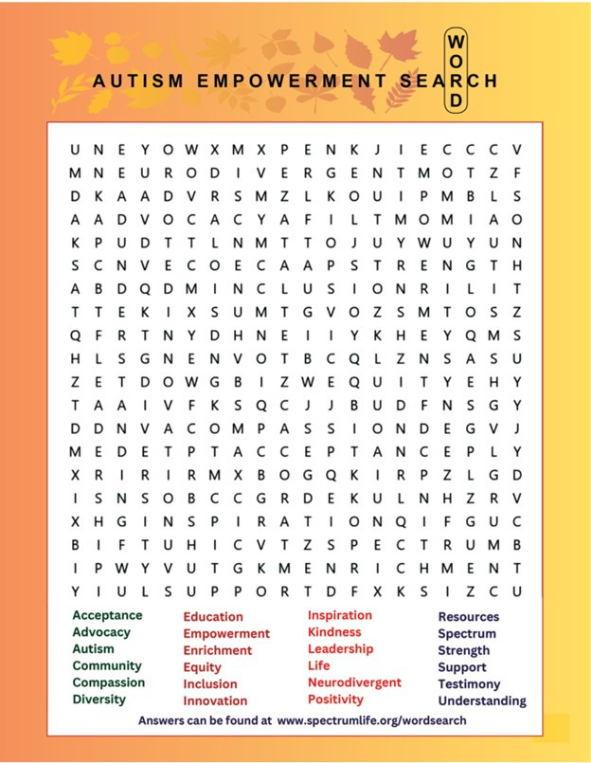
Activity 1:
Autism Word Search
Image by Canva
Notes:
The Autism Empowerment Word Search puzzle was printed in the Fall 2024 issue of Spectrum Life Magazine. Each word in the puzzle represents a core principle that guides the organization’s commitment to enriching the lives of individuals within the autism and neurodivergent communities.
Please spend about 2 minutes finding the words at the bottom of the page In the scrambled word search. (27 sec.)
2 minutes for activity 1.

Slide 6
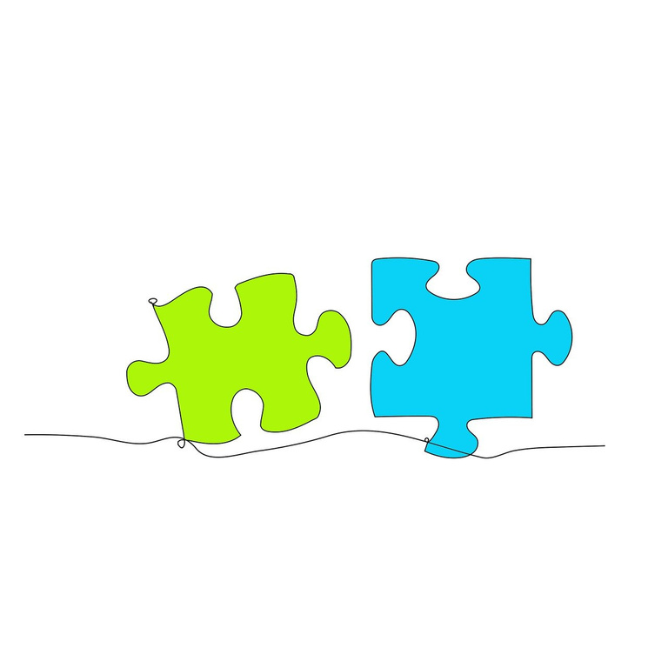
Prevalence
of Autism:
2000:
1 in 150
2010:
1 in 68
2022:
2016:
1 in 54
1 in 31
Image by Bianca Van Dijk from Pixabay
Notes:
It was not until 2000, that the CDC began to collect national data in the Autism and Developmental Disabilities Monitoring Network. The prevalence of autism at that time was estimated to be 1 in 150 children. The prevalence has consistently increased and now it is estimated to be 1 in 31. (22 sec)
[CDC--Center for Disease Control and Prevention]

Slide 7
Prevalence
boys diagnosed with autism 4 times more
than girls
girls may
demonstrate more subtle symptoms –underdiagnosis or misdiagnosis
diagnosing an adult can be more difficult – learn to “mask” symptoms
Notes:
Anybody can be autistic, regardless of sex, age, race or ethnicity. However, research from the CDC says that boys are diagnosed with autism four times more often than girls.
According to the DSM-5, autism may look different in girls and boys. Girls may demonstrate more subtle symptoms, often leading to underdiagnosis or misdiagnosis.
Diagnosing an adult with autism can be more difficult, as adults often learn to “mask,” or hide, their autism symptoms.
(31 sec.)

Slide 8
Factors Contributing to Increased Prevalence
  increase in awareness/media attention
  access to screening
  additional training of screening providers
  increase in acceptance of diagnosis
  improvements in data collection
  expansion of diagnostic criteria for autism
Notes:
Most researchers agree the rise in autism diagnosis is largely driven by changes in how autism is defined, detected, and diagnosed, not by a sudden surge in a single biological cause.
There are several factors:
--An increased awareness and media attention have led to greater recognition of signs and symptoms.
--Access to screening has allowed earlier and more accurate identification.
--Additional training of providers has resulted in more specialized diagnostic programs that are able to accurately identify more subtle presentations of autism.
--An increase in acceptance of this diagnosis has reduced stigma, making people more likely to share their own diagnosis or their child’s diagnosis with others.
--Improvements in data collection have resulted in more comprehensive databases.
-- The final factor is the expansion of autism diagnostic criteria. In simple terms, changes to the Diagnostic and Statistical Manual, which is used to diagnose autism and other disorders, broadened the definition of autism. Updates to the DSM-4 and DSM-5 categorized autism as a spectrum disorder and expanded the criteria for diagnosis.
(1 min.12 sec)
.

Slide 9


Cause of Autism
Genetic factors
  genes account for 80%
  variants in 100+ genes
  takes a number of gene variants beyond threshold to cause autism
  other genes are rare, spontaneous
Image by swiftsciencewriting (Pixabay)
Notes:
Autism has a strong genetic component.
-Some research estimates that genes account for about 80 percent of the likelihood of autism
-variants in more than 100 genes have been identified as playing a role.
-Some of these gene variants are quite common, and it takes a number of them to accumulate beyond a certain threshold to cause autism.
- Other variants are rare and arise spontaneously, meaning they may appear in a child with autism even if neither parent carries the gene.
The genes associated with autism are present at birth and active even earlier, indicating that autism begins during the prenatal period.
(44 sec)

Slide 10

Cause of Autism
Environmental Factors
  parental age at conception
  preterm birth
  birth complications
  pregnant mother’s health
  air pollution
  another child in family with autism
Yamu_Jay-AI generated (Pixabay)
Notes:
The relationship between genes and the environment remains an active area of research, and environmental factors are especially challenging to study because they are difficult to isolate. Several environmental factors now have strong scientific support for an association with autism. However, current evidence does not show that any one factor alone causes autism; rather, autism likelihood may increase when environmental factors interact with genetic tendencies.
•Parents over 40 are linked to a higher likelihood of having a child with autism.
• Premature babies have higher autism rates; those born at 22–27 weeks are nearly four times more likely to be diagnosed than full-term babies.
• Birth complications: Examples include umbilical cord knots, placental abruption, and NICU stays.
• Maternal health: Such as Obesity, diabetes, immune dysfunction, autoimmune disease, and inflammation during pregnancy may affect fetal brain development and raise autism likelihood; adequate folic acid and vitamin D may reduce the risk.
• Prenatal exposure to toxins such as smog is linked to higher autism likelihood, possibly through inflammation that affects fetal brain development.
• Family history: Having an autistic sibling, especially a twin or multiple autistic siblings, is linked to higher autism likelihood due to genetic and environmental factors. (1 min. 23 sec)

Slide 11
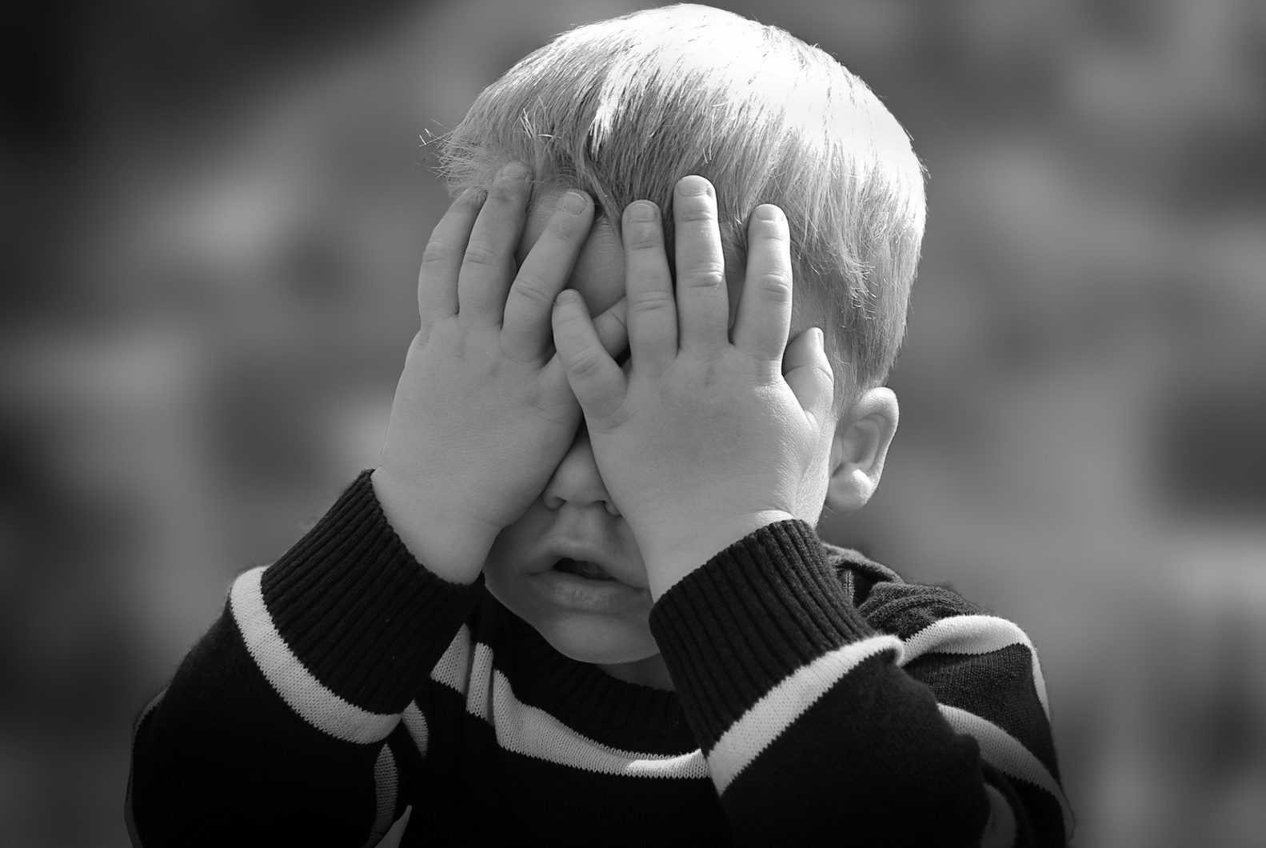
Vaccines
do not
cause autism.
Photo Credit: Pixabay.
Notes:
Numerous large studies have shown no link between vaccination and autism. (5 sec)

Slide 12
social communication
and interaction
Primary areas of Autism Diagnosis
restricted or repetitive behaviors and interests
Notes:
The two primary areas of an autism diagnosis are
social communication and interaction,
and restricted or repetitive behaviors and interests.
(9 sec)

Slide 13
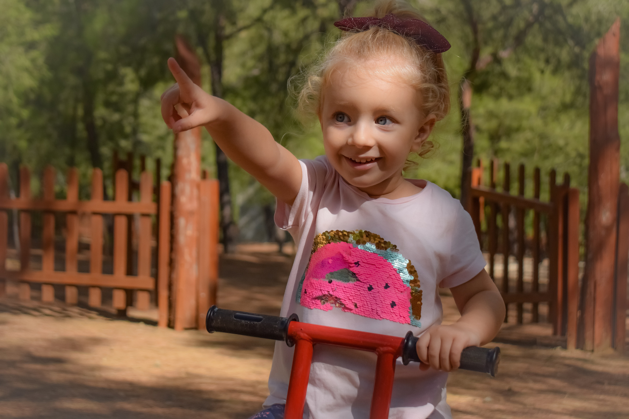
Joint Attention
Shared focus of two individuals on an object -- achieved when one individual alerts another to an object by eye-gazing, pointing, or verbal cues.
Image by Dimitris Vetsikas (Pixabay)
Notes:
Joint attention is basic for both social communication and interaction. Joint attention is the shared focus of two individuals on an object. It is achieved when one individual alerts another to an object by using eye-gazing, pointing, or a verbal cue.
Deficits in joint attention are considered the single most distinguishing characteristic of very young children with autism according to the
American Academy of Pediatrics. (28 sec)

Slide 14
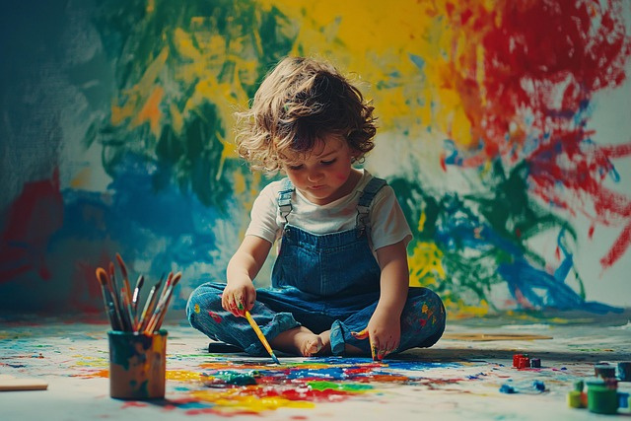
Delays with Social Communication and Interaction
  rarely meets your gaze
  does not respond to their name
  shows few facial expressions
  does not show back-and-forth exchanges of smiles and sounds
  limited language or gestures
Image by Vilius Kukanauskas, AI generated (Pixabay)
Notes:
Some examples of delays with social communication and interaction can include:
rarely meets your gaze
does not respond to their name
shows few facial expressions (such as not showing happy, sad, angry, or surprised expressions)
or does not share back-and-forth exchanges of smiles and sounds
limited language or gestures, like pointing, can also signal a difference
not noticing when others are hurt or upset
not joining in play with other children
(30 sec)

Slide 15
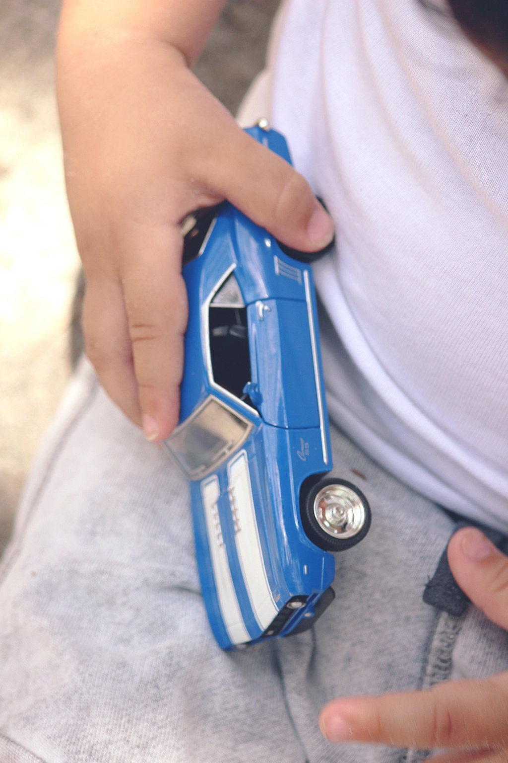
Restricted or Repetitive Behaviors
  pushing a toy back and forth repeatedly
  spinning, rocking, hand flapping
  focusing intensely on parts of an object
Image by Dayronv (Pixabay)
Notes:
Restricted interests and repetitive behaviors are common features of autism, including repeated movements, a need for sameness, and intense focused interests that may affect daily life and social interaction.
Repetitive behaviors include repeated movements, object use, or speech…such as pushing a toy back and forth, spinning, rocking, hand flapping, or repeating phrases.
Restricted interests involve intense focus on specific topics or objects…such as trains, numbers, or focusing on parts of an object like the wheels of a car. These interests may dominate conversations and activities.
(38 sec.)

Slide 16
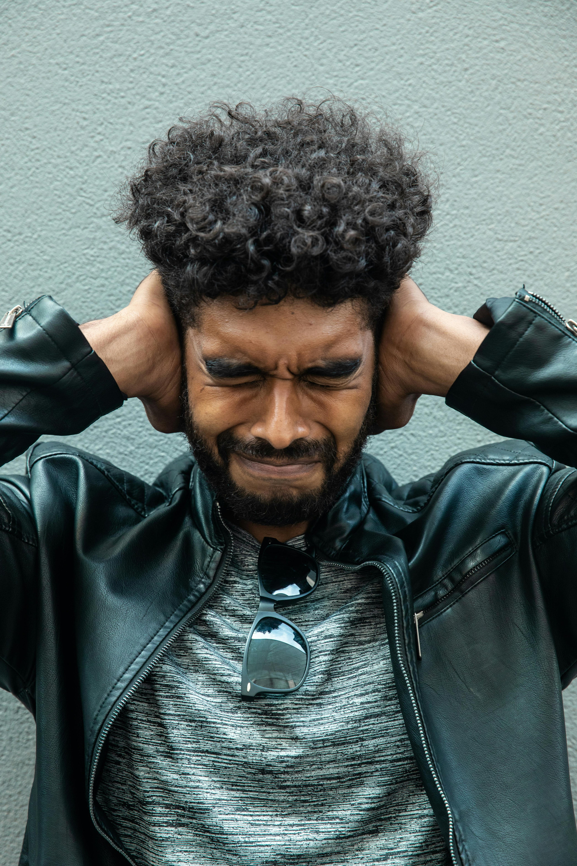
Sensory Interests
or Aversions
  hypo- or hyper-sensitive to loud noises, bright lights, and uncomfortable clothing
  fascination with blinking lights
  touching objects to their lips
  strong reactions to food textures
Image by Canva
Notes:
Sensory aversions cause discomfort or distress in response to certain inputs, for example:
Distress from loud noises or certain frequencies.
Discomfort with bright lights.
Discomfort with textures or fabrics, such as rough clothing or tags.
Avoidance of certain tastes or food textures.
Sensory interests involve actively seeking sensory input, such as:
Fascination with blinking lights
Touching objects to their lips
Use of weighted blankets or squeezing activities for deep pressure.
Movements like swinging and jumping to meet sensory needs.
(34 secs)

Slide 17
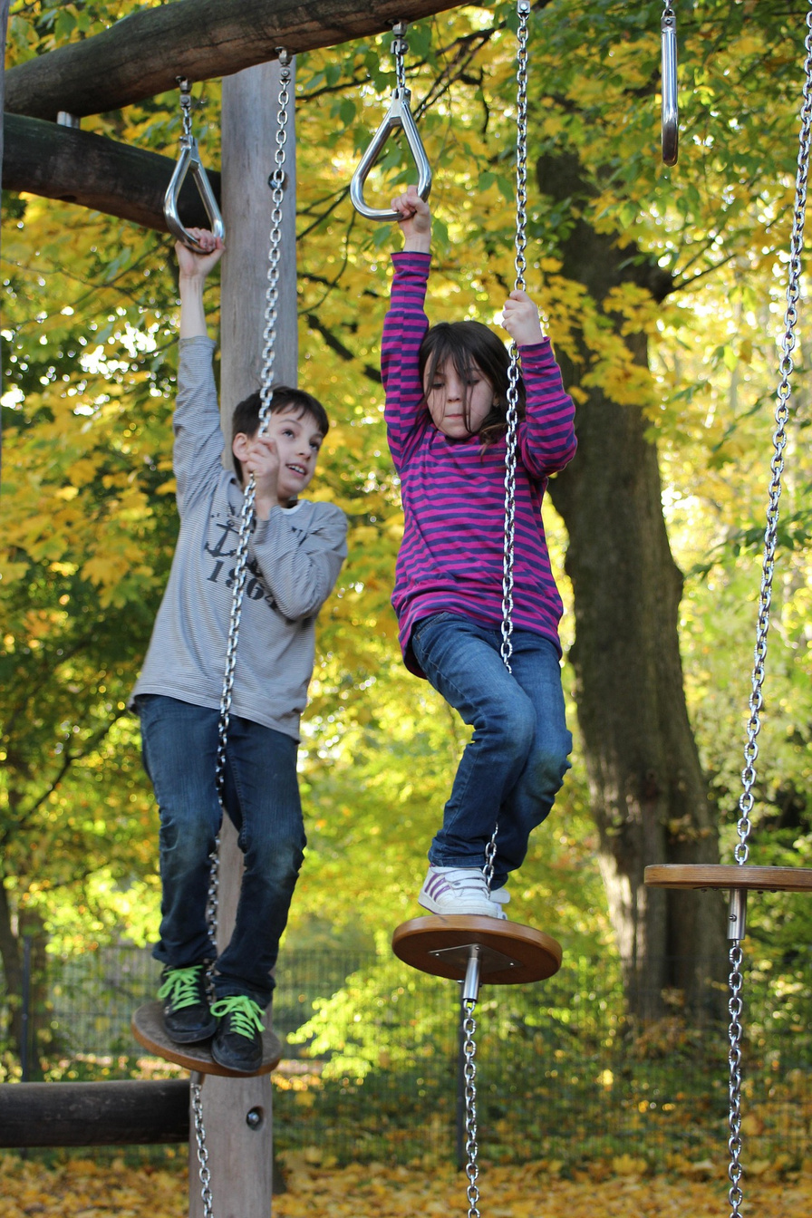
Movement
Challenges
  delayed gross motor skills
  delayed fine motor skills
  lack of coordination
  poor spatial awareness
  difficulty with balance
  difficulty with motor planning
  decreased eye-hand coordination
  walking up on toes
Image by Aprilkind (Pixabay)
Notes:
Other autism-related movement traits may include:
delays in gross motor skills, such as walking, jumping, or skipping;
delays in fine motor skills, such as buttoning a shirt or drawing;
clumsiness or poor coordination;
poor spatial awareness, or difficulty judging body and object positions in relation to the environment;
difficulty with balance and stability;
difficulty with motor planning, or organizing movements to complete tasks efficiently;
reduced eye-hand coordination;
habitual toe walking.
(30 sec)

Slide 18
  professional screening
  pediatrician – 18 & 24 mo.
  state early intervention programs for under age 3
  school-age children through public school systems
Screening
for Autism
Notes:
Early autism screening can improve access to services and supports, helping shape future outcomes for individuals with autism.
The American Academy of Pediatrics recommends autism screening for all children at routine pediatric visits between 18 and 24 months.
For children under 3, state early intervention programs provide free developmental evaluations.
School-age children can receive free assessments through public schools. These evaluations may not diagnose autism, but they can identify the need for services or further assessment.
A positive screening result is not a diagnosis and should be followed by a comprehensive evaluation by a health care professional.
(42 sec.)

Slide 19
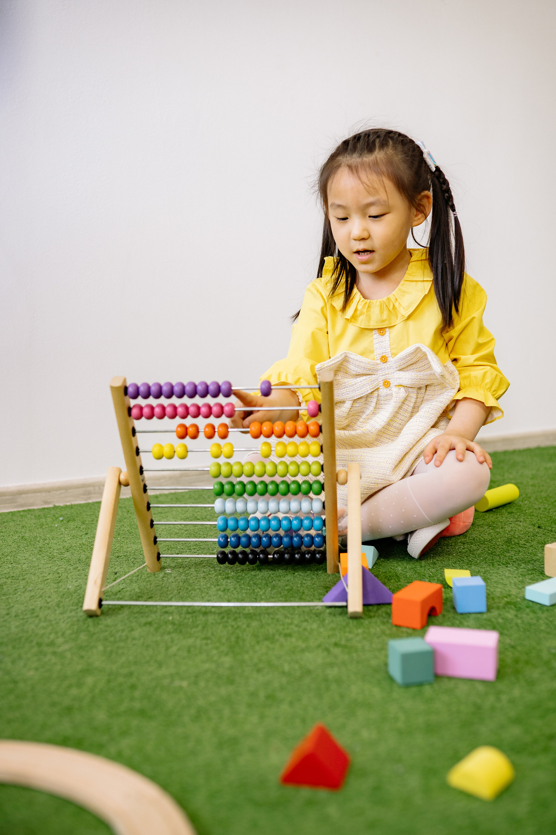
Autism Evaluation
  completed by a developmental pediatrician or neuropsychologist
  assessments include the ADOS and ADI-R
  recent research in developing teleassessment
Image by Canva
Notes:
Autism cannot be diagnosed with a medical test, such as a blood test. Instead, trained clinicians review developmental history and behavior, interview and observe the individual and family, and use standardized screening and diagnostic tools.
Evaluations are typically conducted by a developmental pediatrician or neuropsychologist.
Autism can be diagnosed at any age, though signs usually begin before age 2, even if they are recognized only later. Early signs may include skill regression, when a young child loses abilities they had previously developed.
The gold-standard autism assessment combines the play-based Autism Diagnostic Observation Schedule (ADOS) with the Autism Diagnostic Interview-Revised (ADI-R), a structured parent interview about developmental history.
Recent research has also focused on reliable teleassessment tools to improve access for families who live far from autism diagnostic centers.
(55 sec)

Slide 20
DSM-5
Level 1 Autism
requiring
support
Level 2 Autism
requiring
substantial
support
Level 3 Autism
requiring very substantial
support
Notes:
In 2013, the DSM-5 introduced three autism support levels: Level 1, Level 2, and Level 3.
These levels describe the support a person currently needs, not the overall severity of autism. Support needs are assessed in two main areas: social communication and restricted or repetitive behaviors and interests. Levels may change over time and can differ between these areas.
(25 sec.)

Slide 21
Early intervention services leads to the most positive outcomes in all areas of functioning.
Sanam Hafees, PsyD
Notes:
Early intervention can make a significant difference in the social, behavioral, communication, and self-help outcomes for people affected by autism.
A 2023 study in the journal Autism found that children who began services at 18 months showed more than twice the improvement on social-skills tests than children who started just nine months later, exhibiting major gains in language, social skills, and cognitive development.
(27 sec.)

Slide 22
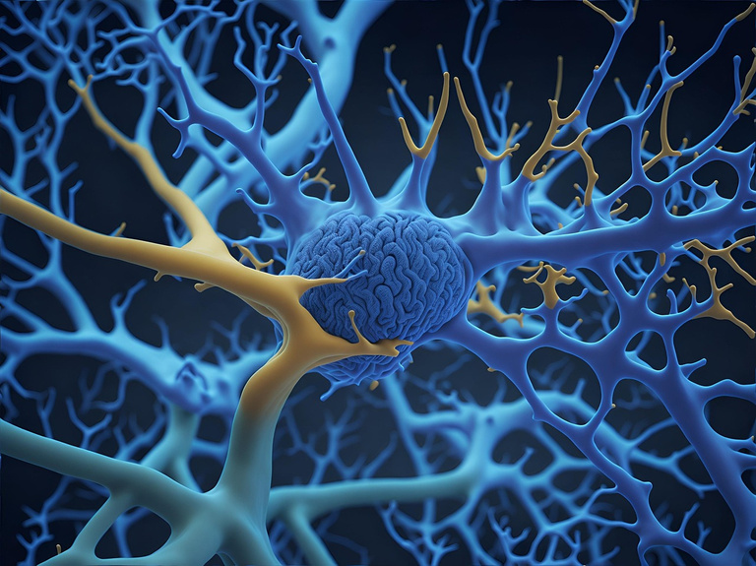
Early Intervention
  neurological pathways formed before age 3
  synapses: connections between neurons
  pruning process
  children with autism have more brain cells/connections
Image by Pete Linforth (Pixabay)
Notes:
Karen Pierce, PhD, a professor of neurosciences at the University of California San Diego, believes that early diagnosis is critical for the different levels of autism because so many neurological pathways are formed before age 3.
Let’s share some of her neuroscience:
“Kids are born with way more connections, called synapses, between neurons that they’re going to end up with as adults. There’s this process called pruning that happens during the first years of life as really good connections are being formed and less useful connections are pruned away. Studies have shown that children with autism have more brain cells than their neurotypical peers, and thus more connections.”
Pierce believes this is a key to understanding autism:
“It indicates that the children with autism brains aren’t pruning cells and forming neural pathways as effectively. If children can be diagnosed early, the hope is that therapies can be created to help them develop more effective neurological connections.”
(1 min. 7 sec.)

Slide 23
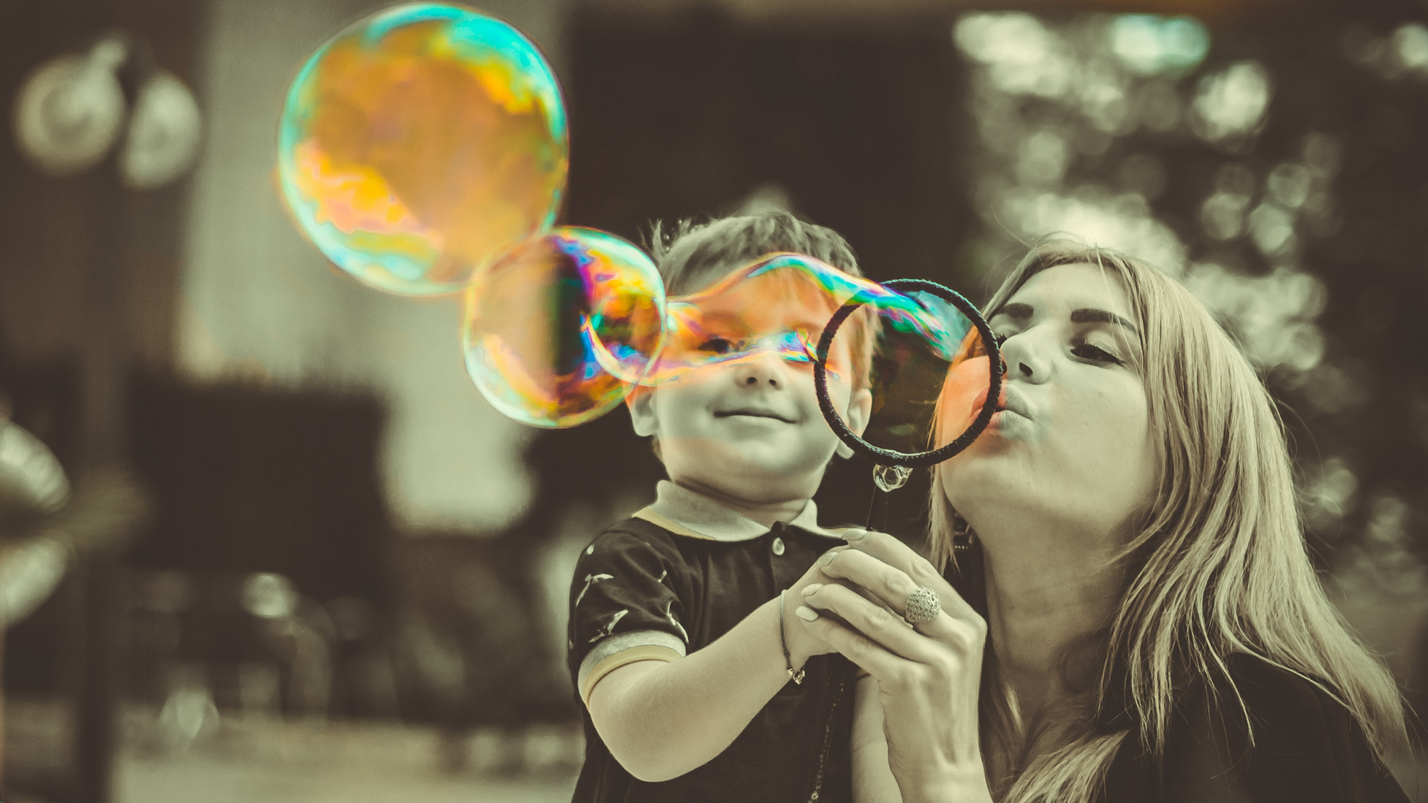
Applied Behavior Analysis (ABA)
  analyze behavior and ability to learn
  use behavioral principles, visual supports and rewards
  increase positive behaviors
  teach new skills
  decrease undesired behaviors
  generalize skills
Image by Marvel Mozhko (Pixabay)
Notes:
Applied behavior analysis (ABA) is one of the most widely used and researched autism interventions. ABA is a structured approach that examines factors influencing behavior and learning, then uses that information to teach new skills. It applies basic behavioral principles and may include strategies such as visual supports and rewards. ABA-based interventions aim to increase positive behaviors, teach new skills, reduce undesired behaviors, and help people use those skills across home, school, and other settings.
There have been numerous studies examining different formats and intensity of ABA services and have shown significant improvement.
“Some studies have shown that when ABA therapy was used for more than 20 hours a week during the first few years of life (before age four), it produced large gains in development and even reduced the need for special services later in life.” (Cleveland Clinic)
(1 min.)

Slide 24

Speech Therapy (SLP)
  increase language-- understanding and expression
  improve speech--articulation and fluency
  develop social communication
  assist with feeding disorders
Image by Canva
Notes:
Individualized approaches may combine ABA with other interventions, such as speech, occupational, and physical therapy.
Speech-language pathologists assess, treat, and help prevent communication disorders. They commonly address:
language difficulties, including understanding and expression;
speech difficulties, including articulation and fluency;
social communication challenges, making SLPs important members of many autism intervention teams;
feeding concerns, especially for children who are selective eaters or sensitive to certain tastes or textures.
(29 sec.)

Slide 25
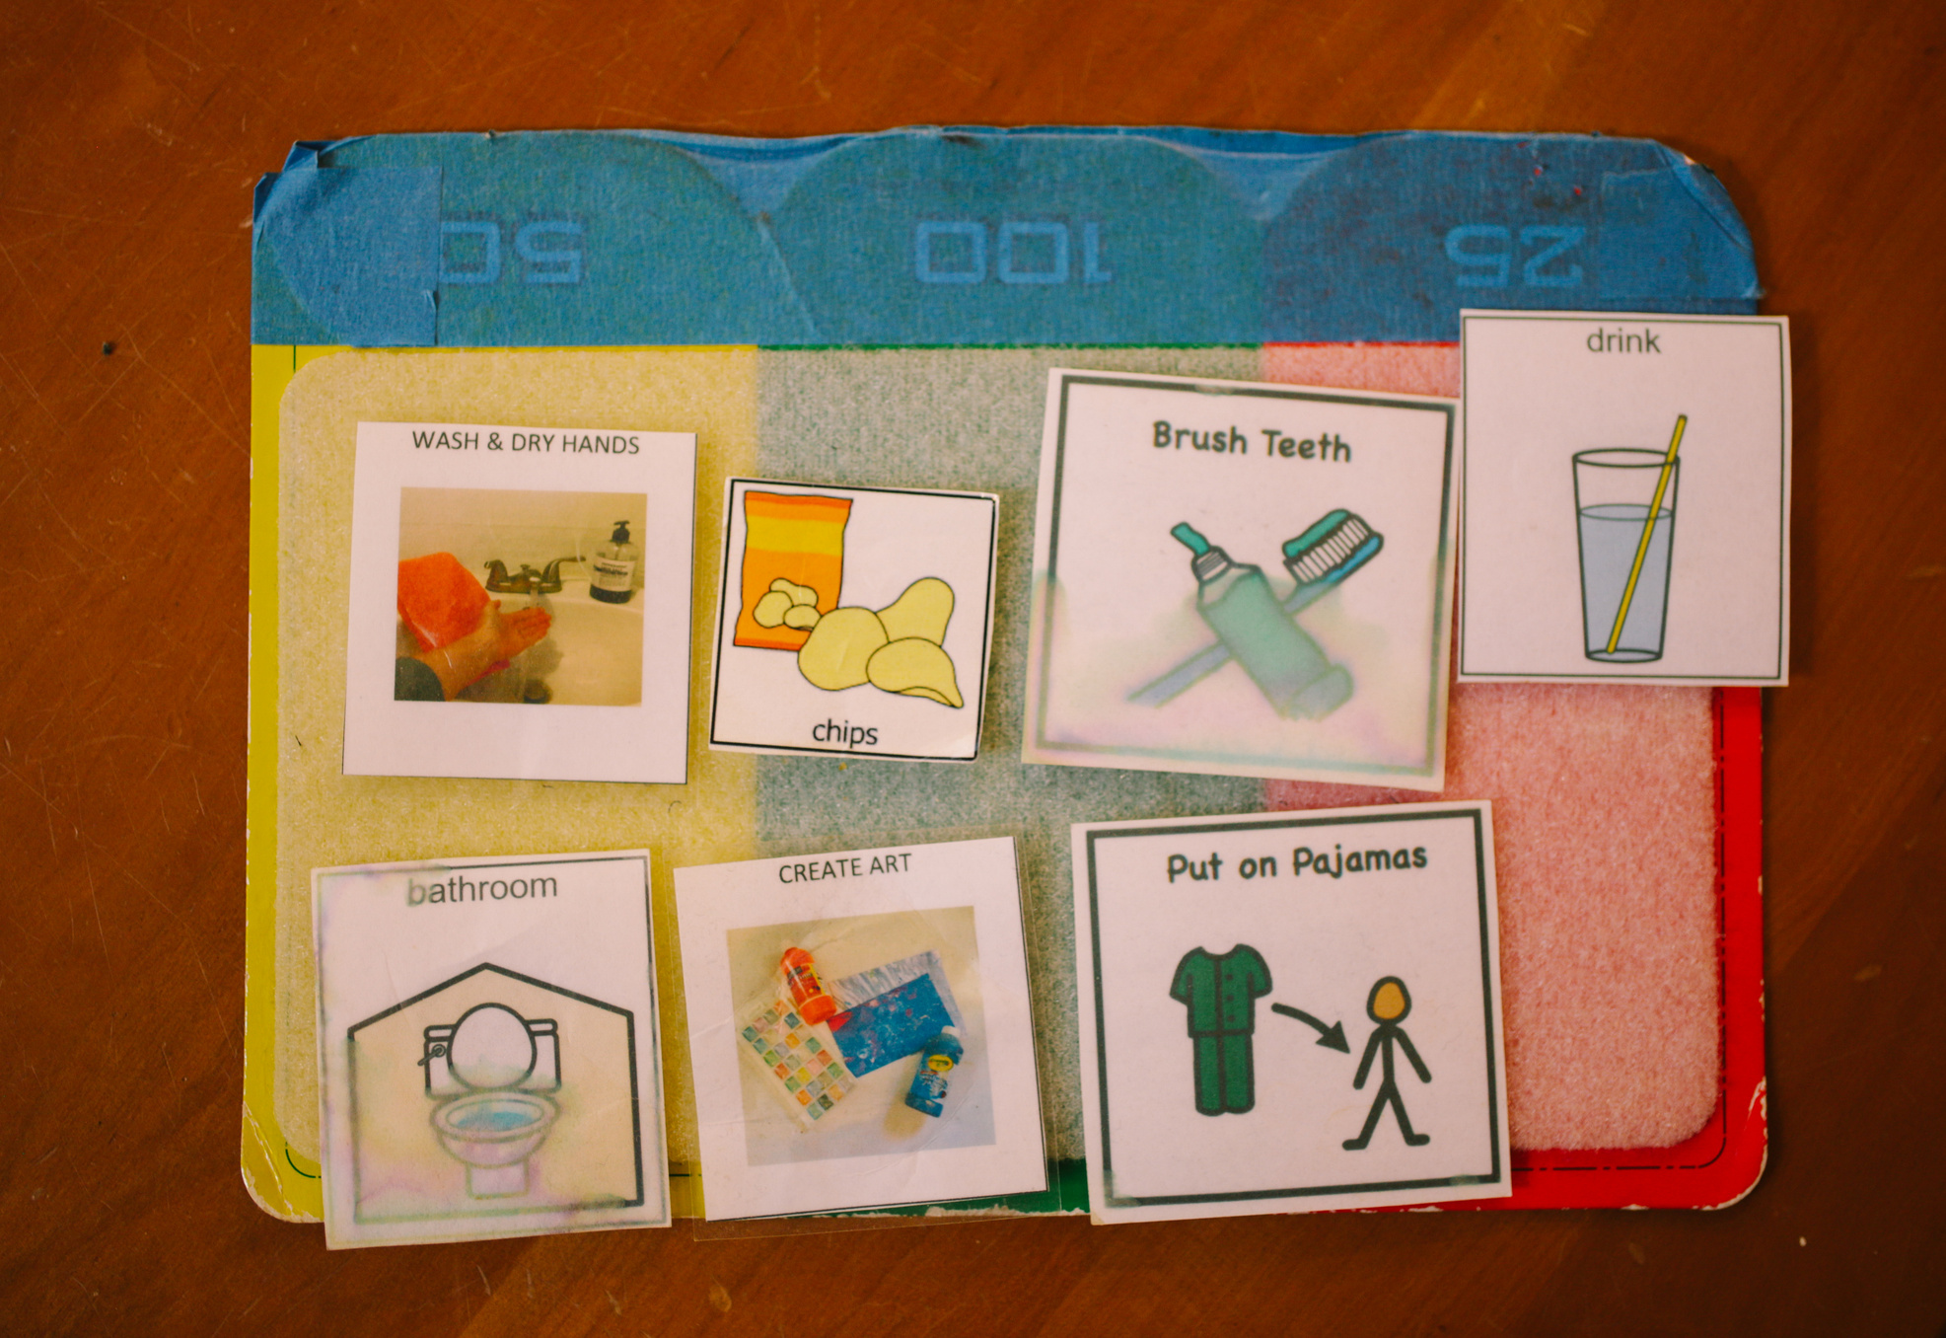
Alternative Augmentative Communication(AAC)
  sign language
  picture exchange communication system (PECS)
  Ipads
  speech output devices
Image by Canva
Notes:
Some people with autism find that using pictures or technology to communicate is more effective than speaking. This technology is called Alternative Augmentative Communication and includes
sign language,
picture exchange communication system (PECS),
Ipads,
or speech output devices.
A Speech-Language Pathologist can provide training for AAC devices. (20 sec.)

Slide 26
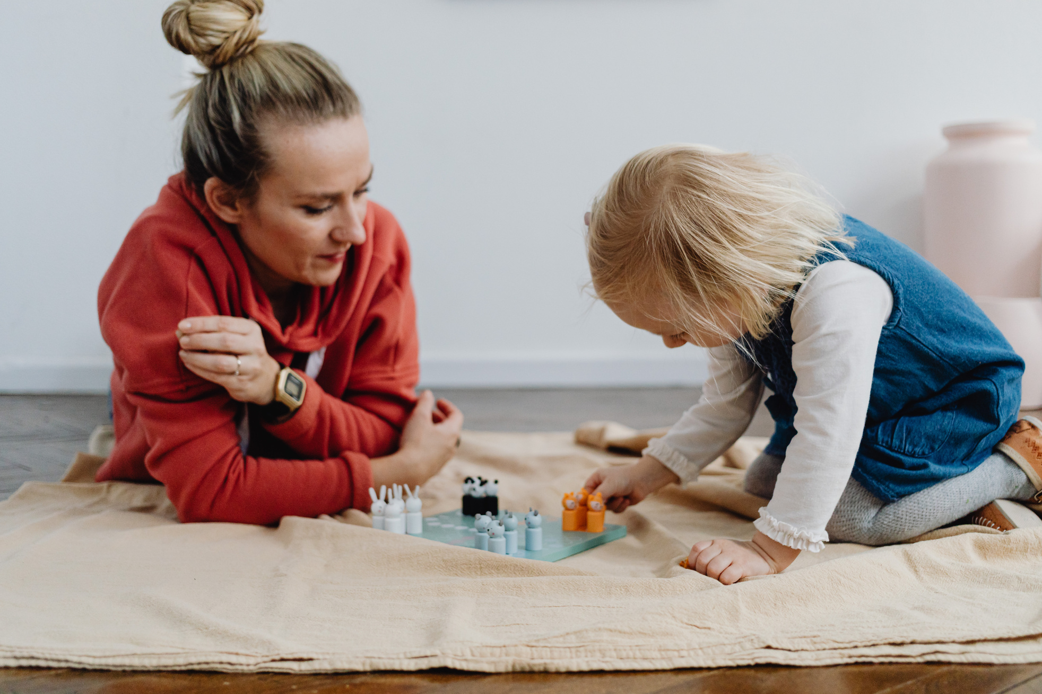
Occupational Therapy (OT)
  develop fine motor skills
  build play skills
  learn self-care skills
  cope with sensory processing differences
Image by Canva
Notes:
Occupational therapists often help people build skills in:
fine motor tasks, such as writing, coloring, and cutting with scissors;
play skills;
self-care skills, including feeding and dressing;
managing sensory processing differences.
Sensory processing is how the brain receives, organizes, and responds to sensory input, including touch, sight, hearing, taste, smell, balance, and body awareness.
(23 sec)

Slide 27
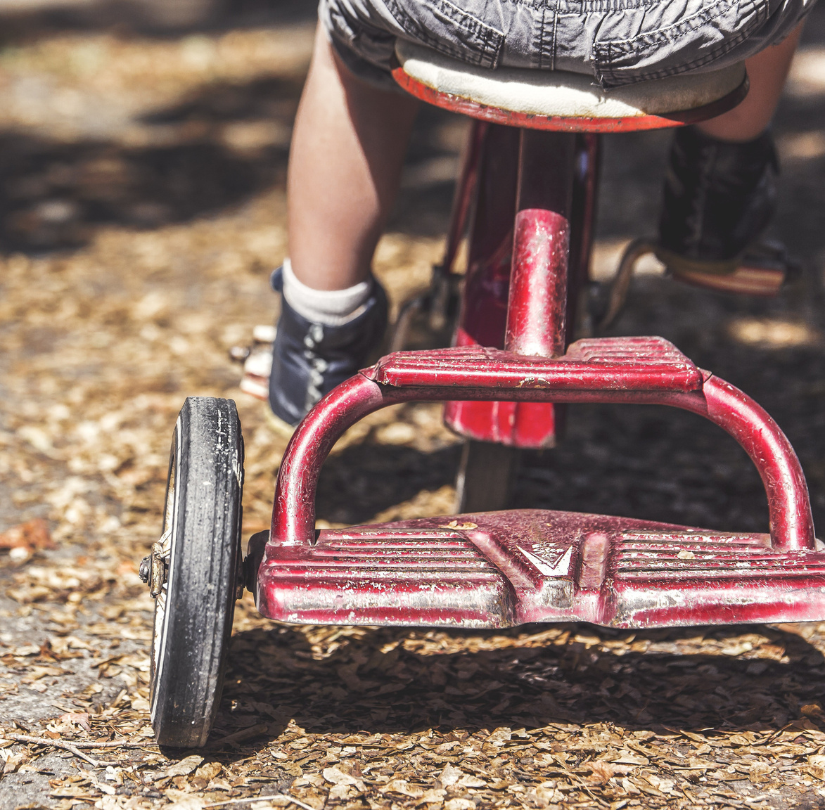
Physical Therapy (PT)
  develop gross motor skills
  improve coordination
  improve balance and stability
  assist with motor planning
  build play skills
Image by soledadsnp (Pixabay)
Notes:
Physical therapists are trained to treat problems with movement and posture. PTs tend to focus on:
developing gross motor skills (movements that involve the larger muscles of the arms and legs).
PTs can help children with autism who have difficulties with coordination,
balance and stability, or
motor planning move about their environment and
participate in play and recreational activities more effectively. (26 sec.)

Slide 28
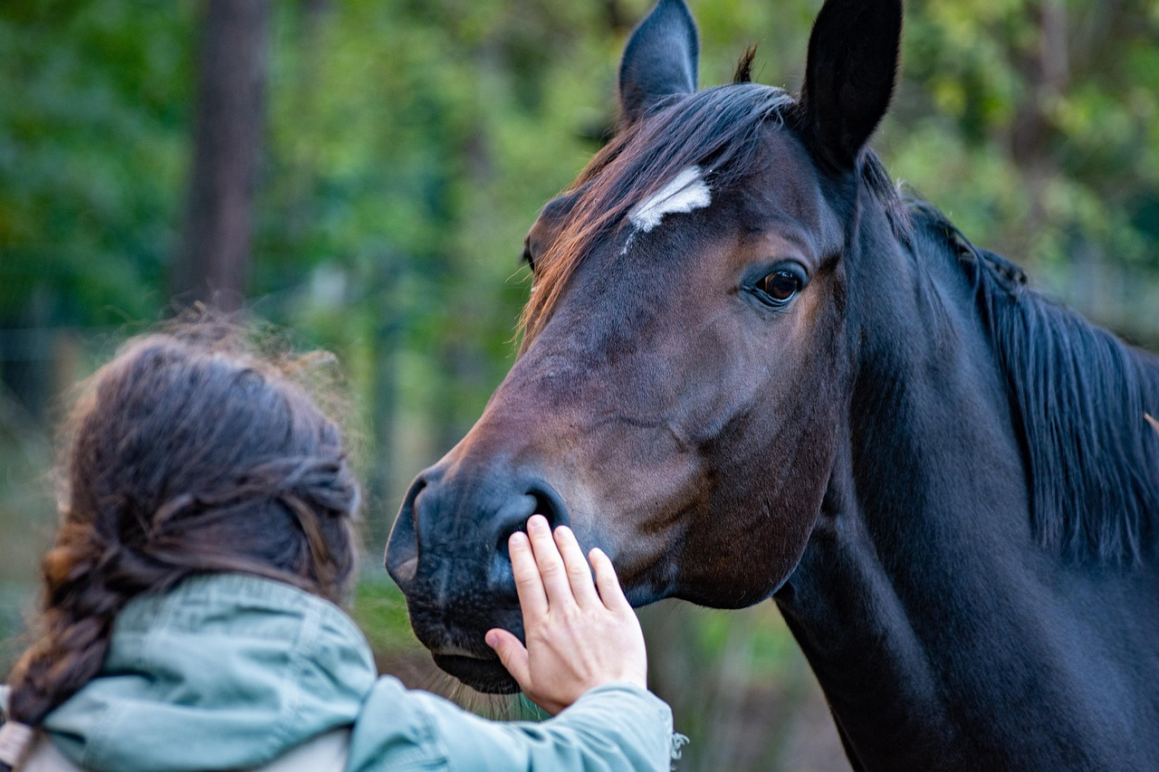
Recreational Therapy (RT)
  reduce behavioral and emotional disorders
  develop social skills and
build relationships
  improve physical and
mental health
  develop interests
Image by wal_172619 (Pixabay)
Notes:
Participation in recreational programs has shown extensive benefits for children with autism. It can:
reduce behavioral and emotional disorders,
help develop social skills and build relationships,
improve physical and mental health, and
help children develop interests.
(15 sec.)

Slide 29
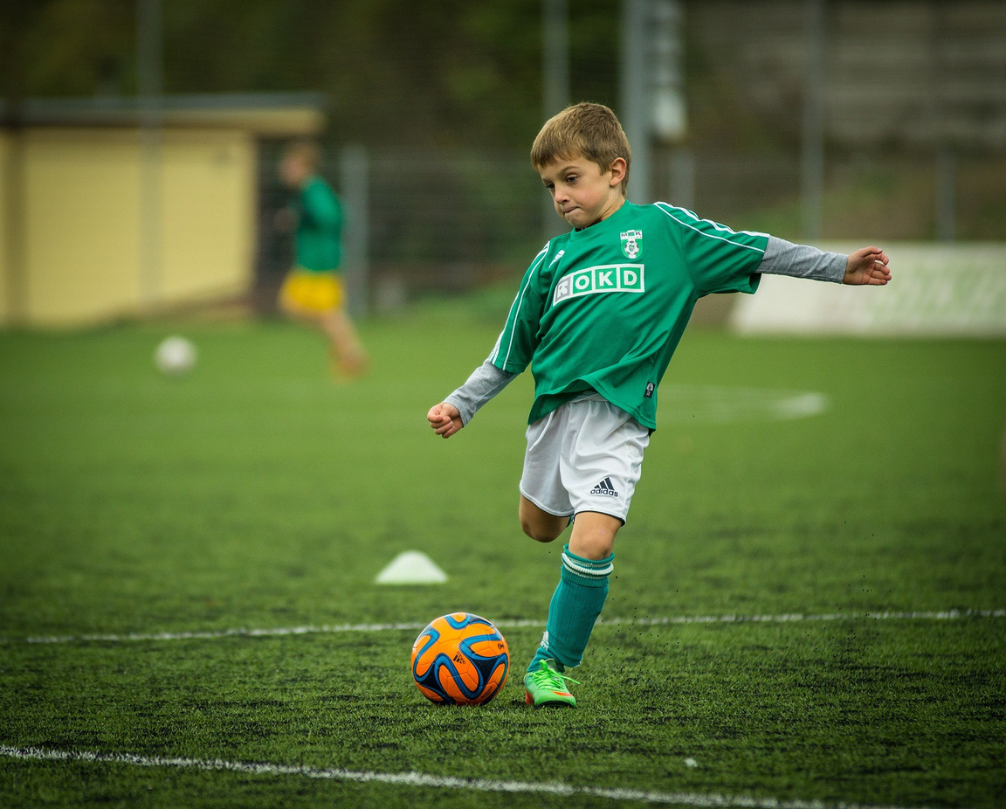
Types of RT Activities
  music therapy
  arts and crafts
  therapeutic yoga, gymnastics, karate, dance
  aquatic therapy or swimming
  adapted team sports
  animal assisted interventions AAI)
Image by bottomlayercz0 (Pixabay)
Notes:
Many different types of therapeutic recreational activities exist today, serving the unique needs of participants.
You can see them listed on the screen...
There are many animal assisted interventions including horses, donkey, rabbits, dogs and more. (15 sec.)

Slide 30
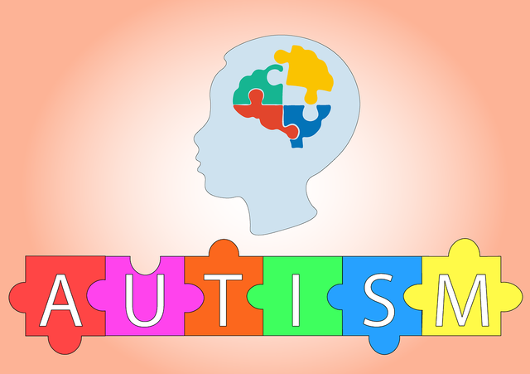
seizures
Associated Medical Diagnoses
sleep concerns
gastrointestinal difficulties
Image by Pixabay.
Notes:
Individuals with autism may be more likely to have related medical conditions, including seizures, sleep problems, and gastrointestinal issues. Depending on a pediatrician’s assessment, specialists in these areas may be important members of a child’s care team. (16 sec)

Slide 31
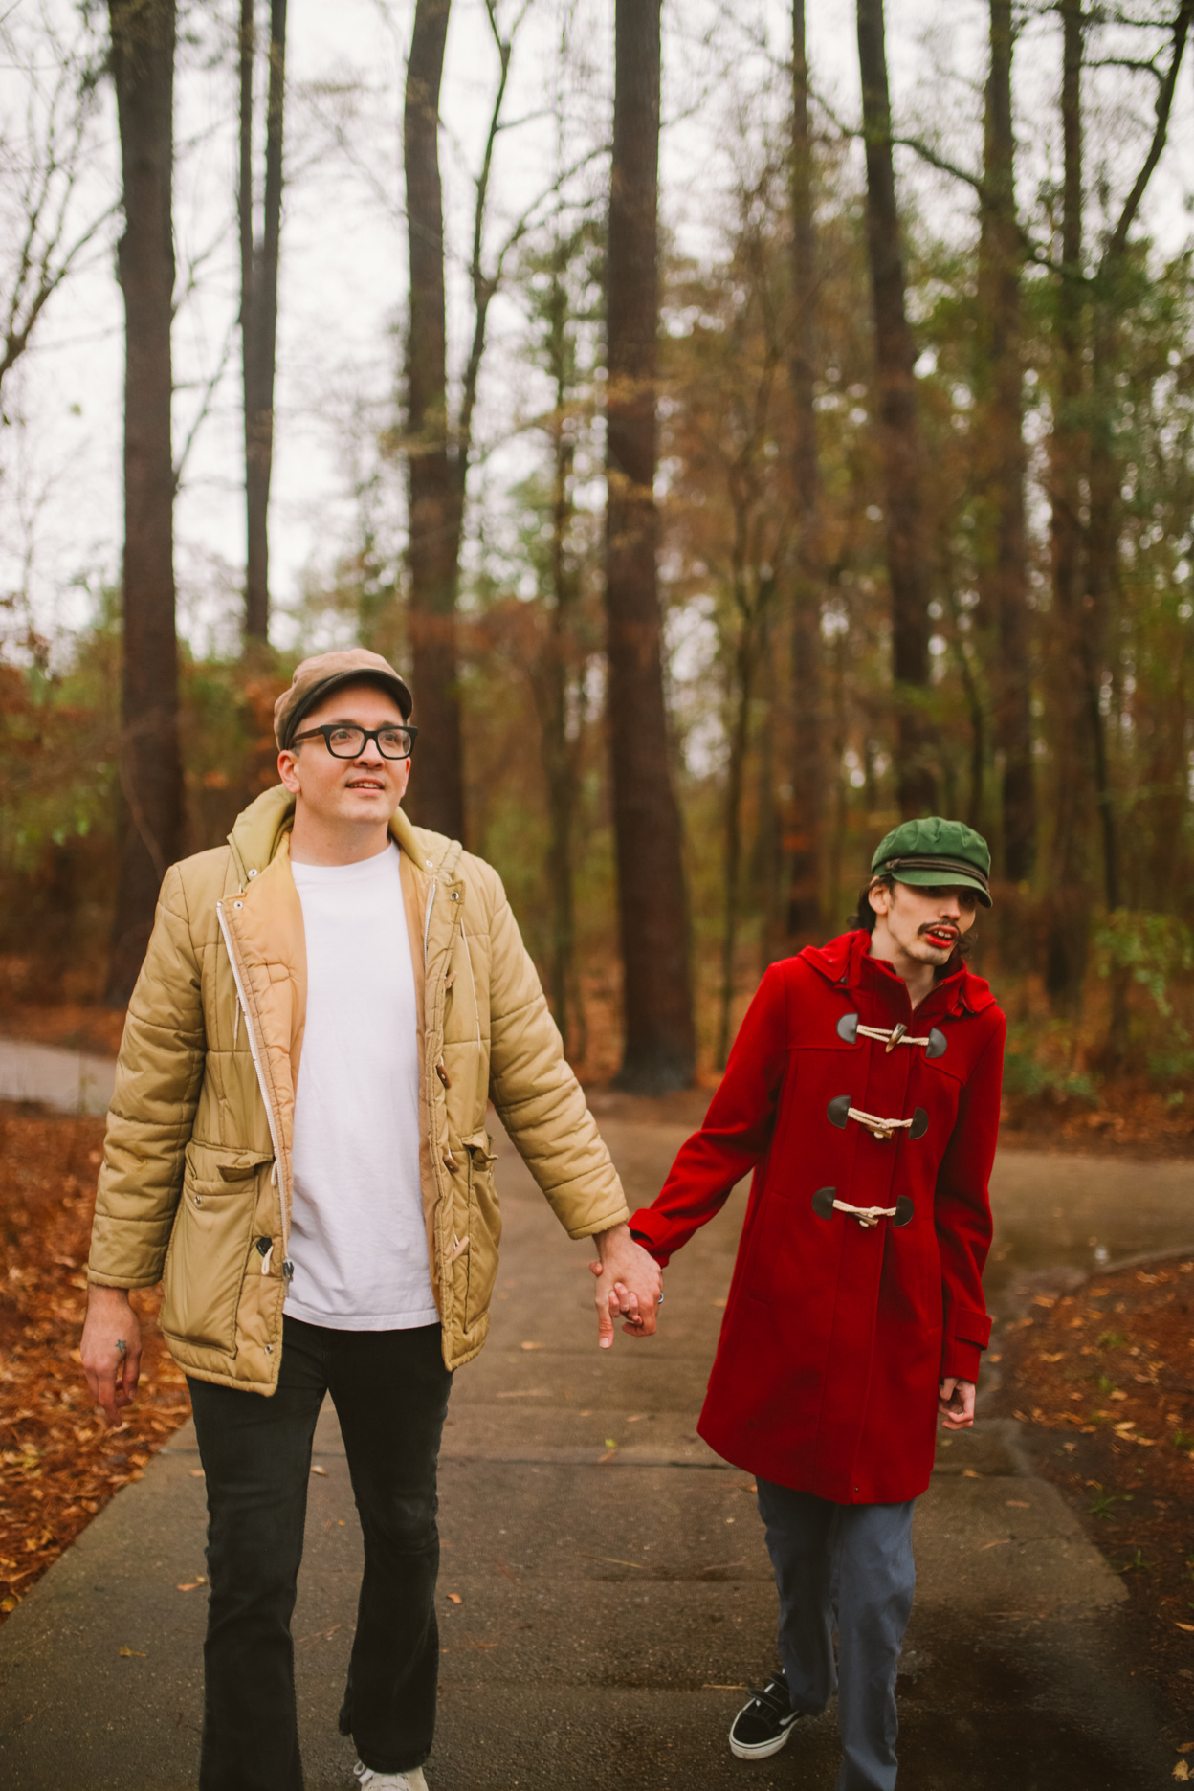
Transitioning to Adulthood
  build independent living skills into education plan early
  familiarize with organizations they will be dealing with in adulthood--AIDD and RSA
Image by Canva
Notes:
Transitioning to adulthood is often one of the biggest challenges for families of autistic children. Independent living skills should be included in the education plan early to help prepare students for work, college, or living on their own.
Autistic students and their advocates should learn about adult-service organizations, including the Administration on Intellectual and Developmental Disabilities (AIDD) and the Rehabilitation Services Administration (RSA), to better navigate supports and negotiations after age 22.
(31 sec)

Slide 32
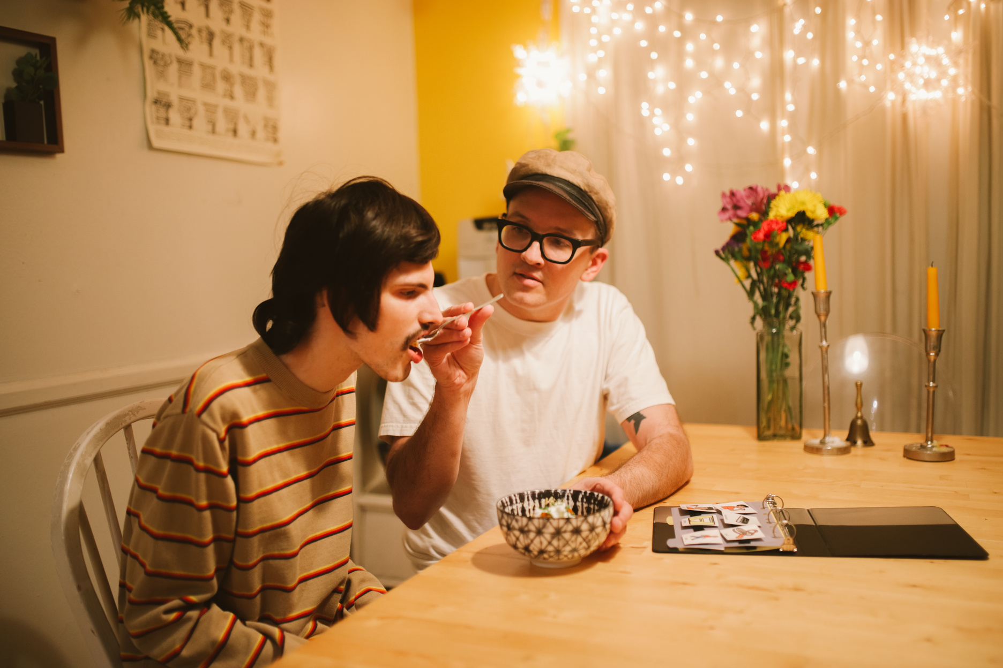
Gap in Services
  40-60% of adults with disabilities were enrolled in Medicaid waiver programs
  adults with autism have lowest enrollment
  demand exceeds access
Image by Canva
Notes:
Parents should anticipate gaps in adult autism services. A 2024 Disability and Health Journal paper found that only about 40 to 60 percent of adults with intellectual and developmental disabilities nationwide were enrolled in Medicaid waiver programs, which help them live in the community. Enrollment was lowest among autistic adults, reflecting that demand far exceeds available access. (24 sec.)

Slide 33

Financial Limitations
  save money from beginning
  apply for SSI and Medicaid
  open an ABLE account
  create a special-needs trust
  explore advocacy organizations
  waiting list for the Housing Choice Voucher program (HCV)
Image by Canva
Notes:
It is important to understand the financial limits of disability service systems.
Families should begin saving as early as possible.
Students with autism should apply for Supplemental Security Income (SSI) and Medicaid as soon as they are eligible.
They may also use an Achieving a Better Life Experience (ABLE) account or special-needs trust without losing SSI or Medicaid benefits.
Parents should consult advocacy organizations, such as The Arc of the United States or the Autism Society of America, to learn about legal rights and financial regulations.
If supported housing is an adulthood goal, families should join the Housing Choice Voucher Program, also known as Section 8, waiting list as early as possible to access low-income housing. (50 sec)

Slide 34

College-Bound
Students
  may have to advocate for their own accommodations
  many colleges have programs to provide accommodations and supports
Image by Canva
Notes:
College-bound students with autism should understand that they may need to request their own accommodations after high school.
Many colleges offer programs that provide accommodations and support, especially for students who had an Individualized Education Program (IEP) in high school. Some postsecondary programs also support autistic students with greater needs while promoting meaningful academic and social college experiences.
(25 sec)

Slide 35
Activity 2: Community Awareness Activity
1. Divide into groups of 4 to 5 people.
2. Group purpose: to discuss possible community activities or
events to support individuals with autism or families with
members with autism.
3. Select a recorder who will write down the ideas on newsprint.
4. Select a reporter who will share the small group ideas with the
larger group.
5. Be ready to share ideas with your small group and large group!
Notes:
The instructions for activity 2 are on the screen…let’s read through the instructions first and then we will move into groups or teams.
1. Divide into groups of 4 to 5 people.
2. Group purpose: to brainstorm and discuss possible community activities or events to support individuals with autism or families with autistic members.
3. Select a recorder who will write down the ideas on newsprint.
4. Select a reporter who will share the small group ideas with the larger group.
5. Be ready to share ideas with your small group and large group! (15 minutes in entirety)

Slide 36
Activity 2: Community Awareness Activity
Community awareness initiatives are actions taken by
individuals or groups to raise awareness about a certain
issue, cause, or problem that affects the community.
These initiatives can take various forms, such as
campaigns, events, workshops, seminars, publications, or
online platforms. The main goal of community awareness
initiatives is to drive social change by informing,
educating, inspiring, and mobilizing the community to
take action, to make a difference in your local community.
Notes:
Handout for Activity 2: Community Awareness Activity
Community awareness initiatives are actions taken by individuals or groups to raise awareness about a certain issue, cause, or problem that affects the community. These initiatives can take various forms, such as campaigns, events, workshops, seminars, publications, or online platforms. The main goal of community awareness initiatives is to drive social change by informing, educating, inspiring, and mobilizing the community to take action, to make a difference in your local community.

Slide 37

Image by Canva
Notes:
Are there any questions?
Are there any comments?
(37 min. 23 sec estimated time before questions.)

Slide 38

Image by Canva
Notes:
Thank you for listening and participating!

