Slide 1


Introducing the
2026 State and National FCE
Essay Contests
By Scott Teeples – Oregon FCE President
9-3-25

Slide 2


Today we will discuss the following FCE Essays:
2026 2nd Grade Essay and Artwork Contest
2026 3rd Grade Essay and Artwork Contest
2026 4th Grade Essay and Artwork Contest
2026 High School Age Essay Contest

Slide 3



2026 2nd and 3rd Grade Essay and Artwork Contests

Slide 4
The 2nd and 3rd Grade Essay and Artwork Contests are currently only offered in Oregon (North Dokata?)
These are a “State Only” Essay and Artwork Contests. Currently there it is NOT a National 2nd and 3rd Grade Contest
The 2nd Grade Contests and the 3rd Grade Contest are separate contest
The yearly theme for the 2nd and 3rd Grade Essay and Artwork contest is the same each year which is “What do I love most about living in Oregon”

Slide 5



Contestants write an essay on the theme and draw artwork depicting what the theme means to them.
Contestants can do the contest at school, home or any other place.
Winners and placers of the contests are awarded a certificate and monetary award at the County and State level.
Complete rules can be located on the Oregon FCE website https://www.oregon-fce.org/

Slide 6
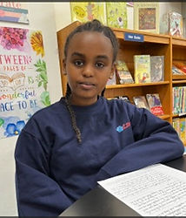
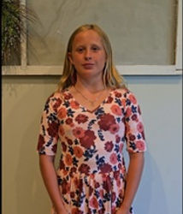
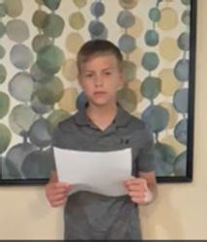
2026 4th Grade Essay and Artwork Contest
2025 - 1st Place National FCE
2025 - 2nd Place National FCE
2025 - 3rd Place National FCE

Slide 7

The 4th Grade Essay and Artwork Contest is both a State and National Contest
The yearly theme for the 4th Grade Essay and Artwork contest changes each year.
The theme for the 2026 4th Grade Essay and Artwork Contest is “Respect”
Each state sets their own deadline for submission.
The deadline to submit the State winner to National FCE is April 15, 2026.

Slide 8
Contestants write an essay on the 2026 theme of “Respect” and draw artwork depicting what the theme means to them.
Contestants can do the contest at school, home or any other place.
Winners and placers of the contests can be awarded a certificate and monetary award at the County and State.
Winners and placers are awarded a certificate and monetary award at the National level.

Slide 9
Complete rules can be located on the State and National FCE 4th Grade Essay and Artwork Contest can be found on the National FCE website https://www.nafce.org/resourcelibrary
The theme for the 2025 4th Grade Essay and Artwork Contest was “Trustworthiness”
Pictures of the placers, essays, and pictures of the artwork can be found on the National FCE website at https://www.nafce.org/2025-essay-and-art-work-winners

Slide 10
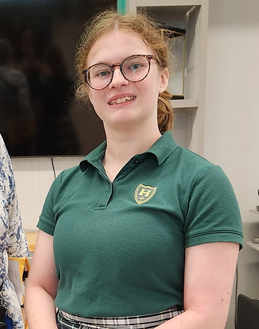
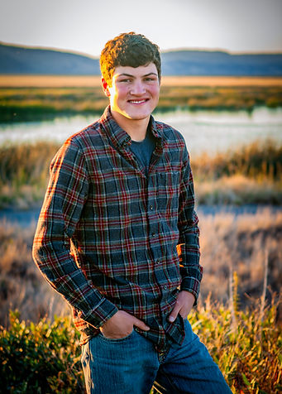
2026 High School Age Essay and Artwork Contest
2025 – 1st Place National FCE
2025 – 2nd Place National FCE

Slide 11

Throughout the years there have been discussions across the USA about producing some way of involving and introducing young adults into the National Association for Family and Community Education (FCE).

Slide 12
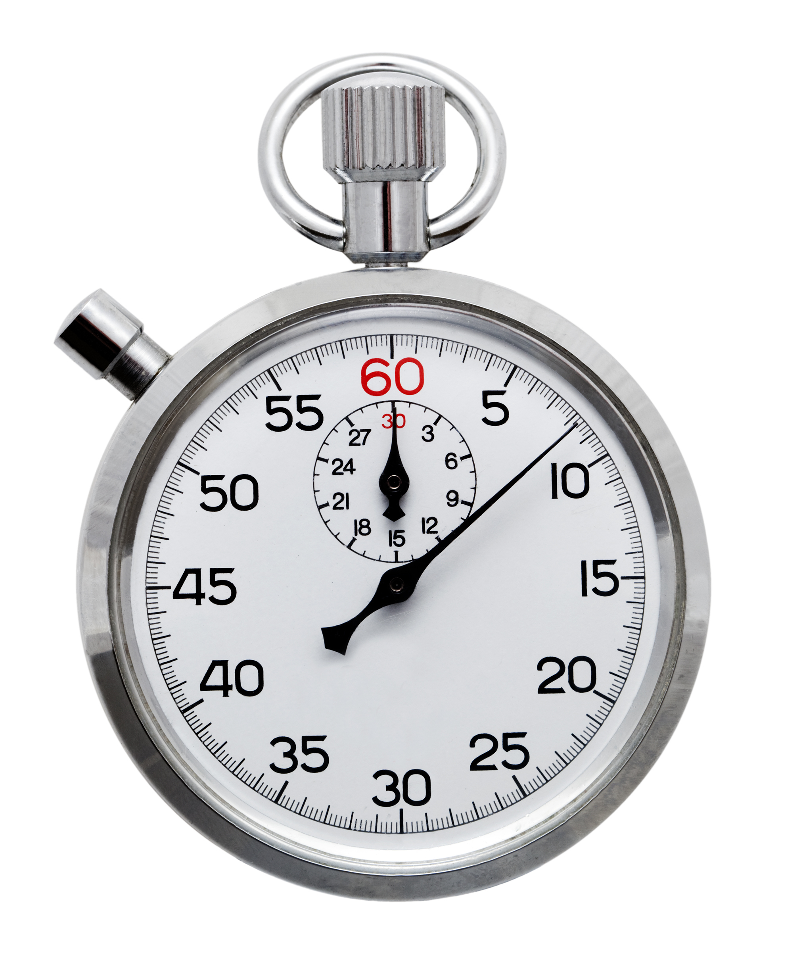

It was way past time to introduce and invite young adults into FCE. Something needed to be done.

Slide 13


Oregon FCE came up with a means of making it happen.
Throughout the years, 4th grade students were introduced to FCE through the National 4th Grade Essay and Artwork contest, but nothing for young adults…

Slide 14


Oregon FCE sponsored the first High School Age Essay
Contest in 2024 and proposed that it become a National Contest.
The National FCE Board approved it and it became a State and National Contest in 2025

Slide 15

All of the forms and information for the 2025 National FCE High School Age CHARACTER COUNTS!® Essay Contest can be located on the National FCE website https://www.nafce.org/resourcelibrary

Slide 16

These are generic forms and will need to be formatted for each State Contest. Instructions for editing the generic forms are also located on the website. You can see a formatted, and completed, contest form for Oregon FCE at www.oregon-fce.org.

Slide 17
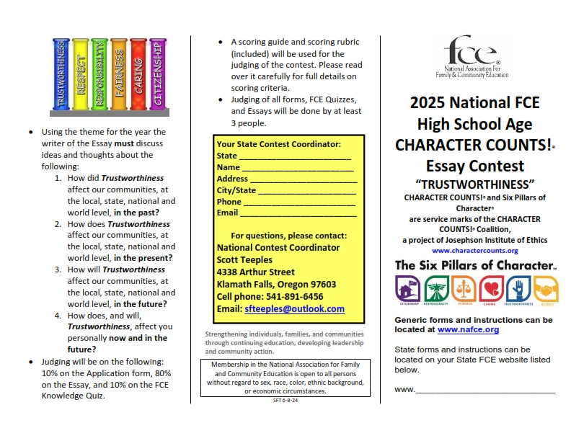
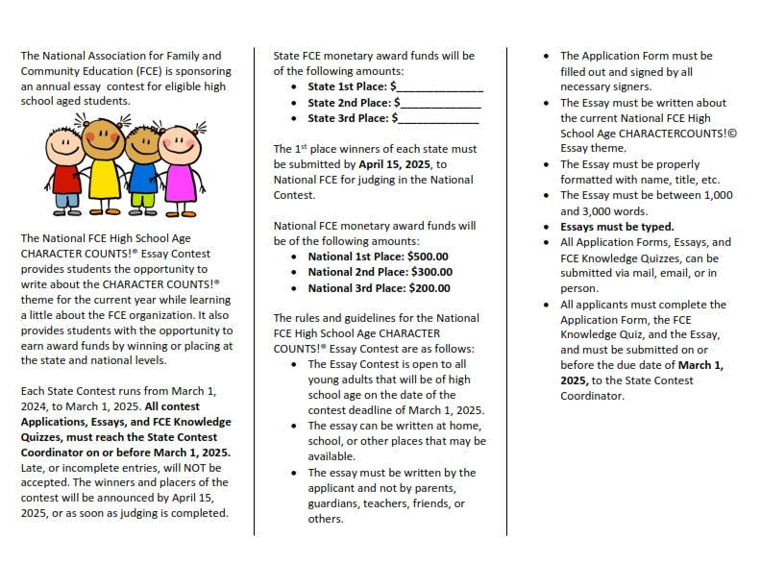
Two brochures relating to the contest are available including the National FCE “Generic” version and the Oregon FCE version. https://www.oregon-fce.org/hs-age-essay-contests https://www.nafce.org/resourcelibrary

Slide 18

The National FCE High School Age Essay Contest provides students the opportunity to write about the theme for the current year while learning a little about the FCE organization.
It also provides students with the opportunity to earn award funds by winning or placing at the state and national level

Slide 19

The High School Age Essay Contest themes are the following for each year.
2026 Respect
2027 Responsibility
2028 Fairness
2029 Caring
2030 Citizenship
2031 Trustworthiness

Slide 20

The rules and guidelines for the National, and State, FCE High School Age Essay Contest are as follows:
The Contest is open to all young adults that will be of High School age on the State Contest date deadline of March 1, 2026.
The essay can be written at home, school, or other places that may be available.
The essay must be written by the applicant and not by parents, guardians, teachers, friends, or others

Slide 21
The Application Form must be filled out and signed by all necessary signers.
The Essay must be written about the current National FCE High School Age Essay theme.

Slide 22


The Essay must be properly formatted with name, title, etc.
The Essay must be between 1,000 and 3,000 words.
Essays must be typed.

Slide 23

2026 High School Age Essay Instructions
Using the theme for the 2026 Contest (Respect), the writer of the Essay must discuss ideas and thoughts about the following:

Slide 24

2026 High School Age Essay Instructions (cont.)
1.How did Respect affect our communities, at the local, state, national and world level, in the past?

Slide 25


2026 High School Age Essay Instructions (cont.)
2.How does Respect affect our communities, at the local, state, national and world level, in the present?

Slide 26


2026 High School Age Essay Instructions (cont.)
3.How will Respect affect our communities, at the local, state, national and world level, in the future?

Slide 27


2026 High School Age Essay Instructions (cont.)
4.How does, and will,
Respect, affect you personally now and in the future?

Slide 28

2026 High School Age Contest Judging and Scoring
• Judging will be on the following: 10% on the Application form, 80% on the Essay, and 10% on the FCE Knowledge Quiz.

Slide 29

High School Age Contest Judging and Scoring (cont.)
• A scoring guide and scoring rubric
(included) will be used for the judging of the contest. Please read over it carefully for full details on scoring criteria.

Slide 30



Contest Judging and Scoring (cont.)
• Judging of all forms, FCE Quizzes, and Essays will be done by at least 3 people.

Slide 31
High School Age State Essay Contest
(Name of State) Association for Family and Community Education
Each State FCE Contest runs from April 1, 2025, to March 1, 2026. All State contest Applications, Essays, and FCE Knowledge Quizzes, must reach the State Contest Coordinator on or before March 1, 2026. (Suggested deadline) Late, or incomplete entries, will NOT be accepted.

Slide 32



The State winners and placers of the State contest will be announced by April 15, 2026, or sooner if judging is completed.
All Application Forms, Essays, and FCE Knowledge Quizzes, can be submitted via mail, email, or in person to the State Contest Coordinator

Slide 33
State Contest Coordinator
Name ________________________________________
Mailing address ______________________________
City ________________________________________ State ________ Zip ______
Phone number _______________________________
Email________________________________________
**(Each state must provide their own Contest Coordinator)

Slide 34
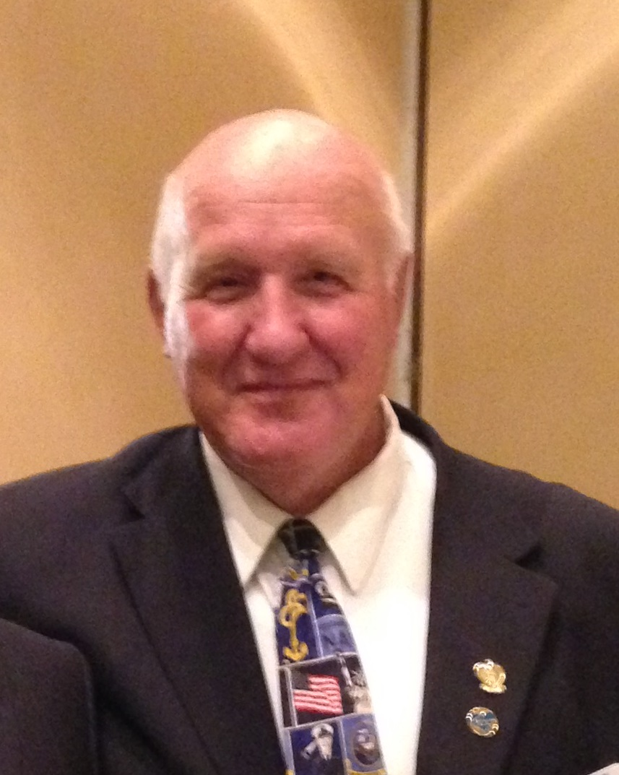

Contact your State Contest Coordinator or Scott Teeples, National Contest Coordinator, email: sfteeples@outlook.com, phone: 541-891-6456 if you have any questions.

Slide 35
State FCE monetary award funds will be of the following amounts:
• State 1st Place: $ __________ (check with each state for amount)
• State 2nd Place: $ __________ (check with each state for amount)
• State 3rd Place: $ __________ (check with each state for amount)

Slide 36
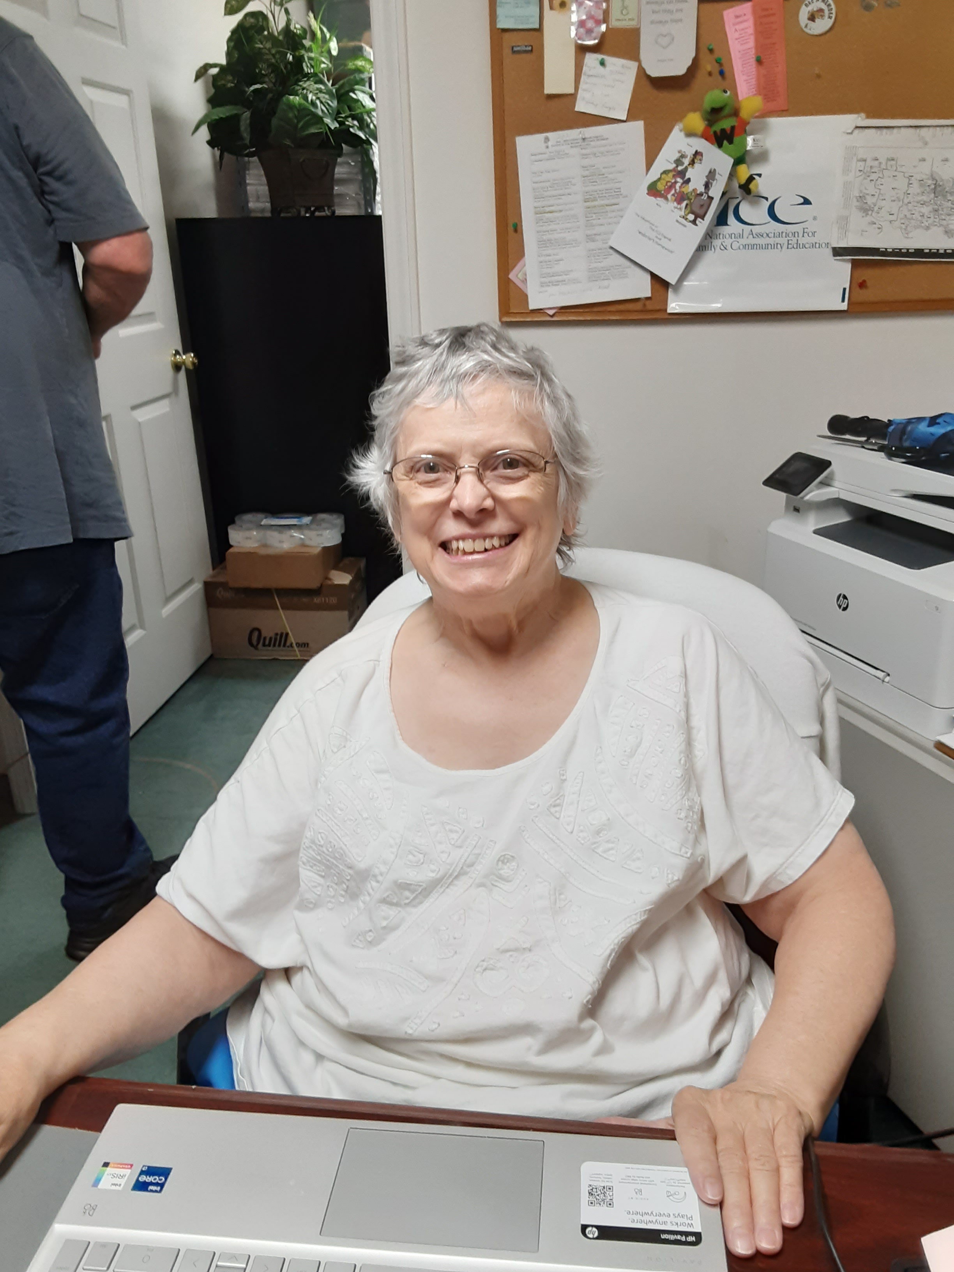
All 1st Place State winners, with completed forms must be submitted to National FCE Headquarters on or before
April 15, 2026.
Judy Jones, National FCE Headquarters Secretary

Slide 37

2026 High School Age National Essay Contest
The rules and guidelines for the National (and State) FCE High School Age Essay Contest, other than due dates, are the same.
National FCE monetary award funds ** will be of the following amounts:
• National 1st Place: $500.00
• National 2nd Place: $300.00
• National 3rd Place: $200.00

Slide 38

** Award funds will be donated by Keeper’s Corner LLC – Antique, Craft and Collectible Mall – located in Klamath Falls, Oregon; Bonnie and Scott Teeples – plus donations from others, when given. National FCE funds will not be used.
Donations to NaFCE for this contest are gladly accepted.

Slide 39

FCE Knowledge Quiz (10% of contest)
(to be filled out, answered, and submitted by contestant)
This FCE Knowledge Quiz, along with the Application, the Essay, and other necessary forms must be submitted on or before March 1, 2025 (suggested deadline) to the State Association Coordinator.

Slide 40

Information to answer these questions can be located on the National FCE website www.nafce.org. Contestants can also use any internet resources, ask FCE members, friends, family or whoever for information. (This is an “open book” quiz).
A 2026 FCE High School Age Essay Knowledge Quiz – Help Sheet will be available.

Slide 41
High School Age FCE Knowledge Quiz Questions:
1. What does the acronym FCE stand for?
FCE

Slide 42
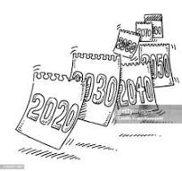
High School Age FCE Knowledge Quiz Questions:
2. In what year was the National FCE organization and your State FCE organization organized? (If your state does not have FCE, write “NA.”)
National organization ___________
State organization ______________

Slide 43

High School Age FCE Knowledge Quiz Questions:
3. Who was the first president of National FCE? Who is the current president of National FCE?
Who is the current president of your State FCE? (If your state does have FCE, write “NA.”)
First National President __________________
Current National President ________________
Current State President __________________

Slide 44

High School Age FCE Knowledge Quiz Questions:
4. Write the National FCE Mission Statement.

Slide 45

High School Age FCE Knowledge Quiz Questions:
5. Write the National FCE Creed.

Slide 46
High School Age FCE Knowledge Quiz Questions:
6. What are 6 things that FCE does?
A.
B.
C.
D.
E.
F.

Slide 47
High School Age FCE Knowledge Quiz Questions:
7. What is the name of the yearly National FCE Contest that is designed and held for 4th grade students?

Slide 48
High School Age FCE Knowledge Quiz Questions:
8. Where was the 2025 National FCE Conference held?
City _________________, State ________

Slide 49
High School Age FCE Knowledge Quiz Questions:
9. What is the name of the 2025, High School Age Essay and Contest Winner and what state did they come from?
Name _______________________________
State ________________________________

Slide 50
High School Age FCE Knowledge Quiz Questions:
10. List 6 states that currently have FCE.
A.
B.
C.
D.
E.
F.

Slide 51
The theme for the 2025 High School Age Essay Contest was “Trustworthiness”
Essays, pictures, and videos of the National Contest placers can be found on the National FCE website at https://www.nafce.org/2025-high-school-essay-winners

Slide 52
Please contact Scott Teeples, 2026 National FCE High School Age Essay Contest Coordinator, Phone/Text: 541-891-6456; Email: sfteeples@.outlook.com or sfteeples@charter.net, if you have any questions.
You can also contact him if you have questions about the 2nd Grade, 3rd Grade, or 4th Grade Essay and Artwork Contest.

Slide 53
Thank You
Questions
or
Comments?

