Slide 1
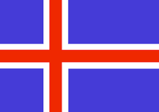
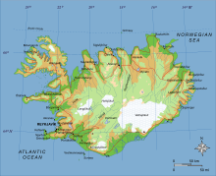
Iceland Land of Fire and Ice that Kisses the Artic Circle
Original written version developed by:
Anne Engen and Sally Wyffels
PowerPoint version developed by:
Scott Teeples
5-14-18

Slide 2
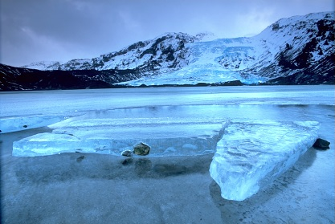
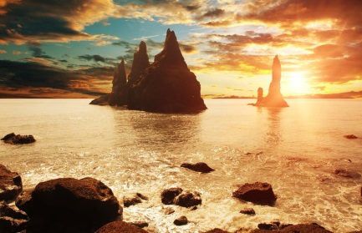
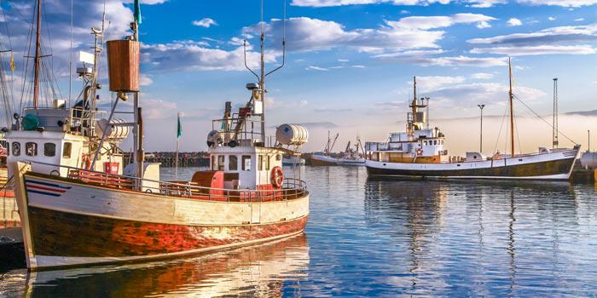
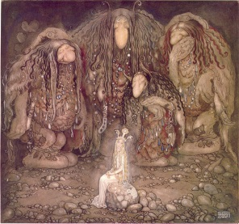
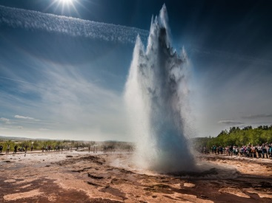
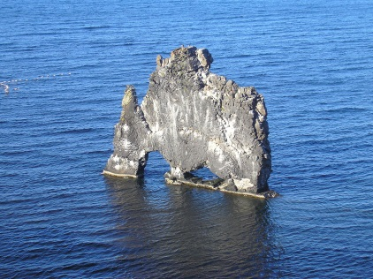
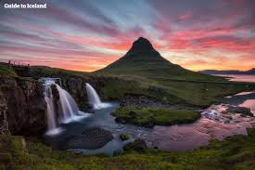
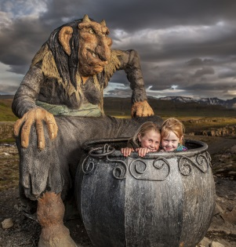
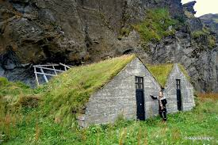
Iceland is a land of geysers, glaciers, volcanoes, and rough hewn coastlines. A landscape full of legends and where the Northern Lights shine. An island country with poor soil, few forests and isolated from the rest of the world.

Slide 3
Iceland on the World Map

Slide 4
Iceland kissing the Artic Circle

Slide 20
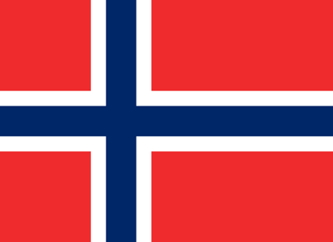
They've been ruled by the King of Norway, the King of Denmark, lost 1/3 of their population to the Black Plague, later lost another 1/3 to Bubonic Plague, then more to a small pox outbreak.

Slide 21
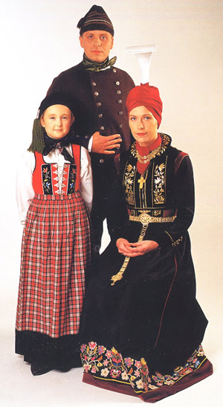
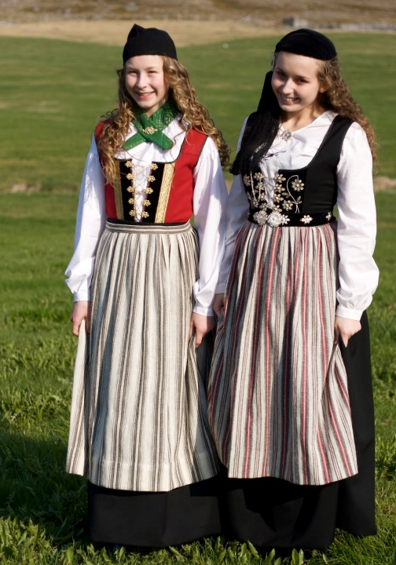
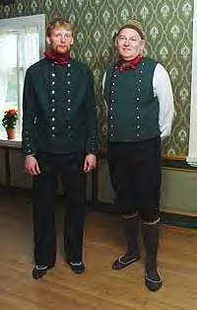
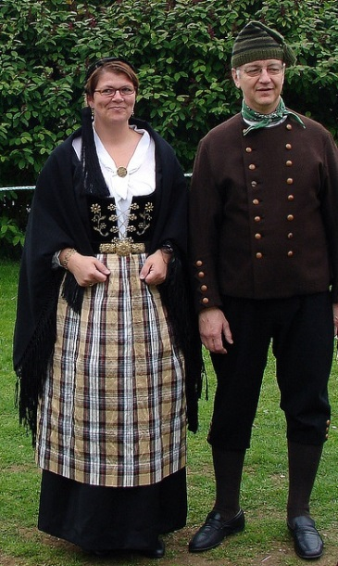
YET, this little country is known for having some of the happiest people in the world, plus some of the healthiest. What makes this country so amazing?

Slide 22
Iceland
Trivia Quiz

Slide 23
Iceland Trivia Quiz - Answers
1. (True or False) Iceland is about the same size as the state of Oregon.
Answer is False. Iceland can fit inside Oregon with room to spare. Oregon is 2 1/2 times larger than Iceland. Its about size of Kentucky. Reykjavik is the capital city.

Slide 24
2. Why are Icelanders’ heritage 60% ___________ and 40% ___________ ?
Icelandic people are 60% or more Nordic, Norse or, Viking and 40% Scottish and Irish. Vikings rowing small boats in good weather could reach Iceland in a week, harsh weather would take longer. They could detour to stop in Scotland or Ireland to take hostages. Settlers brought their language - Old Norse - from Norway, which has evolved into modern Icelandic.

Slide 25
3. Iceland has ______ active and inactive volcanoes, but only ______ active ones.
Iceland has 130 active and inactive volcanoes, but the county is in the middle of or on top of two tectonic plates and has 30 active volcanic systems running through the island.

Slide 26
4. Iceland has no real highways except to the _____________.
Iceland has no real highways except to the Keflavik Airport.

Slide 27
5. __________________________ is related to most Icelanders through Dutch and Norwegian Royalty.
Donald Trump is related to most Icelanders through his Dutch and Norwegian Royalty.

Slide 28
6. From late June to early July Iceland has “midnight sun” which means ___________________________.
From late June to early July Iceland has 'midnight sun' which means 24 hours of sun light. In December they endure 22 hours of darkness and 2 hours of twilight.

Slide 29
7. In August the average temperature is _________________. In January the highest average is 36 degrees, lowest average is 18 degrees.
In August the average temperature is 50 to 55 degrees. In January the highest average is 36 degrees, lowest average is 18 degrees. Iceland has a maritime temperate climate - snow, sleet, hail, rain and often high winds.

Slide 30
8. Who are the 'huldu folk' and why did people build them small wooden houses? Even built small churches to convert them to Christianity.
Huldu Folk means hidden people, and are elves and trolls, part of Icelandic legends. Large fallen rocks in fields are said to be frozen trolls. The smell present in Iceland isn't from sulfur at all - its the smell of the trolls dirty bath water. Of coarse this is said with a sly smile and a wink.

Slide 31
Small Wooden houses for 'huldu folk'

Slide 32
9. (True or False) Iceland has been ocupied by British troops and US troops.
Answer is True. Iceland has been occupied by both British troops and U.S. troops. Iceland has no military of its own, but played a big part in WWII.

Slide 33
10. (True or False) The capital, Reykjavik, has a Phallological Museum.
The answer is True. The capital, Reykjavik has many interesting museums among them is the Icelandic Phallological Museum. There you will find a collection of over 200 penises from almost all of the land and sea mammals in Iceland. Including sixteen types of whales, seven types of seals and walruses, a polar bear and one homo sapiens.

Slide 36
Phallological Museum

Slide 37
Phallological Museum

Slide 38
Phallological Museum

Slide 39
Phallological Museum

Slide 40
The Occupation of Iceland During World War II and Beyond
Small quiet Iceland was an independent sovereign nation ruled by the King of Demark.
It had no military, but the capital was the biggest city and had 70 police officers.

Slide 41
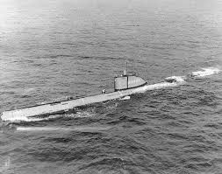
But who had their sites set on Iceland? And why? Great Britain and the United States knew the ships and convoys crossing the north Atlantic needed protection from German submarines.
Also a large airfield should be built on the island.
Life in Iceland is about to change.

Slide 42
September 1939: Germany invades Poland. German sub sinks passenger ship near Ireland.
April 1940: German soldiers march into neutral Demark, government is overthrown.
Britain offers Iceland help, but will need houses and buildings. Iceland says NO.
Iceland declares independence from Denmark, asks United States for recognition.

Slide 43
May 6, 1940: Winston Churchill insists the British military land in Iceland anyway.
May 10, 1940: Four British warships anchor in the harbor of Iceland's capital.
Soldiers disabled radio communications. German citizens arrested to delay news leaks.

Slide 44
Iceland's Prime Minister tells people not to interfere with the troops, treat them as guests.
Icelandic government says its neutrality has been "flagrantly violated". British promise compensation and will not interfere in
Icelandic business and to leave at war's end.
Same day, Germany invades France, Belgium, Luxembourg and the Netherlands

Slide 45
June 1940: Norway surrenders to Germany.
July 7, 1941: British troops leave Iceland as they are now needed to defend Great Britain.
Iceland invites United States to protect their country.
There are now more soldiers in Iceland than all the adult Icelandic men.

Slide 46
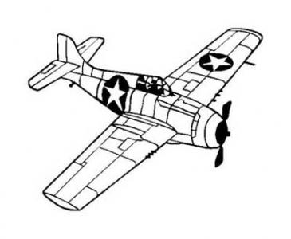
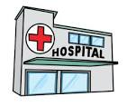
Iceland asks for American financial assistance for road, bridge and public maintenance.
People are put to work helping the soldiers build airstrips, bigger ports and a hospital.
October 1941 - October 1942: Troops working with Icelanders battle heavy seas, high winds, and constant rain to unload tons of cargo and vehicles in months of darkness.

Slide 47
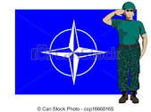
June 17, 1944: Iceland becomes a republic. 1945: US troops leave. 1949: Iceland joins NATO
During occupation 332 Icelandic women marry soldiers, one of them, Sjofn (Shep) Fridsteindottir.
1951: United States accepts NATO agreement to be responsible for the defense of Iceland.

Slide 48
2006: U.S. troops leave Iceland, threat shifted away from North Atlantic.
Now: U.S. reopening its former Icelandic military base Keflavik. Its midway between U.S. and Europe for patrolling waters off Great Britain, Ireland, Iceland and Greenland.

Slide 49
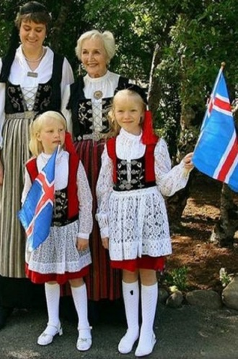
Icelandic National Costume
Icelandic costume is collectively know in Iceland as Pjoobuningurinn, has enjoyed popularity since the 19th century during the fight for independence. Since 2001 the national costume is regulated by the National Costume Authority. It preserves the correct techniques of making them and instructs people how to wear each costume.

Slide 50
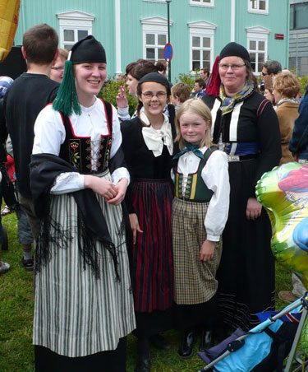
Women’s Costume
The peysufot are black woolen clothes commonly worn by women. It usually consisted of a twill skirt and a jacket of fine knitted woolen yarn with a black tail cap. It is believed that article of clothing was invented when women, desiring simpler working clothes, started to use male articles of clothing.

Slide 51
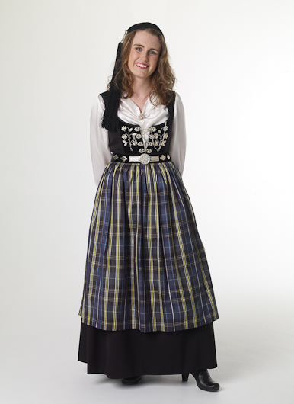
This includes both the tail-cap and the peysa which originally was a jacket with a single row of buttons. The Upphlutur, the bodice, can be colored in bright colors such as red, blue or often black all in woolen fabric.

Slide 52
Women in Traditional Costume

Slide 53
Women in traditional Costume

Slide 54
Men’s Costume
The most considered traditional costume consist of woolen breeches or trousers, a usually double buttoned vest and a double buttoned jacked called Treyia. On the head is a tail cap. The costume is usually black, navy blue or dark green, although the vest, which is usually brighter such as red. In some regions the use of white wool instead of the dark colors.

Slide 55
Men in Traditional Costume

Slide 56
Men in Traditional Costume

Slide 57
Children’s Costume
For the child, their costumes do not differ from the adult’s version (except in size). The girls are given shorter skirts than the adult version.

Slide 58
Man & Woman in Traditional Costume

Slide 59
A Family in Traditional Costume

Slide 60
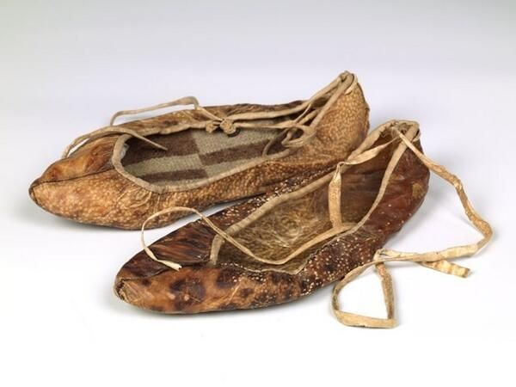
Shoes
Today modern shoes may be worn with the National Costumes. Traditionally, shoes were made of either fish or sheep-skin with woolen inlets and worn with the costume.

Slide 61
Icelandic Traditions and Folklore
Icelanders have several unique holidays and celebrate the more common ones in special ways. Many of the festivities are related to ancient Norse traditions, while others tie into the Christian calendar. There are numerous festivals that take place throughout the years. A few of these are…

Slide 62
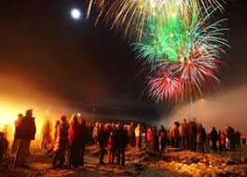
Christmas time to the Twelfth Night
During their Christmas celebrations Icelanders, decorate the interior and exterior of their homes extensively with lights of many colors, in an effort to brighten up the dark winter days and nights.

Slide 63
Traditionally, Icelanders observe a Christmas fast and end the fasting on December 23, St. Porakur’s Day. The Icelanders will eat putrefied shark to symbolize the ending of their fast. Shops are opened very late for the many who leave their Christmas buying frenzy until the last minute. For many, this signifies the beginning of Christmas.

Slide 64
Putrefied Shark

Slide 65
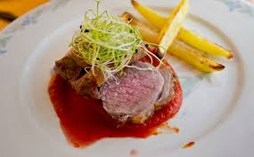
Christmas is celebrated on December 24th promptly at 6 pm in the evening. Traditional dishes include, smoked lamb and smoked pork and pickled red cabbage. Presents are opened after Christmas dinner, which is a fairly formal affair.

Slide 66
Instead of Santa Claus, Iceland has the 13 Yule Lads. These 13 Lads visit the fortunate Icelandic children over the 13 days of the Icelandic Christmas Season. The children place a shoe in their bedroom window every evening. During the night one Yuletide lad visits, leaving sweets and small gifts or rotting potatoes depending on how that particular child has behaved on the proceeding day. Each Yule Lad has a specific characteristic and will leave a gift to fit his characteristic.

Slide 67
The 13 Lads of Christmas

Slide 68
Old Icelandic folklore state that every Icelander must receive a new piece of clothing for Christmas or they find themselves in mortal danger. An enormous black cat prowls the Iceland on Christmas Eve. It eats anyone who doesn’t follow a simple rule of receiving a garment. This obnoxious feline is known as The Christmas Cat.

Slide 69
Icelandic Christmas Cat

Slide 70
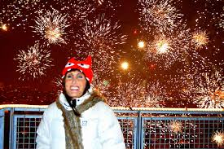
New Year’s Eve is celebrated with the gathering of family and friends at home and visits to the local bonfire. Most Icelanders buy their own fireworks an set them off at midnight to welcome in the New year.

Slide 71
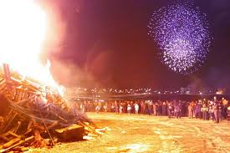
January 6th is celebrated as the last day of Christmas, the Twelfth Night. The occasion is marked by various fireworks displays and bonfires throughout the countryside.

Slide 72
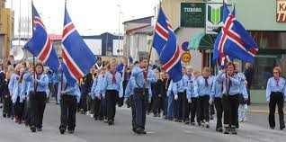
Icelandic Republic Day
Iceland’s National Day of Independence is June 17. It commemorates the creation of Iceland as a republic in 1944. The day is also the birthday of the country’s independence hero, Jon Sigurdsson.

Slide 73
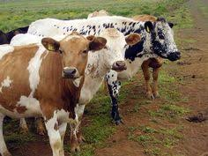
Midsummer Night
The longest day of daylight of the year, is endowed with great mystical powers. According to Icelandic folklore cows gain the power of speech for the night, and seals can take a human form. Surely a treacherous magical time. (Wonder what cows talk about?)

Slide 74
Elves and Trolls
Polls taken over the years have shown that the majority of Icelanders believe in elves. These elves usually live in rocky areas, have magical powers and cause trouble if someone tries to disturb their home. In some cases, bulldozers have been reported to malfunction when trying to work on a supposed elf site. This belief is so important that some people are actually called in to arbitrate with elves in the hopes of getting them to leave.

Slide 75
Icelandic Trolls

Slide 76
Icelandic Trolls and Elves

Slide 77
Elves and Trolls… frozen in time

Slide 78
One final troll, Gryla is the ogress who lives in the Icelandic mountains. She is a dreadful character, described as part troll and part animal and mother of 13 precocious boys (the Yule Lads). She lives in the mountains with her third husband, her thirteen children and a black cat.

Slide 79
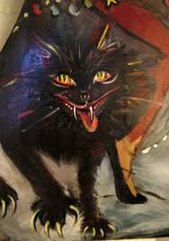
Gryla and her black cat

Slide 80
Every Christmas, Gryla and her sons come down from the mountains: Gryla is in search of naughty children to boil in her caldron and the boys are in search of mischief. She can only capture children who misbehave but those that repent must be released. Despite how strange the belief might be, it persist among the many Icelanders and doesn’t seem likely to go away anytime soon.

Slide 81
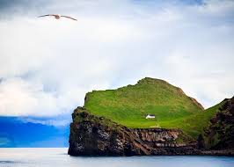
Icelandic Food – Interesting? Tasty? Or You’re Kidding Aren’t You?
If you lived on a small island far out to sea, you would eat almost everything.
So What’s on Iceland’s Menu?

Slide 82
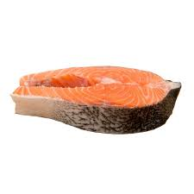
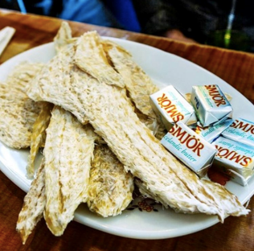
Very fresh cod – Remains on of Iceland’s biggest export and favorite food.
Very dried fish – Think fish jerky. Put butter on top to soften it, chew each bite thoroughly.

Slide 83
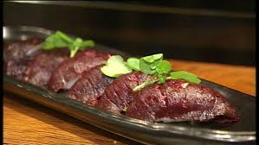
Salted Fish – Completely covered in salt to preserve it. First wipe away salt then soak fish for hours or even 2 or 3 days before eating.
Minke Whale – Has never been considered endangered. Eaten raw or cooked. The meat is similar to beef steak but leaner and softer and not fishy tasting.

Slide 84
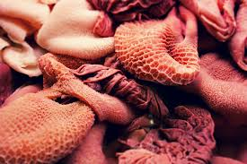
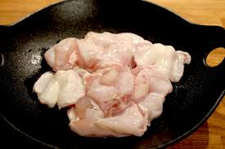
Fish Stomach – Its stuffed with fish liver and boiled with rye.
Gellur (cod tongues) – Not tongues at all, it’s the fleshy muscle behind and under the cod’s tongue. Tasty cooked au gratin, just boiling them not so much.

Slide 85
Puffin – A black and white sea bird with brightly colored bill. Either boiled in milk sauce or smoked. It’s a delicacy found in many Icelandic restaurants.
Hot Springs Rye Bread – Dark, slightly sweet dough put in special wooden casks in the ground near a hot spring. You pick up your baked bread the next day.

Slide 86
Puffin… what’s for lunch?

Slide 87
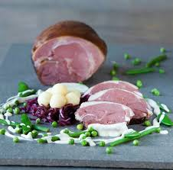
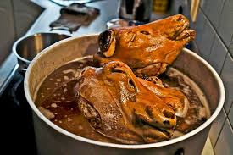
Hangikjot (hon-key-kurt) - Lamb roast, hung and twice smoked but not roasted, thinly sliced and served with potatoes, white gravy and green peas.
Sheep's Head - A favorite smoked and cooked main dish, the whole head is eaten except the brain. Eyes, cheeks and tongue are tasty, its the presentation that throws you off. Most markets and drive-thru sell it.

Slide 88
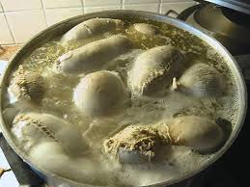
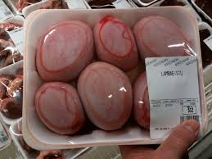
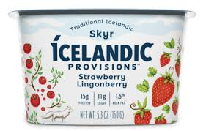
Blood Pudding - Sheep's innards stuffed with blood and fat, sewn together then boiled. Served with Sheep's Head and many times sweet rice pudding. Humm-mm.
Sour Ram's Testicles - A recipe that's rarely made now.
Skyr - A popular traditional Icelandic food. Its a low fat dairy product, rich and creamy resembling yogurt, but it's different. Now found at Whole Foods.

Slide 89
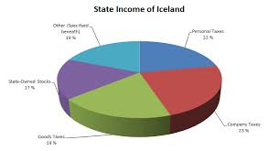
Taxation in Iceland
Taxes in Iceland are levied by the Federal Government and the local communities. Iceland, similar to Scandinavian Countries, it is a Nordic social democracy, but the government welfare spending is less than most other European countries.

Slide 90
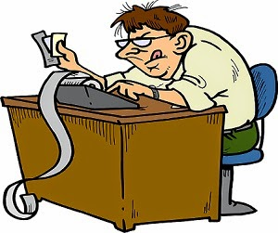
The country has an Income Tax which the Icelanders pay through their employers. Up to 8% of the Icelander gross income may be deducted for pension insurance, like our Social Security. Their income tax rate ranges from 37% to over 46%. It is a progressive tax as is our taxes.

Slide 91
Local communities’ rate is 14 ½% and is collected by municipal authorities. In the US we have voluntary compliance, where we file our own taxes. US income tax rate ranges from 10% to 39% depending on filing status and income level. Oregon income tax rates range from 5% to 9.9% again depending on filing status and income level. Iceland’s total tax rate is 59.5% to 64.5% + 11% “Added value tax”

Slide 92
Iceland’s corporate tax rate is 20%, one of the lowest in the world. In the US it can be as high as 38.9%, but businesses can claim deductions.
Iceland does have a value-added tax, similar to a national sales tax. The standard rate is 11%. Both the US government and Oregon do NOT have a value added tax nor sales tax.

Slide 93
Healthcare in Iceland
Iceland has universal healthcare. Their system is paid for by taxes and service fees. It is administered by the Ministry of Welfare. There is vey little private health care insurance and no private hospitals. This public service is heavily funded through taxation to support the general public, in order for the population to have equal access to the healthcare system.

Slide 94
Health care providers fall into legally defined categories of clinics, institutions, university hospitals, and teaching hospitals. This care includes personal assistance and domestic care, including nursing homes and even child care. Interesting note: hospital professionals and doctors are salaried employees and are paid through hospital budgets.

Slide 95
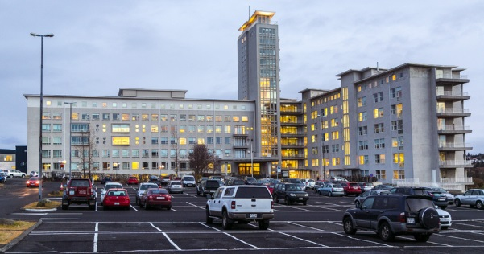
Iceland has a relatively small population. It has 6 regional hospitals and 16 clinics and care homes. The main hospital is located in Reykjavik.

Slide 96
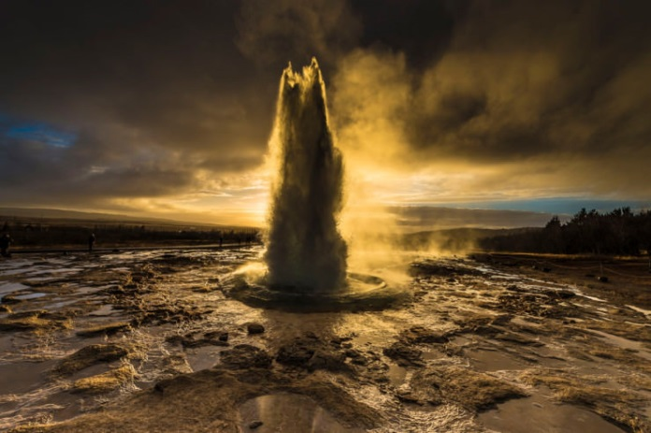
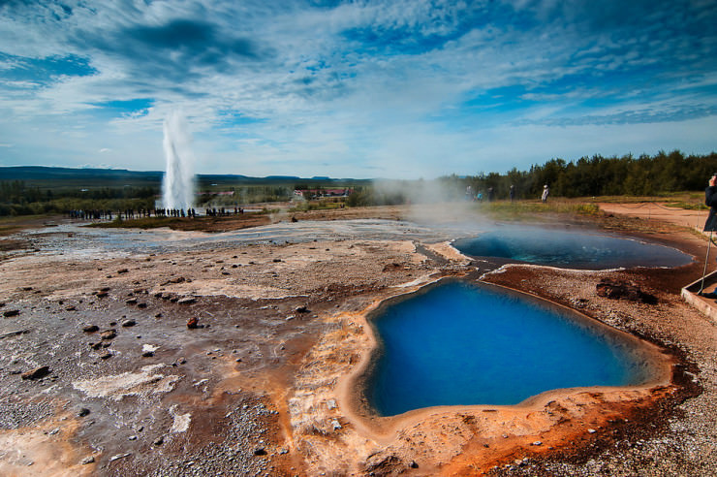
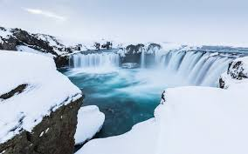
The Golden Circle Tour: Attractions to see in Iceland.
Iceland is world famous for its diverse and unique geothermal landscape. It captures you from all directions.

Slide 97
After arriving in Keflavik, the airport near Reykjavik, you don’t have to look too far to see plumes of smoke rising from the ground, natural hot springs, waterfalls, bubbling mud pots and erupting geysers, in fact you can see all of this on this Golden Circle tour. We will enjoy eleven attractions.

Slide 98
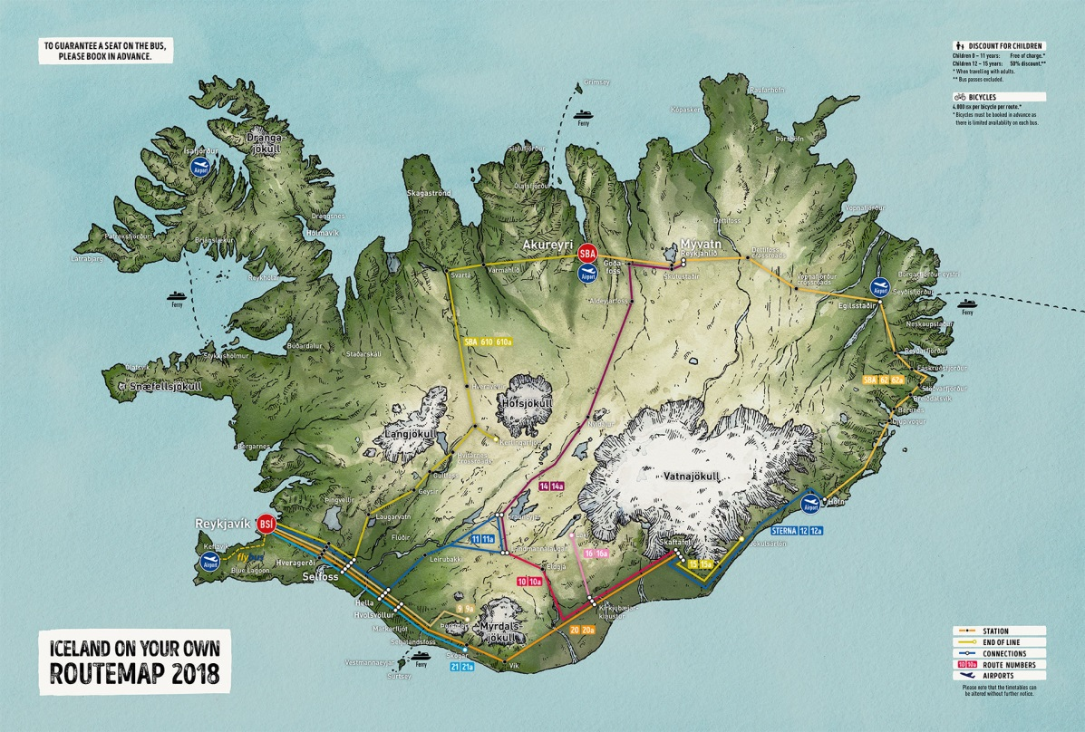
This tour usually requires about 4 hours of driving and after you add the time which will be needed to enjoy each attraction, you need to put aside a full day.

Slide 99
Stop number one: Thingvellir National Park
The National Park is situated on the tectonic plate boundaries on the Mid Atlantic Ridge. You see the rifting of the earth’s crust through main faults and fissure in the ground’s surface.

Slide 100
Thingvellir National Park

Slide 101
Thingvellir National Park

Slide 102
Thingvellir National Park

Slide 103
Thingvellir National Park

Slide 104
Thingvellir National Park

Slide 105
Thingvellir National Park

Slide 106
Thingvellir National Park

Slide 107
Thingvellir National Park is also a UNESCO World Heritage Site. It was in 930 AD the founding home of Althingi, the parliament of Iceland. Many historical buildings are found in the park.

Slide 108
Althingi… 930 AD the oldest parliament in the world

Slide 109
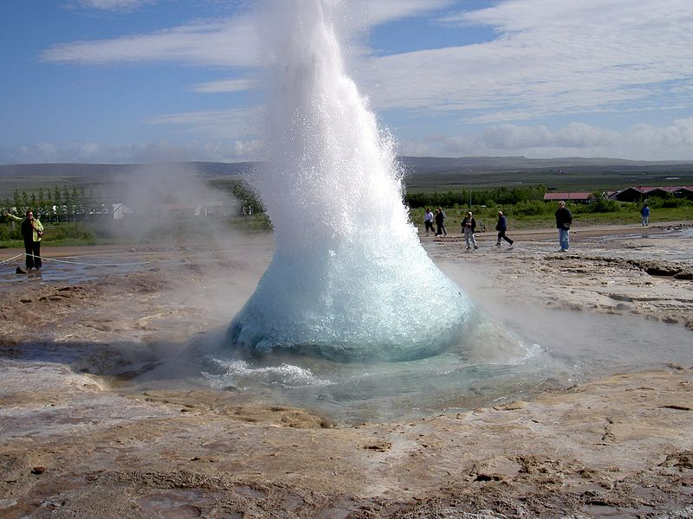
Stop number two: Geyser Area: Great Geyser Hot Springs
“Geyser” from the Icelandic verb geysa, “to gush”, the verb itself is from Old Norse.

Slide 110
Upon arriving at the Geyser areas, the smell of Sulphur in the air is what hits you at first! Phew! And multiple of bubbling hot polls are in every direction and a low running stream at your feet. Suddenly in the distance, a huge jet of water appears, several feet high spraying upwards. The geyser erupts every 4 to 8 minutes.

Slide 111
Icelandic Geysir

Slide 112
Icelandic Geysir

Slide 113
Icelandic Geysir

Slide 114
Icelandic Geysir

Slide 115
Icelandic Geysir

Slide 116
Icelandic Geysir

Slide 117
Icelandic Geysir

Slide 118
Icelandic Geysir

Slide 119
Stop number three and four: Gullfoss and Gymur – Waterfalls
Walking down towards the Gullfoss waterfall, you first hear it before you see it, and then you watch in wonder as the water vapor floats upward along the canyons edge. At first sight, all that can be made out is the ferocious waters that seemingly disappear into the abyss below. A huge cavern of water, 61 feet wide, gashes and churns down into the river below.

Slide 120
The Gymur waterfalls is the highest waterfall in Iceland. What make it so very unique is the trail that goes behind the falls. The trail is well developed loop trail.
Booth waterfalls are majestic and powerful. Prepare to get wet!

Slide 121
Gymur Waterfalls

Slide 122
Icelandic Water Falls

Slide 123
Icelandic Water Falls

Slide 124
Icelandic Water Falls

Slide 125
Icelandic Water Falls

Slide 126
Icelandic Water Falls

Slide 127
Icelandic Water Falls

Slide 128
Stop number five: Lake Myvatn and Raufarholshellir
Myvatn is a volcanic lake. On the east shore are natural baths that are naturally heated by the nearby lagoon with its mineral rich waters know for their geothermal caves to see and tour. The Raufarholskellir, a lava tub cave, has lighting for the adventurist tourist to explore.

Slide 129
Icelandic Lakes

Slide 130
Icelandic Lakes

Slide 131
Icelandic Lakes

Slide 132
Icelandic Lakes

Slide 133
Icelandic Lakes

Slide 134
Icelandic Lakes

Slide 135
Icelandic Lakes

Slide 136
Icelandic Cave

Slide 137
Icelandic Cave

Slide 138
Icelandic Cave

Slide 139
Stops number six and seven: Latrabjarg Cliffs and Hvitserkur Latrabjarg Cliffs is the westernmost point in Iceland. It is home to millions of birds including puffins, razorbills, and gannets. It is the largest bird cliff in Europe. Take your binoculars to get a close up look at the many, many birds.

Slide 140
Latrabjarg Cliffs

Slide 141
Latrabjarg Cliffs

Slide 142
Latrabjarg Cliffs

Slide 143
Latrabjarg Cliffs

Slide 144
Latrabjarg Cliffs

Slide 145
According to legend, Hvitserkur is a petrified troll who wanted to tear down the bells at Pineyraklauster convent, but was caught by daylight and turned to stone. The less fun version of the story is that Hvitserkur is a volcanic plug from a volcano which was eroded by the ocean. The troll being turned to stone is more in tune to the folklore of Iceland… a more fascinating story.

Slide 146
Hvitserkur “Troll Rock”

Slide 147
Hvitserkur “Troll Rock”

Slide 148
Hvitserkur “Troll Rock”

Slide 149
Last stop is the Capital City of Iceland: Reykjavik
We will visit four notable landmarks in our quick overview of the city. Reykjavik sits on the shore of the Smoky Bay and surrounded by towering mountain cliffs. We see no smoke rising from the households because of the geothermal heating used in the home and commercial buildings of the city.

Slide 150
Reykjavik

Slide 151
Reykjavik

Slide 152
Reykjavik

Slide 153
Reykjavik’s immense white-concrete church, Hallgrimskirkja (big church on the hill), star of thousands of postcards, dominates the skyline, and is visible from miles around. Get a fantastic view of the city by taking an elevator to the top viewing area within the tower. The Lutheran Church was built in 1945 and is 240 feet high.

Slide 154
Hallgrimskirkja

Slide 155
Hallgrimskirkja

Slide 156
Hallgrimskirkja

Slide 157
One of the most unusual building to see in our tour is the Harpa Concert Hall and Conference Center. It opened in 2011. The design was influenced by Iceland’s dramatic nature. Its is a gleaming sculpture reflecting both sky and sea. There are four concert halls within the building and has seating for 1800.

Slide 158
Harpa Concert Hall & Conference Center

Slide 159
Harpa Concert Hall & Conference Center

Slide 160
Harpa Concert Hall & Conference Center

Slide 161
In stark contrast to the Harpa Center is the Parliament House, Albinglshuslo. It is a classical 19th century structure built in 1881. It is one of the oldest stone building in Iceland. Today it housed a museum and parliament debating hall.

Slide 162
Parliament House

Slide 163
Last on our tour and possibly the most famous site is The Blue Lagoon. The lagoon is a geothermal spa and is one of the most visited attraction in Iceland. The spa is located in a lava field not far from the city. It is a man-made lagoon which is fed by the water output of the nearby geothermal poser plant and it is renewed every two days.

Slide 164
The Blue Lagoon

Slide 165
The Blue Lagoon

Slide 166
The Blue Lagoon

Slide 167
People typically spend 1 to 3½hours in the healing waters. Currently the price to visit the lagoon spa with round trip transportation from Reykjavik and admission start at $133.85 and up. No wonder people stay up to 3 ½ hours.

Slide 168
Highlights of Some Museums in Reykjavik
As you enter the Whales of Iceland exhibit you feel quite small, for up above you, hanging from the ceiling are 23 life-size models of whales, including a humpback whale, a blue whale and an orca.

Slide 169
Whales of Iceland Exhibit

Slide 170
Whales of Iceland Exhibit

Slide 171
The Settlement Exhibition is the perfect place to step into the Viking age. In downtown Reykjavik a 2001 excavation revealed a 10th century Viking hall, and the oldest evidence of an Icelandic settlement including a house and artifacts dating to before 871. An interactive display gives you a glimpse into the everyday life of Viking settlers.

Slide 172
Settlement Exhibit

Slide 173
Settlement Exhibit

Slide 174
Settlement Exhibit

Slide 175
Admission Prices:
17 and younger are free
67 years and older are free
Disabled are free
Adults are 1,600 ISK which is Krona
($15.04 U.S. dollars)
Students are 900 ISK

Slide 176
The Icelandic Punk Museum Officially opened by punk rocker Johnny Rotten in 2016 to exhibit photos and objects related to the period of music in 1980.
Punk Museum is located in an abandoned public toilet facility.

Slide 177
Punk Museum

Slide 178
Punk Museum

Slide 179
There are several museums that showcase the country's seafaring heritage. How important the fishing industry was to Icelandic history, survival and how they won the Cod Wars. Maritime Museum and The Culture House.

Slide 180
Maritime Museum

Slide 181
Maritime Museum

Slide 182
Maritime Museum

Slide 183
The Saga Museum is where history comes alive. The museum uses life-like replicas of Icelandic figures to recreate moments in everyday life and turbulent times in history. Replicas were created based on descriptions found in the Viking Sagas (passed down stories).

Slide 184
Saga Museum

Slide 185
Saga Museum

Slide 186
Saga Museum

Slide 187
The Arbaer Open Air Museum is located outside Reykjavik.

Slide 188
Arbaer Open Air Museum

Slide 189
Arbaer Open Air Museum

Slide 190
Arbaer Open Air Museum

Slide 191
Arbaer Open Air Museum

Slide 192
Sod Houses
So here's the question - If you lived on a small island far out to sea, an island with poor soil, few forests, and long cold winters what would you use to build a house?

Slide 193
Answer - You would cut large bricks of grassy sod to build turf houses, barns and churches.
This open air museum has 20 vintage turf homes and buildings spread around a large green area.
To build a turf house first mark the small floor and remove the grassy turf. Scrape floor smooth.
Drag flat chunks of rock to your site and build a 3 or 4 foot wide base on just 3 sides of your house .

Slide 194
You may need to make a sled of hide with leather straps to pull rocks or turf to your site.
Using saws, blades and flat shovels cut grassy turf into large blocks, stack with sticks between layers so turf can air dry.

Slide 195
On top of rocks, stack turf bricks flat or on edge in a herring bone design to form three sides of your house. Walls 3 or 4 feet thick. Stack to edge of roof line. Smooth inside walls.
Hunt for drift wood or birch trees to use as framing inside turf house and roof. Lay turf on roof.
If possible, best to build wooden front for house with windows and a door.

Slide 196
Half of the population still lived in turf homes in 1910. By 1960 there were 234 inhabited turf homes in Iceland, most were deserted in the next decade.

Slide 197
Sod Houses

Slide 198
Sod Houses

Slide 199
Sod Houses

Slide 200
Sod Houses

Slide 201
Sod Houses

Slide 202
Sod Houses

Slide 203
Inside a Sod House

Slide 204
Inside a Sod House

Slide 205
Sod Houses

Slide 206
Inside a Sod House

Slide 207
Inside a Sod House

Slide 208
Inside a Sod House

Slide 209
A Modern Stone House

Slide 210
The Cod Wars, 1958-1975
Who would have guessed that something as harmless as favorite fishing spots could incite wars between two nations? In a way, that exactly what happened between Iceland and the United Kingdom during the three Cod Wars – meaning Fish Wars

Slide 211
Icelandic Fishing Bay

Slide 212
Icelandic Fishing Ships

Slide 213
In the 1950s and 1970s, the neighboring nations engages in naval conflict over fishing waters and territorial claims. Iceland had extended its fishing water borders from 50 nautical miles to 200 nautical miles and the UK believed them to be international waters.

Slide 214
The problem? Iceland is very dependent on Cod as its main export and the income from the fishing industry. Icelandic Government increased the distance from its mainland to include rich fishing waters also used by the United Kingdom. Fishing trawlers from both countries mixed in the fishing area.

Slide 215
The British government reacted to the change of Iceland boundaries by ordering warships to protect their fishing nets. This is what happened over the next three decades. British warships fired upon Icelandic fishing boats and patrols. Icelandic patrols fired on British vessels. Trawlers, tugboats and frigates were rammed. Fishing nets were cut. Each side lost one man.

Slide 216
The 200 nautical miles is now the sea-zone prescribed by the United Nations Convention on the Law of the Sea.

Slide 217
The World's Most Precious Genes?
If you lived on a small island far out to sea you'd probably end up marrying your neighbor.
Iceland's population of 332,000 is 90% pure Icelandic. Their genealogy database goes back 1,100 years. Most Icelanders can trace their lineage to a single Viking settler.

Slide 218
It's that unique gene pool that brought neurologist and geneticist Kari Stefansson home after 20 years abroad to found a company called deCODE with the ambitious goal of mapping the genome of the entire country.
A genome is your entire set of DNA, the chemical compound that contains genetic instructions that tells our bodies how to function.

Slide 219
More that 150,000 Icelanders have donated their blood samples to this project but not all Icelanders wish to participate this double blind project.
When researchers find a gene mutation or variant, it is easier to trace.

Slide 220
DeCODE discovered a variant a few years ago that confers protection against Alzheimer's disease. It's a rare gene variance found in about 1% of the Icelandic population, and if you carry that variant, you are almost completely protected against Alzheimer's disease.

Slide 221
The next step is to replicate what the genetic variant does in the body, in the form of medicine to protect the health of others. Trials are underway on drugs based on that Alzheimer's variant, as well as a new cardiovascular drug by Amgen of California who purchased the company deCODE in 2012.

Slide 222
The Northern Lights in Iceland

Slide 223
The Northern Lights in Iceland

Slide 224
The Northern Lights in Iceland

Slide 225
The Northern Lights in Iceland

Slide 226
Whales of Iceland

Slide 227
Whales of Iceland

Slide 228
Arctic Henge… started in 1996

Slide 229
Arctic Henge… started in 1996
Located in one of Iceland’s most remote northern villages, the Arctic Henge is a colossal piece of stone construction that, when finished, will make Stonehenge look like amateur hour.

Slide 230
Conclusion:
Iceland - an island gem surrounded by icy cold water and bathed by the Northern Lights.
Hearty creative people who've endured volcanoes, plagues, lack of traditional building materials, and occupations by foreign governments. They've harnessed bubbling hot springs to heat their homes. They enjoy low crime rates and unarmed police. Most sweet of all, they share this land with elves, trolls and talking cows.

Slide 231
US Navy plane moved from Sicily to Iceland for the May 2017 World Summit in Sicily.

Slide 232
Mike Teeples, the man in charge of moving the US Navy planes from Sicily to Iceland for the May 2017 World Summit in Sicily.
Quite a change in temperatures…. 90 degrees in Catania, Sicily… 25 degrees in Iceland and lots of WIND.

