Slide 1
Am I PREPARED for the BIG one?!
Cascadia Subduction Zone

Slide 2
What is the Cascadia Subduction Zone?

Slide 3
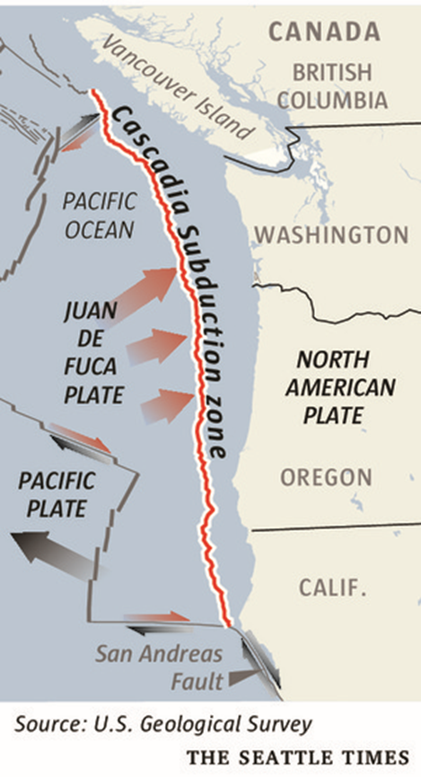

Slide 5
YES!!! We are really in a subduction zone
Two parallel mountain ranges
Coast Range and the Cascades
Forearc basin
Willamette Valley and Puget Sound

Slide 6
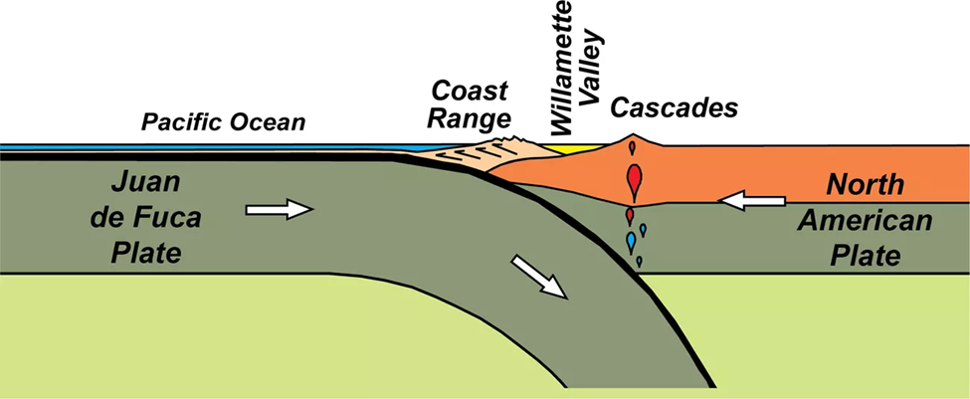

Slide 7
So…What is happening?
Plates are converging-One sliding under the other
Coastal range mountains form
Cascade range mountains form from volcanic activity
Earthquakes

Slide 8
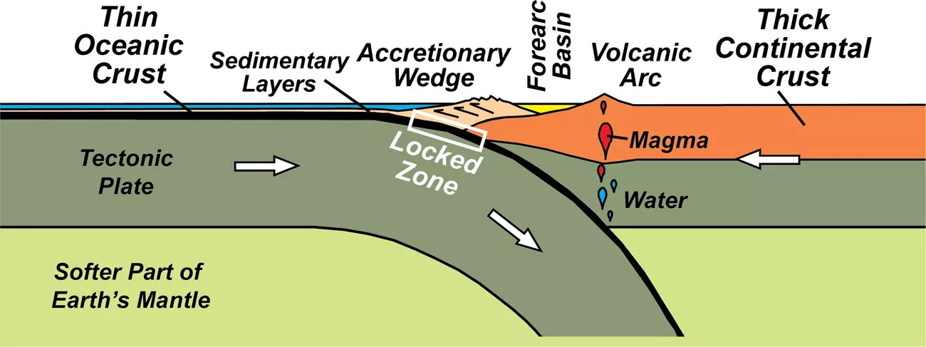

Slide 9
Formation of the Coast Range

Slide 10
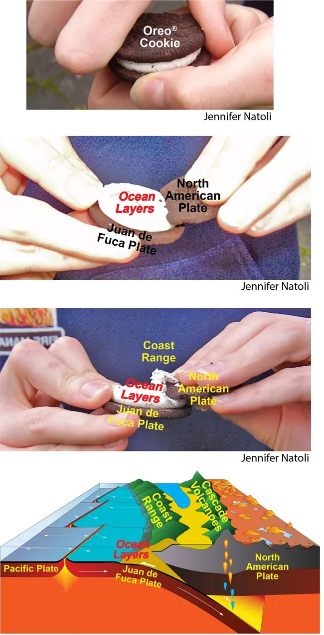
MAKE YOUR OWN SUBDUCTION ZONE!

Slide 11
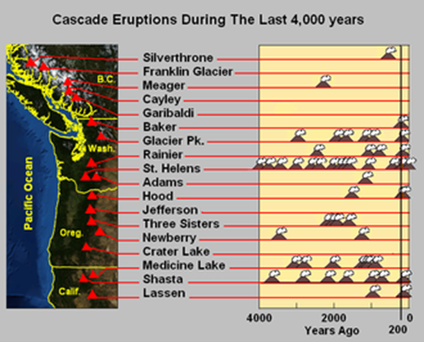
ERUPTIONS

Slide 12
When, not if, the earthquake and tsunami happen, daily life will look all but recognizable.
LEARN AND
BE READY
BE READY
BE READY
Be ready, for most of us the real risk will not be the earthquake and tsunamis. The real risk is that we may not be ready for the AFTERMATH

Slide 13
QUESTIONS??
JUST BE READY!

