Slide 1

Fire Prevention and Evacuation Planning
2017 Oregon Association for Family and Community Education Fall Conference
Scott Teeples & Ed Dolan

Slide 2
Who are your Presenters
Scott Teeples
Oregon Association for Family and Community Education – Secretary/President Elect
Ed Dolan
Oregon Association for Family and Community Education – FCE Member and retired Klamath County Fire Dist. #1 Fireman

Slide 3
Goals and Objectives
Participants will gain an understanding of the cause of fires, what can be done to prevent them, and what to do in the case of a fire.
Participants will be able to teach this lesson to others.
Participants will gain an understanding of the importance of know where fire exits are, how to find them and how to use them.

Slide 4
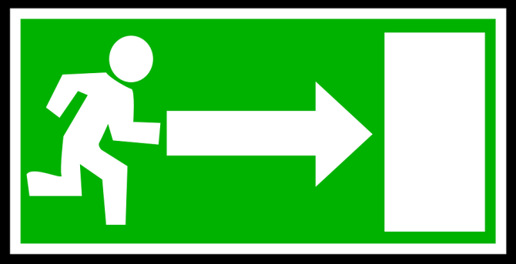
Activity # 1
Find your escape route
Place the Quiz on the table in front of you face down.
Place a pen or pencel in the center of the page.
Close your eyes.
Think of your nearest exit but not the one you used to come into this room.
Draw an arrow to that exit on the back of the Quiz.
Open your eyes and see how accurate you are.

Slide 5

Activity #2
Turn over your Quiz and answer the questions.
You have 5 minutes to complete this activity.

Slide 6

Fire Is Everyone’s Fight™ is a national initiative to unite the fire service, life safety organizations and professionals in an effort to reduce home fire injuries, deaths and property loss by changing how people think about fire and fire prevention.
Fact: Each year, an estimated 380,200 residential building fires were reported to fire departments. These fires caused an estimated 2,695 deaths; 12,000 injuries; and $7 billion in property loss.

Slide 7
OREGON CIVILIAN FIRE FATALITIES thru May 2017
3/01/2017 Riddle
35 woman, 4 girl, 7 girl, 10 boy, and 2 13 y/o boys Died in a house fire
1/30/2017 Junction City A man & Woman Died in a house fire
4/12/2017 Beaver Township 55 year old Died in house fire
2/16/2017 Glide
A 51 female Died in a house fire
1/14/2017 White City
A man Died in house fire
1/11/2017 McKenzie Bridge
Person Died in house fire
1/15/2017 Haines
A 83 man Died in house fire

Slide 8
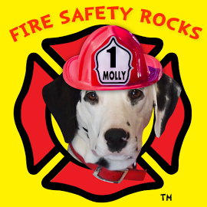
Deaths in one- and two-family residential building fires accounted for far more deaths in most years than all natural disasters combined.
One- and two-family residential building fires accounted for 64 percent of all residential building fires, representing the largest subgroup of residential building fires.
One- and two-family residential building fires occurred more often in the cooler months, peaking in January at 11 percent.
Cooking, at 37 percent, was the leading cause of one- and two-family residential building fires reported to the fire service. Of these cooking fires, 85 percent were small, confined fires with limited damage.
In 53 percent of nonconfined one- and two-family residential building fires, the fire extended beyond the room of fire origin.

Slide 9
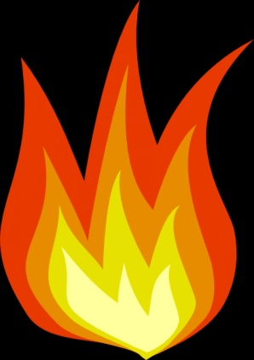
The leading causes of larger fires
were other unintentional
  careless actions (17 percent);
  a) Deep frying food while watching TV.
  b) Empting Fire place ashes into a paper sack
  c) Leaving matches in the reach of children.
  Electrical malfunctions (14percent)
  a) Over loading outlets.
  b) Electrical Appliances used near water.
  c) Placing cords under carpet or rugs.
  Open flames (11 percent)
  a) Unattended candles.
  Intentional actions (10 percent)
  a)Arson

Slide 10
The leading causes of larger fires
Smoke alarms were not present in 23 percent of nonconfined fires in occupied one- and two-family residential buildings.
This is a high percentage when compared to the 3 percent of households lacking smoke alarms nationally.
Automatic extinguishing systems (AESs) were present in only 1 percent of nonconfined fires in occupied one- and two-family residential buildings.

Slide 11
QUESTION
Do you have Bunk Beds in your home?
Do you place the bigger child in the upper bunk or lower?
Answer: If the smaller child is on the bottom bunk then they may not be able to rescue the other child.

Slide 12
Activity #3
Normal Response:
From a Bed or Couch in the middle of the night.
The smoke is 2 feet over you when lying down.
The Smoke Alarm goes off.
You jump up when you hear the Alarm.
You rise up in to supper heated gasses.
Your lungs are instantly burnt and you become the next Fire Fatality.

Slide 13
Activity #3
Safer Response:
From a Bed or Couch in the middle of the night.
The smoke is 2 feet over you when lying down.
The Smoke Alarm goes off.
You roll out when you hear the Alarm.
Crawl under supper heated gasses.
You safely escape the fire.

Slide 14
There are two types of smoke alarms.
1. Ionization smoke alarms are quicker to warn about flaming fires.
2. Photoelectric alarms are quicker to warn about smoldering fires.
It is best to use both types of alarms in the home.

Slide 15

How long do you have to Escape your home?

Slide 16
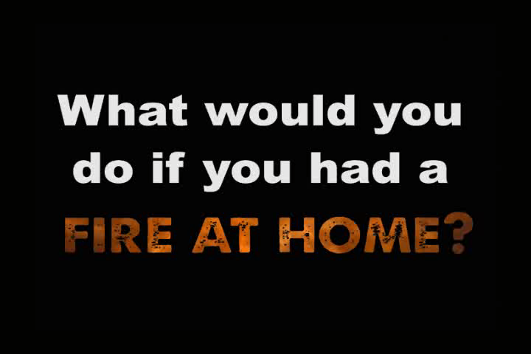

Slide 17
Emergency escape masks
There are a variety of fire/emergency escape devices, commonly called “smoke hoods” or “smoke masks,” marketed to assist civilians in safe egress from fire emergencies. They provide head, eye and respiratory protection from particulate matter, eye irritants, carbon monoxide and other toxic gases commonly produced by structural fires.
The Consumer Product Safety Commission (CPSC) and the U.S. Fire Administration (USFA) evaluated respiratory protective escape device (RPED) performance to determine if RPEDs have the potential to reduce fire-related residential deaths and injuries.

Slide 18
The Consumer Product Safety Commission (CPSC) and the U.S. Fire Administration
The test results showed that the respiratory protective escape device selected for evaluation did not meet standard requirements associated with donning. These results indicate that improvements may be needed in operational packaging to allow novice users to quickly determine correct RPED donning procedures. All of the models tested complied with requirements to assess field of vision, and two of the three models met requirements to evaluate leakage.

Slide 19
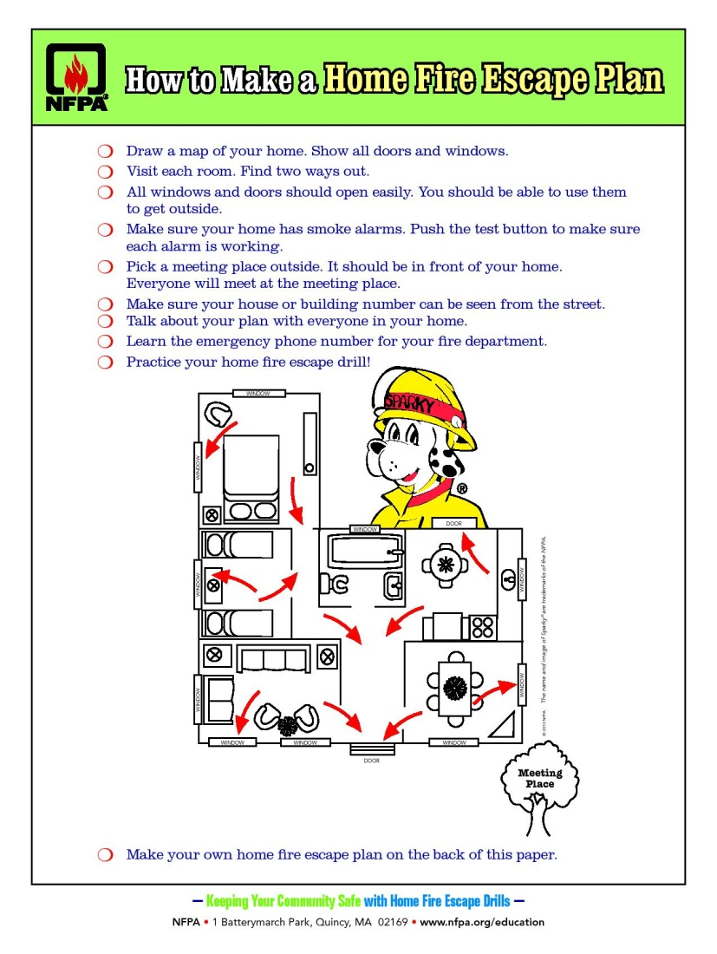

Slide 20
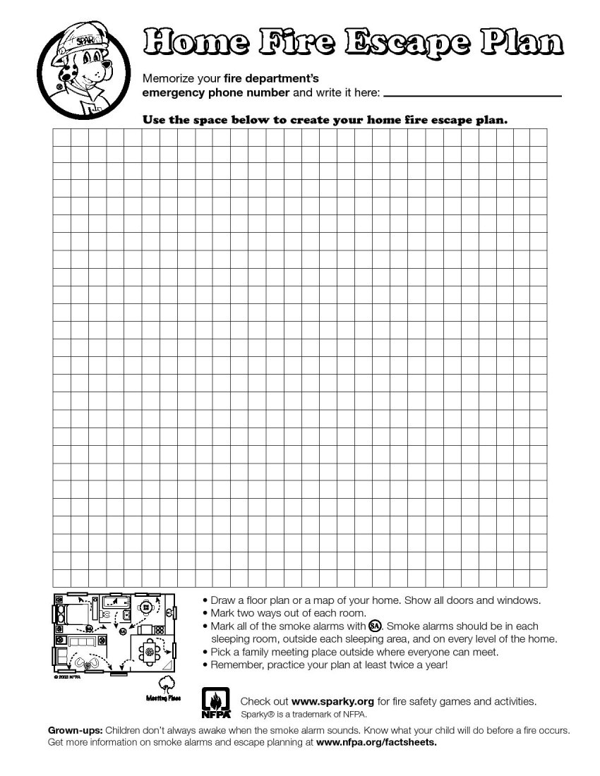

Slide 21
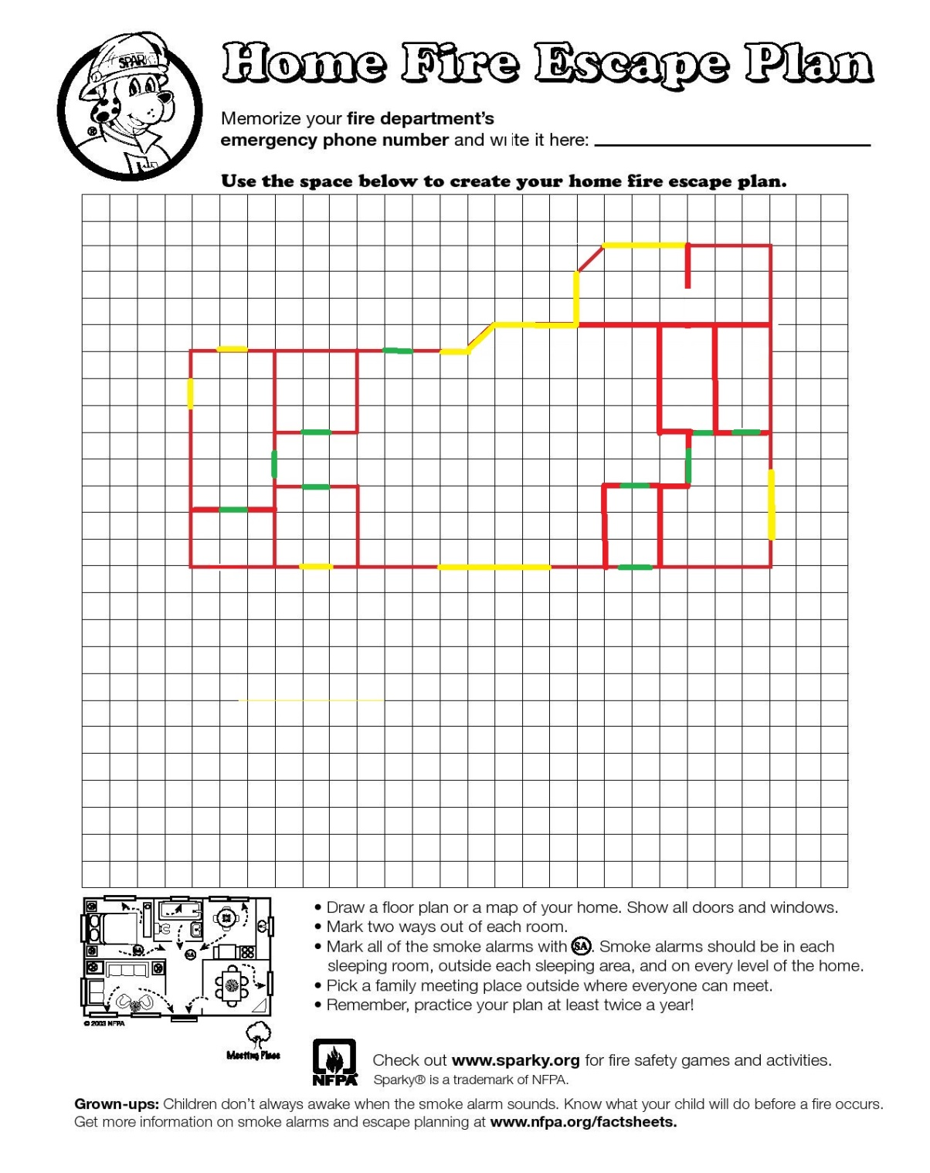

Slide 22
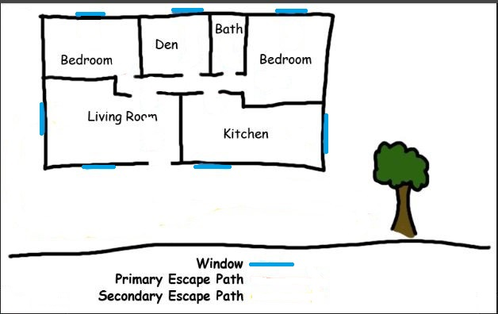
Sample Escape Plan

Slide 23
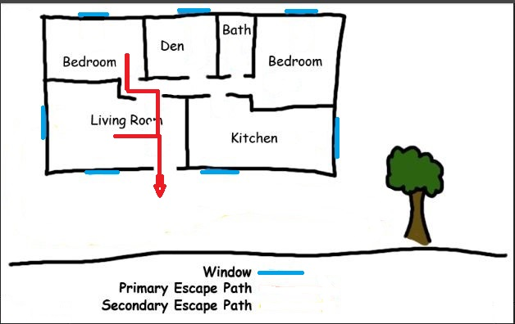
Sample Escape Plan

Slide 24
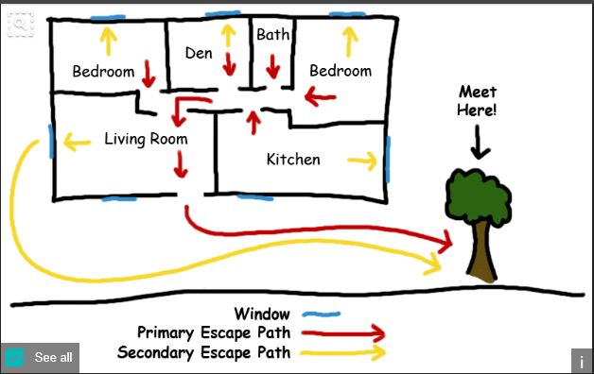
Your ability to get out depends on advance warning from smoke alarms and advance planning.

Slide 25
Prepare, Act, Survive
Step 1: Make sure you have working smoke alarms
Step 2: Create a home fire escape plan
Step 3: Practice your home fire escape plan

Slide 26
When you get home:
Have a family fire drill to make sure your loved ones can wake up and get to your outside meeting place in three minutes or less.
Keep an eye on what you fry. Remember to stay in the kitchen whenever you are cooking with high heat on the stove.
Push the test button on all your smoke alarms. If they do not sound, fix or replace them immediately.

Slide 27
Conclusion
Prepare for the worst and hope for the best.
Do a home fire inspection when you change the batteries in your smoke detectors (when you change your clocks).
If your Smoke Detectors are over 10 years old then replace them.
Most Smoke Detectors have a date of Manufacture on the back.
If it doesn't make sense then don’t do it!

Slide 28
Our Partners
We recognize partnership as a critical means of delivering accurate and consistent safety messages to the community.
FireSafetySource.com
Special thanks to the Oregon State Police - Oregon Office of State Fire Marshal for the handouts.

Slide 29
Our Partners
http://www.oregon.gov/OSP/SFM
https://www.usfa.fema.gov/prevention
http://www.nfpa.org
http://www.nfpa.org/public-education
WWW.alarmingtruth.org

Slide 30

Questions
Notes:
Questions

